Slide 1
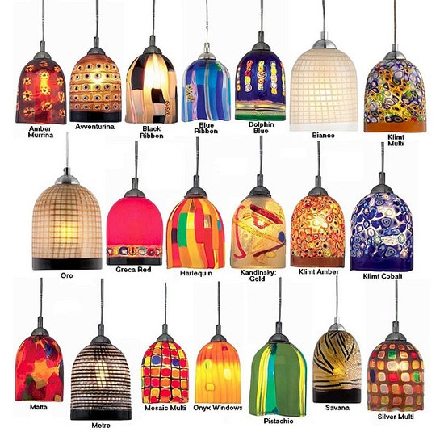
Commercial Building Electrical Systems - Lighting

Slide 2
Commercial Building Electrical Systems - Lighting

Slide 3
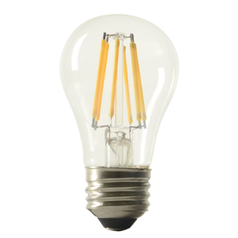
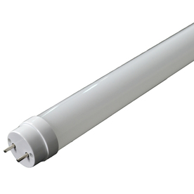
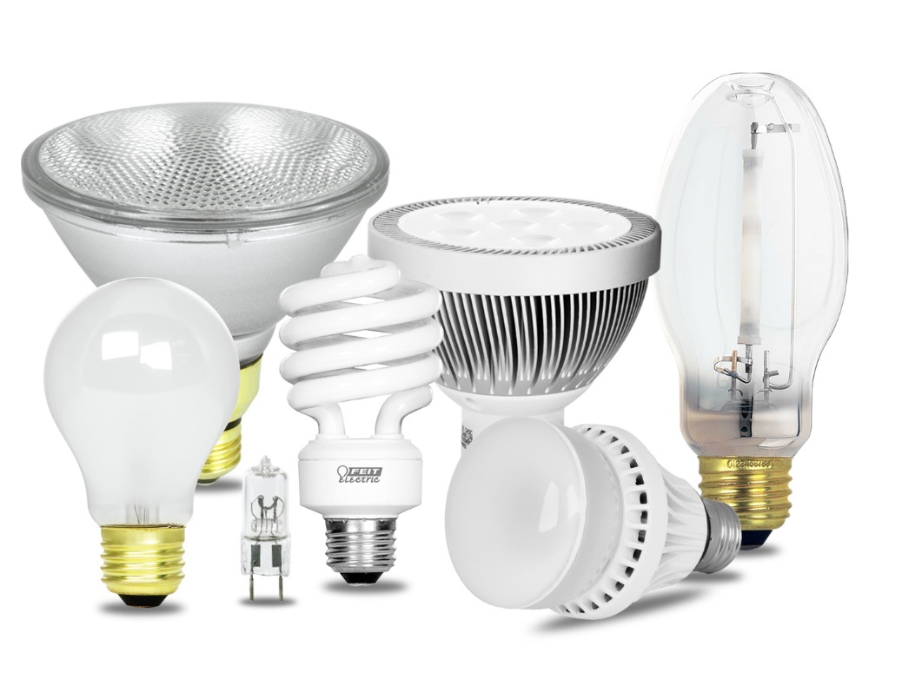
Commercial Building Electrical Systems - Lighting
Lamp Types
Light Emitting Diode - LED
Fluorescent - FL
Compact Fluorescent (CFL)
Incandescent (INC)
Halogens
High Intensity Discharge (HID)
High Pressure Sodium (HPS)
Metal Halide (MH)
Mercury Vapor (MV)
Low Pressure Sodium (LPS)

Slide 4
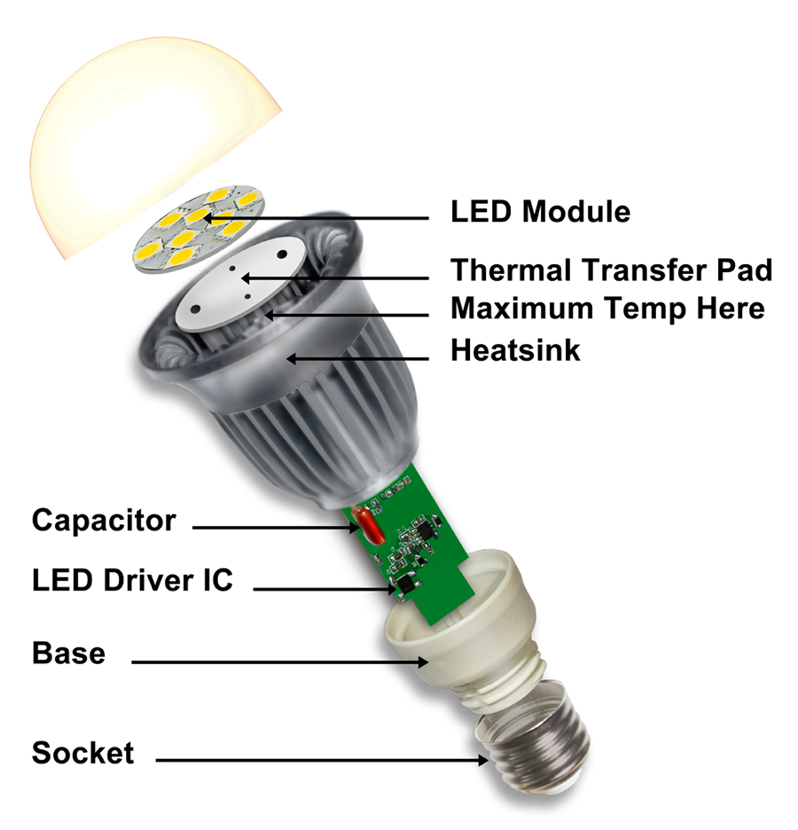
Commercial Building Electrical Systems - Lighting
Light Emitting Diode

Slide 5
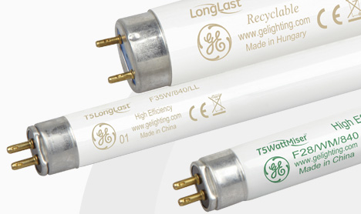
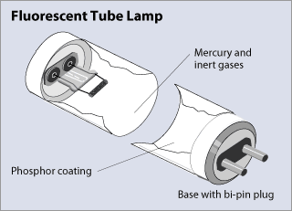
Commercial Building Electrical Systems - Lighting
T5 5 x 1/8" = 5/8"
T8 8 x 1/8" = 1"

Slide 6
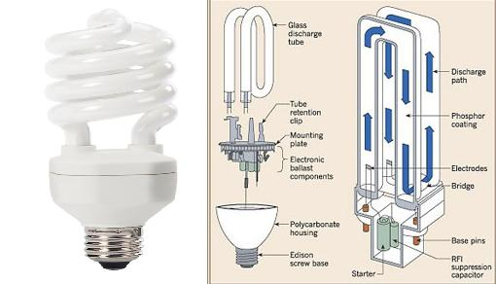
Commercial Building Electrical Systems - Lighting

Slide 7
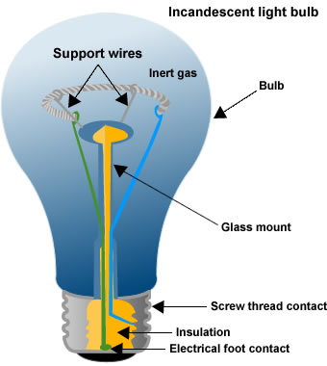
Commercial Building Electrical Systems - Lighting
Shape
General (A)
Globe (G)
Decorative
Typical
40 W to 100 W

Slide 8
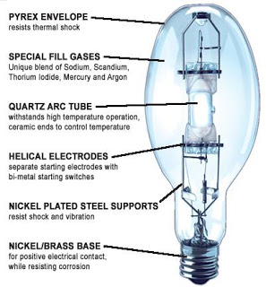
Commercial Building Electrical Systems - Lighting
Low Pressure Discharge
Compact Fluorescent
Fluorescent
Low Pressure Sodium
High Pressure Discharge
Metal Halide
High Pressure Sodium
High Pressure Mercury-Vapor
High-Intensity Discharge (HID)
Mercury-vapor lamps
Metal halide lamps
Ceramic discharge metal halide lamps
Sodium vapor lamps
Xenon arc lamps
Ultra-High Performance (UHP)

Slide 9
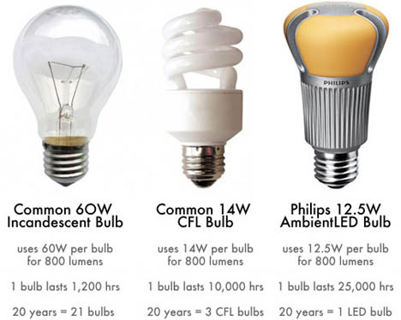
Commercial Building Electrical Systems - Lighting

Slide 10
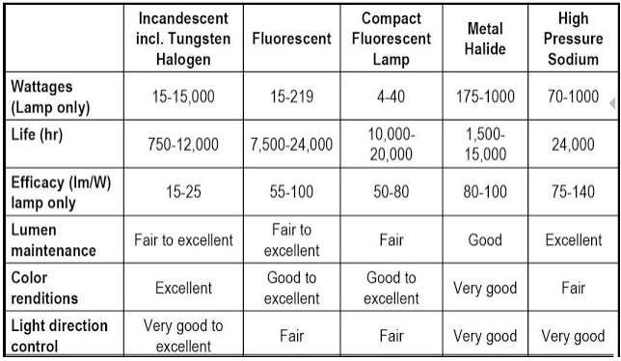
Commercial Building Electrical Systems - Lighting

Slide 11
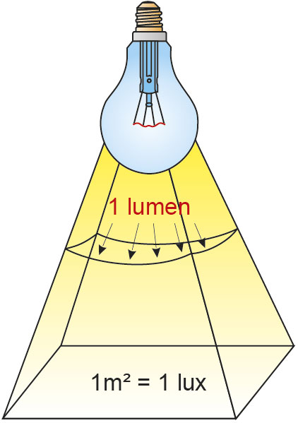
Commercial Building Electrical Systems - Lighting
Watts vs. Lumens
40W bulb: at least 450 lumens
60W bulb: at least 800 lumens
75W bulb: at least 1,100 lumens
100W bulb: at least 1,500 lumens
Fact: The more lumens of light you get per watt of electricity, the more efficient the bulb is.
A 10W LED can easily outshine a 12W competitor if it converts watts to lumens more efficiently.
Efficiency = lumens / watts

Slide 12
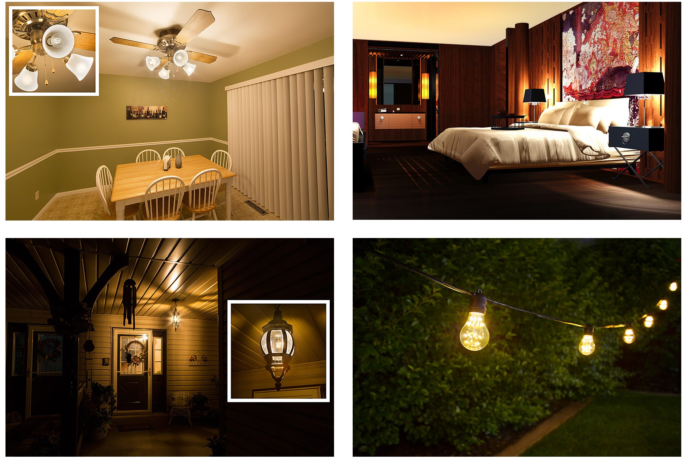
Commercial Building Electrical Systems - Lighting
A Group
A19 LED filament bulbs in ceiling fan fixture
A21 LED bulbs in bedroom lamps
A19 gold-tint LED filament bulb in porch light fixture
A19 LED fireworks bulbs in string lights

Slide 13
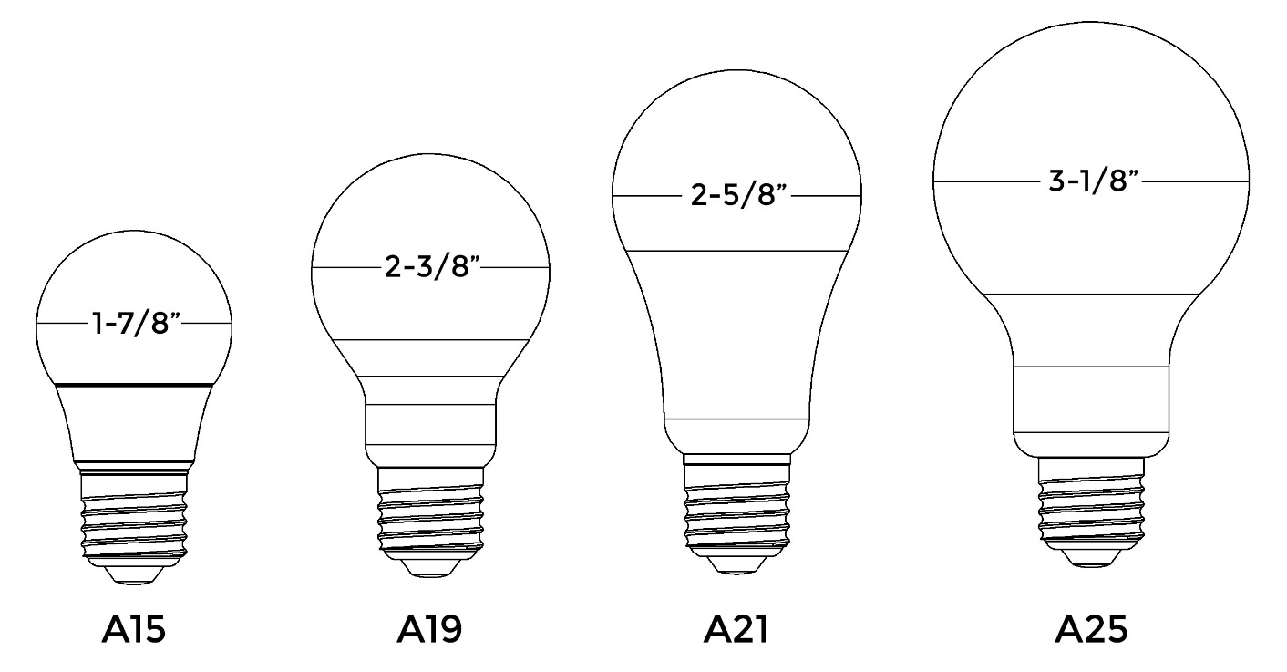
Commercial Building Electrical Systems - Lighting
Standard/Arbitrary (A) Bulb
Most widely used and thought of when it comes to household lighting.
These bulbs work well for a variety of applications
Numbers in each code refer to the bulb’s diameter in one-eighths of an inch.

Slide 14
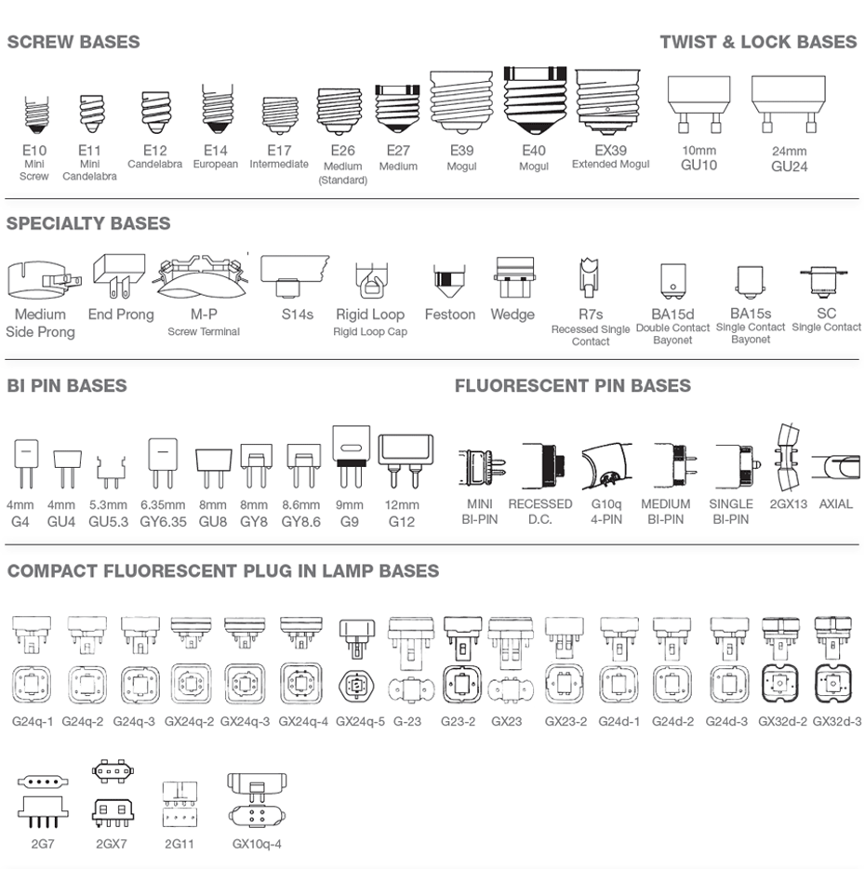
Commercial Building Electrical Systems - Lighting

Slide 15
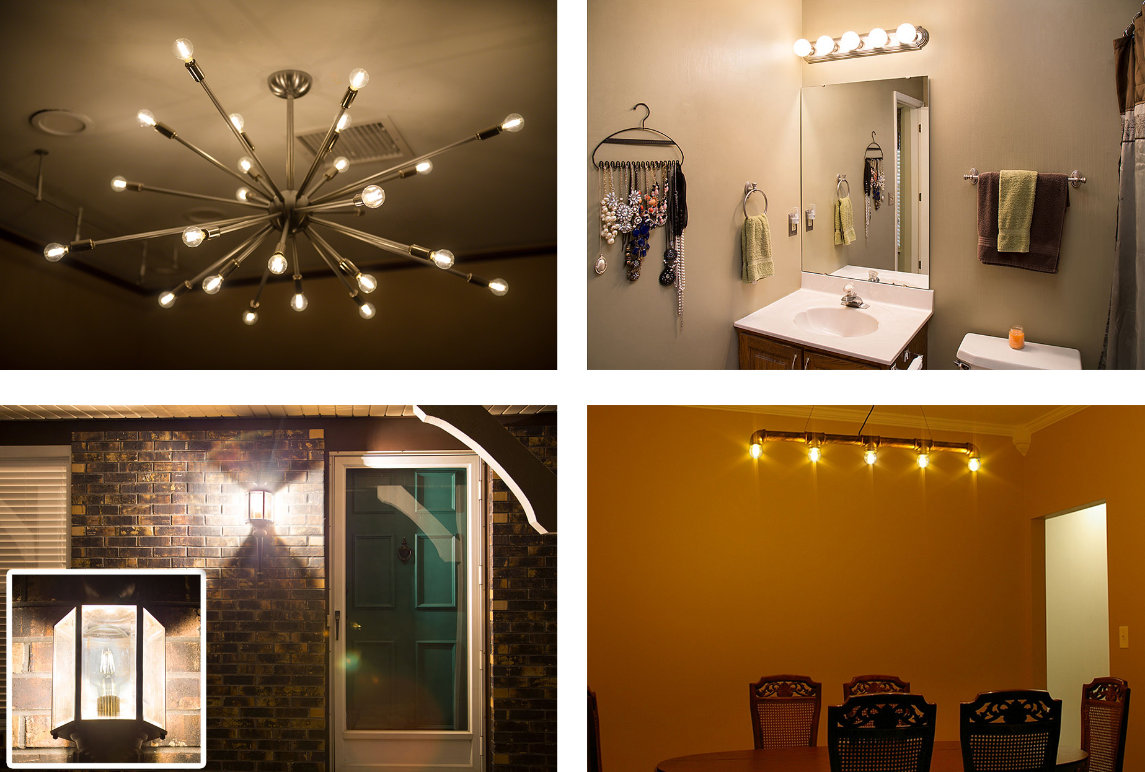
Commercial Building Electrical Systems - Lighting
G Group
,,,
G14 LED bulbs in ceiling light fixture
G30 LED bulbs in bathroom vanity
G30 LED filament bulb in porch light fixture
G16 gold-tint LED filament bulbs in ceiling light fixture

Slide 16
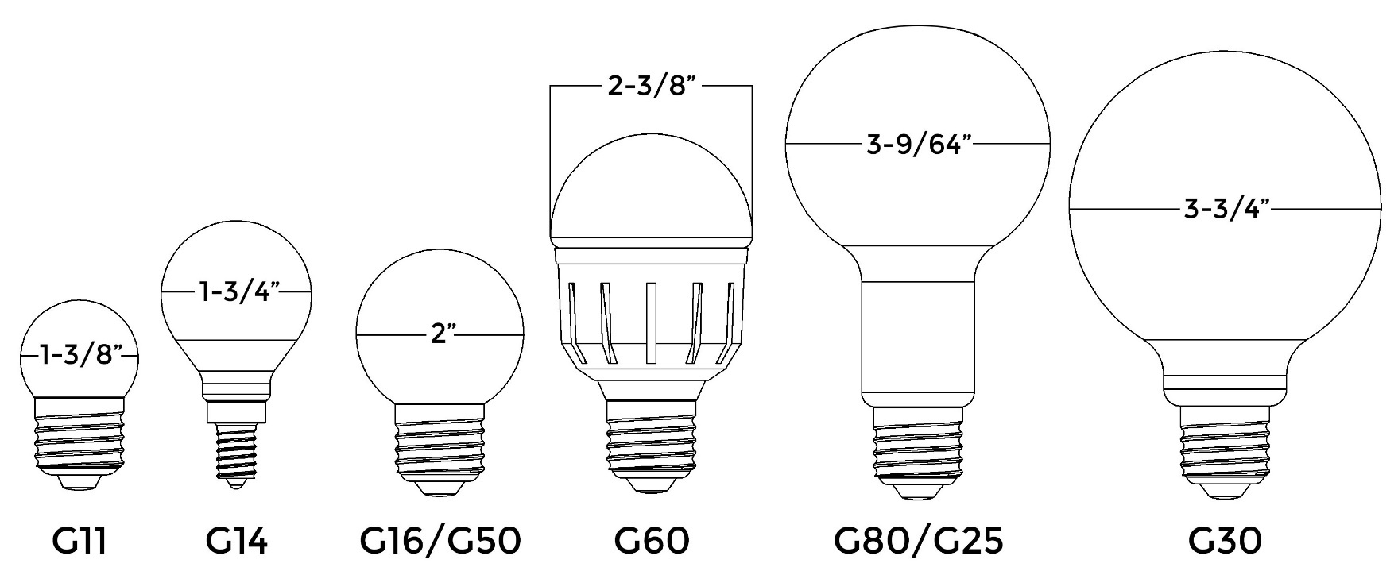
Commercial Building Electrical Systems - Lighting
Globe (G) Bulb
Full, round shape and are available in various sizes.
The most common type is the large G30 bulb, which is used in bathroom and makeup vanities.
Depending on the bulb, numbers in each code can refer to the bulb’s diameter in one-eighths of an inch or in millimeters.

Slide 17
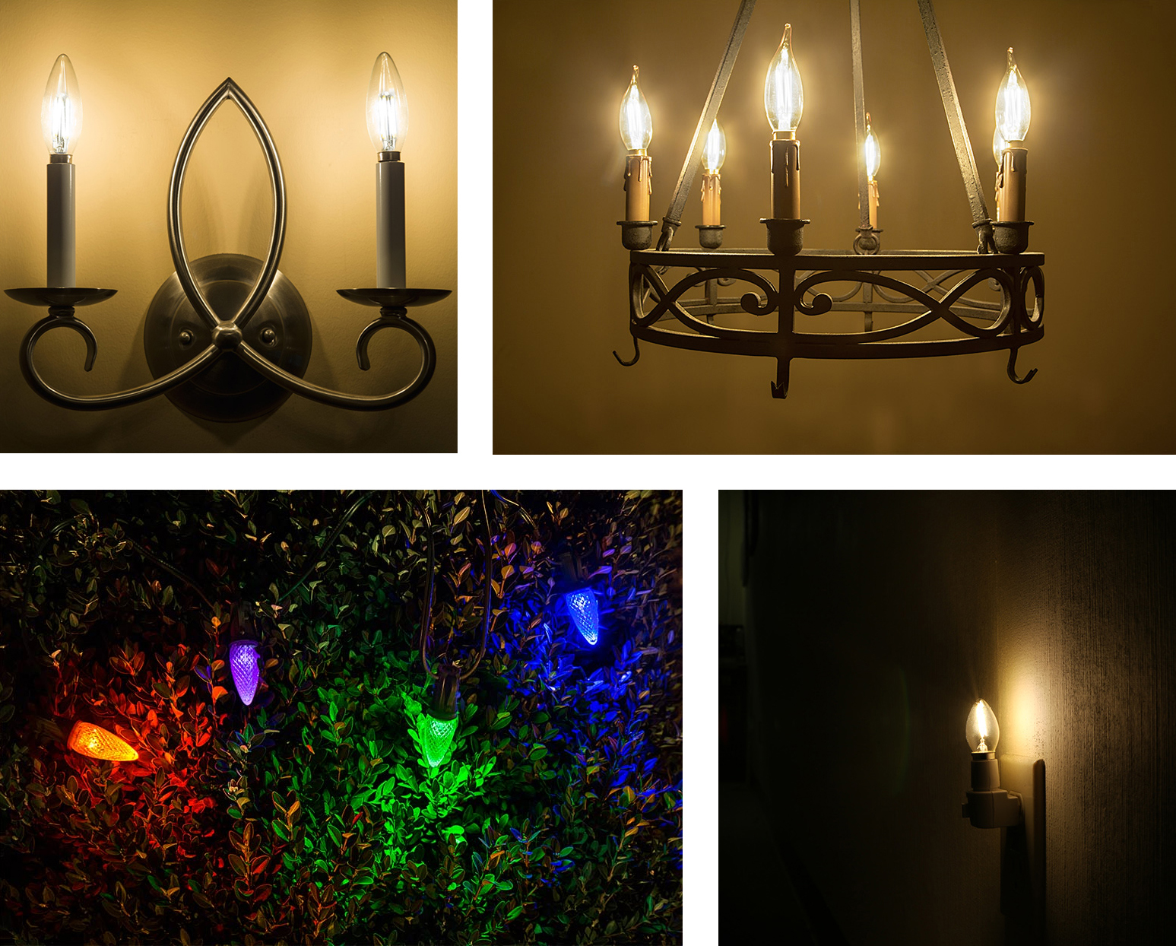
Commercial Building Electrical Systems - Lighting
B and C Group
,,,
B10 LED bulbs in wall sconce
CA10 LED bulbs in chandelier
C7 LED bulb in night light
C9 LED bulbs in Christmas light strings

Slide 18
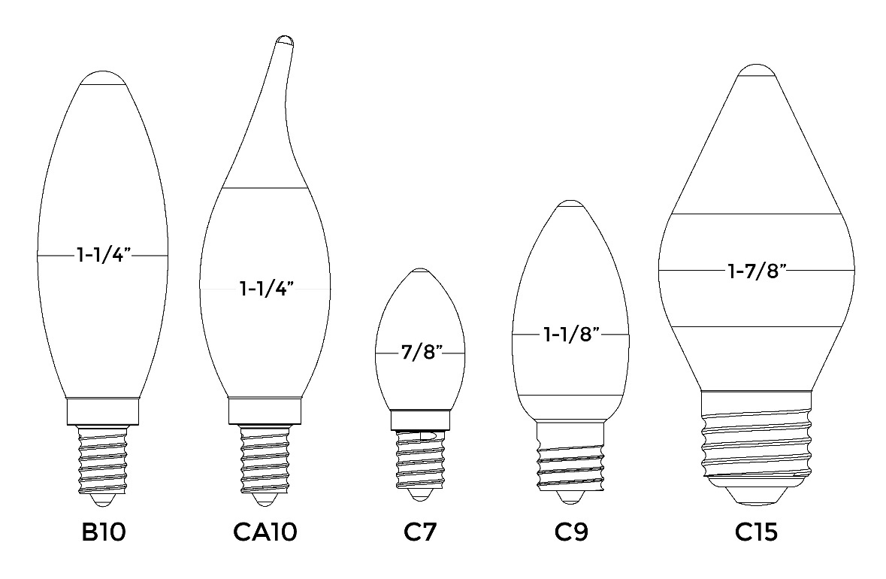
Commercial Building Electrical Systems - Lighting
Conical (C) – Conical Angular (CA) – Blunt-Tip (B) Bulbs
All of the bulbs in these groups resemble the shape of a candle flame and are often referred to as candle bulbs.
Chandeliers, night lights, decorative home lighting applications
Numbers in each code refer to the bulb’s diameter in one-eighths of an inch.

Slide 19
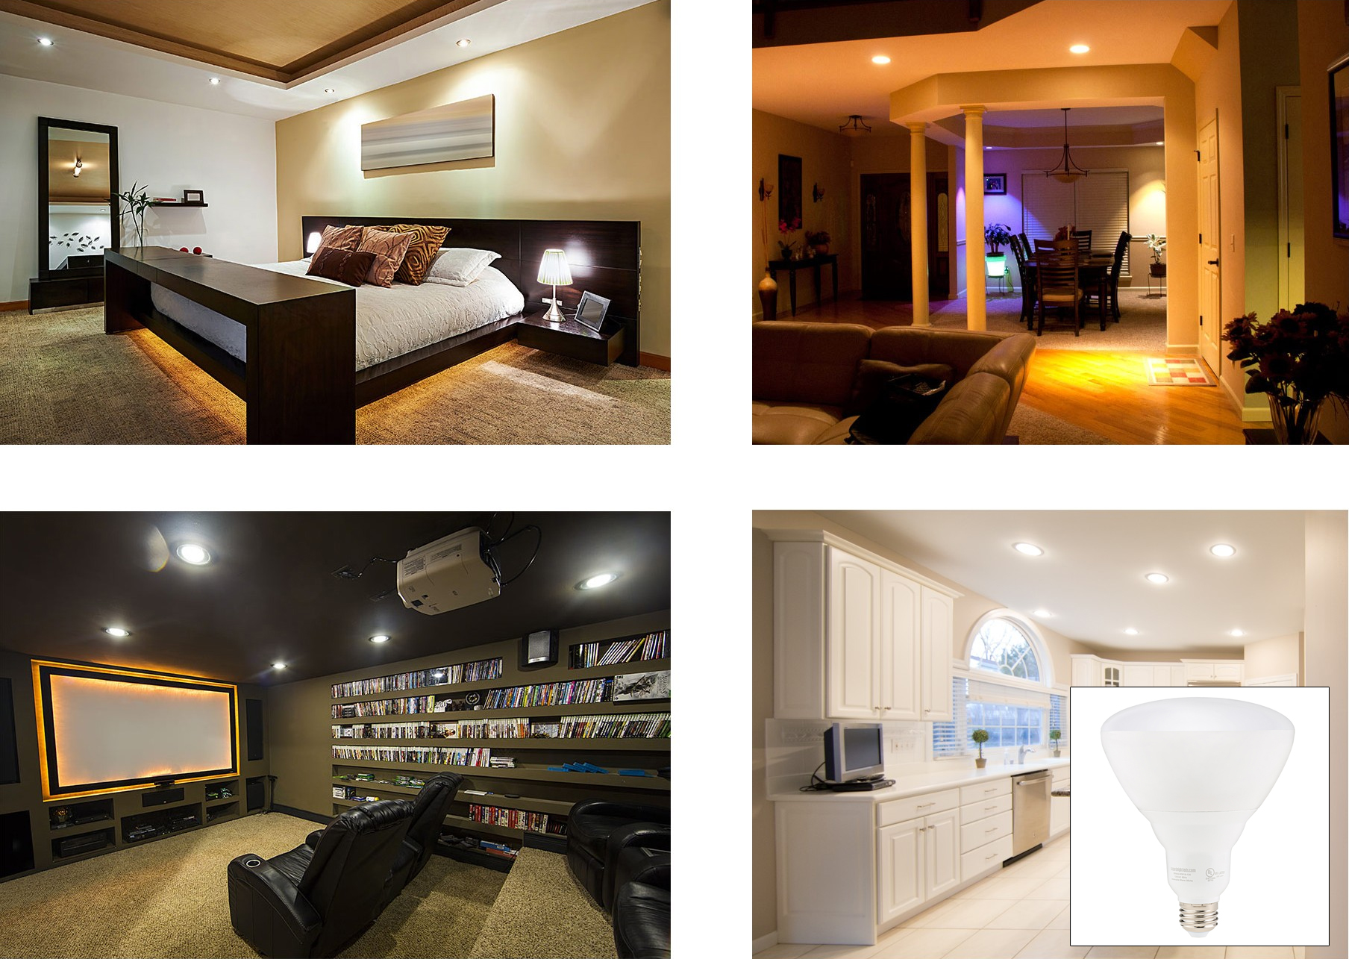
Commercial Building Electrical Systems - Lighting
BR Group
,,,
BR30 LED bulbs in bedroom can lights
BR40 LED bulbs in living room can lights
BR40 LED bulbs in kitchen can lights
BR30 LED bulbs in home theater can lights

Slide 20
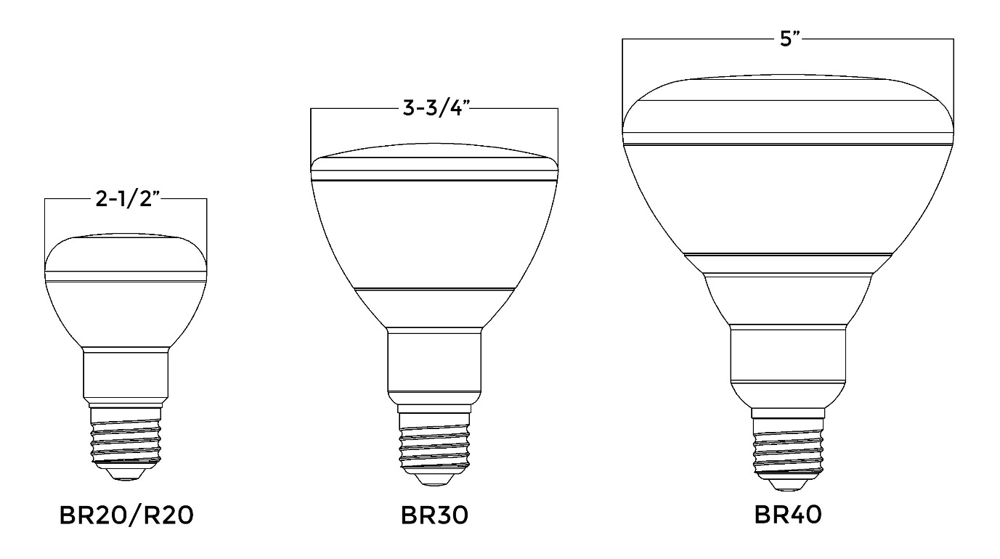
Commercial Building Electrical Systems - Lighting
Bulged Reflector (BR) Bulb
These bulbs can have a frosted, clear, or patterned dome-shaped lens that diffuses light and provides a gradual fade into nonilluminated areas.
Numbers in each code refer to the bulb’s diameter in one-eighths of an inch.

Slide 21
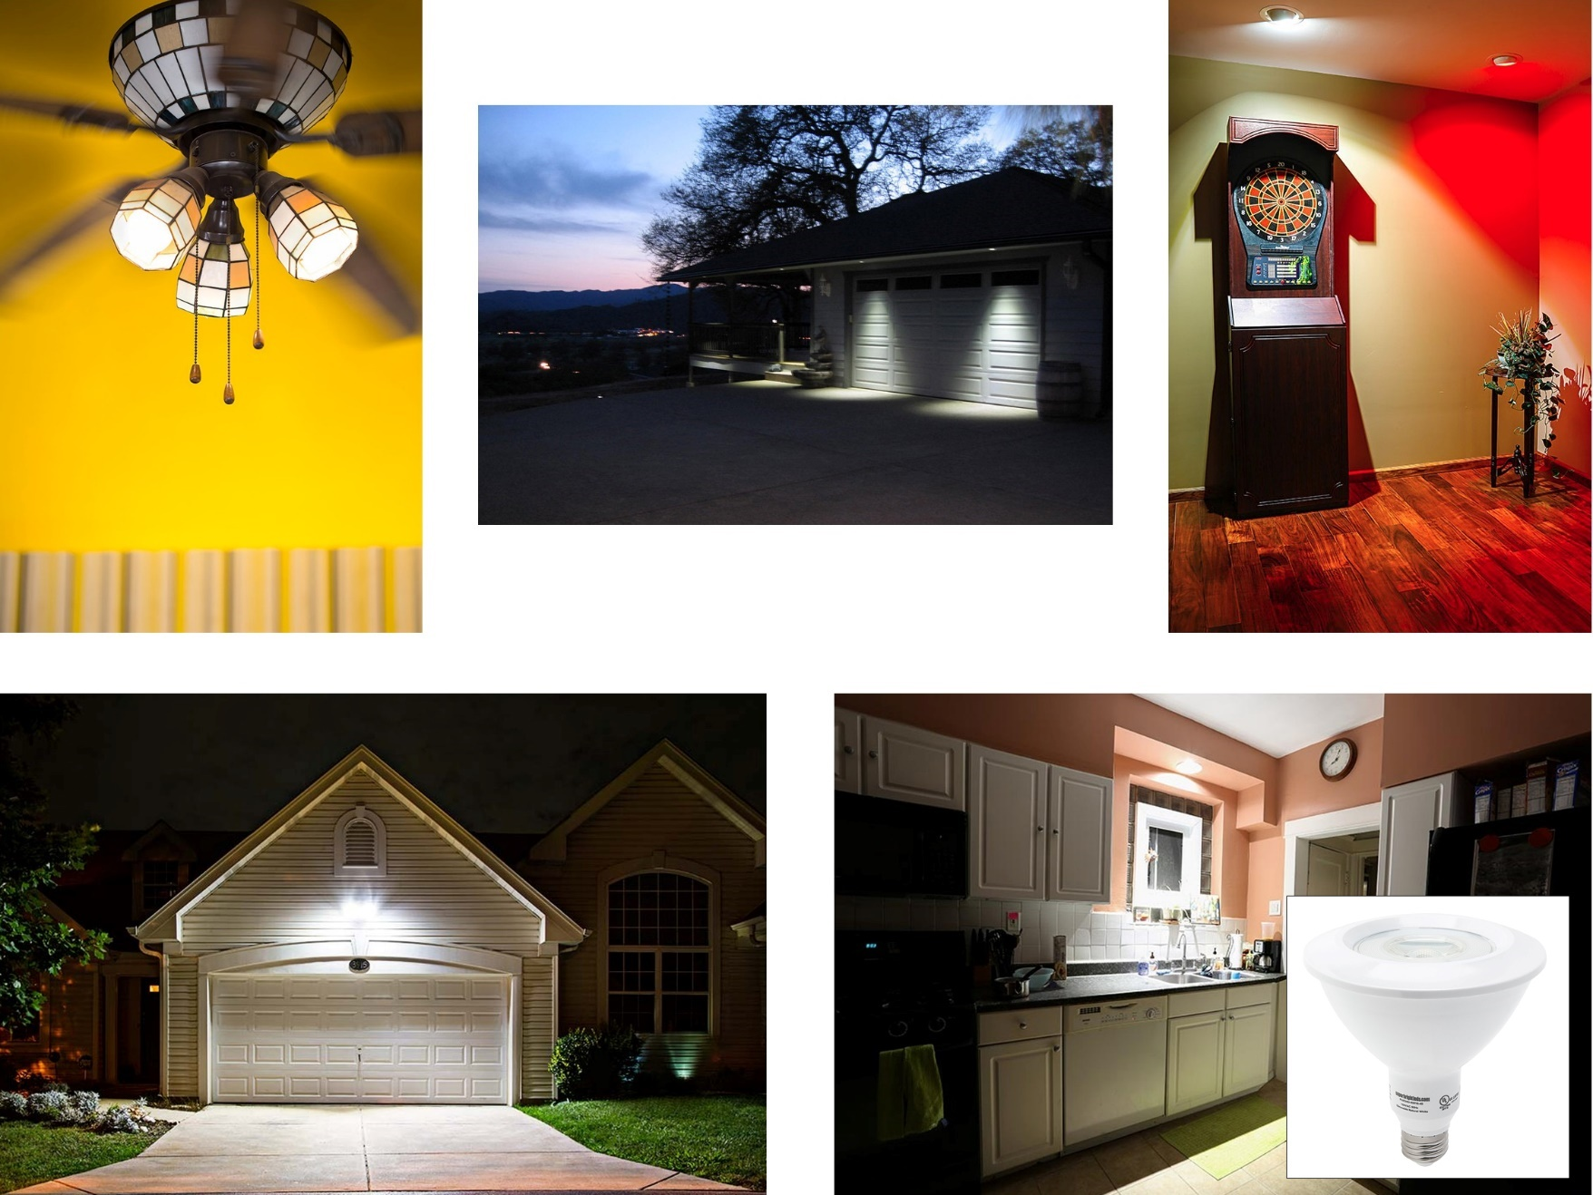
Commercial Building Electrical Systems - Lighting
PAR Group
,,,
PAR16 LED bulbs in eyeball light fixtures
PAR16 LED bulbs in ceiling fan fixture
PAR30 LED bulbs in recessed soffit light fixtures
PAR38 LED bulb in kitchen can light
PAR38 LED bulbs in garage security light

Slide 22
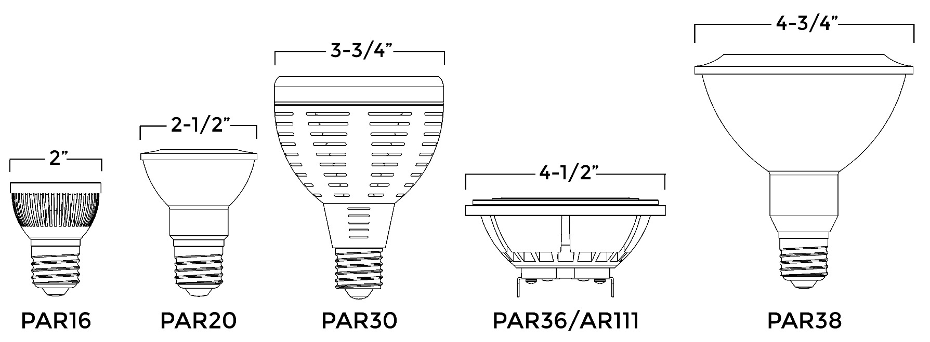
Commercial Building Electrical Systems - Lighting
Parabolic Aluminized Reflector (PAR) Bulb
Traditional incandescent PAR bulbs, a U-shaped reflector is used to maximize brightness and direct light through the front of the bulb in a narrow spot beam or wide flood beam pattern.
Numbers in each code refer to the bulb’s diameter in one-eighths of an inch. The numbers after “AR” refer to the bulb’s diameter in millimeters.

Slide 23
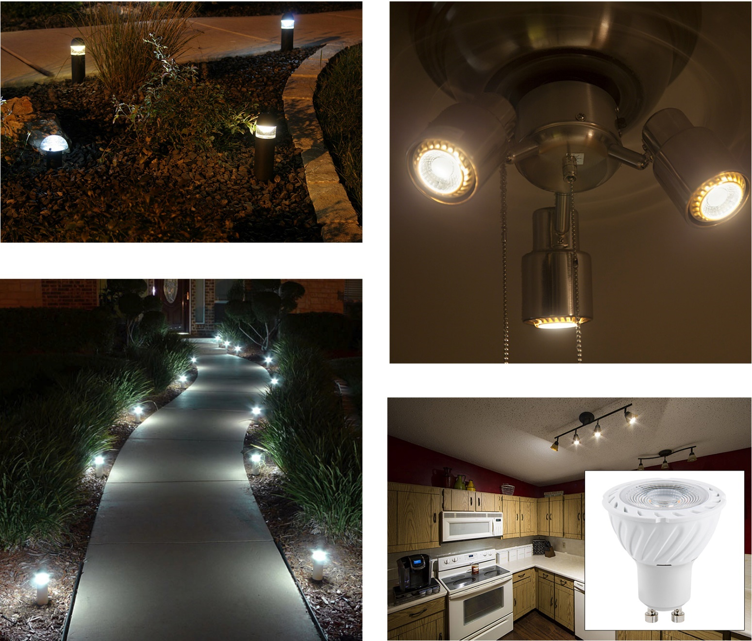
Commercial Building Electrical Systems - Lighting
MR Group
MR11 LED bulbs in bollard lights
MR16 LED bulbs in ceiling fan fixture
MR16 LED bulbs in kitchen track light fixture
MR11 LED bulbs in path lights

Slide 24
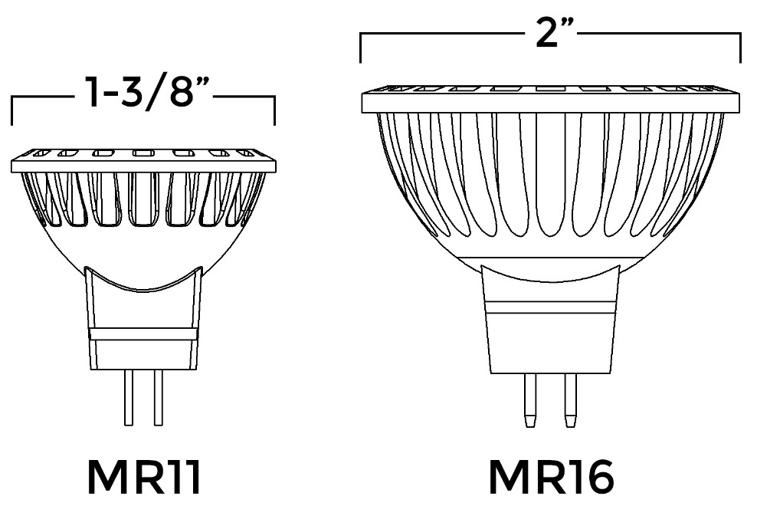
Commercial Building Electrical Systems - Lighting
Multifaceted Reflector (MR) Bulb
The facets create a concentrated beam of light that can be displayed in a narrow spot or wide flood beam pattern.
Numbers in each code refer to the bulb’s diameter in one-eighths of an inch.

Slide 25
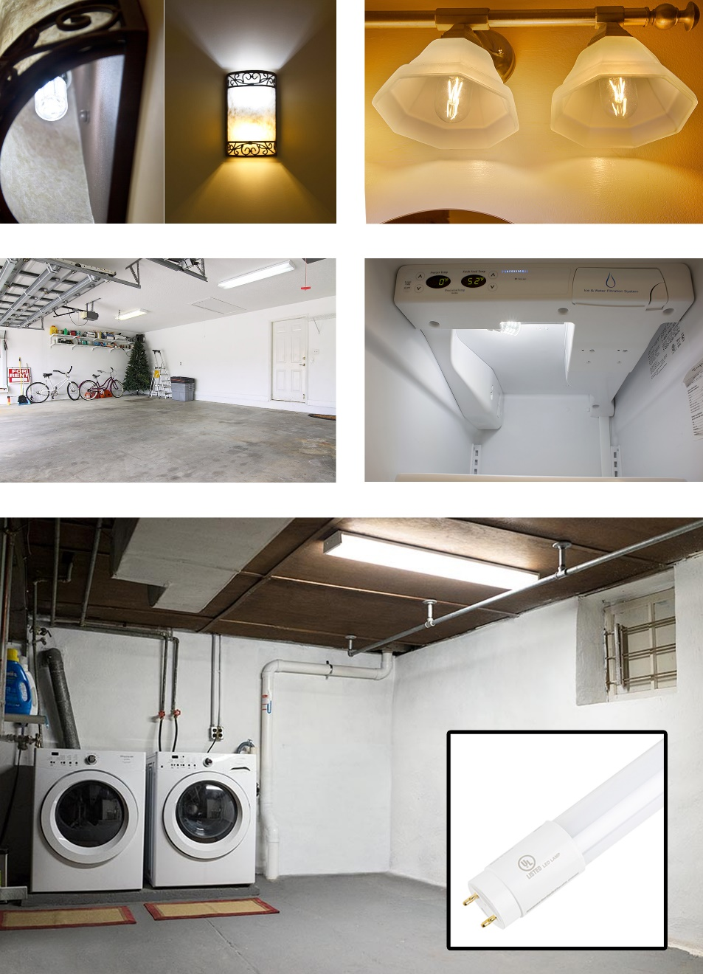
Commercial Building Electrical Systems - Lighting
T Group
T14 LED bulbs in bathroom vanity light fixture
T7 LED bulb in wall sconce
T8 LED bulbs in garage tube light fixture
T10 LED bulb in freezer
T8 LED bulb in basement tube light fixture

Slide 26
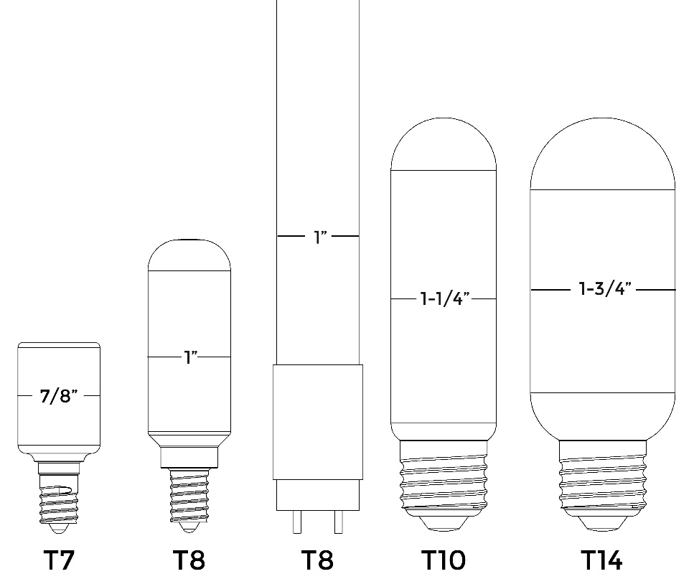
Commercial Building Electrical Systems - Lighting
Tubular (T) Bulb
Depending on their size, these bulbs can be used in applications ranging from chandeliers, wall sconces, and pendant lights to basement and garage light fixtures.
Numbers in each code refer to the bulb’s diameter in one-eighths of an inch.

Slide 27
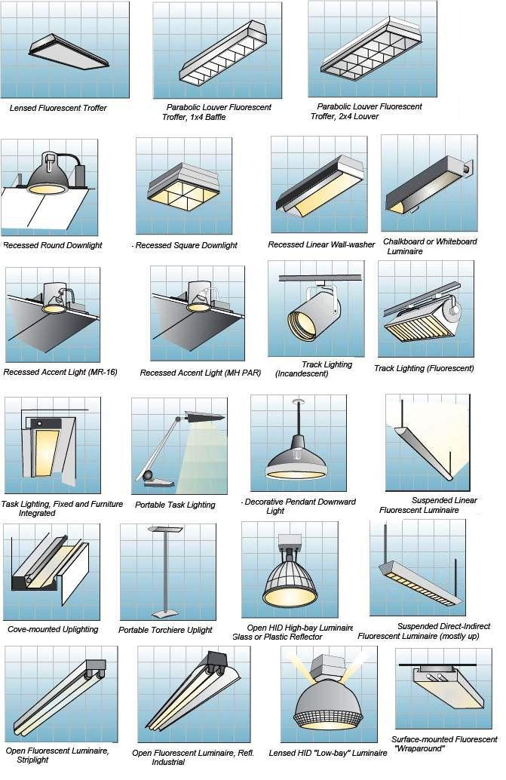
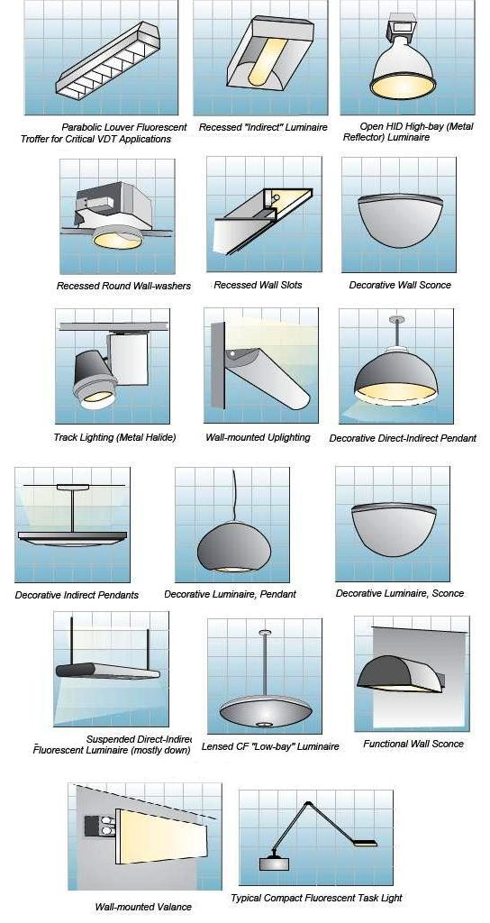
Commercial Building Electrical Systems - Lighting

Slide 28
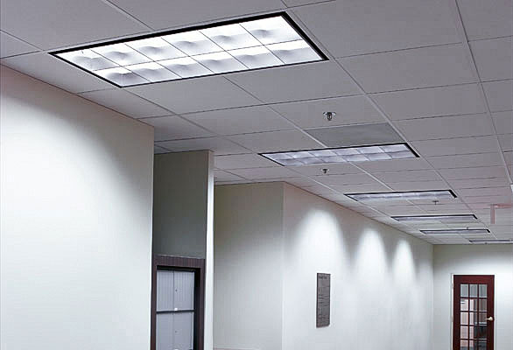
Commercial Building Electrical Systems - Lighting
Surface
Wall
Ceiling
Recessed
Suspended
Lay-In
Under-Cabinet
Cove
Track

Slide 29
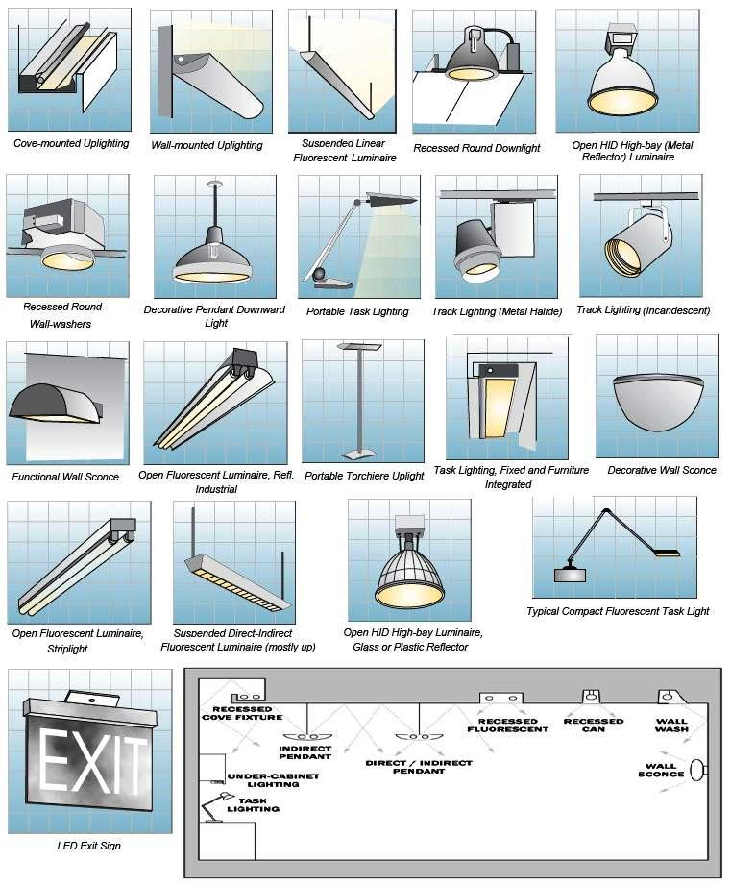
Commercial Building Electrical Systems - Lighting

Slide 30
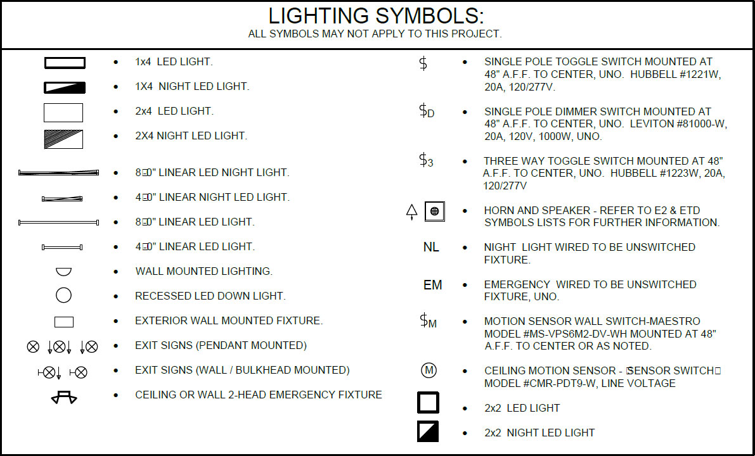
Commercial Building Electrical Systems - Lighting

Slide 31
Commercial Building Electrical Systems - Lighting

Slide 32
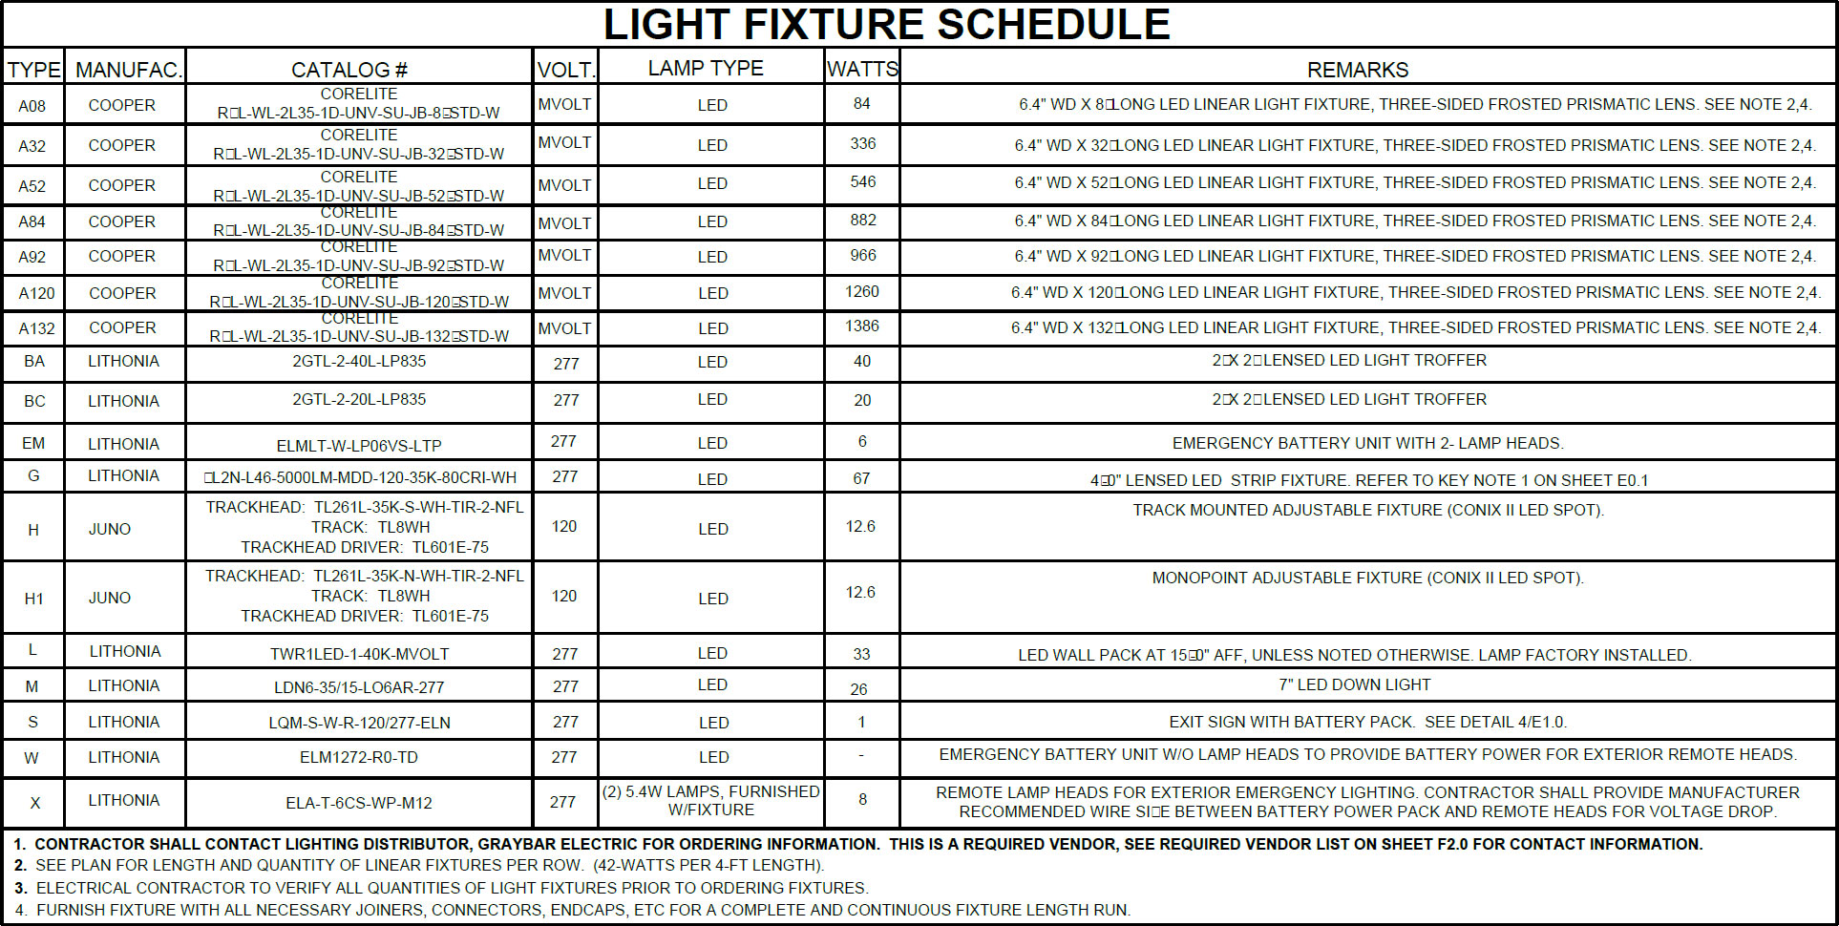
Commercial Building Electrical Systems - Lighting

Slide 33
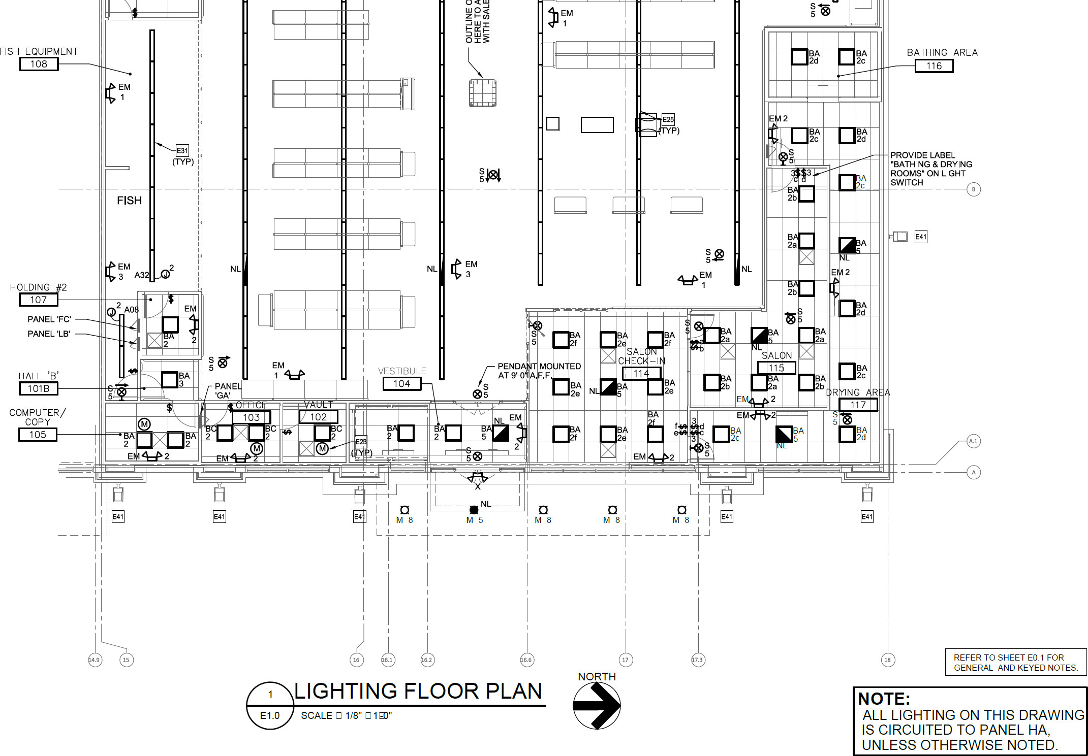
Commercial Building Electrical Systems - Lighting

Slide 34
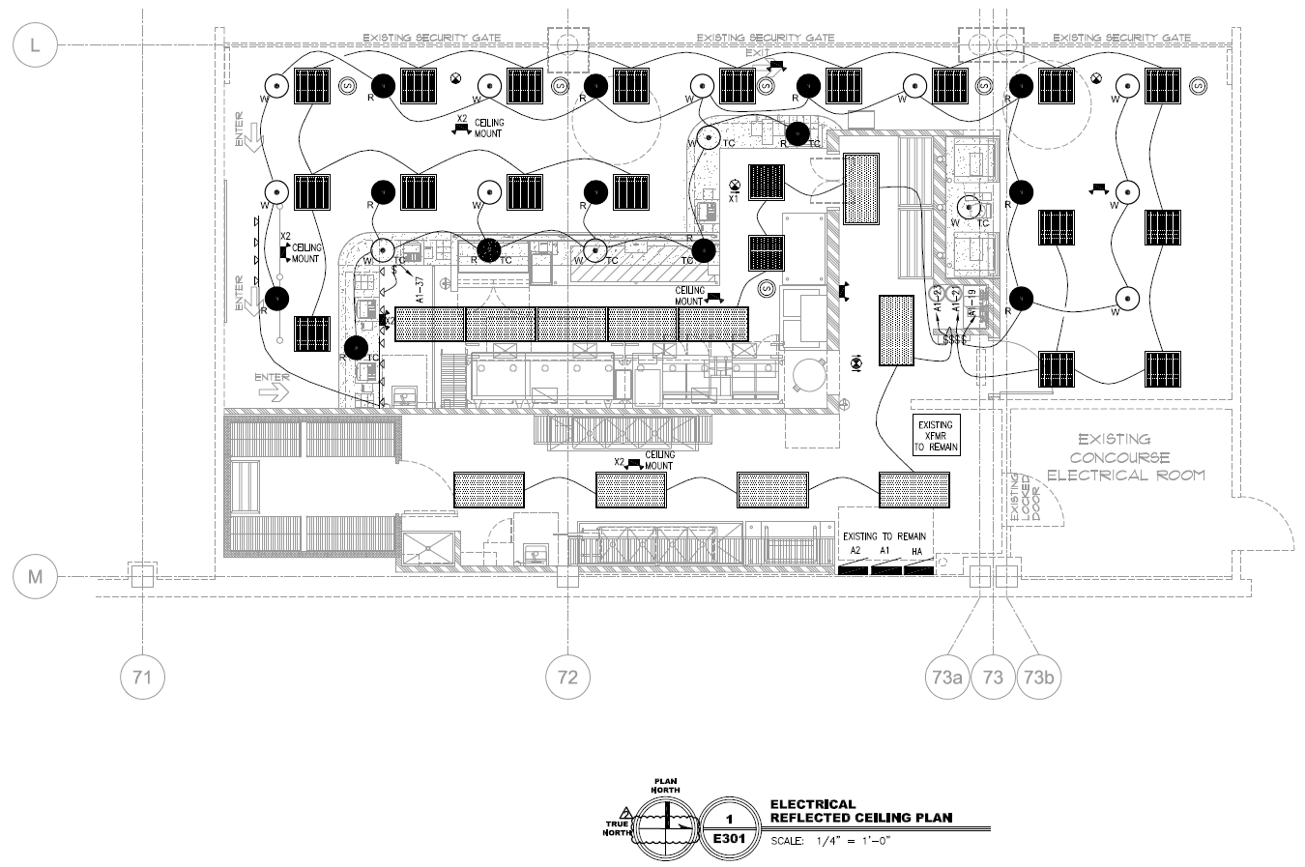
Five Guys Burgers and Fries

Slide 35
Five Guys Burgers and Fries

Slide 36
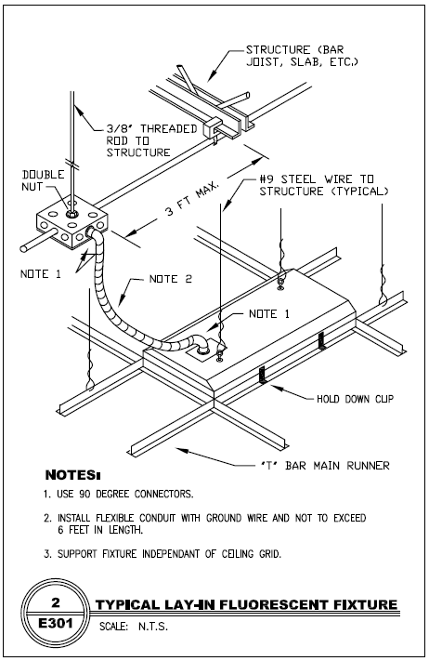
Five Guys Burgers and Fries

Slide 37
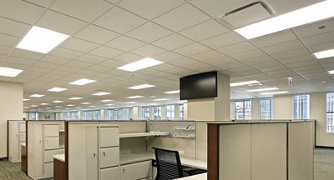
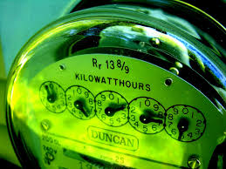
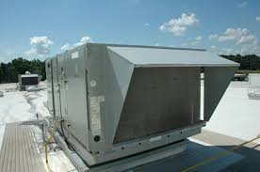
Electrical Energy Costs
Commercial Building
Lighting
Cooling and Heating

Slide 38
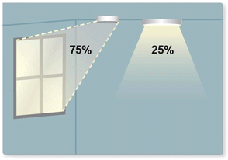
Daylighting
Introducing natural light into a space with the intention of reducing or eliminating the electric light.

Slide 39
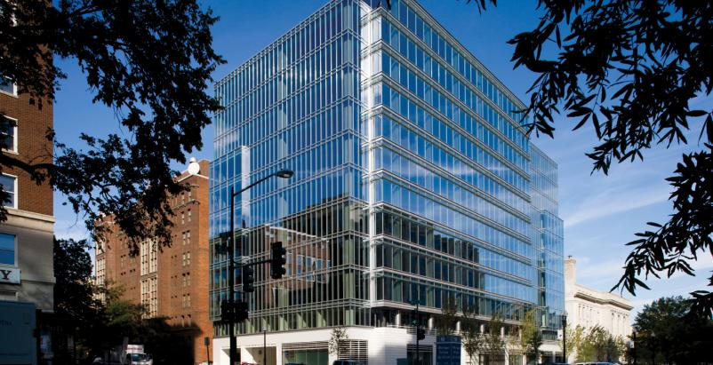
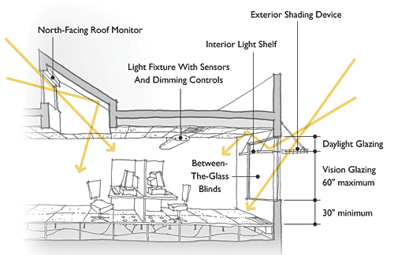
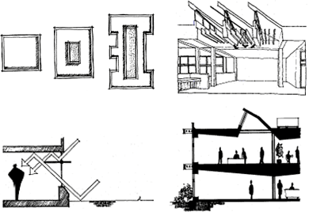
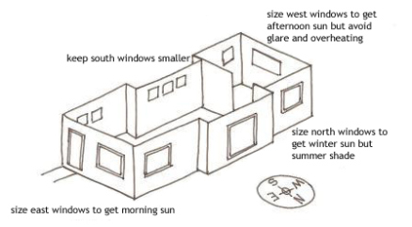
Daylighting

Slide 40
High-Performance Building
Engineering design integrates the electric lighting system design with the architectural design to:
► Supplement the changing daylighting levels
► Maintain constant prescribed lighting levels in the space
► Use efficient lighting technologies and control strategies

Slide 41
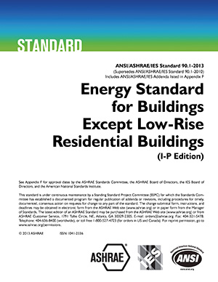
Lighting Standards

Slide 42
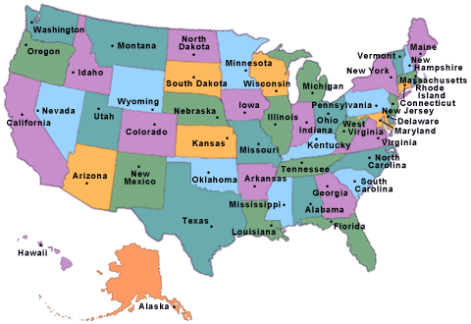
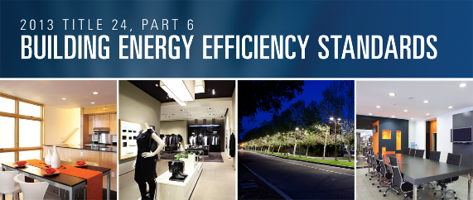
Lighting Codes

Slide 43
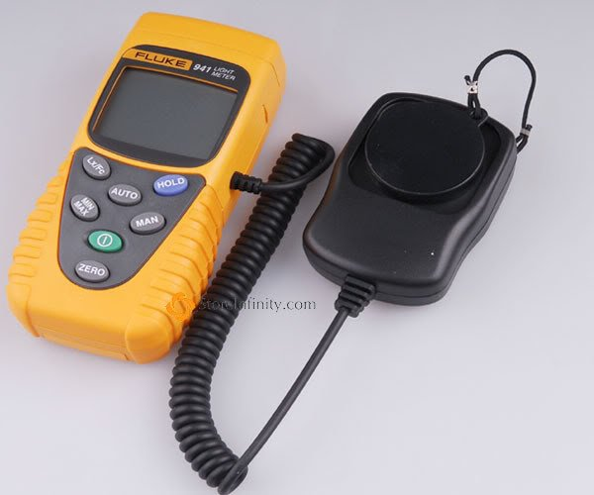
Lighting Measurements
Wattage The amount of electricity consumed by a light source
Lumens The amount of light that a light source produces
Footcandles The amount of light reaching a subject
Lux Lumens per meter squared

Slide 44
Lamp Operating Characteristics
Efficacy Lumens per watt
Life Lamp life rated in hours
Color Color temperature is used to describe the color of light. i.e. INC 2,600 to 3,000 K
CRI Color Rendering Index

Slide 45
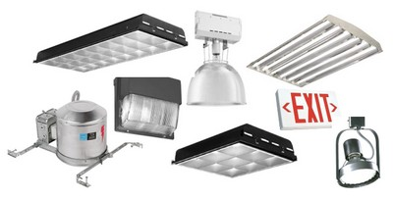
Types of Fixtures

Slide 46
Lighting Control

Slide 47
Lighting Control

Slide 48
Lighting Control

Slide 49
Lighting Control

Slide 50
Lighting Control

Slide 51
Lighting Control

Slide 52
Occupancy Sensor

