Slide 1

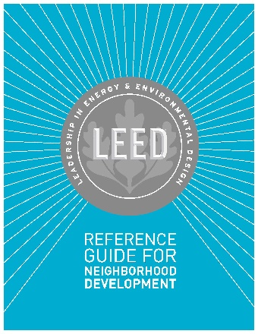

LEED ND v4
Exam Preparation
Lori A. Brown
LEED AP BD+C, LEED AP ND, LEED AP O+M
CSU, Chico
Friday, May 5, 2017
Lend Lease
Chicago, IL

Slide 2
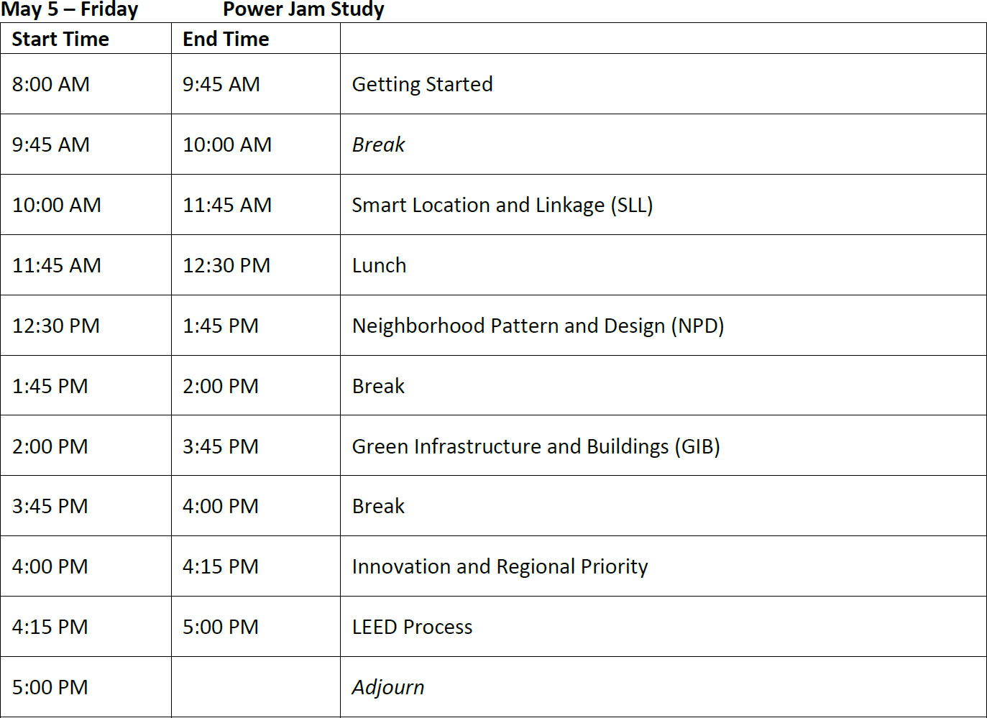
Power Jam Study - Agenda

Slide 3
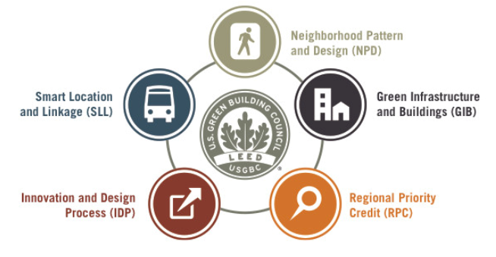
LEED for Neighborhood Development

Slide 4
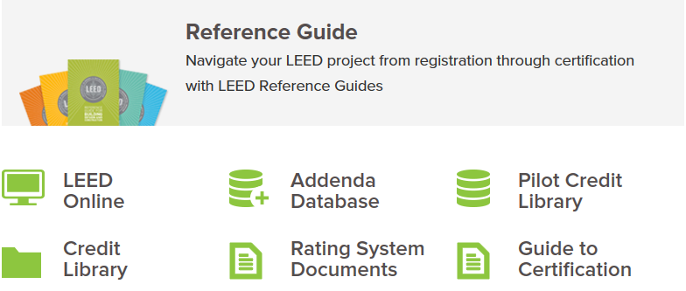
LEED for Neighborhood Development
USGBC Resources (http://usgbc.org)

Slide 5
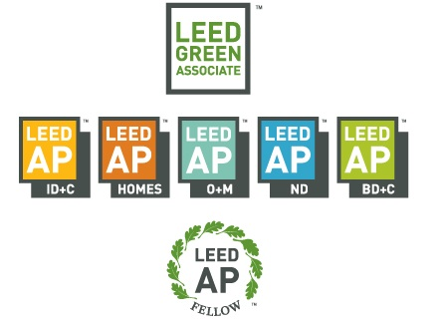
Credential Overview
LEED Credentials

Slide 6
Getting Started on the LEED AP ND Credential
Earning the LEED AP ND credential requires passing a two-part exam:
Exam Part 1: LEED® Green Associate™ Exam
The first part of your exam is the LEED Green Associate, which tests your general knowledge of green building practices for both commercial and residential spaces and both new construction and existing buildings as well as how to support other professionals working on LEED projects.
Exam Part 2: ND Specialty Exam
The second part of your exam is the LEED ND specialty exam which tests the knowledge and skills necessary to participate in the design process, to support and encourage integrated design, and to streamline the application and certification process.
You may take both parts of the exam either on the same day or on separate days.

Slide 7
Getting Started on the LEED AP ND Credential
Taking the exam – each part
Two-hour computer-based test
100 randomly delivered multiple-choice questions
Your score will be available immediately at the end of the exam, and you will receive a printed score report.
A passing score is 170 or higher on a scale of 125 to 200.
Full exam: $400 ($550 for non-members)
Specialty only: $250 ($350 for non-members)
Maintenance: $85 every two years

Slide 8


Slide 9
Maintaining Your Credential
LEED Green Associate 15 CE hours, 3 LEED-specific
LEED AP with specialty 30 CE hours, 6 LEED-specific
Renewal is available one year into your reporting period.
To renew:
Report required CE hours in your Credentials account, ensuring you have met all requirements
Follow onscreen instructions
Pay the $85 renewal fee

Slide 10
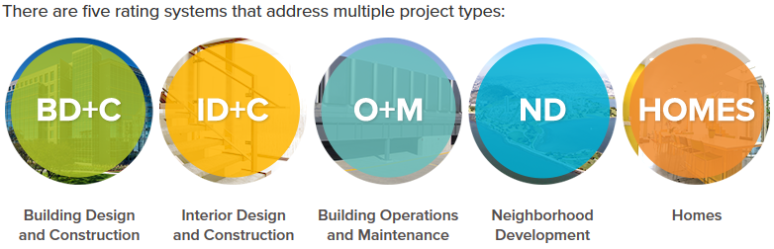
Green Building with LEED

Slide 11
Green Building with LEED
Plan
Built Project
Adaptations

Slide 12
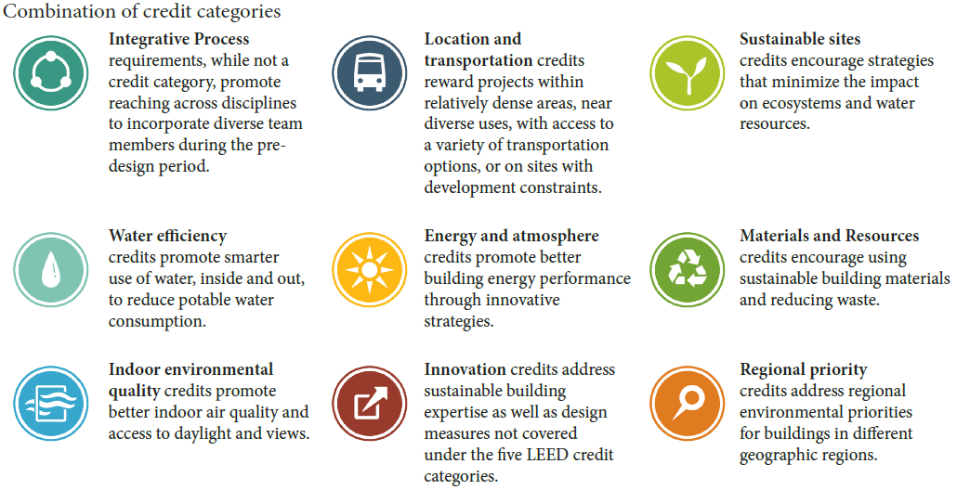
Green Building with LEED

Slide 13
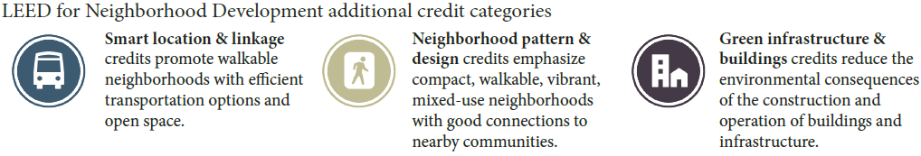
Green Building with LEED

Slide 14
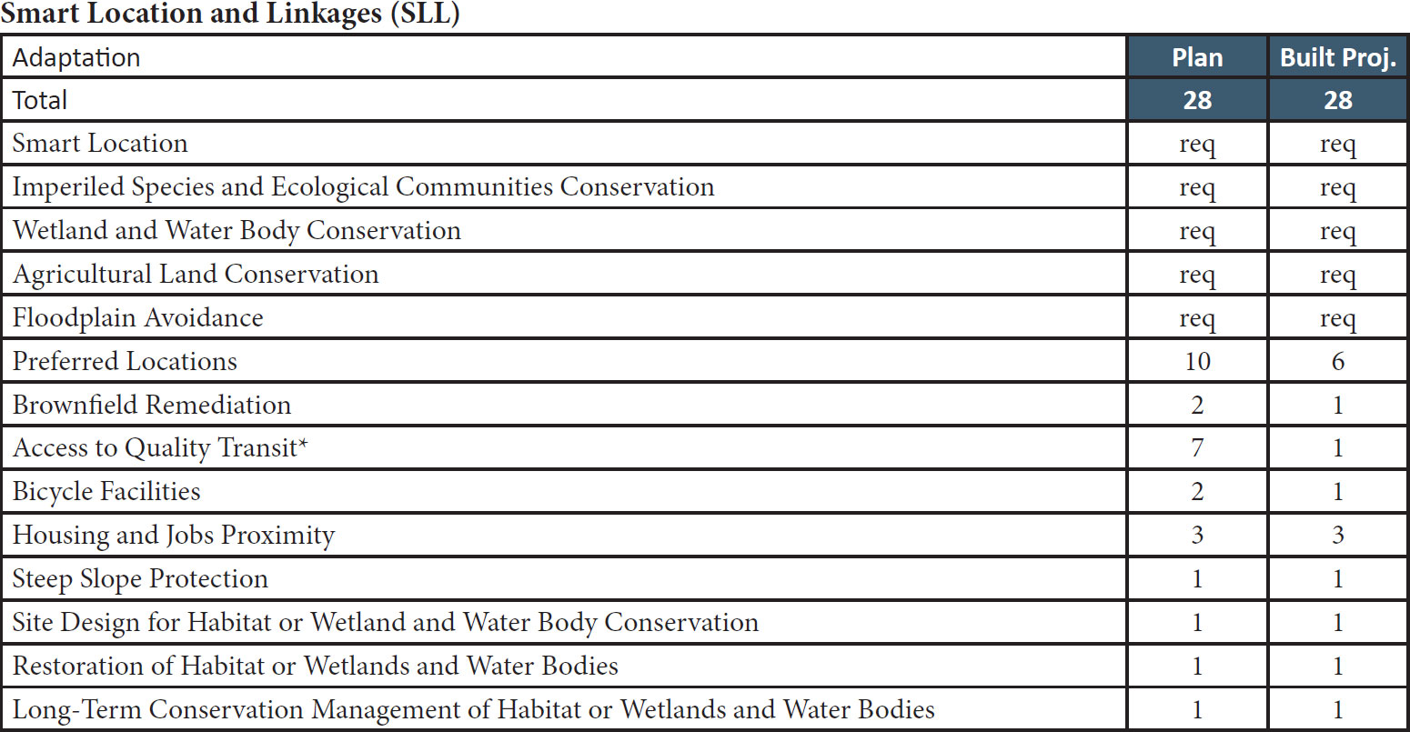
LEED ND Credit Categories

Slide 15
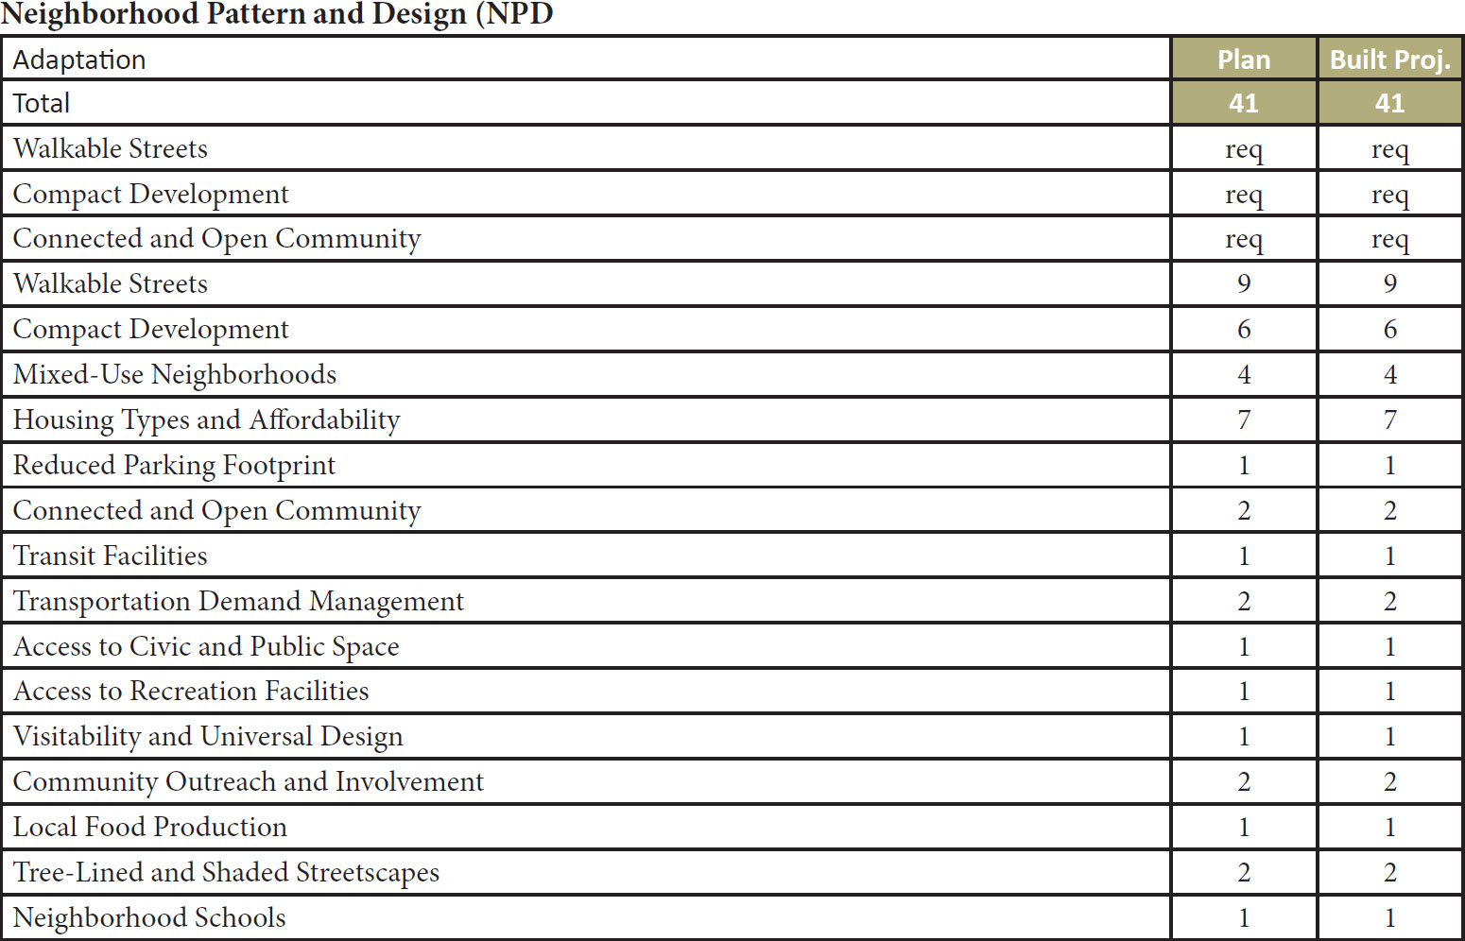
LEED ND Credit Categories

Slide 16
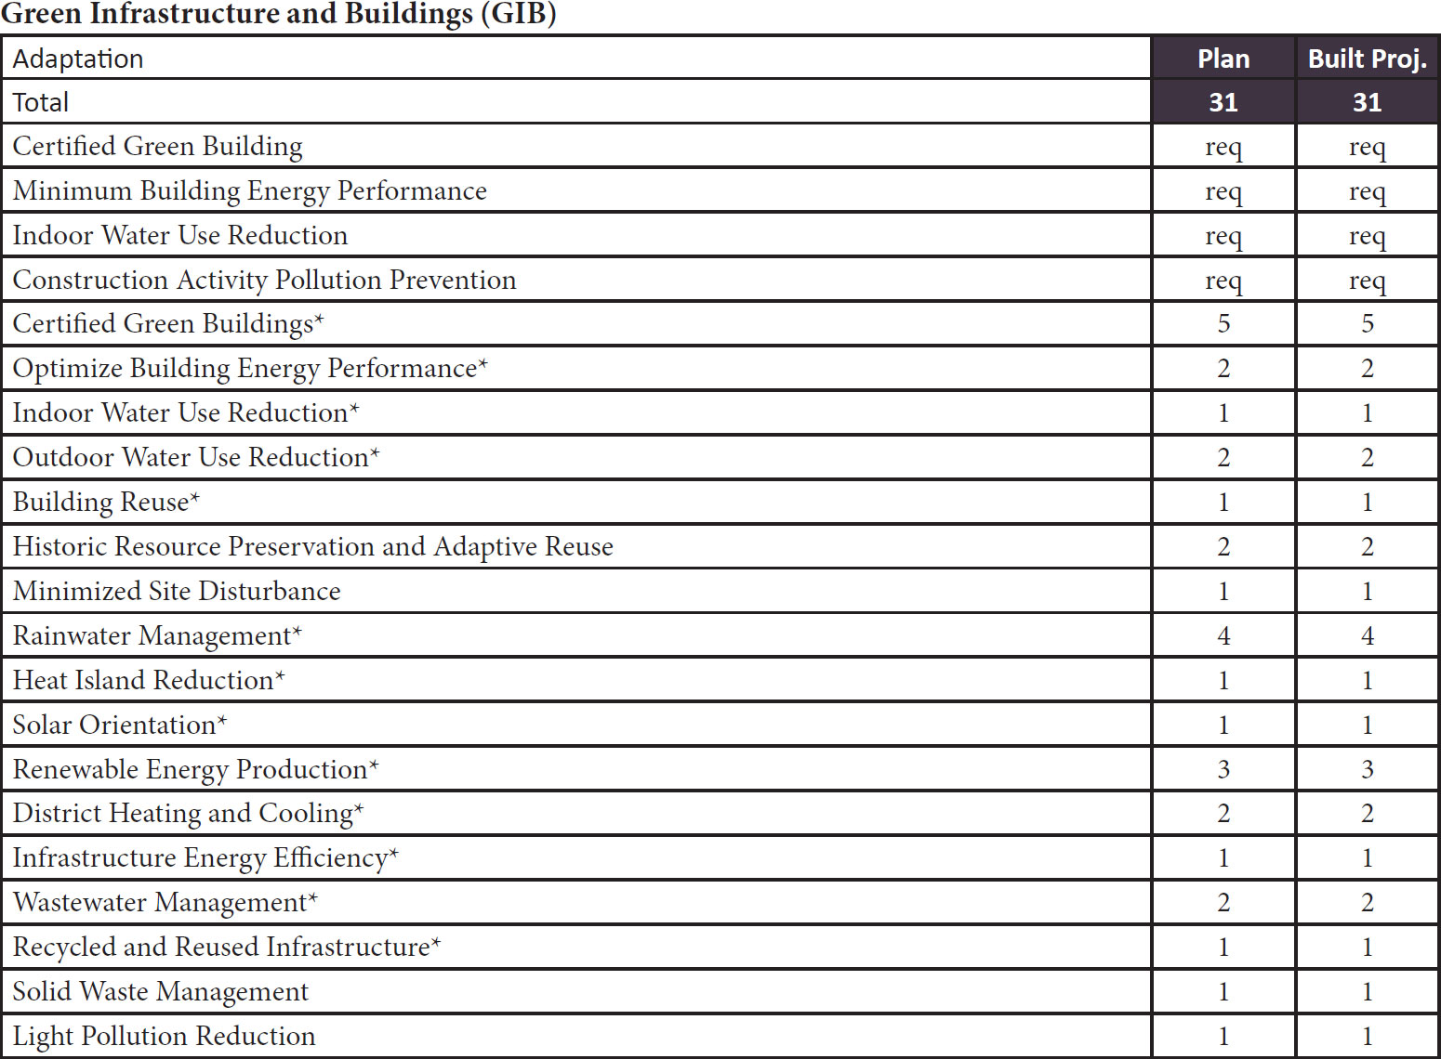
LEED ND Credit Categories

Slide 17
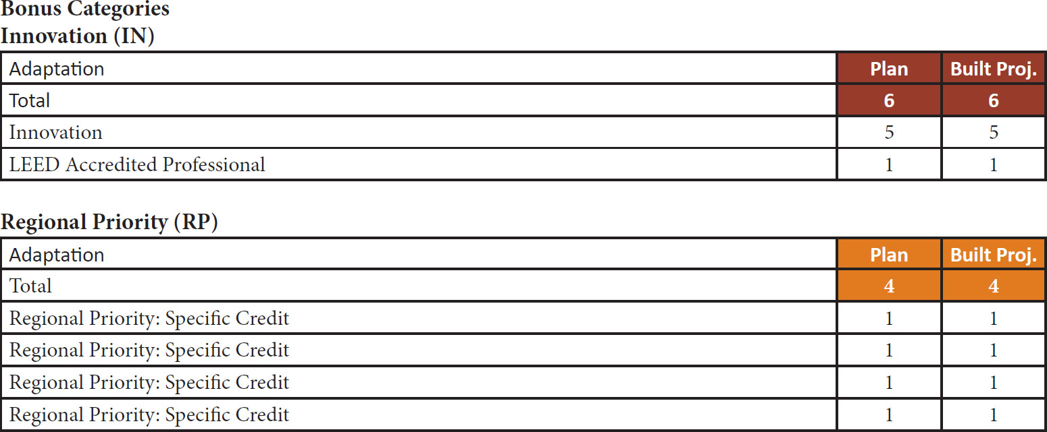
LEED ND Credit Categories

Slide 18
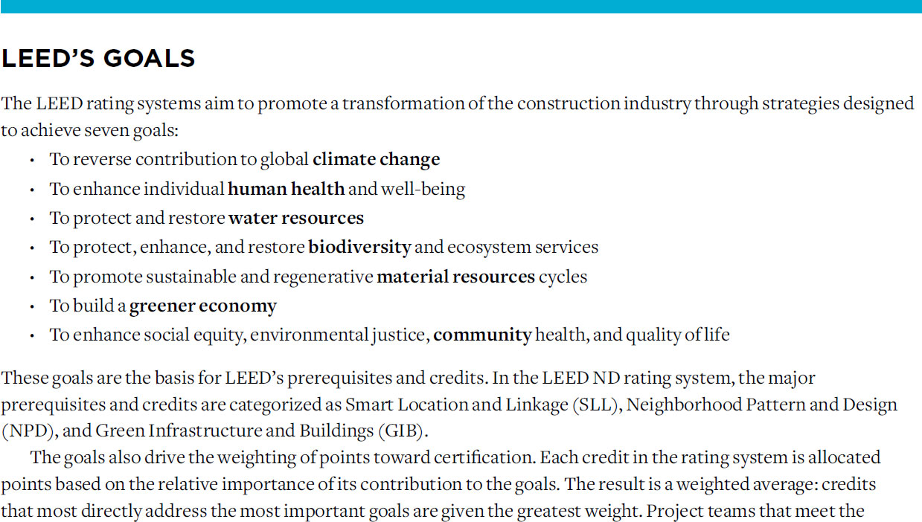

Slide 19
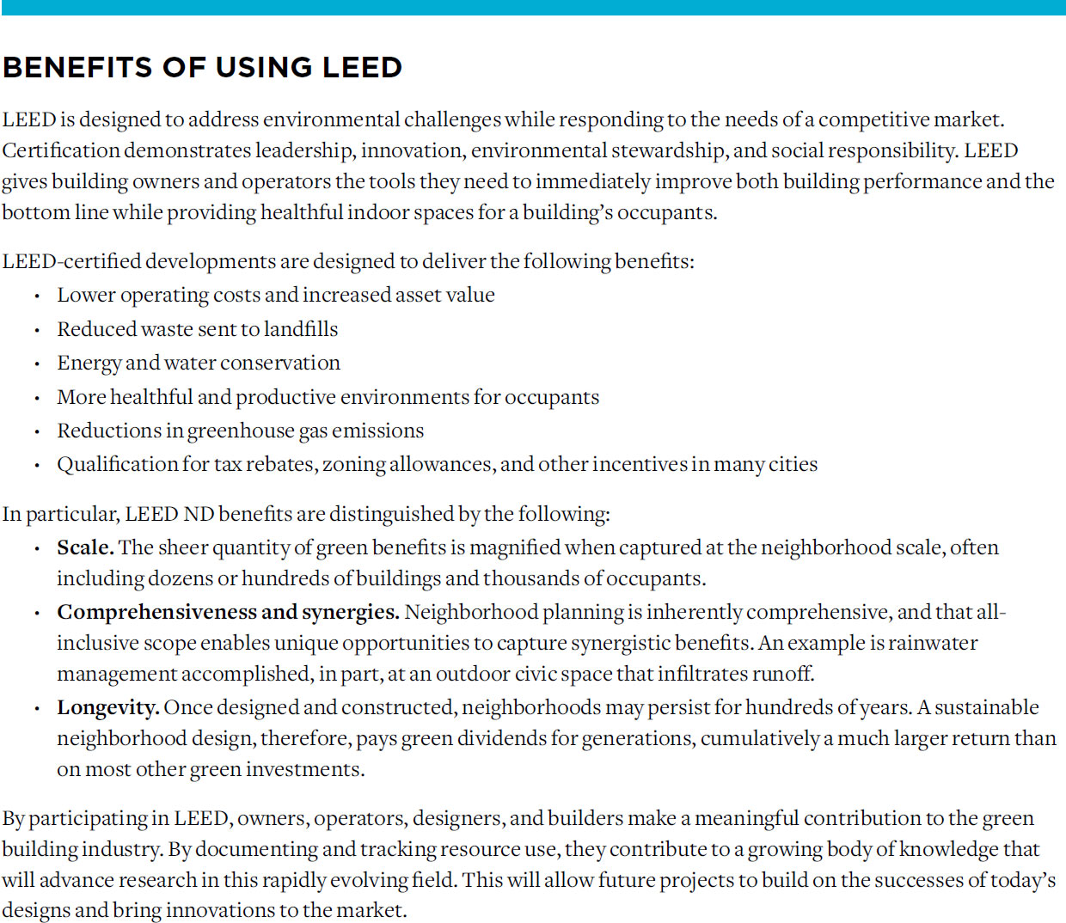

Slide 20
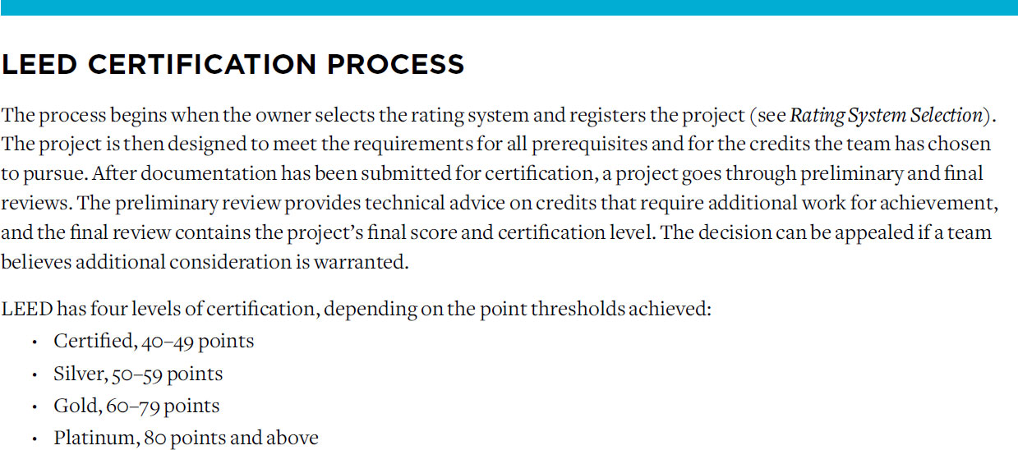
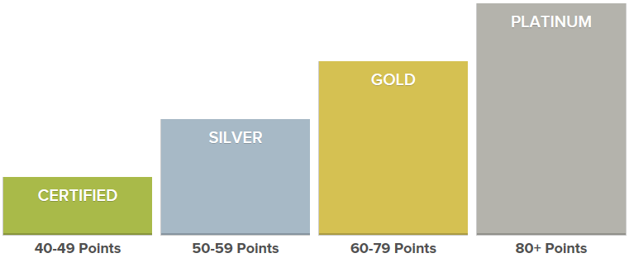

Slide 21
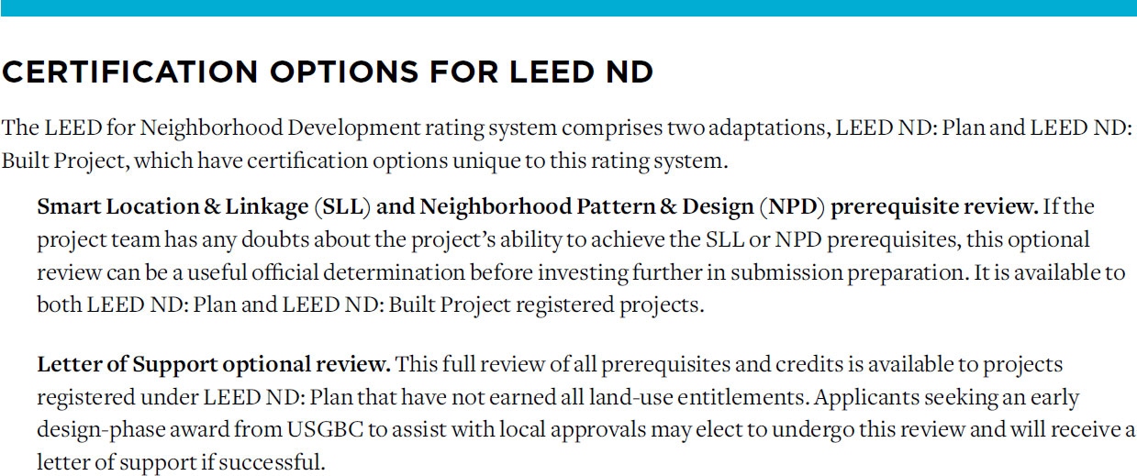

Slide 24
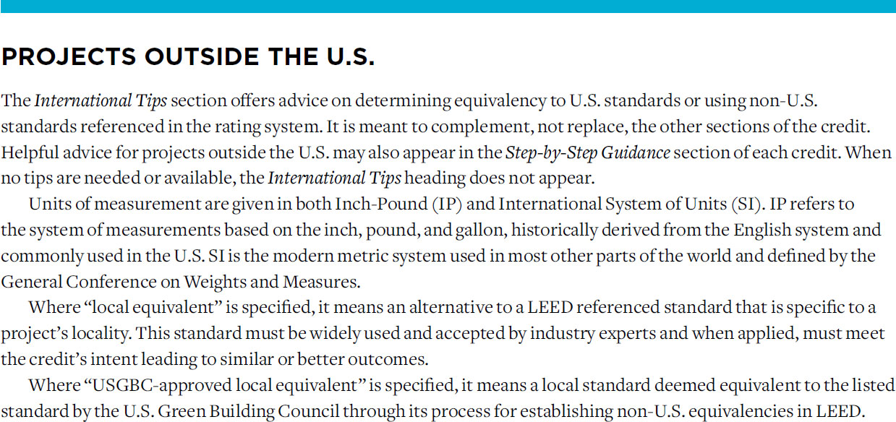

Slide 25
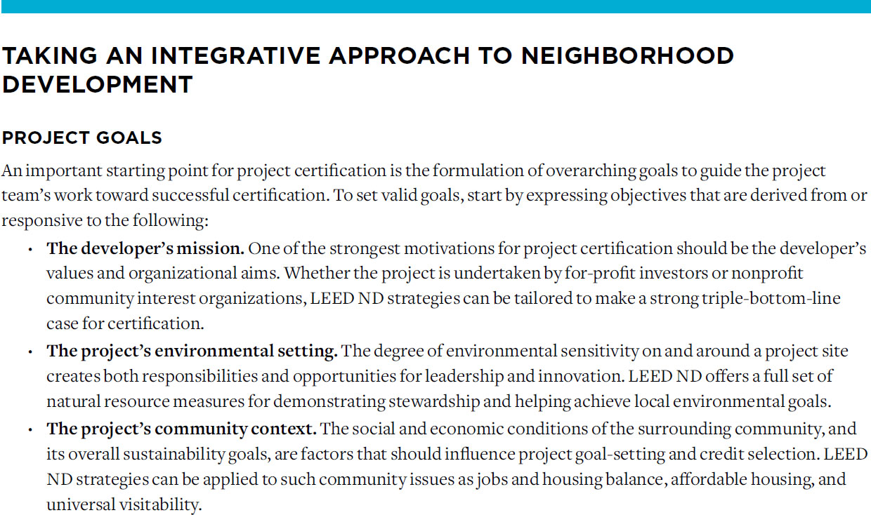

Slide 26
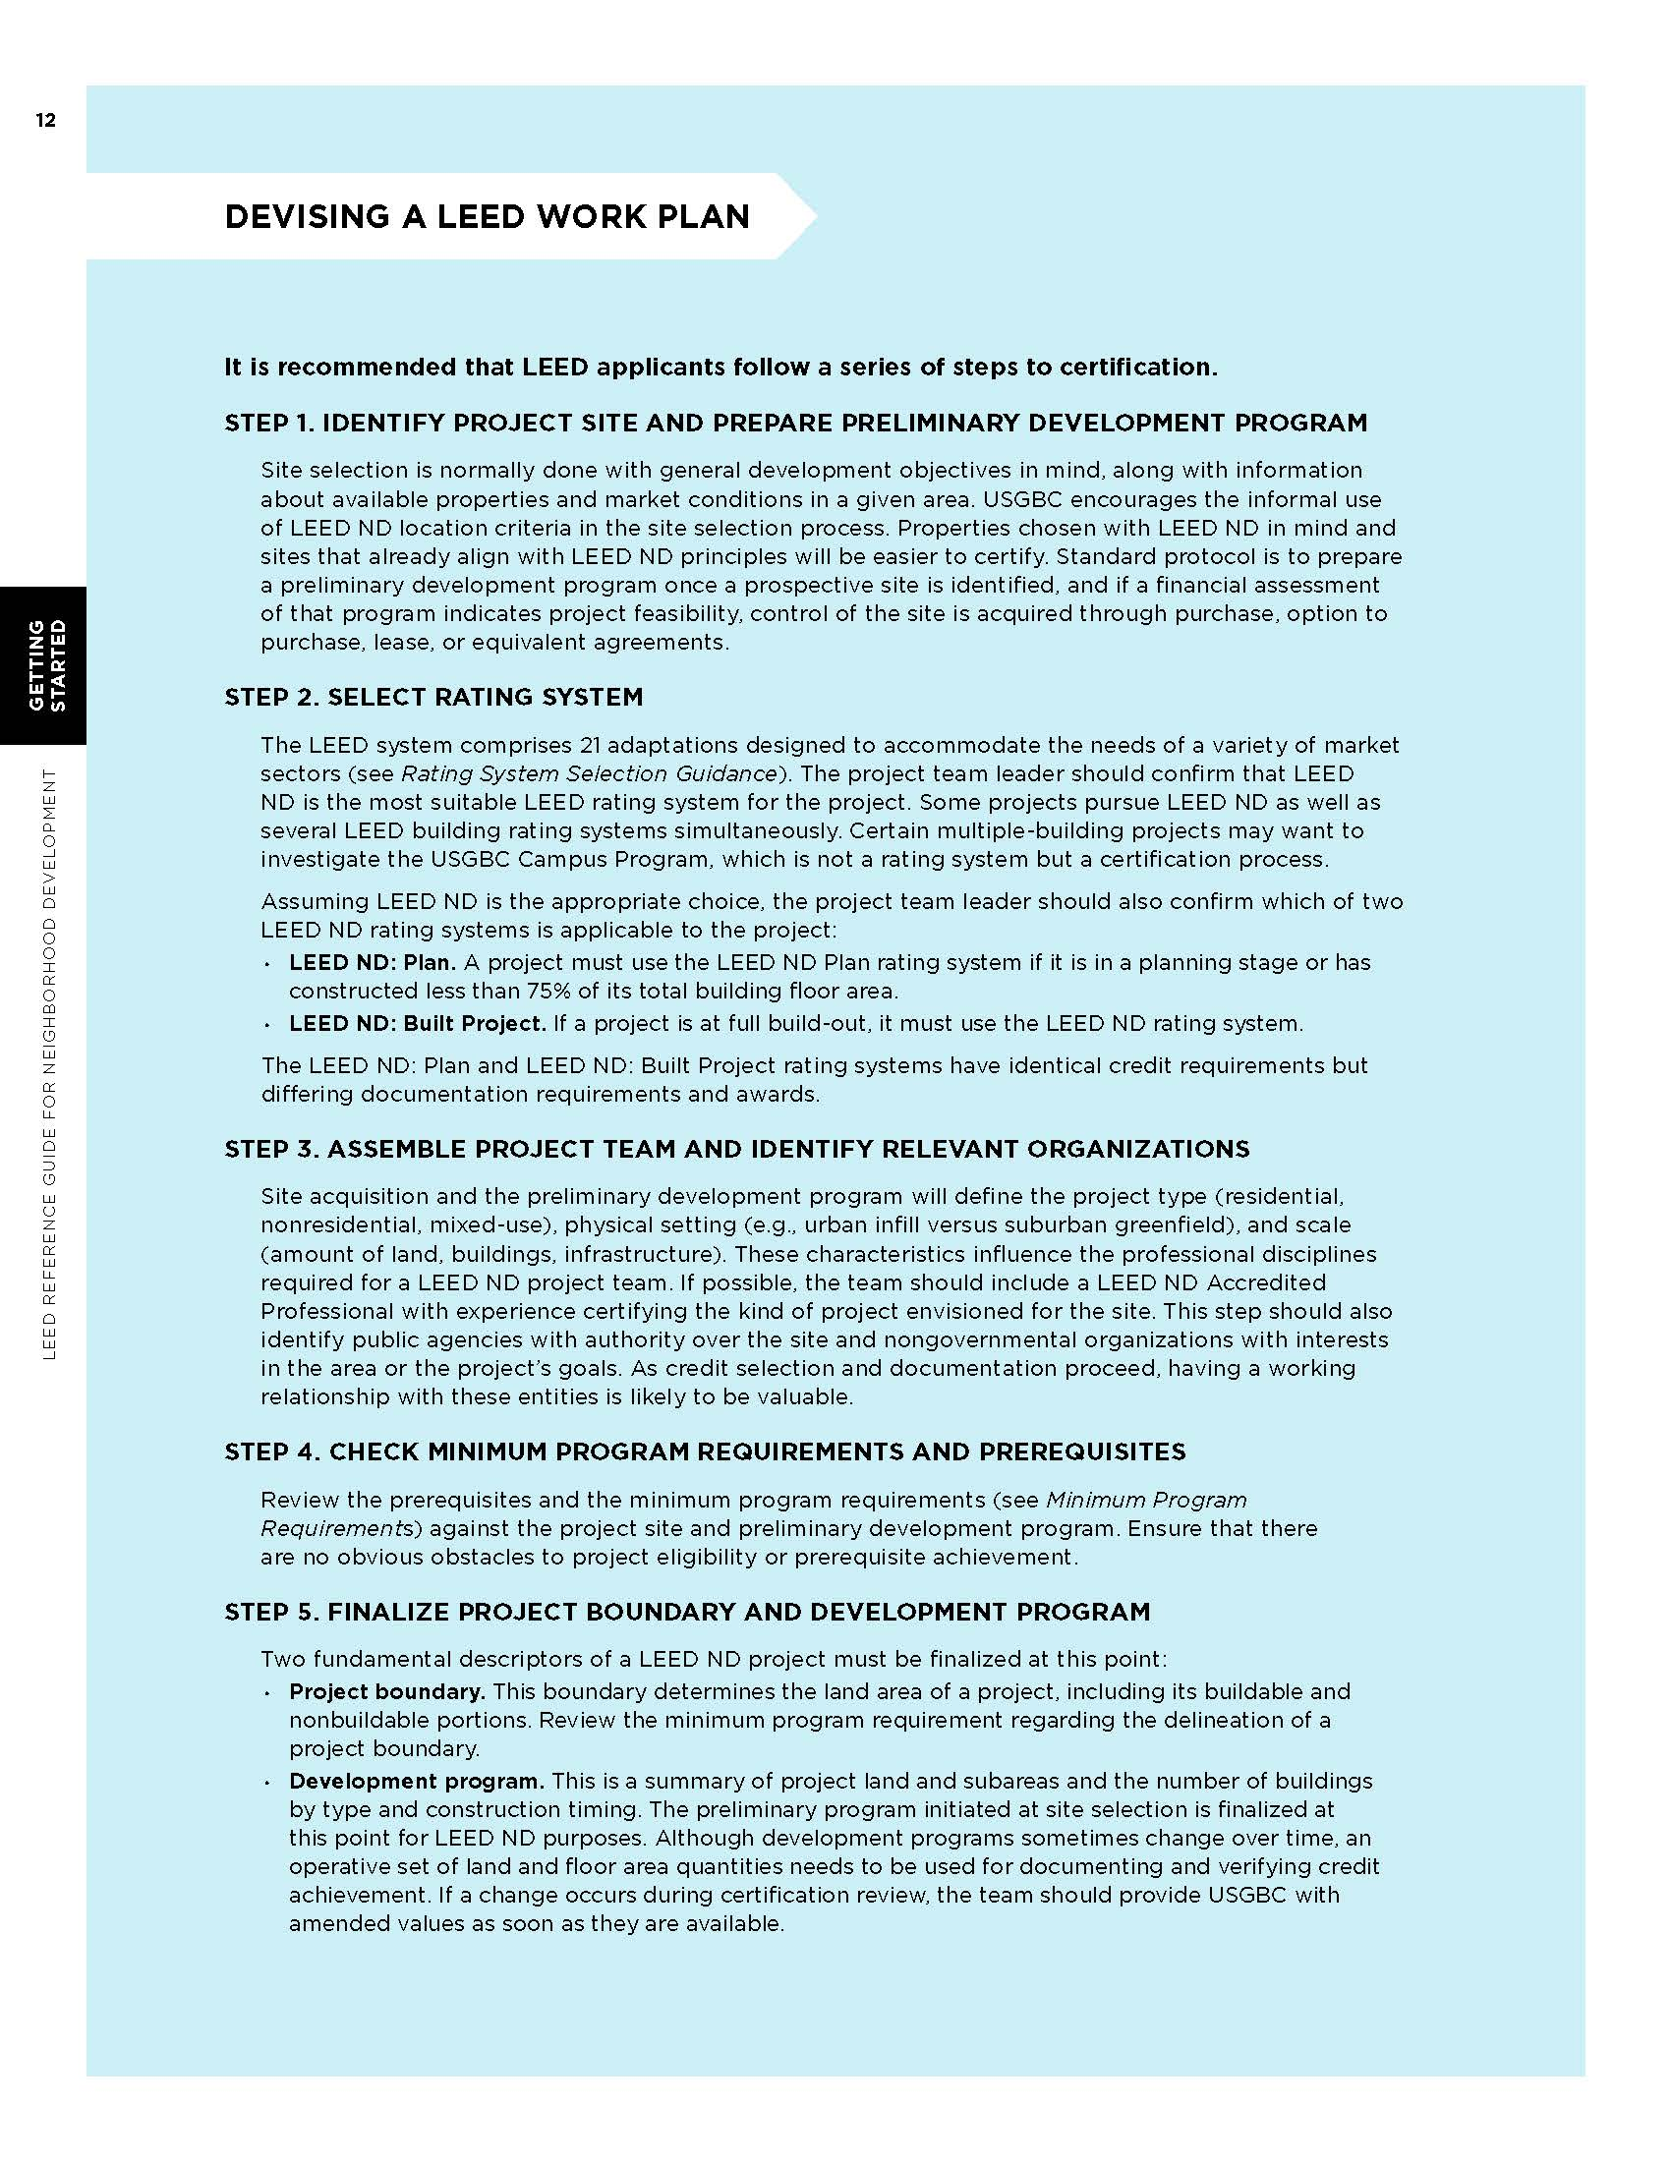
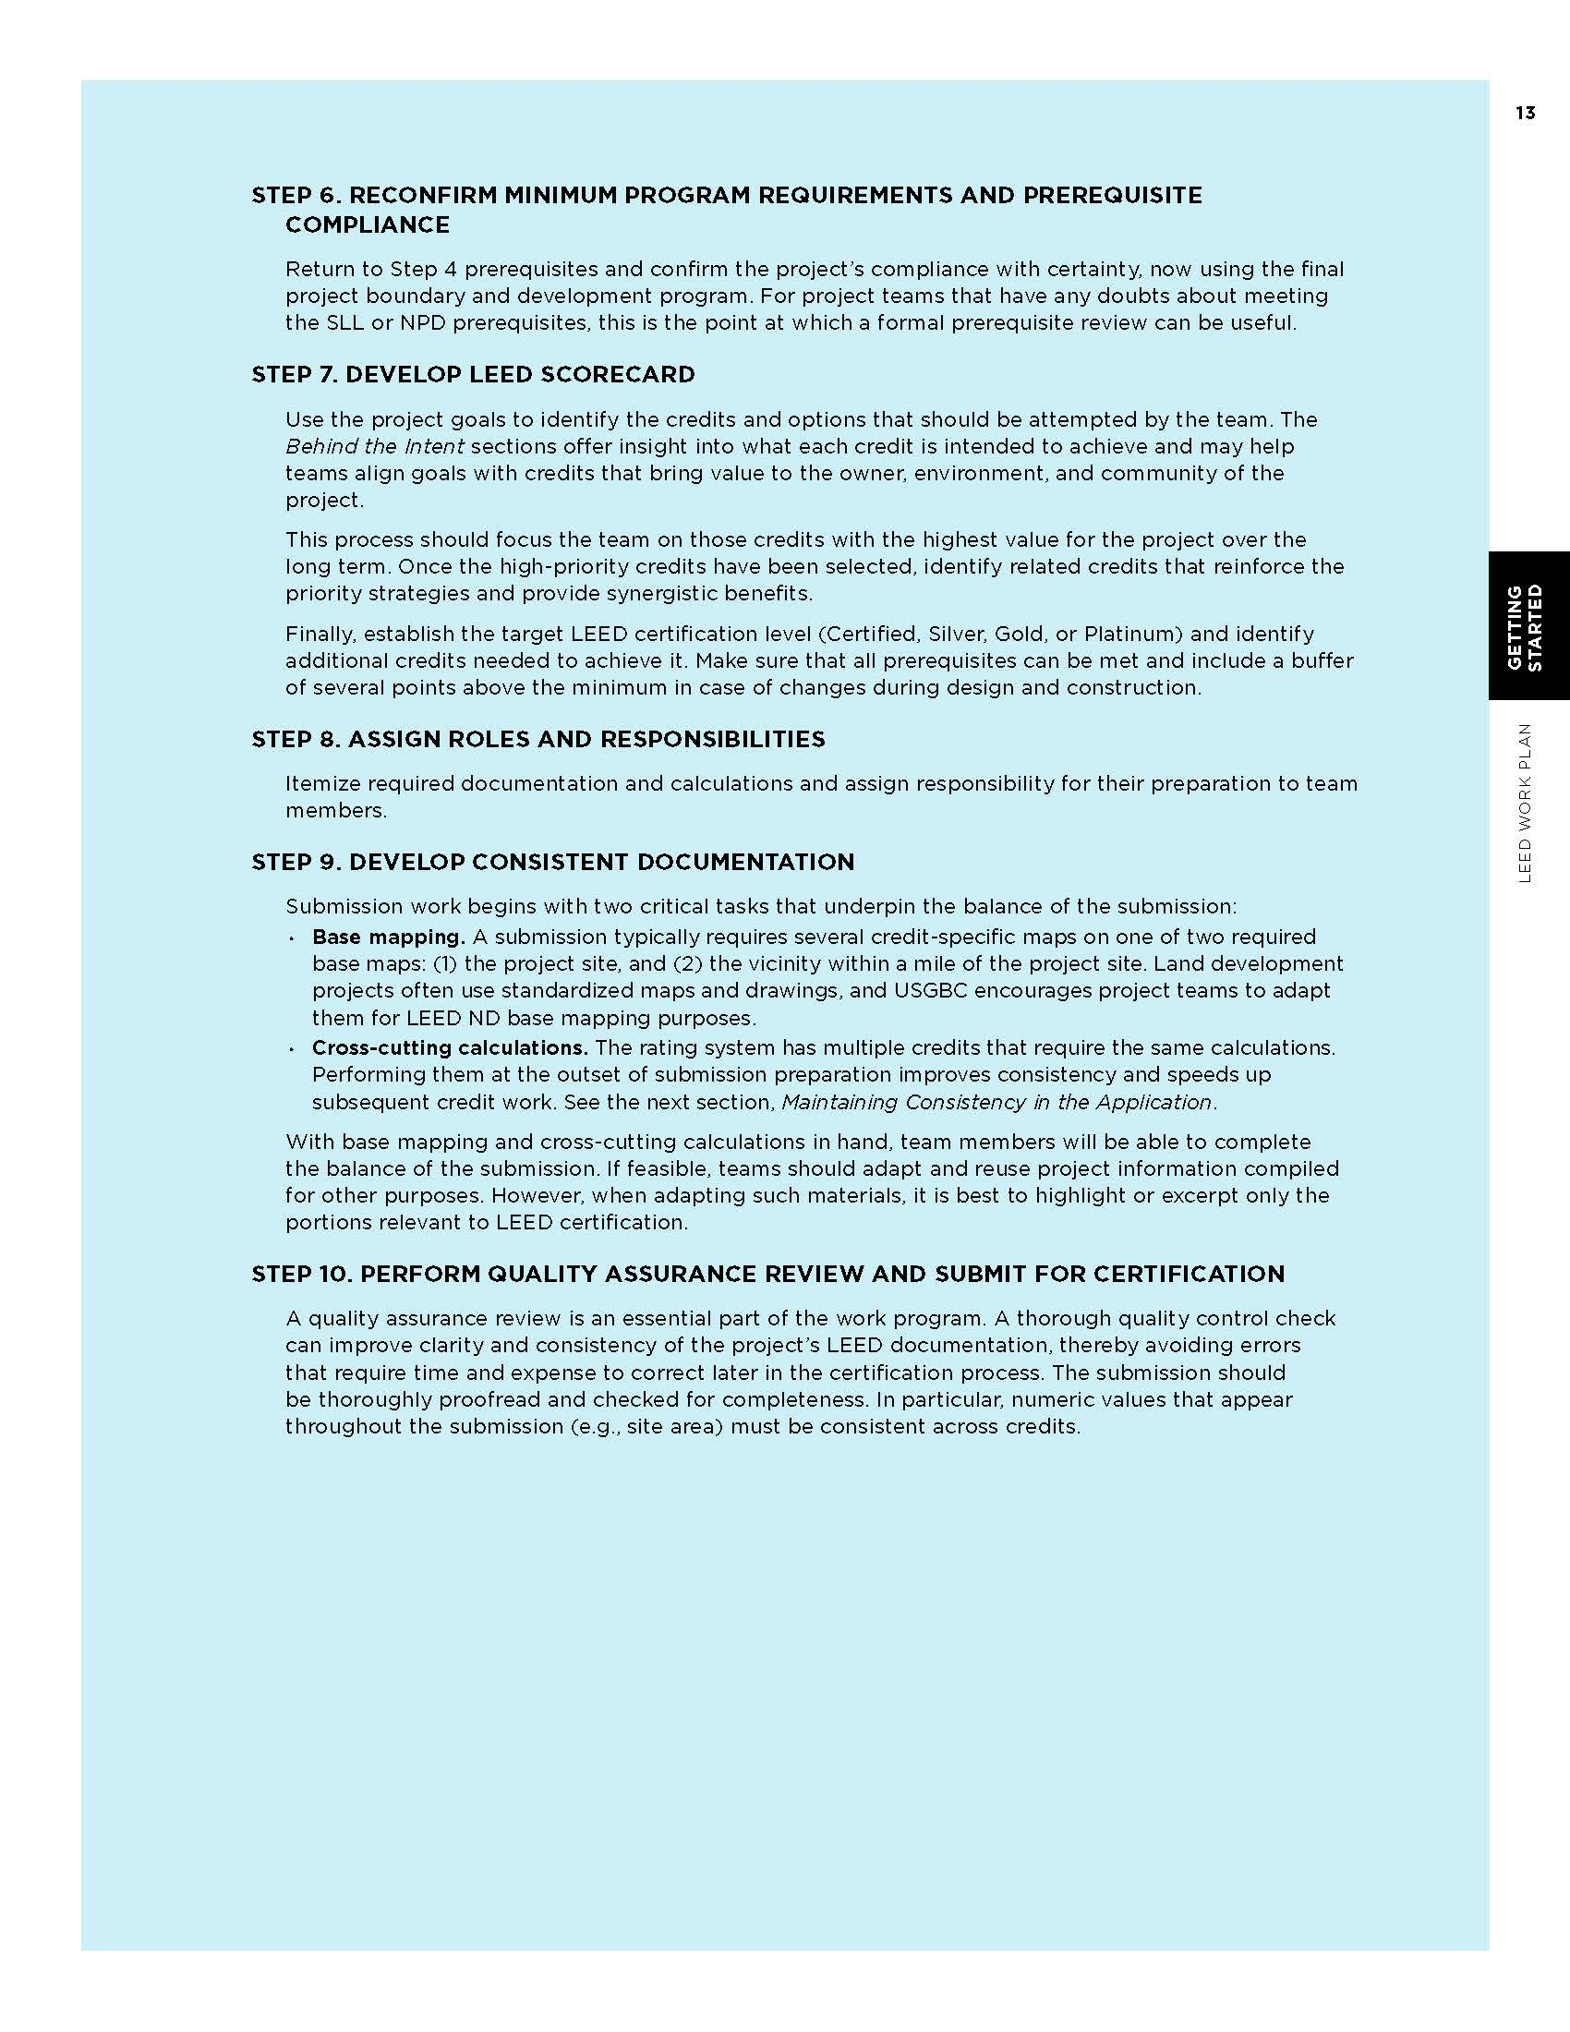

Slide 27
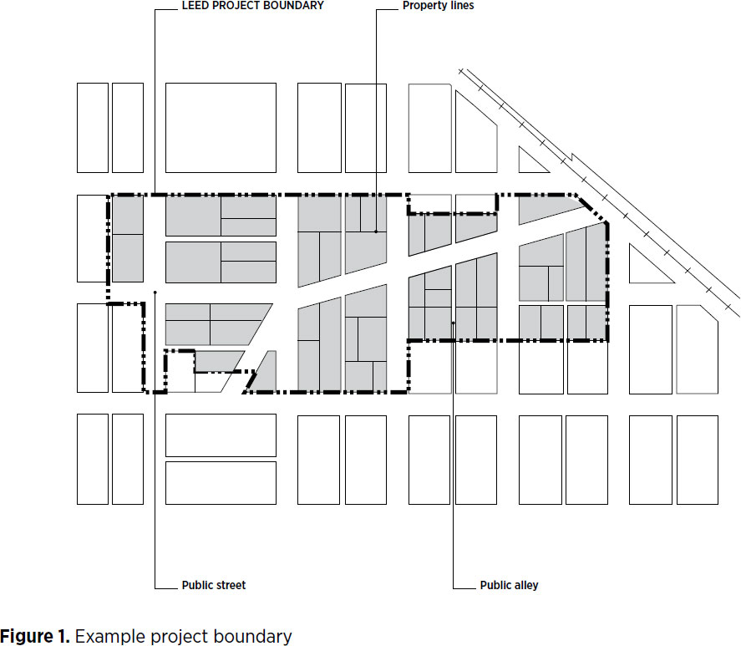
Project Boundary
The project boundary defines the land and water area that is reviewed for certification (see Minimum Program Requirements).

Slide 28
Site Type
A project is categorized by site type depending on where its boundary is set, the status of land inside the boundary, and the status of properties surrounding the boundary.
The following site types may apply:
Previously developed
Infill
Adjacent
The subsections below define these terms and explain their use.

Slide 29
Previously Developed
previously developed altered by paving, construction, and/or land use that would typically have required regulatory permitting to have been initiated (alterations may exist now or in the past). Land that is not previously developed and landscapes altered by current or historical clearing or filling, agricultural or forestry use, or preserved natural area use are considered undeveloped land. The date of previous development permit issuance constitutes the date of previous development, but permit issuance in itself does not constitute previous development.
previously developed site a site that, prior to the project, consisted of at least 75% previously developed land.

Slide 30
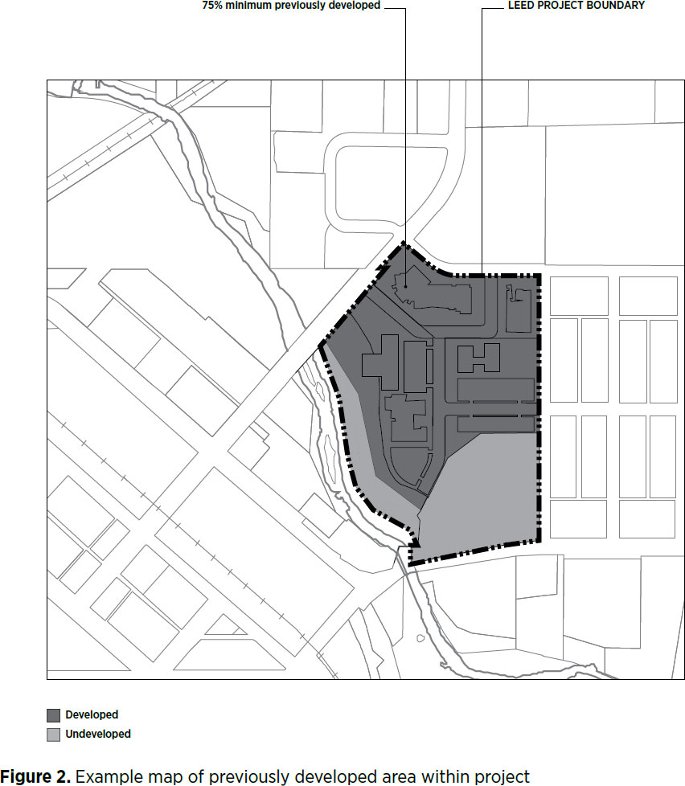

Slide 31
Infill Site
infill site a site that meets any of the following four conditions:
At least 75% of its boundary borders parcels that individually are at least 50% previously developed, and that in aggregate are at least 75% previously developed.
The site, in combination with bordering parcels, forms an aggregate parcel whose boundary is 75% bounded by parcels that individually are at least 50% previously developed, and that in aggregate are at least 75% previously developed.
At least 75% of the land area, exclusive of rights-of-way, within 1/2 mile (800 meters) of the project boundary is previously developed.
The lands within 1/2 mile (800 meters) of the project boundary have a preproject connectivity of at least 140 intersections per square mile (54 intersections per square kilometer).

Slide 32
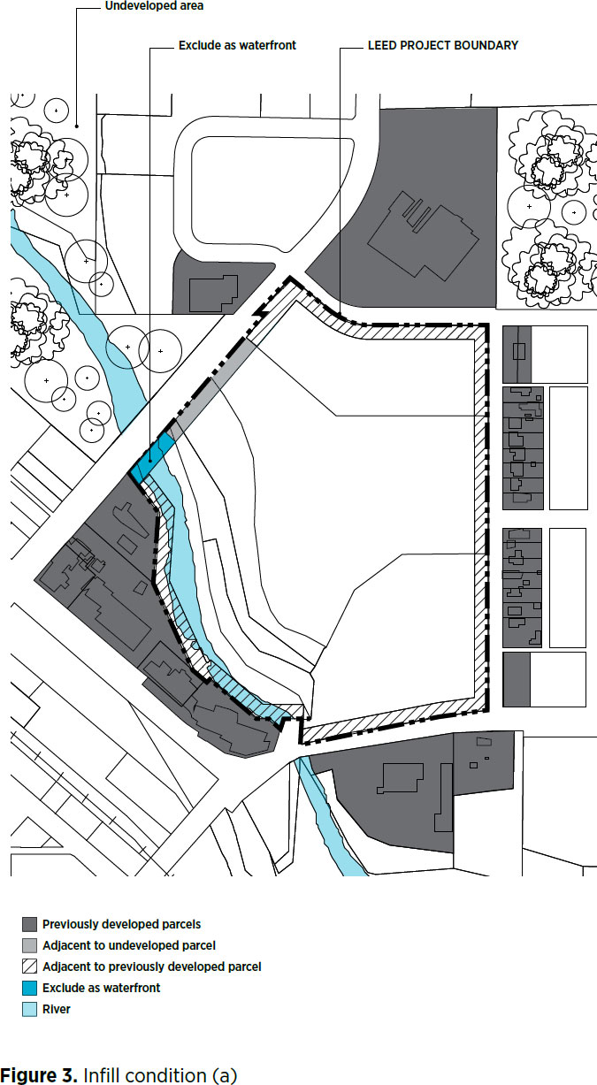

Slide 33
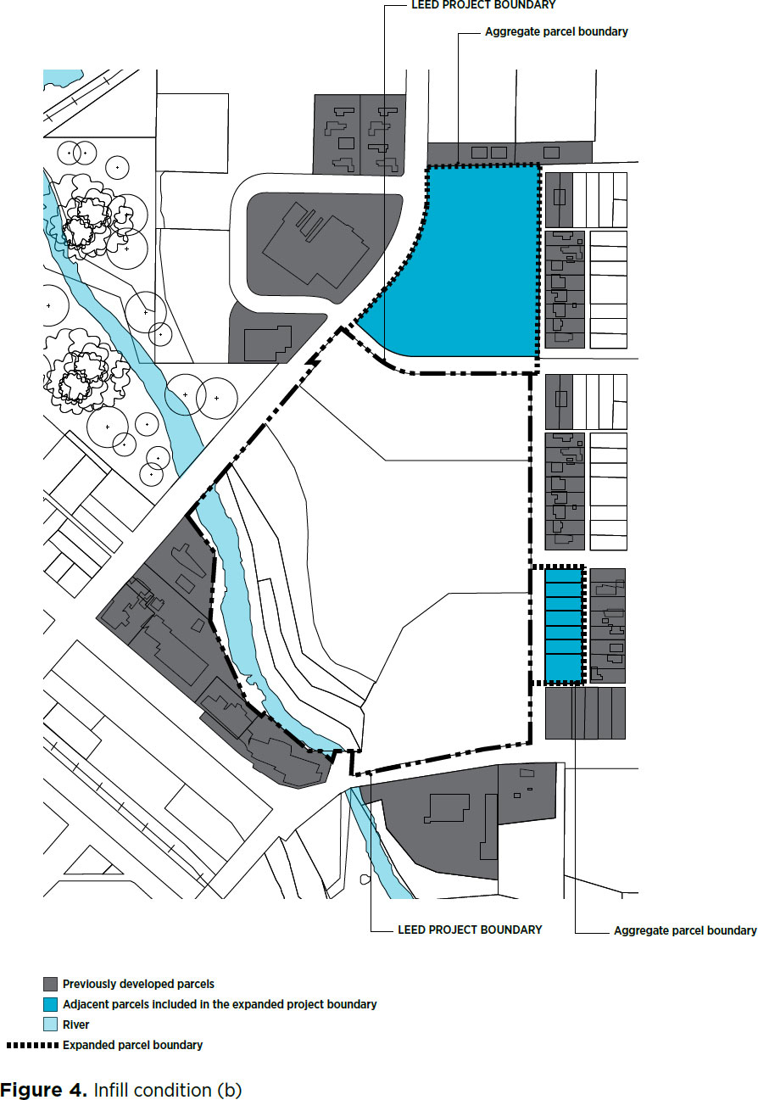

Slide 34
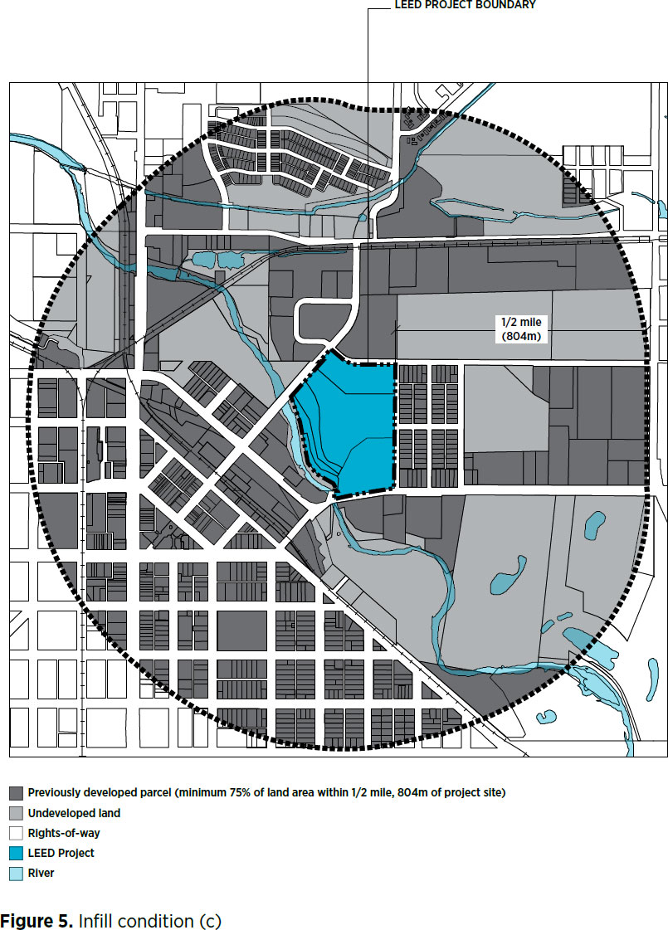

Slide 35
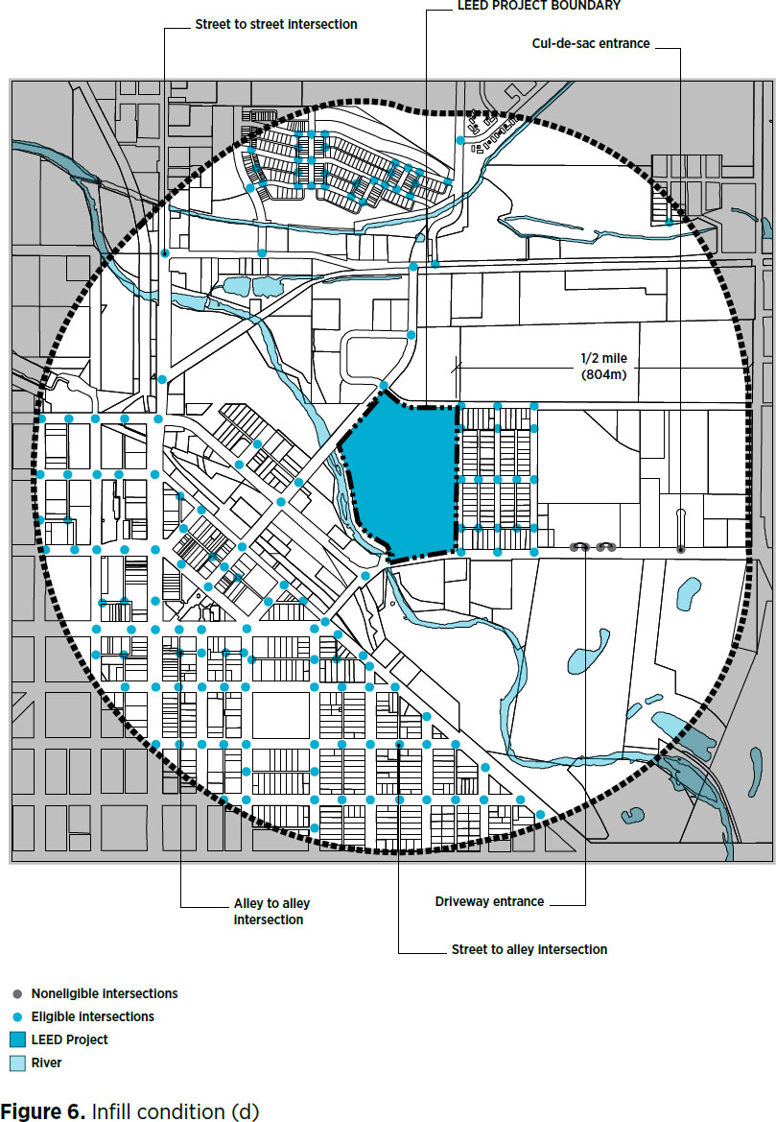

Slide 36
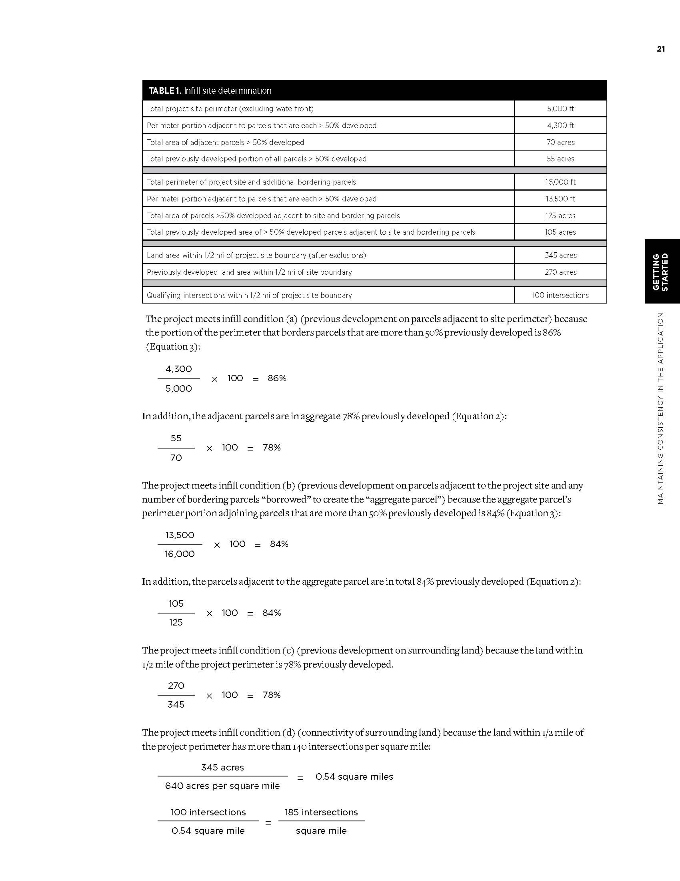

Slide 37
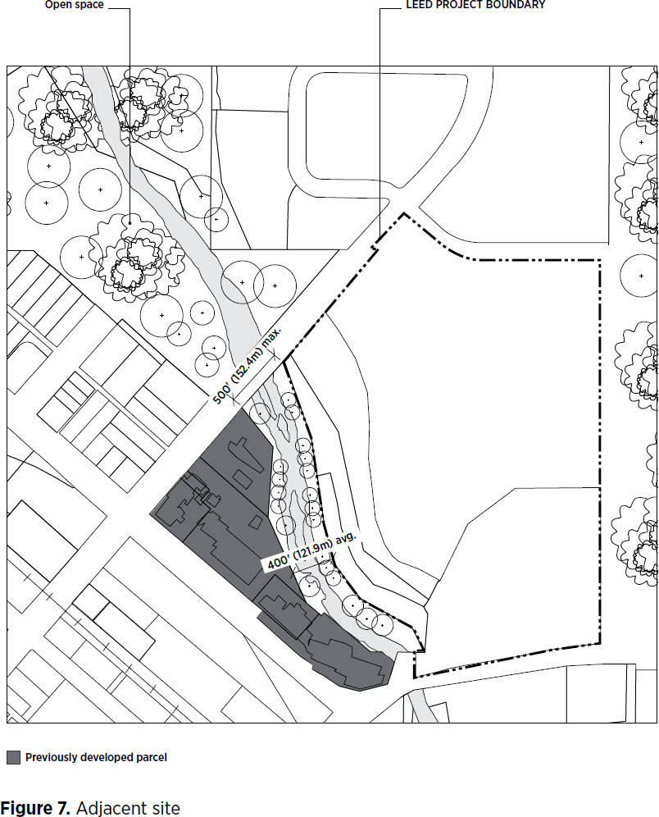
Adjacent Site
adjacent site a site having at least a continuous 25% of its boundary bordering parcels that are previously developed sites.
Only consider bordering parcels, not intervening rights-of-way.
Any fraction of the boundary that borders a water body is excluded from the calculation.

Slide 38
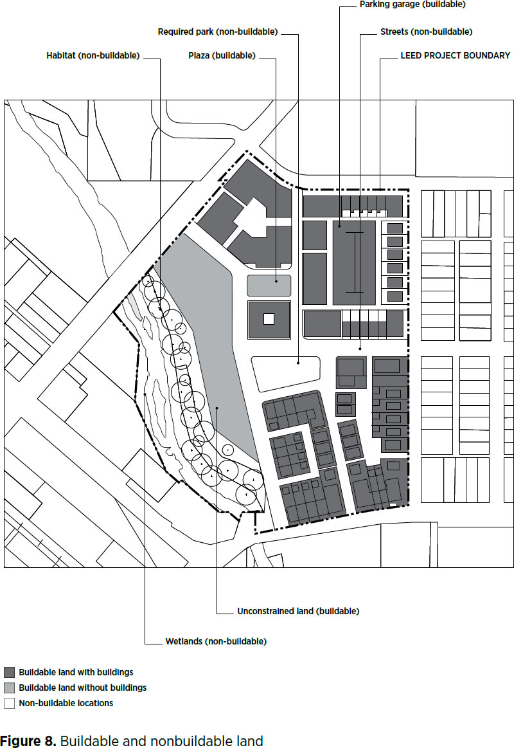
Buildable Land
buildable land the portion of the site where construction can occur, including land voluntarily set aside and not constructed on.
When used in density calculations, buildable land excludes public rights-of-way and land excluded from development by codified law or LEED for Neighborhood Development prerequisites.

Slide 39
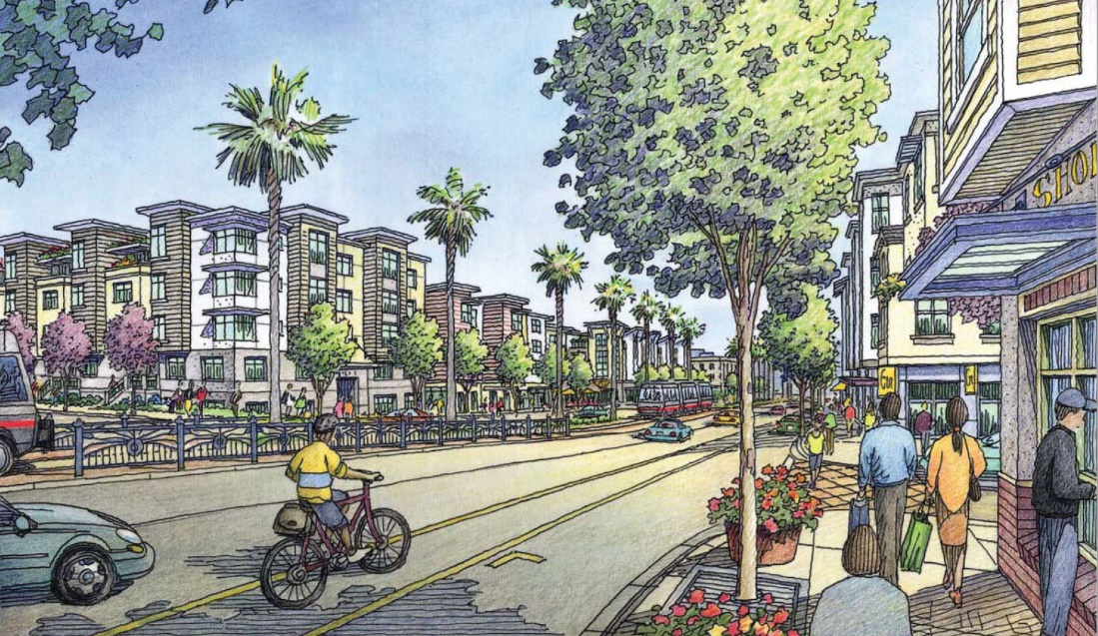
Development Program
The development program is a tabular presentation typically prepared by a developer detailing land uses and the demolition, construction, renovation, or retention of buildings within the project boundary.
The development program should account for all land and water within the boundary according to the buildable and nonbuildable categories, discussed above.

Slide 40
Development Timeline
Several provisions of the rating system are tied to milestone dates on a project’s development timeline, beginning with property acquisition and extending through build-out and occupancy.
Some rating system provisions must be applied in perpetuity.
It is critical that the project team understand the timeline concepts within LEED ND.

Slide 41
Development Timeline
The following milestone dates should be carefully considered in the LEED ND context:
Property acquisition is the date that the project developer purchased or took equivalent control of a majority of the land area inside the project boundary.
Preproject conditions are those present on the date the developer acquired rights to a majority of its buildable land through purchase or option to purchase.
Existing conditions are those present on the date of certification submission. However, a built feature is not considered existing if it was constructed by the project developer as part of the LEED ND project (this will come into play only for projects under construction).
Build-out is the time at which all habitable buildings on the project are complete and ready for occupancy.

Slide 42
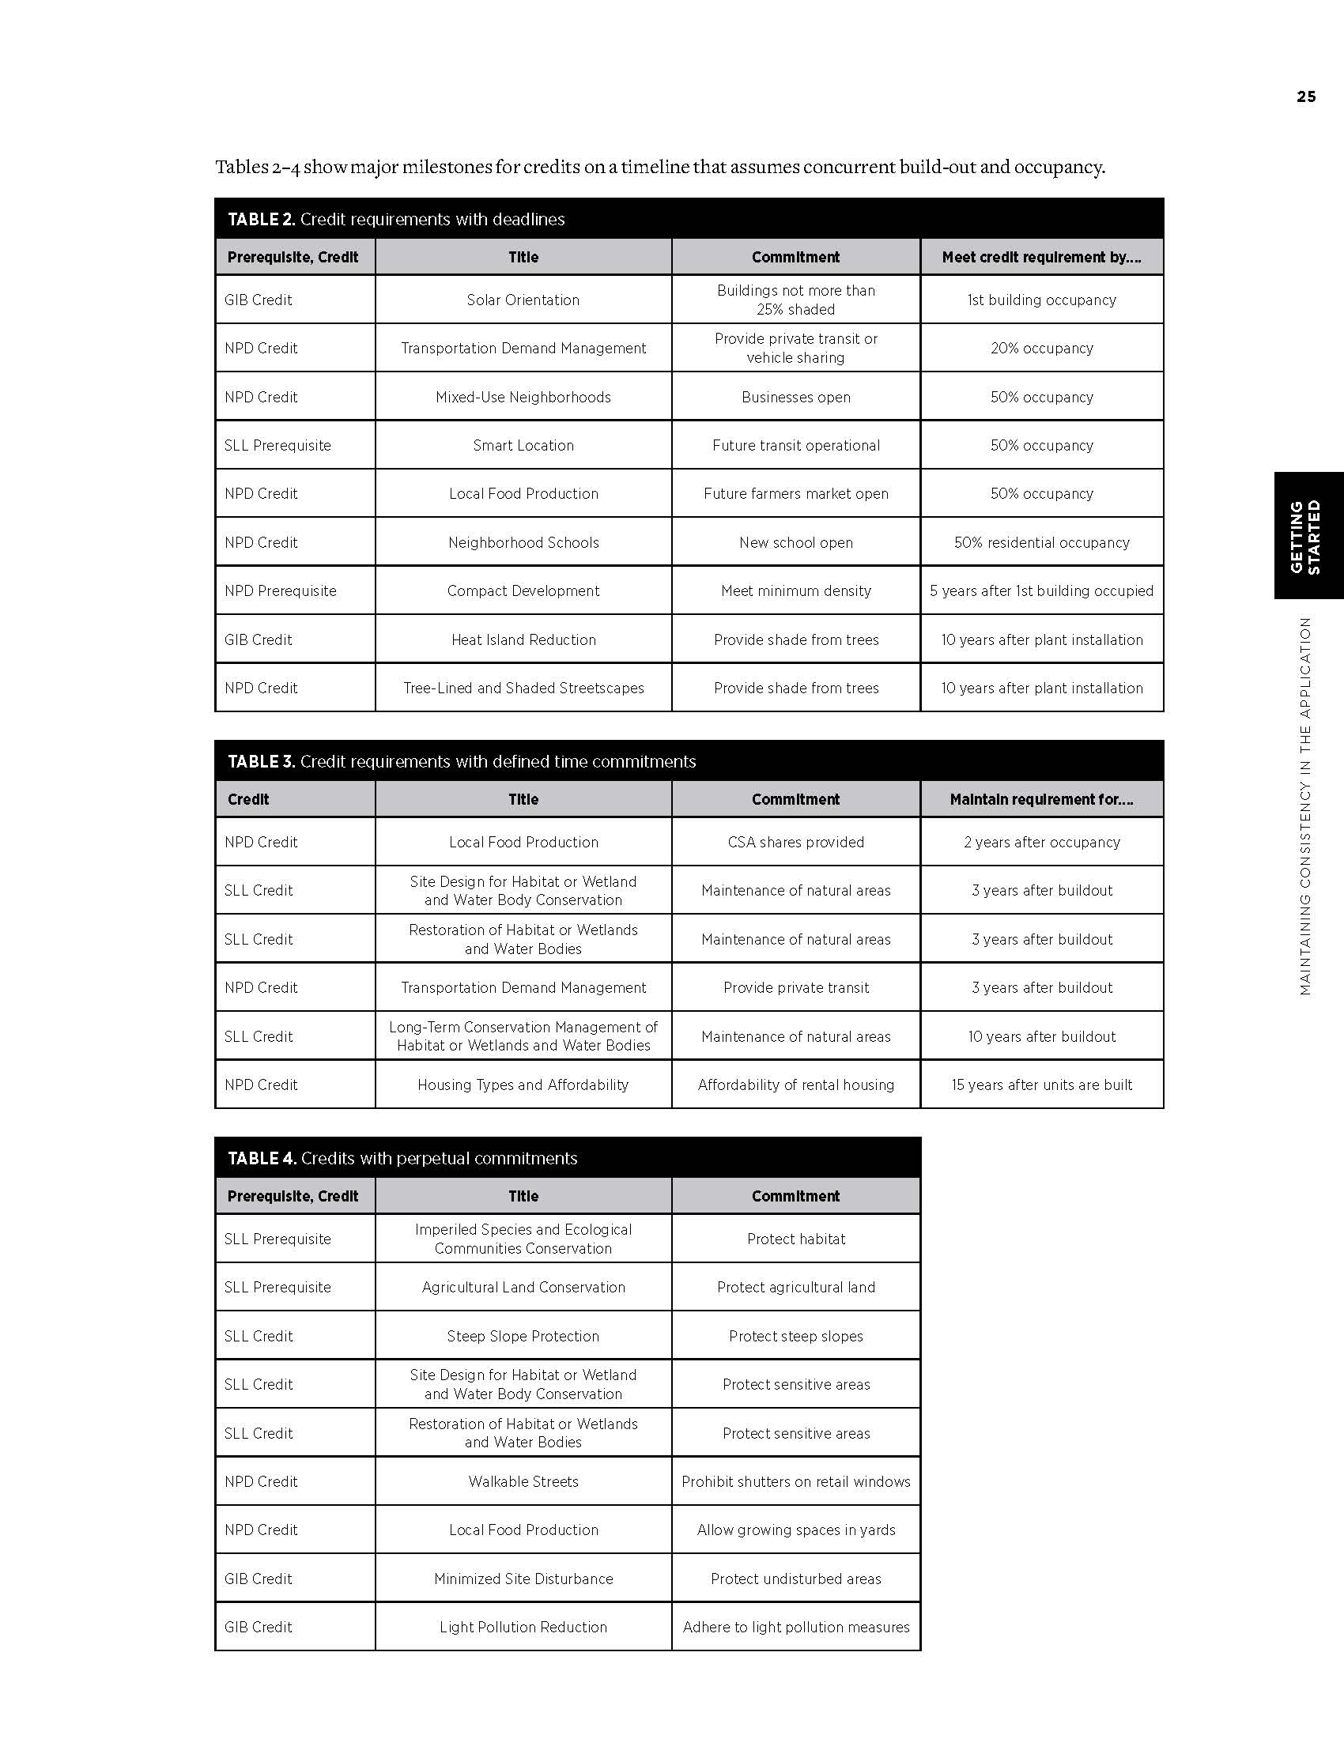

Slide 43
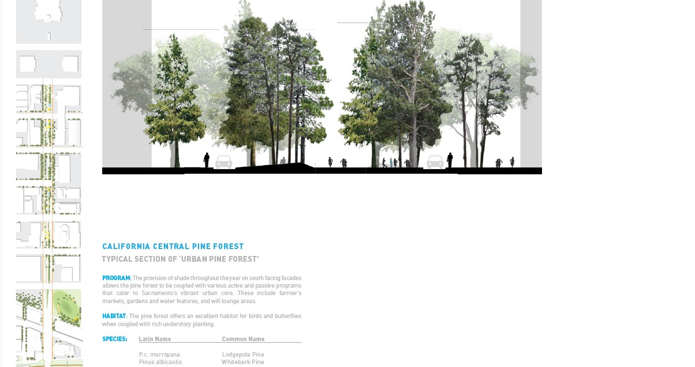

Slide 44
Mapping
Because of the numerous geographic provisions and calculations in the rating system, mapping is an important part of documenting project characteristics and verifying credit achievement. Project teams should use the following types of maps (Figure 9):
Project site. A standardized project site base map should be used throughout the submission to illustrate site level features relevant to individual credits.
Vicinity. A standardized vicinity base map should be used throughout the submission to illustrate relevant surrounding features for up to 1 mile (1.6 km) around the project boundary.
Special maps. Certain credits require information that is more feasibly shown on special maps instead of the standard base maps. For example, maps of the high-priority redevelopment areas under Option 3 of SLL Credit Preferred Locations may cover large parts of communities.

Slide 45
Mapping
Visual verification of credit documentation is an important element of LEED ND certification.
Each map should have a title with the applicable credit name, northpoint, scale, and the relevant features clearly labeled and dimensioned in sufficient detail to enable verification of credit compliance.
Maps and other drawings should be concise, clear, and of sufficiently high resolution to allow detailed review of project features.
Overly large documents, however, are difficult to manage; create concise maps that document only the relevant credit requirements.

Slide 46
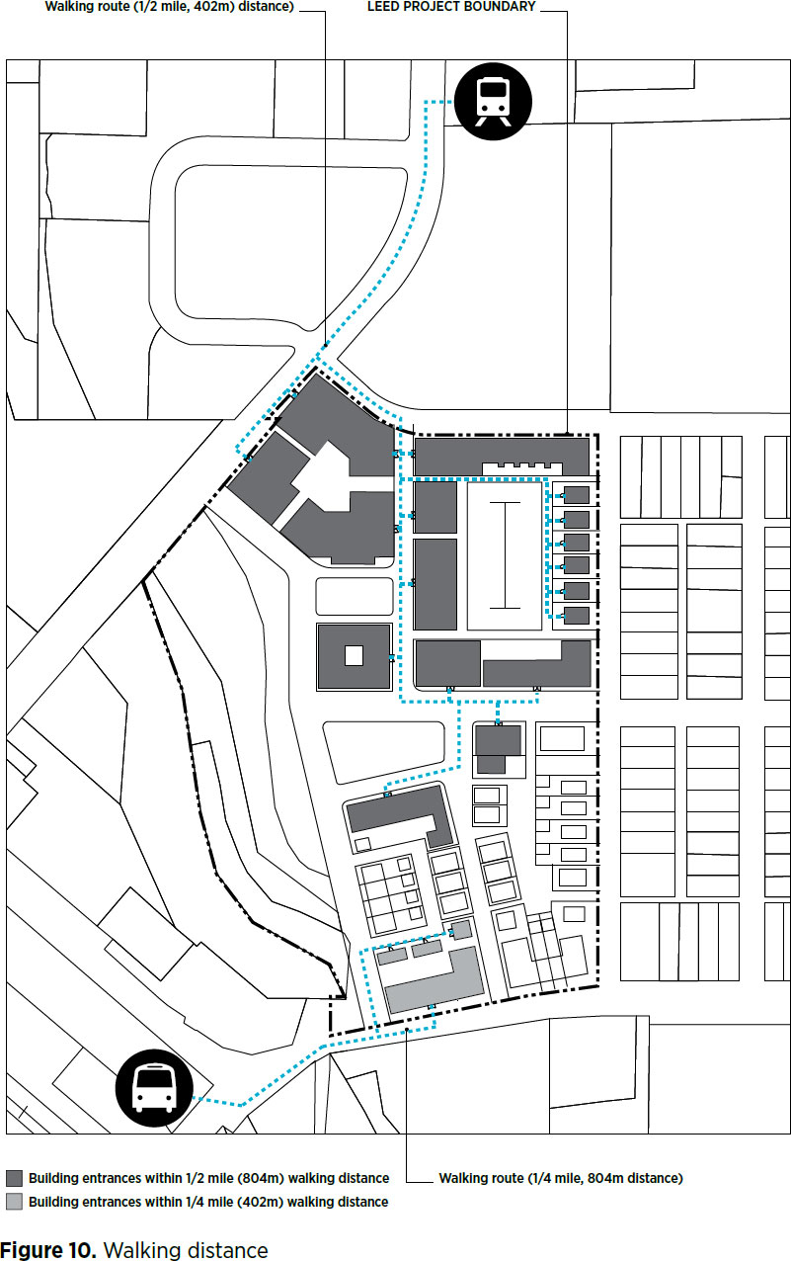
Walking and Bicycling Distances
The second most common set of metrics in the rating system is the distances traveled by pedestrians and bicyclists from origins, such as dwellings, to destinations, such as schools.

Slide 47
Walking and biking distances must be measured along pedestrian and bicycle networks that comply with the following LEED definitions:
walk distance the distance that a pedestrian must travel between origins and destinations without obstruction, in a safe and comfortable environment on a continuous network of sidewalks, all weather-surface footpaths, crosswalks, or equivalent pedestrian facilities. The walking distance must be drawn from an entrance that is accessible to all building users.
bicycle network a continuous network consisting of any combination of the following:
off-street bicycle paths or trails at least 8 feet wide for a two-way path and at least 5 feet wide for a one-way path,
physically designated on-street bicycle lanes at least 5 feet wide, and
streets designed for a target speed of 25 mph

Slide 48
Land-Use Densities
The rating system measures land-use density in two categories, residential and nonresidential. Density is calculated according to the following definitions:
density the amount of building structures constructed on the project site, measured for residential buildings as dwelling units per acre of buildable land available for residential uses, and for nonresidential buildings as the floor-area ratio of buildable land area available for nonresidential uses. In both cases, structured parking is excluded.
floor-area ratio (FAR) the density of nonresidential land use, exclusive of structured parking, measured as the total nonresidential building floor area divided by the total buildable land area available for nonresidential buildings.

Slide 49
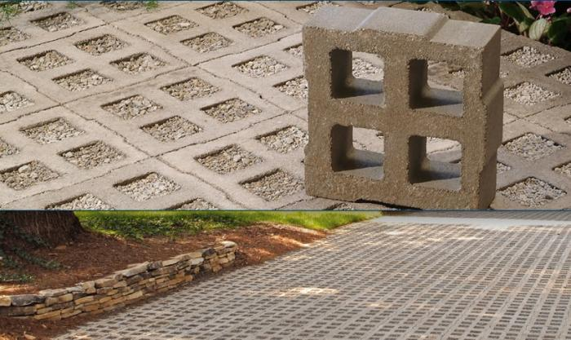
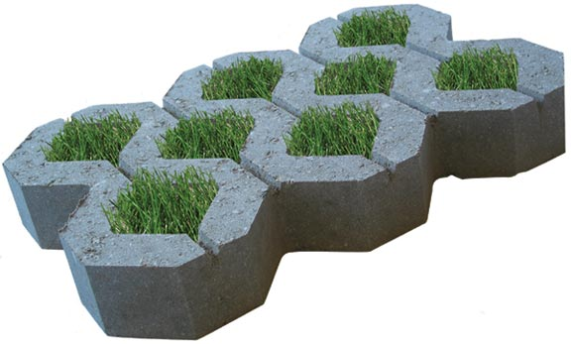
Development Footprint
A project’s development footprint is essentially all of its impervious surfaces. The footprint calculation is used in seven credits where imperviousness is a consideration, such as GIB Credit Rainwater Management. Development footprint is defined as follows:
development footprint the total land area of a project site covered by buildings, streets, parking areas, and other typically impermeable surfaces constructed as part of the project.
Surfaces paved with permeable pavement (at least 50% permeable) are excluded from the development footprint.

Slide 50
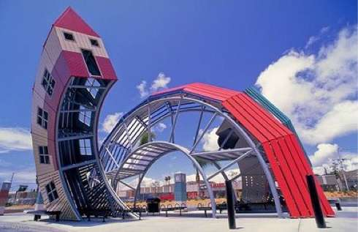
Transit Service
Another common cross-cutting metric is transit service, expressed in daily trips at stops.
An important partner in projects with a transit component is the transit agency serving the site.
Transit-related credits should be reviewed with the agency during goal setting and credit selection, and if possible, submission documentation should be reviewed with the agency before submission.

Slide 51
Connectivity (Intersection Density)
Another rating system metric is connectivity, expressed as intersections per square mile (square kilometer).
Connectivity is an important objective of LEED ND because it enables multimodal travel that, in turn, reduces energy use and emissions of pollutants, including greenhouse gases, while improving public health and equitable access.
Connectivity can be calculated internally (within the project boundary) or in the area surrounding the project (within a specified distance of the project boundary).

Slide 52
Connectivity (Intersection Density)
For both internal and surrounding connectivity, eligible and ineligible intersections are as follows (Figure 12):
Count publicly accessible intersections of the circulation network, including intersections of streets with dedicated alleys and transit rights-of-way, and intersections of streets with nonmotorized rights-of-way.
If one must both enter and exit an area through the same intersection, exclude that intersection and any intersections beyond that point; intersections leading only to culs-de-sac are also not counted.

Slide 53
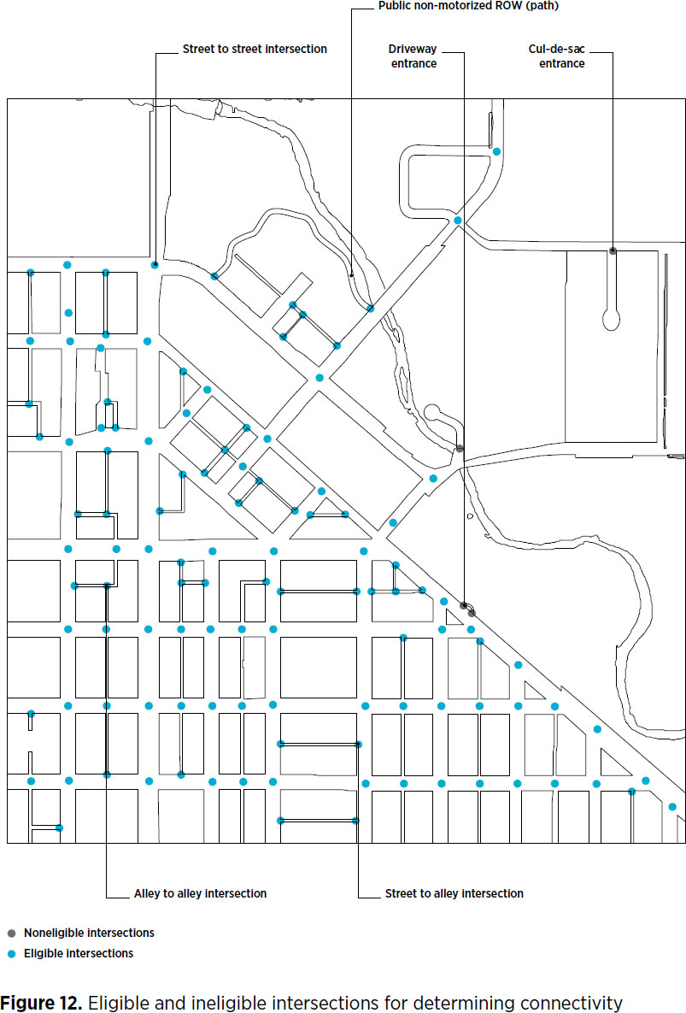

Slide 54
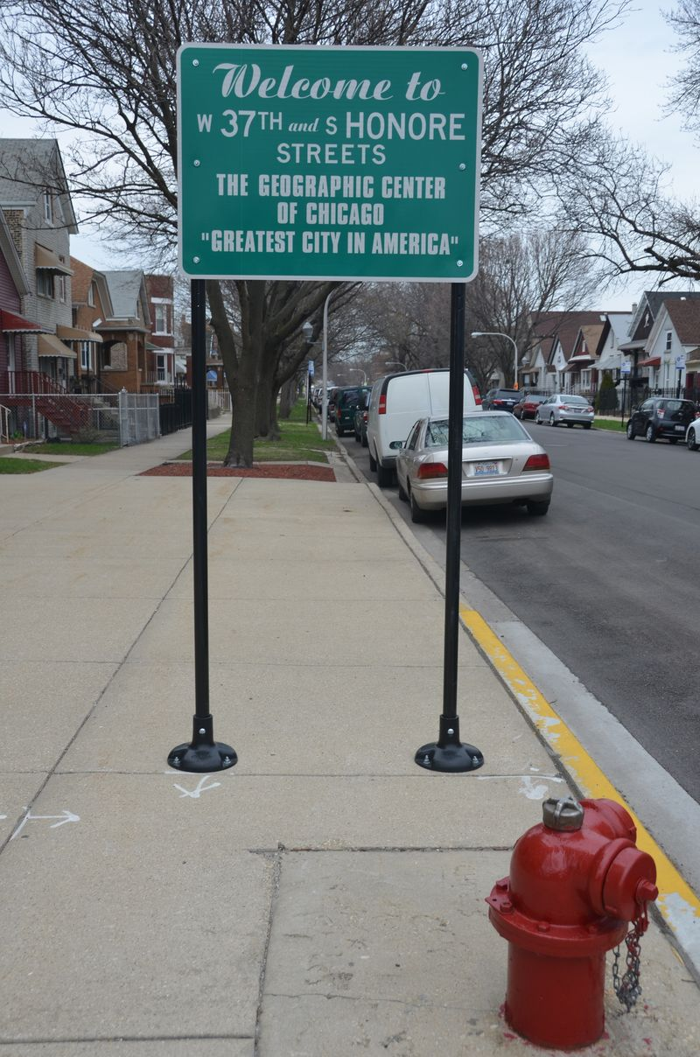
Project Geographic Center
Several credits require measuring the distance from a project’s geographic center to certain features, such as farmers markets.
In CAD or GIS terms, the project’s geographic center is the “centroid” of the polygon created by the project boundary.

Slide 55
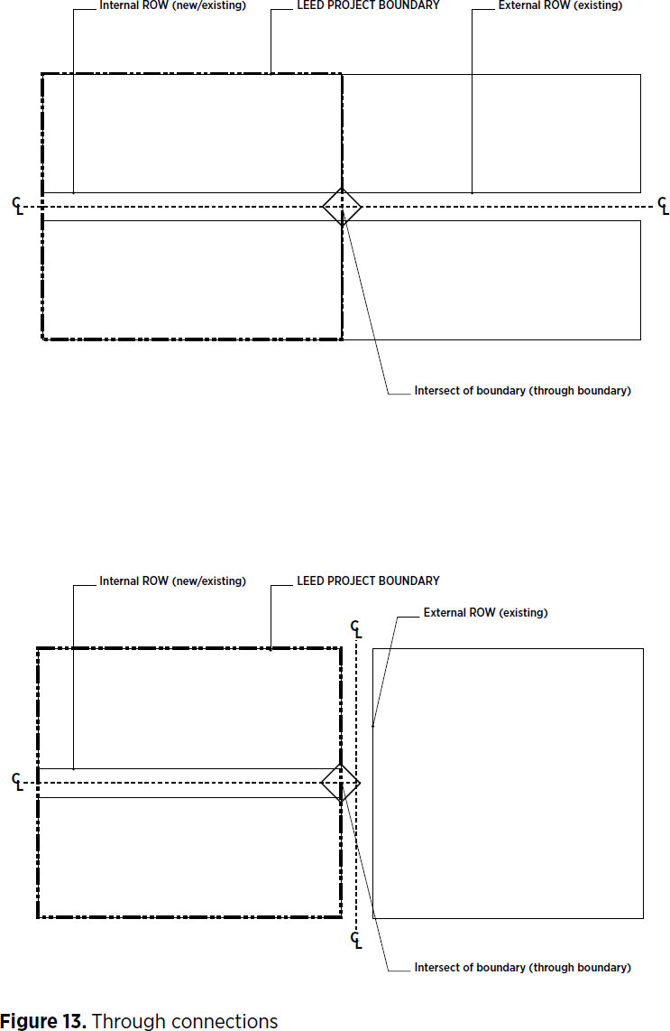
Through Connections and Right-of-Way Intersects

Slide 56
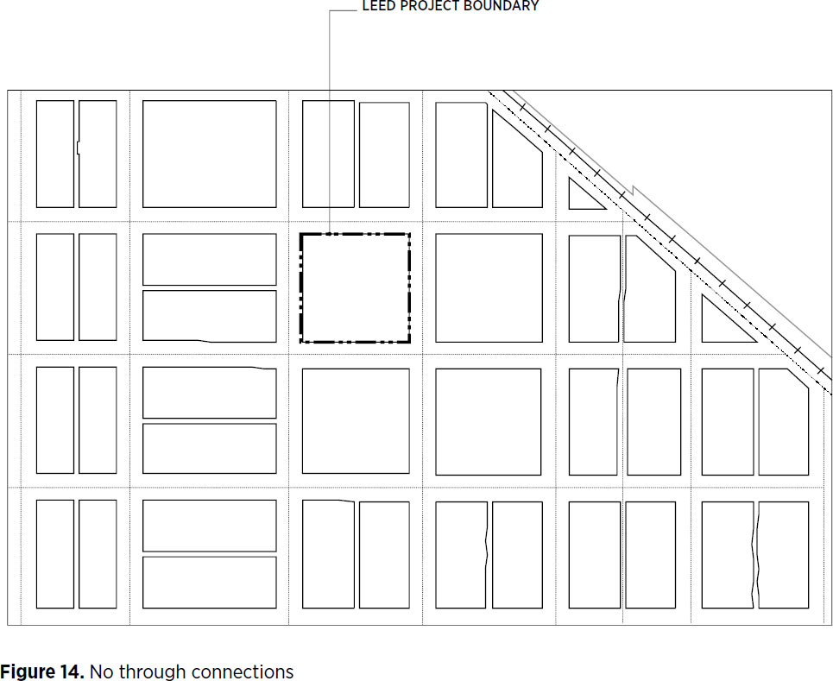
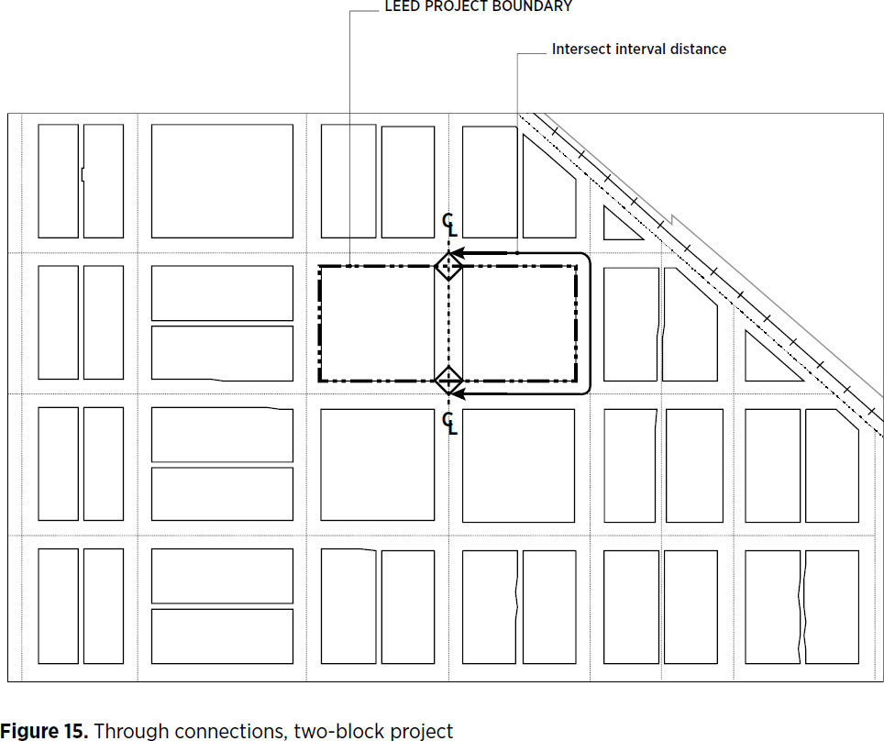
Through Connections and Right-of-Way Intersects

Slide 57
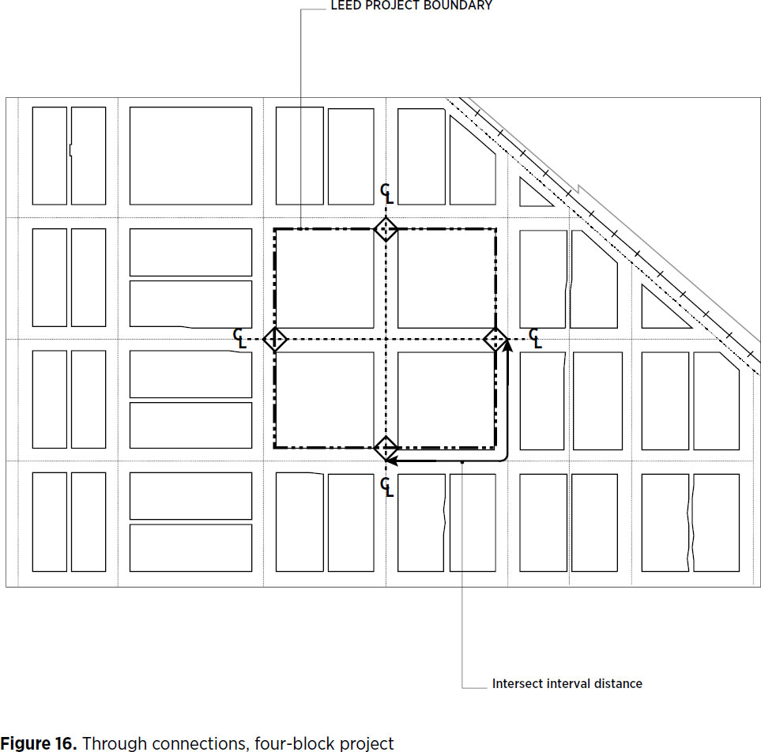
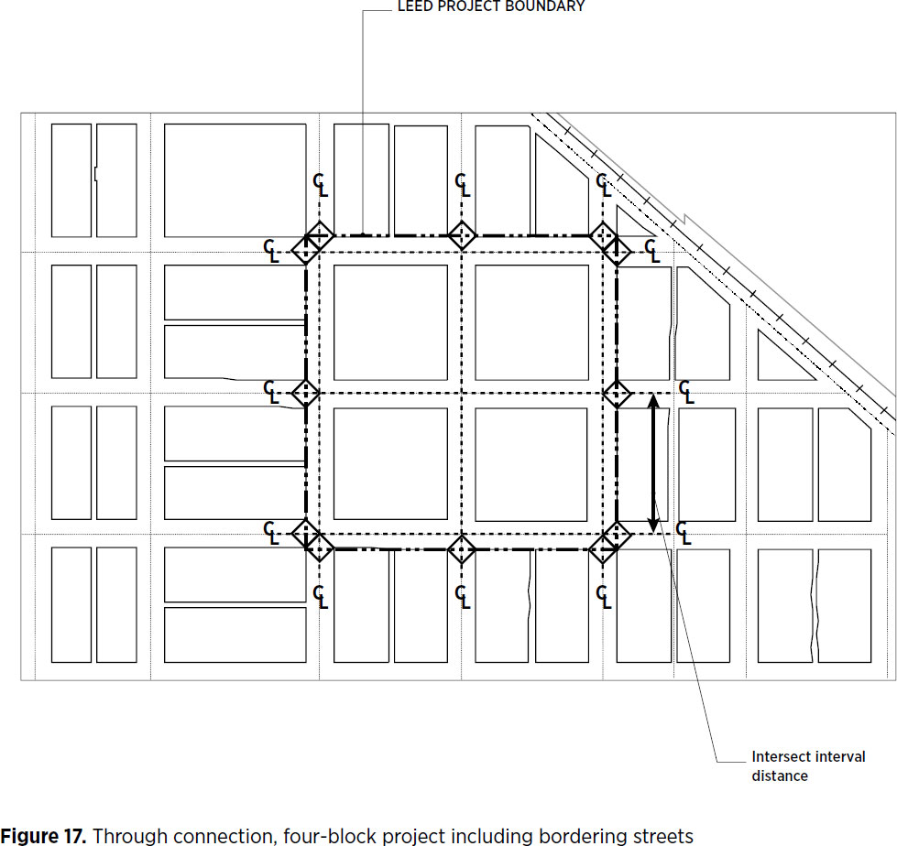
Through Connections and Right-of-Way Intersects

Slide 58
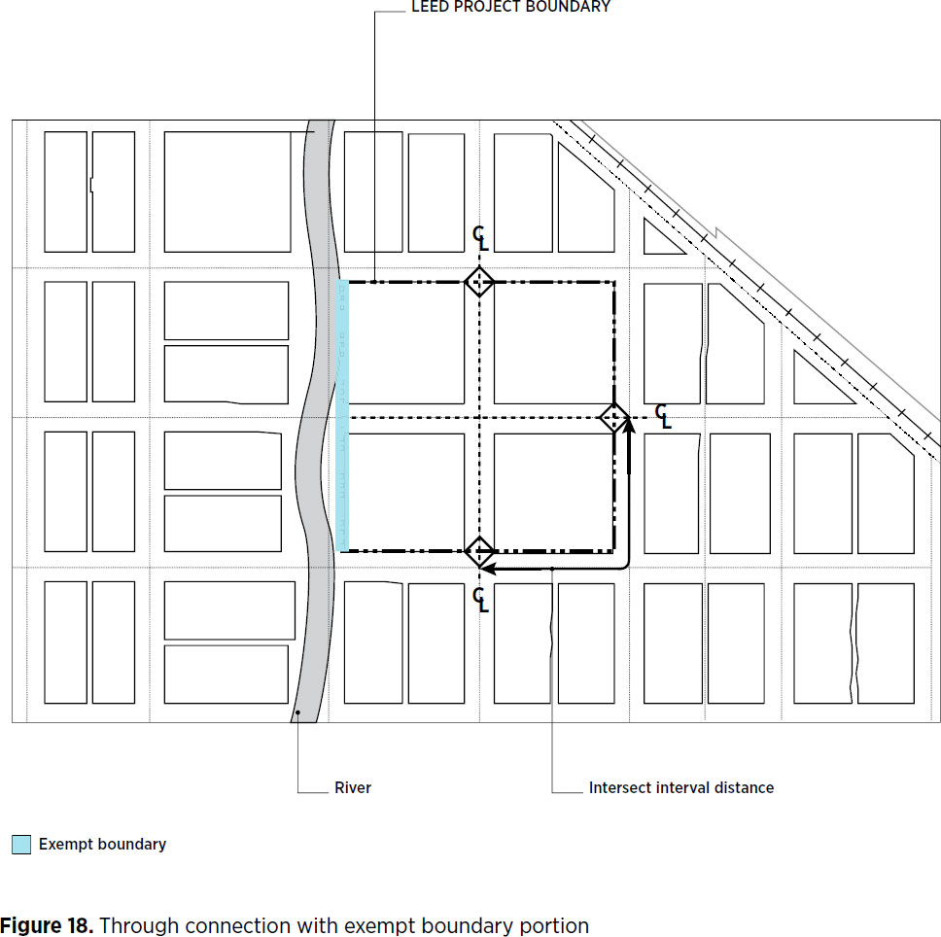
Through Connections and Right-of-Way Intersects

Slide 59
Circulation Network and Block Frontages
Three NPD credits stipulate requirements for circulation networks, block length, and building frontages. Circulation network and block length are defined as follows:
circulation network all motorized, nonmotorized, and mixed-mode travel ways permanently accessible to the public, not including driveways, parking lots, highway access ramps, and rights-of-way exclusively dedicated to rail. It is measured in linear feet.
block length the distance along a block face; specifically, the distance from an intersecting right-of-way edge along a block face, when that face is adjacent to a qualifying circulation network segment, to the next ROW edge intersecting that block face, except for intersecting alley ROWs.

Slide 60
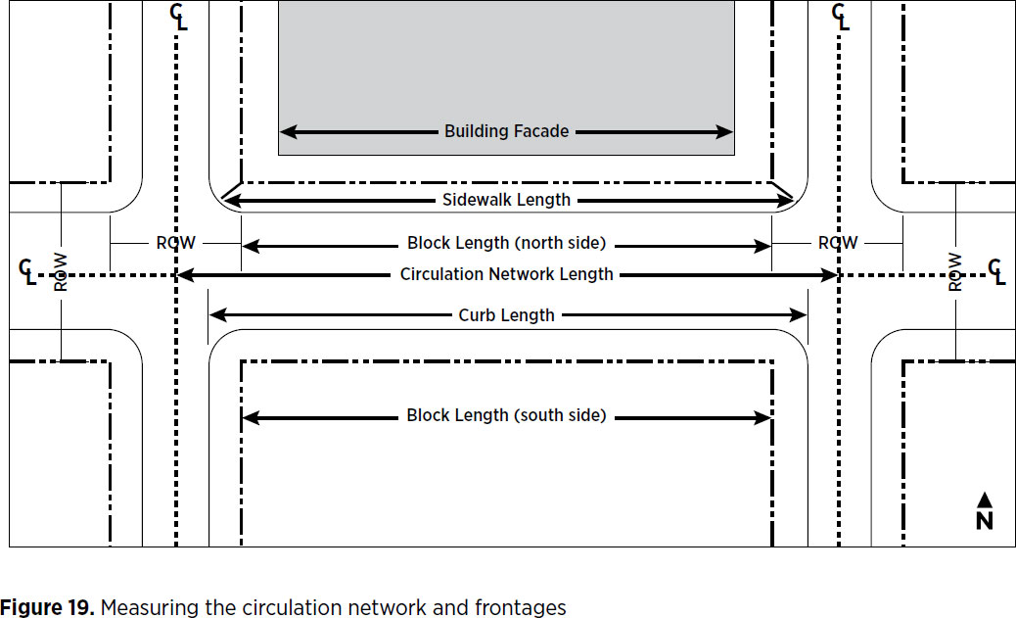
Circulation Network and Block Frontages

Slide 61
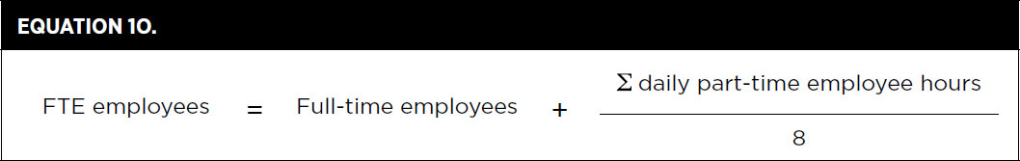
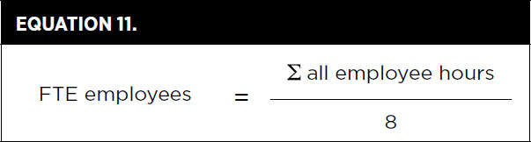
Occupancy
Regular Building Occupants Visitors
Part-time and full-time employees Retail customers
Staff Outpatients
Volunteers – regularly use a building Volunteers – periodically use a building
Residents Higher-education students
Primary and secondary school students
Hotel guests
Inpatients

Slide 62
Occupancy
In calculations, occupant types are typically counted in two ways:
Daily averages take into account all the occupants of a given type for a typical 24-hour day of operation.
Peak totals are measured at the moment in a typical 24-hour period when the highest number of a given occupant type is present.

Slide 63
Occupancy
Whenever possible, use actual or predicted occupancies. If occupancy cannot be accurately predicted, use one of the following resources to estimate occupancy:
a. Default occupant density from ASHRAE 62.1–2010, Table 6-1
b. Default occupant density from CEN Standard EN 15251, Table B.2
c. Appendix 2 Default Occupancy Counts
d. Results from applicable studies.

Slide 64
Minimum Program Requirements (MPRs)
Minimum Program Requirements (MPRs)
Purpose:
Give clear guidance to customers
Protect the integrity of the LEED program
Reduce challenges that occur during the LEED certification process

Slide 65
Minimum Program Requirements (MPRs)
1. Must be in a permanent location on existing land
Requirements
All LEED projects must be constructed and operated on a permanent location on existing land.
No project that is designed to move at any point in its lifetime may pursue LEED certification.
This requirement applies to all land within the LEED project.

Slide 66
Minimum Program Requirements (MPRs)
2. Must use reasonable LEED boundaries
Requirements
The LEED project boundary must include all contiguous land that is associated with the project and supports its typical operations.
The LEED boundary may not unreasonably exclude portions of the building, space, or site to give the project an advantage in complying with credit requirements.
The LEED project must accurately communicate the scope of the certifying project in all promotional and descriptive materials and distinguish it from any non-certifying space.

Slide 67
Minimum Program Requirements (MPRs)
3. Must comply with project size requirements
Requirements
LEED BD+C: minimum 1,000 square feet of gross floor area
LEED O+M: minimum 1,000 square feet of gross floor area
LEED ID+C: minimum 250 square feet of gross floor area
LEED for Homes: defined as a “dwelling unit” by all applicable codes
LEED for ND: at least 2 habitable buildings, no larger than 1500 acres

Slide 68
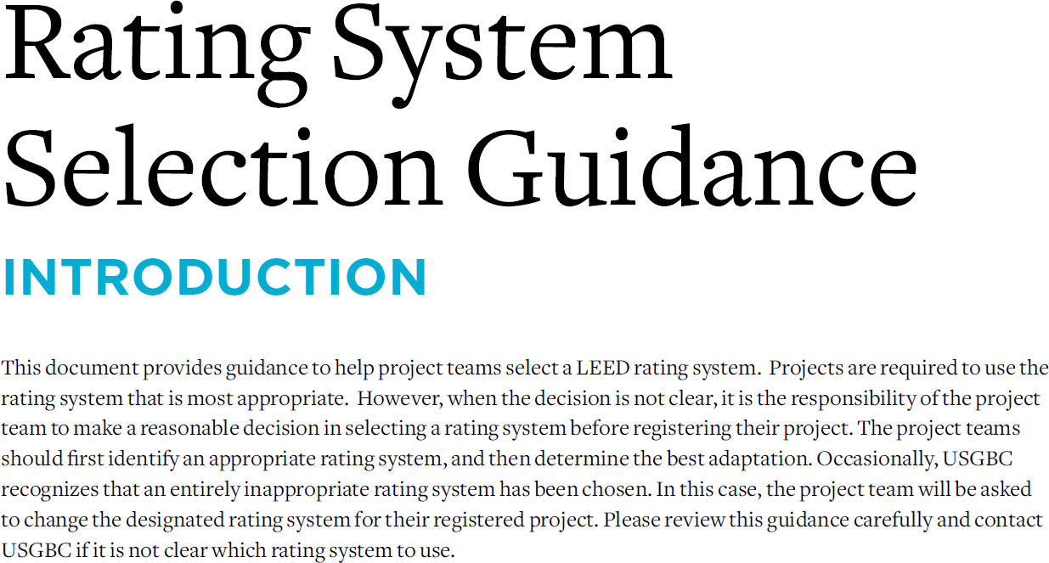

Slide 69
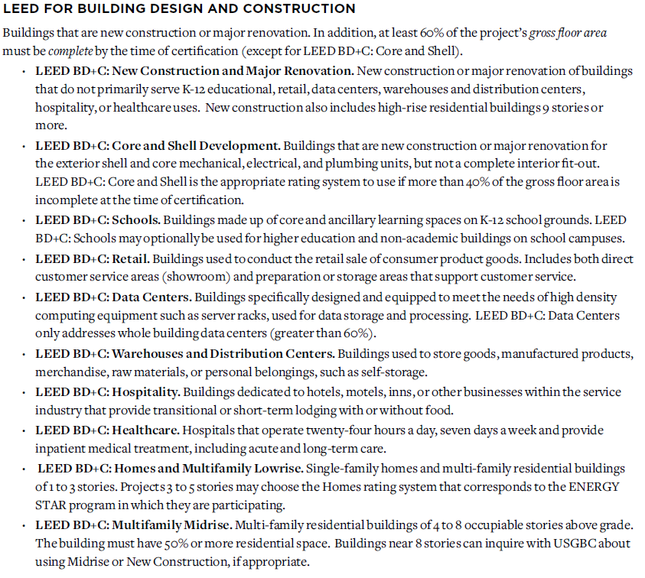
Rating System Descriptions

Slide 70



Rating System Descriptions

Slide 71


Rating System Descriptions

Slide 72


Slide 73


Slide 74


74

