Slide 1
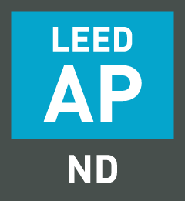
Fundamentals of LEED v4 for
Neighborhood Development
Exam Preparation
Lori A. Brown, LEED AP BD+C – Power Jam Study! Lorisweb.com
1

Slide 2
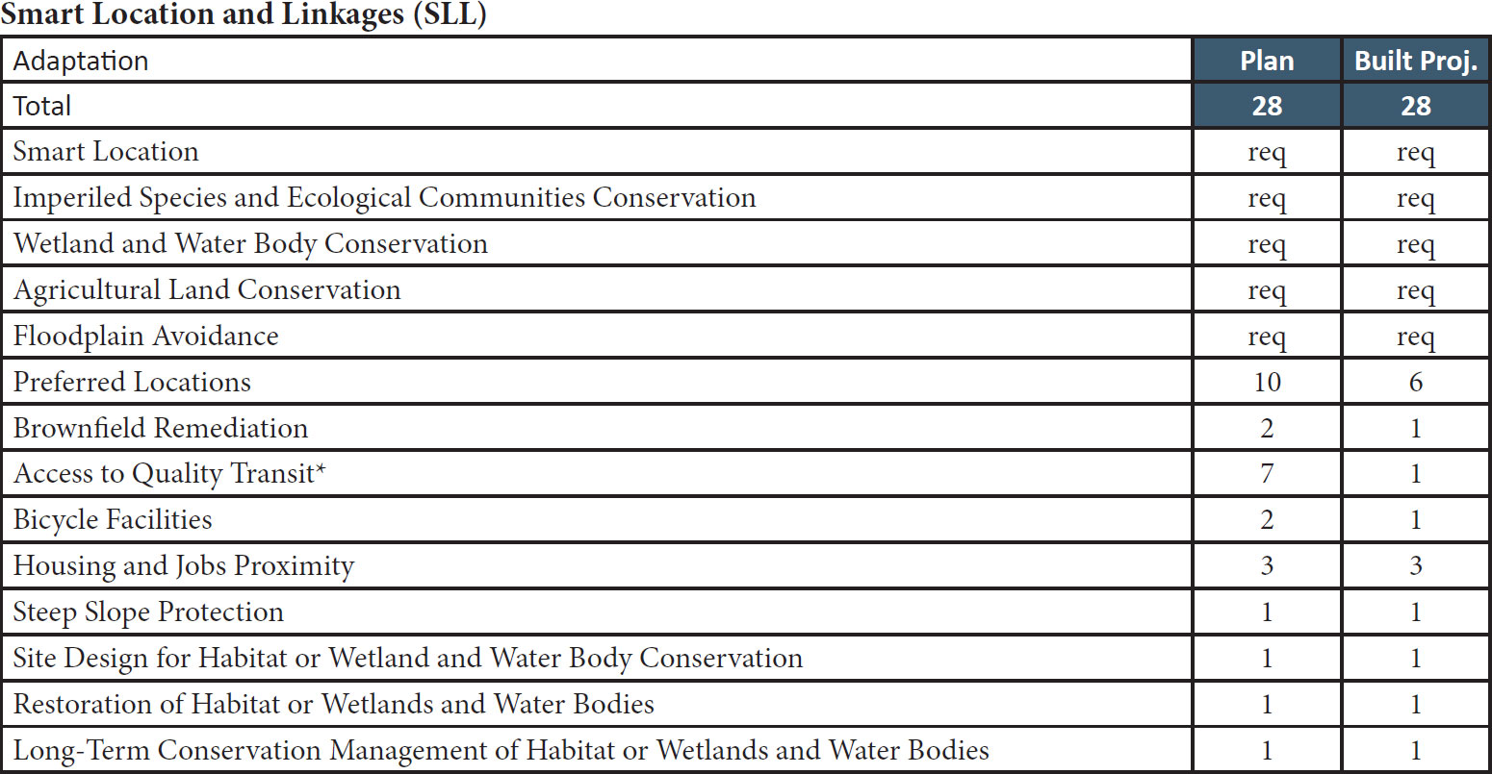
Lori A. Brown, LEED AP BD+C – Power Jam Study! Lorisweb.com
2

Slide 3
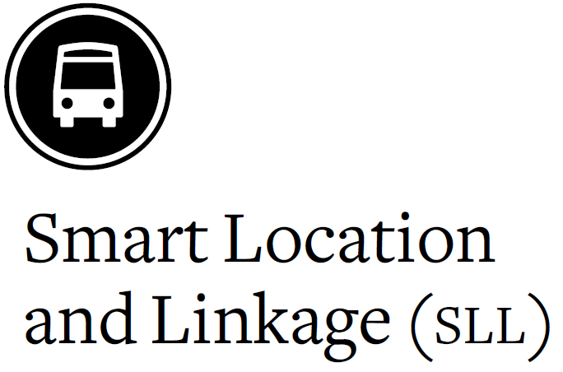
Lori A. Brown, LEED AP BD+C – Power Jam Study! Lorisweb.com
3

Slide 4

Prerequisite - Smart Location
Plan
Built Project
Intent
To encourage development within and near existing communities and public transit infrastructure.
To encourage improvement and redevelopment of existing cities, suburbs, and towns while limiting the expansion of the development footprint in the region.
To reduce vehicle trips and vehicle distance traveled.
To reduce the incidence of obesity, heart disease, and hypertension by encouraging daily physical activity associated with walking and bicycling.
Lori A. Brown, LEED AP ND – Power Jam Study! Lorisweb.com
4

Slide 5
Prerequisite - Smart Location
Plan
Built Project
Requirements
For All Projects
Either:
(1) locate the project on a site served by existing water and wastewater infrastructure or
(2) locate the project within a legally adopted, publicly owned, planned water and wastewater service area, and provide new water and wastewater infrastructure for the project.
Lori A. Brown, LEED AP ND – Power Jam Study! Lorisweb.com
5

Slide 6
Prerequisite - Smart Location
Plan
Built Project
The site should also meet the requirements of one of the following four options.
Option 1. Infill Sites
Locate the project on an infill site.
OR
Option 2. Adjacent Sites with Connectivity
Locate the project on an adjacent site (i.e., a site that is adjacent to previously developed land) where the connectivity of the adjacent land is at least 90 intersections per square mile as measured within a
½-mile distance of a continuous segment of the project boundary that constitutes at least 25% of the total project boundary and is adjacent to previous development.
Lori A. Brown, LEED AP ND – Power Jam Study! Lorisweb.com
6

Slide 7
Prerequisite - Smart Location
Plan
Built Project
Existing intersections may be counted if they were not constructed or funded by the project developer within the past 10 years.
Locate and/or design the project such that a through-connection (of the circulation network) intersects the adjacent portion of the project boundary at least every 600 feet on average and at least every 800 feet, connecting it with an existing circulation network outside the project; nonmotorized through-connections of the circulation network may count for no more than 20% of the total.
The exemptions listed in NPD Prerequisite Connected and Open Community do not apply to this option.
OR
Lori A. Brown, LEED AP ND – Power Jam Study! Lorisweb.com
7

Slide 8
Prerequisite - Smart Location
Plan
Built Project
Option 3. Transit Corridor
Locate the project on a site with existing or planned transit service such that at least 50% of dwelling units and nonresidential use entrances (inclusive of existing buildings) are within a ¼-mile walking distance of at least one bus, streetcar, or rideshare stop, or within a
½-mile walking distance of at least one bus rapid transit stop, light or heavy rail station, or commuter ferry terminal.
Lori A. Brown, LEED AP ND – Power Jam Study! Lorisweb.com
8

Slide 9
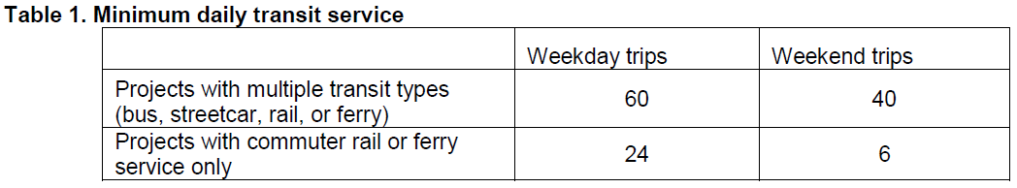
Prerequisite - Smart Location
Plan
Built Project
The transit service at the stop(s) in aggregate must meet the minimums listed in Table 1.
Projects must meet the requirements for both weekday and weekend trips and provide service every day.
Lori A. Brown, LEED AP ND – Power Jam Study! Lorisweb.com
9

Slide 10
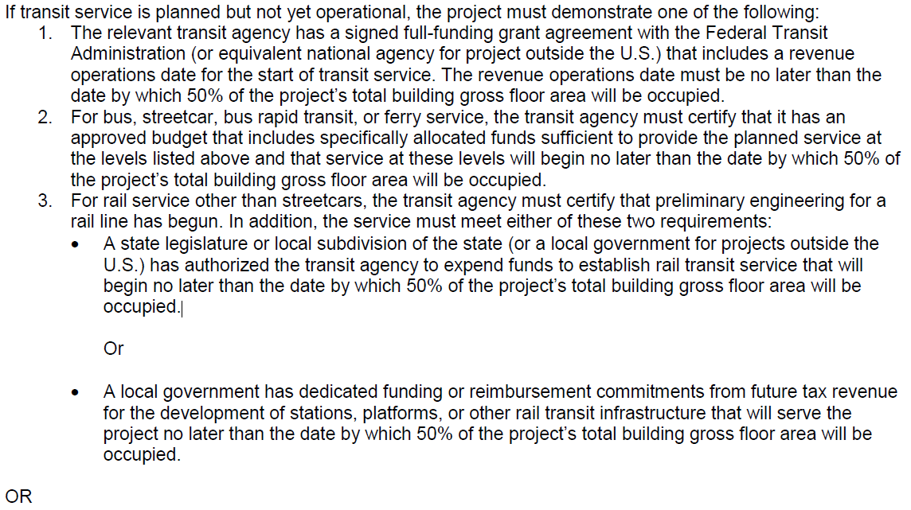
Prerequisite - Smart Location
Plan
Built Project
Lori A. Brown, LEED AP ND – Power Jam Study! Lorisweb.com
10

Slide 11
Prerequisite - Smart Location
Plan
Built Project
Option 4. Sites with Nearby Neighborhood Assets
Include a residential component equaling at least 30% of the project’s total building gross floor area (exclusive of portions of parking structures devoted exclusively to parking) and locate the project near existing uses (see Appendix 1) such that the project boundary is within a ¼-mile walking distance of at least five uses, or such that the project’s geographic center is within a ½-mile walking distance of at least seven uses.
Lori A. Brown, LEED AP ND – Power Jam Study! Lorisweb.com
11

Slide 12
Prerequisite - Smart Location
Plan
Built Project
The following restrictions apply.
A use counts as only one type (e.g., a retail store may be counted only once even if it sells products in several categories).
No more than two uses in each use type may be counted (e.g., if five restaurants are within the required distance, only two may be counted).
The uses accessible to the project must represent at least two categories.
Lori A. Brown, LEED AP ND – Power Jam Study! Lorisweb.com
12

Slide 13
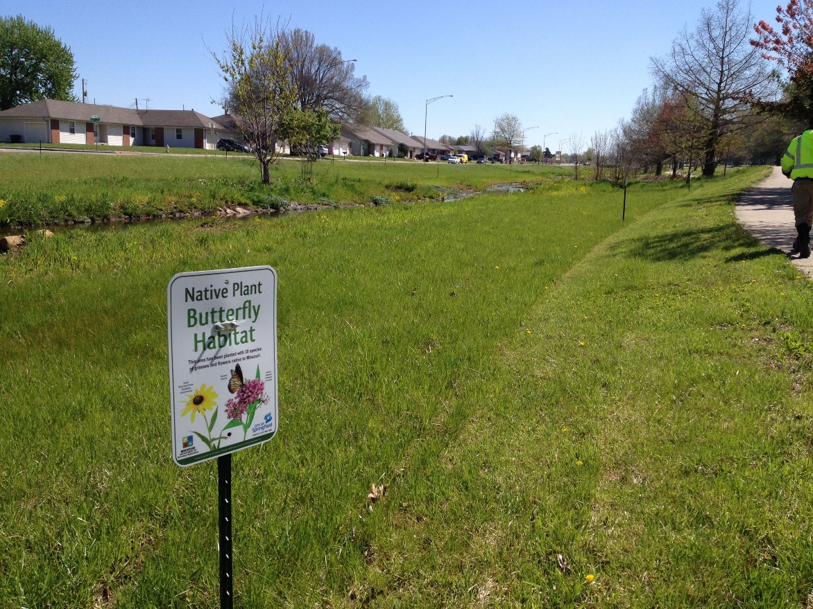
Prerequisite – Imperiled Species and Ecological Communities Conservation
Plan
Built Project
Intent
To conserve imperiled species and ecological communities.
Lori A. Brown, LEED AP ND – Power Jam Study! Lorisweb.com
13

Slide 14
Prerequisite – Imperiled Species and Ecological Communities Conservation
Plan
Built Project
Requirements
Consult with the state Natural Heritage Program and state fish and wildlife agencies to determine if any of the following have been or are likely to be found on the project site because of the presence of suitable habitat and nearby occurrences:
species listed as threatened or endangered under the U.S. Endangered Species Act or the state’s endangered species act, or
species or ecological communities classified by NatureServe as GH (possibly extinct), G1 (critically imperiled), or G2 (imperiled), or
species listed as threatened or endangered specified under local equivalent standards that are not covered by NatureServe data.
Lori A. Brown, LEED AP ND – Power Jam Study! Lorisweb.com
14

Slide 15
Prerequisite – Imperiled Species and Ecological Communities Conservation
Plan
Built Project
If the consultations are inconclusive and site conditions indicate that imperiled species or ecological communities could be present, perform biological surveys using accepted methodologies during appropriate seasons to determine whether such species or communities occur or are likely to occur on the site.
Lori A. Brown, LEED AP ND – Power Jam Study! Lorisweb.com
15

Slide 16
Prerequisite – Imperiled Species and Ecological Communities Conservation
Plan
Built Project
Comply with the appropriate case or option below.
Case 1. Sites without Affected Species or Ecological Community
The prerequisite is satisfied if the consultation and any necessary biological surveys determine that no such imperiled species or ecological communities have been found or have a high likelihood of occurring.
OR
Lori A. Brown, LEED AP ND – Power Jam Study! Lorisweb.com
16

Slide 17
Prerequisite – Imperiled Species and Ecological Communities Conservation
Plan
Built Project
Case 2. Sites with Affected Species or Ecological Community
If the site has any affected species or ecological communities, meet either of the following two options.
Option 1. Habitat Conservation Plan
Comply with an approved habitat conservation plan under the U.S. Endangered Species Act for each identified species or ecological community.
OR
Lori A. Brown, LEED AP ND – Power Jam Study! Lorisweb.com
17

Slide 18
Prerequisite – Imperiled Species and Ecological Communities Conservation
Plan
Built Project
Option 2. Habitat Conservation Plan Equivalent
Work with a qualified biologist or ecologist, a conservation organization, or the appropriate national, state or local agency to create and implement a conservation plan that includes the following actions:
Identify and map the extent of the habitat and the appropriate buffer, not less than 100 feet, according to best available scientific information.
If on-site protection can be accomplished, analyze threats from development and develop a monitoring and management plan that eliminates or significantly reduces the threats.
Protect the identified habitat and buffer in perpetuity by donating or selling the land or a conservation easement on the land to an accredited land trust, conservation organization, or relevant government agency.
If any portion of the identified habitat and buffer cannot be protected in perpetuity, quantify the effects by acres (hectares) or number of plants and/or animals affected, and protect from development in perpetuity habitat of similar or better quality, on-site or off-site, by donating or selling a conservation easement on it to an accredited land trust, conservation organization, or relevant government agency. The donation or easement must cover an amount of land equal to or larger than the area that cannot be protected.
Lori A. Brown, LEED AP ND – Power Jam Study! Lorisweb.com
18

Slide 19
Prerequisite – Wetlands and Water Body Conservation
Plan
Built Project
Intent
To preserve water quality, natural hydrology, habitat, and biodiversity through conservation of wetlands and water bodies.
Lori A. Brown, LEED AP ND – Power Jam Study! Lorisweb.com
19

Slide 20
Prerequisite – Wetlands and Water Body Conservation
Plan
Built Project
Requirements
Limit development effects on wetlands, water bodies, and surrounding buffer land according to the requirements below.
Case 1. Sites without Sensitive Areas
Locate the project on a site that includes no preproject wetlands, water bodies, land within 50 feet of wetlands, and land within 100 feet of water bodies.
Lori A. Brown, LEED AP ND – Power Jam Study! Lorisweb.com
20

Slide 21
Prerequisite – Wetlands and Water Body Conservation
Plan
Built Project
Case 2. Sites with Sensitive Areas
If the site has preproject wetlands, water bodies, land within 50 feet of wetlands, or land within 100 feet of water bodies, select one of the following two options:
Option 1. No Development on Wetlands and Water Bodies
Locate the project such that preproject wetlands, water bodies, land within 50 feet of wetlands, and land within 100 feet of water bodies are not affected by new development, unless the development is minor improvements or is on previously developed land.
OR
Lori A. Brown, LEED AP ND – Power Jam Study! Lorisweb.com
21

Slide 22
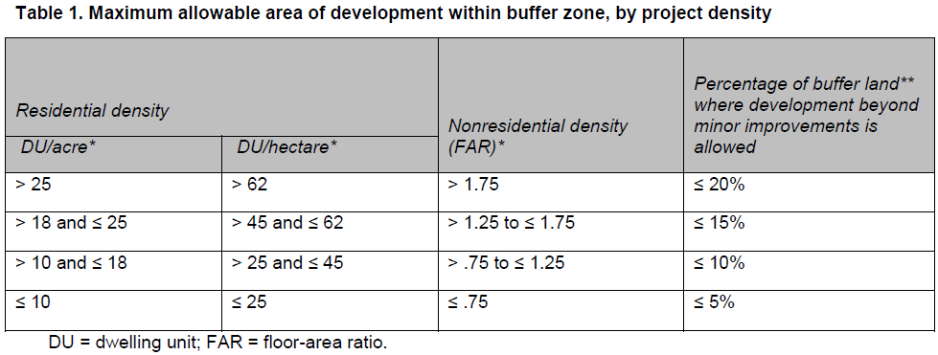
Prerequisite – Wetlands and Water Body Conservation
Plan
Built Project
Option 2. Rainwater Management and Protected Buffers
Earn at least 1 point under GIB Credit Rainwater Management, and limit any development beyond minor improvements to less than the percentage of buffer land listed in Table 1.
Lori A. Brown, LEED AP ND – Power Jam Study! Lorisweb.com
22

Slide 23
Prerequisite – Wetlands and Water Body Conservation
Plan
Built Project
* For this option, a mixed-use project may use either its residential or its nonresidential density to determine the percentage of allowable development, regardless of which is higher.
** Buffer width may vary as long as the total buffer area is equal to the area within 50 feet of wetlands and/or within 100 feet of water bodies, minus excluded features (see list of minor improvements, below).
In no case may the buffer width be less than 25 feet for wetlands and 50 feet for water bodies, measured from the edge.
Inside this minimum buffer, only minor improvements and/or improvements that result in no ecological impairment of the wetland or water body, as determined by a qualified biologist, are allowed.
Lori A. Brown, LEED AP ND – Power Jam Study! Lorisweb.com
23

Slide 24
Prerequisite – Wetlands and Water Body Conservation
Plan
Built Project
For All Projects
Comply with all local, state, and national regulations pertaining to wetland and water body conservation.
The following features are not considered wetlands, water bodies, or buffer land that must be protected for the purposes of this prerequisite:
previously developed land;
man-made water bodies (such as industrial mining pits, concrete-lined canals, or stormwater retention ponds) that lack natural edges and floors or native ecological communities in the water and along the edge;
man-made linear wetlands that result from the interruption of natural drainages by existing rights-of-way; and
wetlands that were man-made incidentally and have been rated “poor” for all measured wetland functions, as assessed by a qualified biologist using a method that is accepted by state or regional permitting agencies.
Lori A. Brown, LEED AP ND – Power Jam Study! Lorisweb.com
24

Slide 25
Prerequisite – Wetlands and Water Body Conservation
Plan
Built Project
Minor improvements within the buffer may be undertaken to enhance appreciation for the wetland or water body, provided such facilities are open to public access. Only the following improvements are permitted:
bicycle and pedestrian pathways no more than 12 feet wide, of which no more than 8 total feet may be impervious;
activities to maintain or restore native natural communities and/or natural hydrology;
one single-story structure not exceeding 500 square feet per 300 linear feet of buffer, on average;
grade changes necessary to ensure public access;
clearings, limited to one per 300 linear feet of buffer, on average, not exceeding 500 square feet each, for tables, benches, and access for nonmotorized recreational watercraft;
removal of hazardous trees (up to 75% of dead trees), trees smaller than 6 inches in diameter at breast height, trees with a condition rating of less than 40%, and up to 20% of trees larger than 6 inches in diameter at breast height with a condition rating of 40% or higher, as based on an assessment by an arborist certified by the International Society of Arboriculture (ISA) using ISA standard measures; and
brownfield remediation activities.
Off-street parking is not considered a minor improvement.
Lori A. Brown, LEED AP ND – Power Jam Study! Lorisweb.com
25

Slide 26
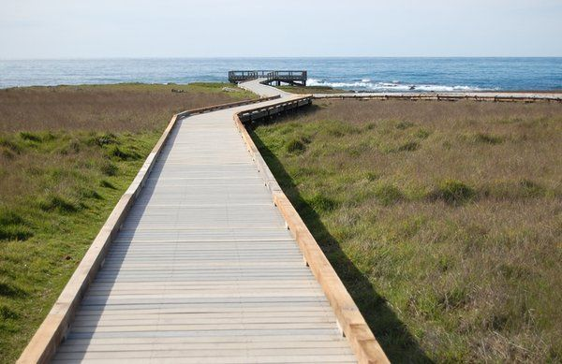
Prerequisite – Wetlands and Water Body Conservation
Plan
Built Project
Direct development of wetlands and water bodies is prohibited, except for minimal-impact structures, such as an elevated boardwalk, that allow access to the water for educational and recreational purposes.
Lori A. Brown, LEED AP ND – Power Jam Study! Lorisweb.com
26

Slide 27
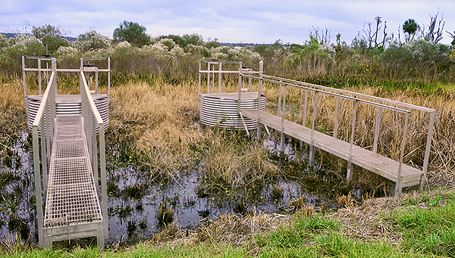
Prerequisite – Wetlands and Water Body Conservation
Plan
Built Project
Structures that protrude into wetlands or water bodies may be replaced, provided the replacement structure has the same or smaller footprint and a similar height.
Lori A. Brown, LEED AP ND – Power Jam Study! Lorisweb.com
27

Slide 28
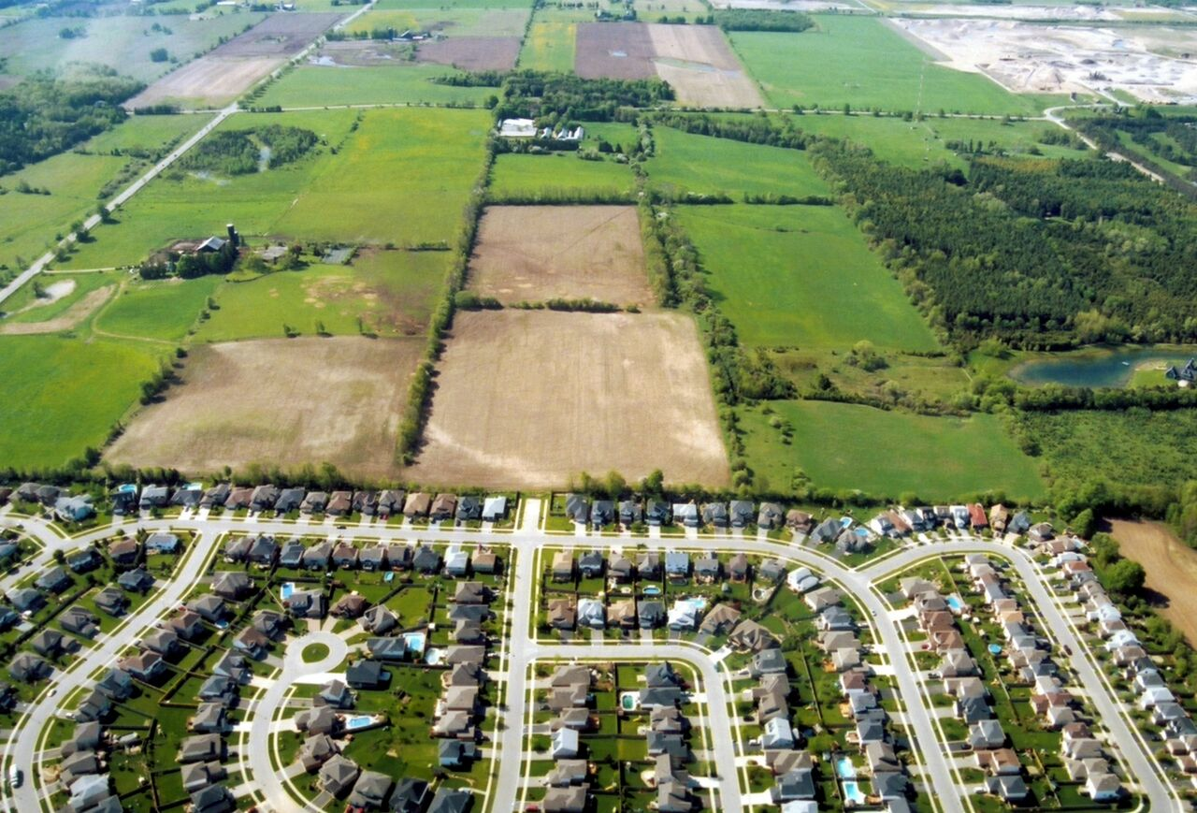
Prerequisite – Agricultural Land Conservation
Plan
Built Project
Intent
To preserve irreplaceable agricultural resources by protecting prime and unique farmland from development.
Lori A. Brown, LEED AP ND – Power Jam Study! Lorisweb.com
28

Slide 29
Prerequisite – Agricultural Land Conservation
Plan
Built Project
Requirements
Locate the project on a site that is not within a state or locally designated agricultural preservation district, unless any changes made to the site conform to the requirements for development within the district (as used in this requirement, “district” does not equate to land-use zoning).
Meet the requirements of one of the following five options.
Lori A. Brown, LEED AP ND – Power Jam Study! Lorisweb.com
29

Slide 30
Prerequisite – Agricultural Land Conservation
Plan
Built Project
Option 1. Infill Sites
Locate the project on an infill site.
OR
Option 2. Sites Served by Transit
Comply with SLL Prerequisite Smart Location, Option 3, Transit Corridor.
OR
Lori A. Brown, LEED AP ND – Power Jam Study! Lorisweb.com
30

Slide 31
Prerequisite – Agricultural Land Conservation
Plan
Built Project
Option 3. Development Rights Receiving Area
Locate the project within a designated receiving area for development rights under a publicly administered farmland protection program that provides for the transfer of development rights from lands designated for conservation to lands designated for development.
OR
Lori A. Brown, LEED AP ND – Power Jam Study! Lorisweb.com
31

Slide 32
Prerequisite – Agricultural Land Conservation
Plan
Built Project
Option 4. Sites without Affected Soils
Locate the project’s development footprint such that it does not disturb prime farmland, unique farmland, or farmland of statewide or local importance as defined by the U.S. Code of Federal Regulations, Title 7, Volume 6, Parts 400 to 699, Section 657.5 and identified in a state Natural Resources Conservation Service soil survey.
OR
Lori A. Brown, LEED AP ND – Power Jam Study! Lorisweb.com
32

Slide 33
Prerequisite – Agricultural Land Conservation
Plan
Built Project
Option 5. Sites with Affected Soils
If development footprint affects land with prime farmland, unique farmland, or farmland of statewide or local importance as defined by the U.S. Code of Federal Regulations, Title 7, Volume 6, Parts 400 to 699, Section 657.5 and identified in a state Natural Resources Conservation Service soil survey, mitigate the loss through the purchase or donation of easements providing permanent protection from development on land with comparable soils in accordance with the ratios based on densities per acre (per hectare) of buildable land listed in Tables 1 and 2.
Lori A. Brown, LEED AP ND – Power Jam Study! Lorisweb.com
33

Slide 34
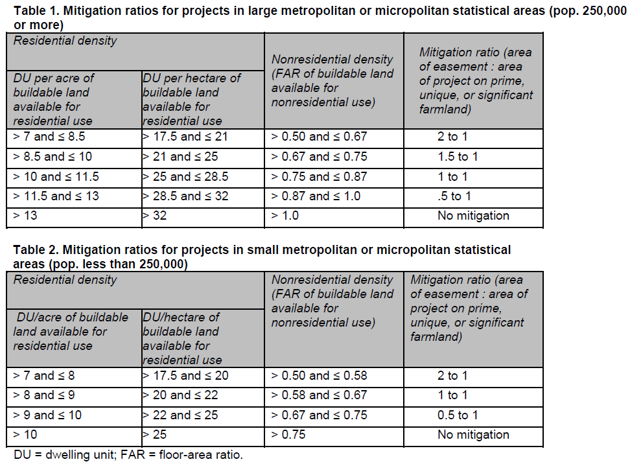
Prerequisite – Agricultural Land Conservation
Plan
Built Project
Lori A. Brown, LEED AP ND – Power Jam Study! Lorisweb.com
34

Slide 35
Prerequisite – Agricultural Land Conservation
Plan
Built Project
All off-site mitigation must be located within 100 miles of the project.
Up to 15% of the affected farmland area may be subtracted from the mitigation area required of the project in Tables 1 and 2 if it is permanently dedicated for community gardens.
Portions of parking structures devoted exclusively to parking must be excluded from the numerator when calculating the floor-area ratio (FAR).
Lori A. Brown, LEED AP ND – Power Jam Study! Lorisweb.com
35

Slide 36
Prerequisite – Agricultural Land Conservation
Plan
Built Project
The mitigation ratio for a mixed-use project is calculated as follows:
Determine the total floor area of all residential and nonresidential uses.
Calculate the percentage residential and percentage nonresidential of the total floor area.
Determine the density of the residential and nonresidential components as measured in dwelling units per acre and FAR, respectively.
Referring to Tables 1 and 2, find the appropriate mitigation ratios for the residential and nonresidential components.
If the mitigation ratios are different, multiply the mitigation ratio of the residential component by its percentage of the total floor area, and multiply the mitigation ratio of the nonresidential component by its percentage.
Add the two numbers produced by step 5. The result is the mitigation ratio.
Lori A. Brown, LEED AP ND – Power Jam Study! Lorisweb.com
36

Slide 37
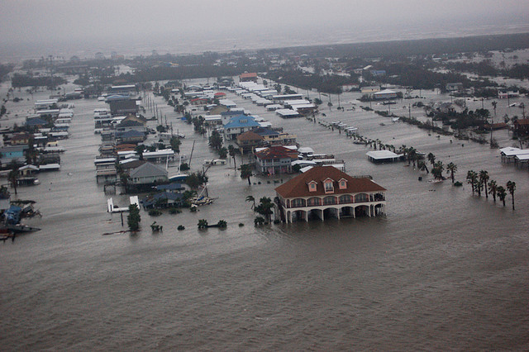
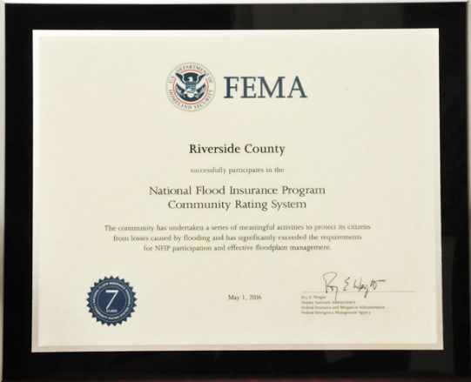
Prerequisite – Floodplain Avoidance
Plan
Built Project
Intent
To protect life and property, promote open space and habitat conservation, and enhance water quality and natural hydrologic systems.
Lori A. Brown, LEED AP ND – Power Jam Study! Lorisweb.com
37

Slide 38
Prerequisite – Floodplain Avoidance
Plan
Built Project
Requirements
Case 1. Sites without Flood Hazard Areas
Locate on a site that is entirely outside any flood hazard area shown on a legally adopted flood hazard map or otherwise legally designated by the local jurisdiction or the state.
For projects in places without legally adopted flood hazard maps or legal designations, locate on a site that is entirely outside any floodplain subject to a 1% or greater chance of flooding in any given year.
Lori A. Brown, LEED AP ND – Power Jam Study! Lorisweb.com
38

Slide 39
Prerequisite – Floodplain Avoidance
Plan
Built Project
Case 2. Infill or Previously Developed Sites with Flood Hazard Areas
Locate the project on an infill site or a previously developed site and select one of the following two options.
Option 1. American Society of Civil Engineers Standard
For any portion of the site within the flood hazard area, design buildings in accordance with American Society of Civil Engineers Standard 24-05 (ASCE 24).
Option 2. National Flood Insurance Program
For any portion of the site within the flood hazard area, design buildings in accordance with National Flood Insurance Program (NFIP) requirements.
Lori A. Brown, LEED AP ND – Power Jam Study! Lorisweb.com
39

Slide 40
Prerequisite – Floodplain Avoidance
Plan
Built Project
If the project includes construction of a critical facility that is intended to remain operational in the event of a flood, or whose function is critical for postflood recovery, design the facility to be protected and operable at the floodwater levels specified in ASCE 24, or at the water levels represented by a 0.2% annual chance (500-year) flood, whichever is higher.
For the purpose of this requirement, critical facilities include, but are not limited to, hospitals, emergency operations centers, building or portions of buildings designated as emergency shelters, water and sewage treatment facilities, and fire and police stations.
OR
Lori A. Brown, LEED AP ND – Power Jam Study! Lorisweb.com
40

Slide 41
Prerequisite – Floodplain Avoidance
Plan
Built Project
Case 3. All Other Sites with Flood Hazard Areas
Meet the requirements of one of the following two options.
Option 1. American Society of Civil Engineers Standard
Previously developed portions of the site
On portions of the site that are previously developed and in the flood hazard area, design buildings in accordance with American Society of Civil Engineers Standard 24-05 (ASCE 24).
Nonpreviously developed portions of the site
On portions of the site that are not previously developed and in the flood hazard area, do not develop on land that is within either a regulatory floodway or a coastal high hazard area (Zone V), as shown on the flood hazard map.
On all other portions of the site that are not previously developed and in the flood hazard area, design buildings in accordance with ASCE 24.
Lori A. Brown, LEED AP ND – Power Jam Study! Lorisweb.com
41

Slide 42
Prerequisite – Floodplain Avoidance
Plan
Built Project
Option 2. National Flood Insurance Program
Previously developed portions of the site
On portions of the site that are previously developed and in the flood hazard area, design buildings in accordance with National Flood Insurance Program (NFIP) requirements.
Nonpreviously developed portions of the site
On portions of the site that are not previously developed and in the flood hazard area, do not develop on land that is within either a regulatory floodway or a coastal high hazard area (Zone V), as shown on the flood hazard map.
On all other portions of the site that are not previously developed and in the flood hazard area, design buildings in accordance with NFIP.
Lori A. Brown, LEED AP ND – Power Jam Study! Lorisweb.com
42

Slide 43
Prerequisite – Floodplain Avoidance
Plan
Built Project
Critical facilities in the flood hazard area
If the project involves a critical facility that is intended to remain operational in the event of a flood, or whose function is critical for postflood recovery, design the facility to be protected and operable at the water levels represented by a 0.2% annual chance (500-year) flood.
For the purpose of this requirement, critical facilities include, but are not limited to, hospitals, emergency operations centers, building or portions of buildings designated as emergency shelters, water and sewage treatment facilities, and fire and police stations.
Lori A. Brown, LEED AP ND – Power Jam Study! Lorisweb.com
43

Slide 44
Credit – Preferred Locations
Plan
Built Project
Intent
To encourage development within existing cities, suburbs, and towns to reduce the environmental and public health consequences of sprawl.
To reduce development pressure beyond the limits of existing development.
To conserve the natural and financial resources required for infrastructure.
Lori A. Brown, LEED AP ND – Power Jam Study! Lorisweb.com
44

Slide 45
Credit – Preferred Locations
Plan
Built Project
Requirements
Option 1. Location Type (1–5 points)
Locate the project in one of the following locations:
a previously developed site that is not an adjacent site or infill site (1 point);
an adjacent site that is also a previously developed site (2 points);
an infill site that is not a previously developed site (3 points); or
an infill site that is also a previously developed site (5 points).
AND/OR
Lori A. Brown, LEED AP ND – Power Jam Study! Lorisweb.com
45

Slide 46
Credit – Preferred Locations
Plan
Built Project
Option 2. Connectivity (1-5 points)
Locate the project in an area that has existing connectivity, as listed in Table 1.
Measure connectivity one of two ways:
within 1/2 mile of the project boundary; or
within the project and within ½ mile of the project boundary.
Intersections within the site cannot be counted if they were constructed or funded by the developer within the past 10 years.
Lori A. Brown, LEED AP ND – Power Jam Study! Lorisweb.com
46

Slide 47
Credit – Preferred Locations
Plan
Built Project
Option 2. Connectivity (1-5 points)
Locate the project in an area that has existing connectivity, as listed in Table 1.
Measure connectivity one of two ways:
within 1/2 mile of the project boundary; or
within the project and within ½ mile of the project boundary.
Intersections within the site cannot be counted if they were constructed or funded by the developer within the past 10 years.
Lori A. Brown, LEED AP ND – Power Jam Study! Lorisweb.com
47

Slide 48
Credit – Preferred Locations
Plan
Built Project
Option 2. Connectivity (1-5 points)
Locate the project in an area that has existing connectivity, as listed in Table 1.
Measure connectivity one of two ways:
within 1/2 mile of the project boundary; or
within the project and within ½ mile of the project boundary.
Intersections within the site cannot be counted if they were constructed or funded by the developer within the past 10 years.
Lori A. Brown, LEED AP ND – Power Jam Study! Lorisweb.com
48

Slide 49
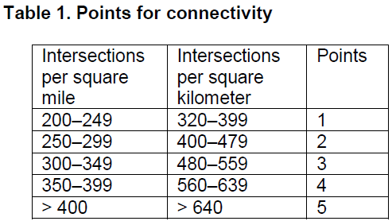
Credit – Preferred Locations
Plan
Built Project
Lori A. Brown, LEED AP ND – Power Jam Study! Lorisweb.com
49

Slide 50
Credit – Preferred Locations
Plan
Built Project
Option 3. Designated High-Priority Locations (3 points)
Earn at least 2 points under NPD Credit Housing Types and Affordability, Option 2, Affordable Housing.
AND
Locate the project in one of the following high-priority redevelopment areas:
a site listed by the EPA National Priorities List;
a Federal Empowerment Zone site;
a Federal Enterprise Community site;
a Federal Renewal Community site;
a Department of the Treasury Community Development Financial Institutions Fund Qualified Low-Income Community (a subset of the New Markets Tax Credit Program);
a site in a U.S. Department of Housing and Urban Development’s Qualified Census Tract (QCT) or Difficult Development Area (DDA); or
a local equivalent program administered at a national level for projects outside the U.S.
Lori A. Brown, LEED AP ND – Power Jam Study! Lorisweb.com
50

Slide 51
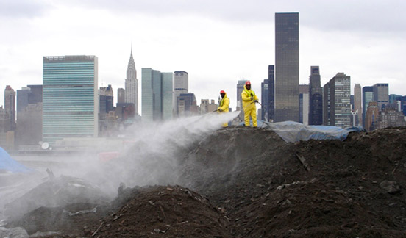
Credit – Brownfield Remediation
Plan
Built Project
Intent
To encourage the cleanup of contaminated lands and developing sites that have been identified as contaminated.
Lori A. Brown, LEED AP ND – Power Jam Study! Lorisweb.com
51

Slide 52
Credit – Brownfield Remediation
Plan
Built Project
Requirements
Option 1. Brownfield Site (1 point)
At a project site identified as a brownfield or where soil or groundwater contamination has been identified, and the local, state, or national authority (whichever has jurisdiction) requires its remediation, perform remediation to the satisfaction of that authority.
OR
Lori A. Brown, LEED AP ND – Power Jam Study! Lorisweb.com
52

Slide 53
Credit – Brownfield Remediation
Plan
Built Project
Option 2. High-Priority Redevelopment Area (2 points)
Achieve the requirements in Option 1.
AND
Locate the project in one of the following high-priority redevelopment areas:
EPA National Priorities List
Federal Empowerment Zone
Federal Enterprise Community
Federal Renewal Community
Department of the Treasury Community Development Financial Institutions Fund Qualified Low-Income Community (a subset of the New Markets Tax Credit Program)
U.S. Department of Housing and Urban Development’s Qualified Census Tract (QCT) or Difficult Development Area (DDA)
Or a local equivalent program administered at the national level for projects outside the U.S.
Lori A. Brown, LEED AP ND – Power Jam Study! Lorisweb.com
53

Slide 54
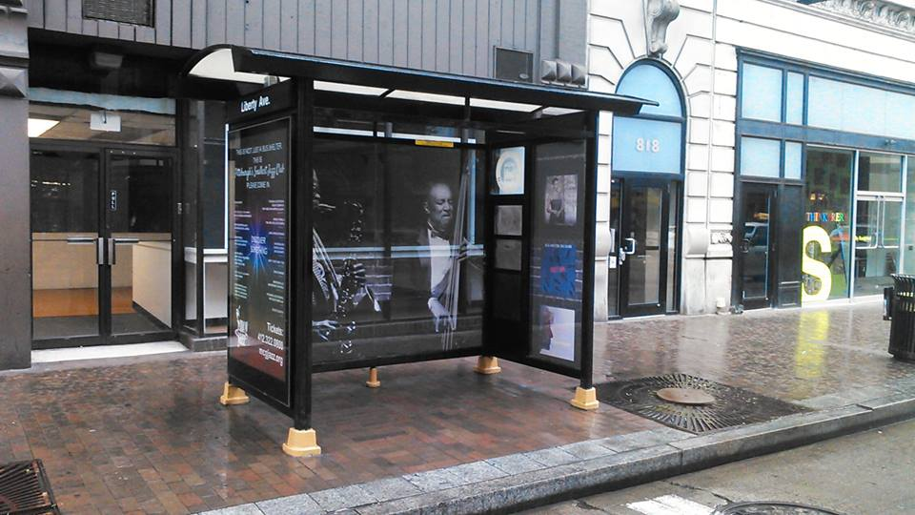
Credit – Access to Quality Transit
Plan
Built Project
Intent
To encourage development in locations shown to have multimodal transportation choices or otherwise reduced motor vehicle use, thereby reducing greenhouse gas emissions, air pollution, and other environmental and public health harms associated with motor vehicle use.
Lori A. Brown, LEED AP ND – Power Jam Study! Lorisweb.com
54

Slide 55
Credit – Access to Quality Transit
Plan
Built Project
Requirements
Locate the project on a site with existing or planned transit (i.e., service with the funding commitments as specified in SLL Prerequisite Smart Location) service such that at least 50% of dwelling units and nonresidential use entrances (inclusive of existing buildings) are within a ¼-mile walking distance of at least one bus or streetcar stop, or within a ½-mile walking distance of at least one bus, streetcar, or rideshare stops or within a ½-mile walking distance of bus rapid transit stop, light or heavy rail station, commuter rail station, or commuter ferry terminal and the transit service at the stop(s) in aggregate meets the minimums listed in Tables 1 and 2.
Projects must meet the requirements for both weekday and weekend trips and provide service every day.
Lori A. Brown, LEED AP ND – Power Jam Study! Lorisweb.com
55

Slide 56
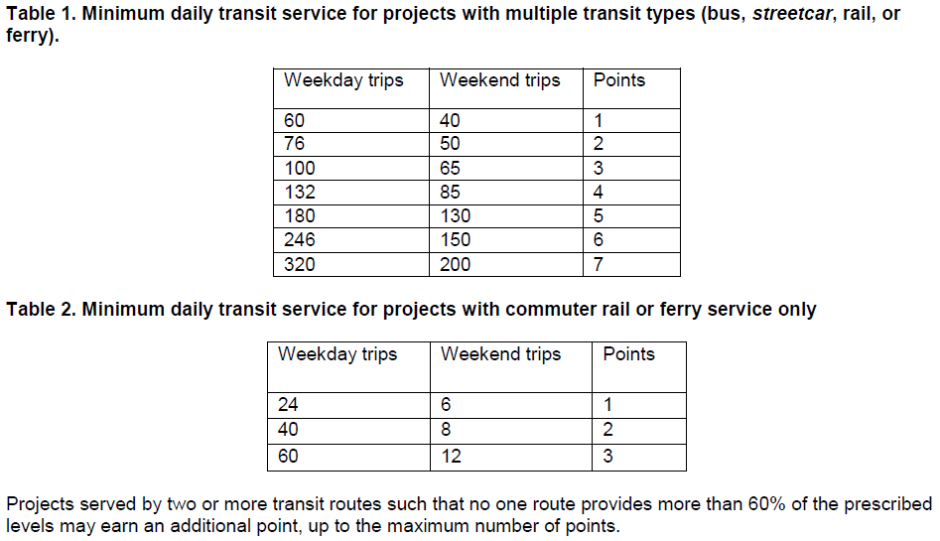
Credit – Access to Quality Transit
Plan
Built Project
Lori A. Brown, LEED AP ND – Power Jam Study! Lorisweb.com
56

Slide 57
Credit – Access to Quality Transit
Plan
Built Project
If existing transit service is temporarily rerouted outside the required distances for less than two years, the project may meet the requirements, provided the local transit agency has committed to restoring the routes with service at or above the prior level.
Lori A. Brown, LEED AP ND – Power Jam Study! Lorisweb.com
57

Slide 58
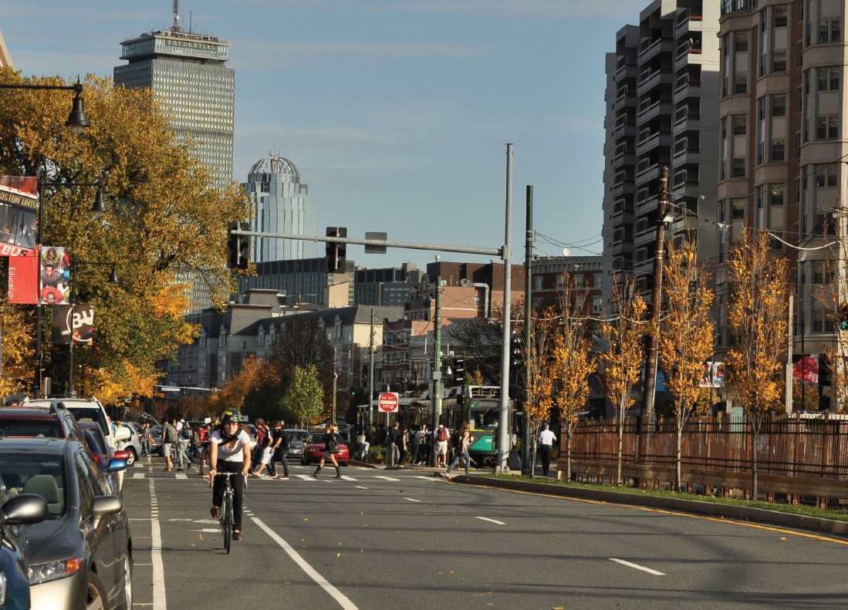
Credit – Bicycle Facilities
Plan
Built Project
Intent
To promote bicycling and transportation efficiency and reduce vehicle distance traveled. To improve public health by encouraging utilitarian and recreational physical activity.
Lori A. Brown, LEED AP ND – Power Jam Study! Lorisweb.com
58

Slide 59
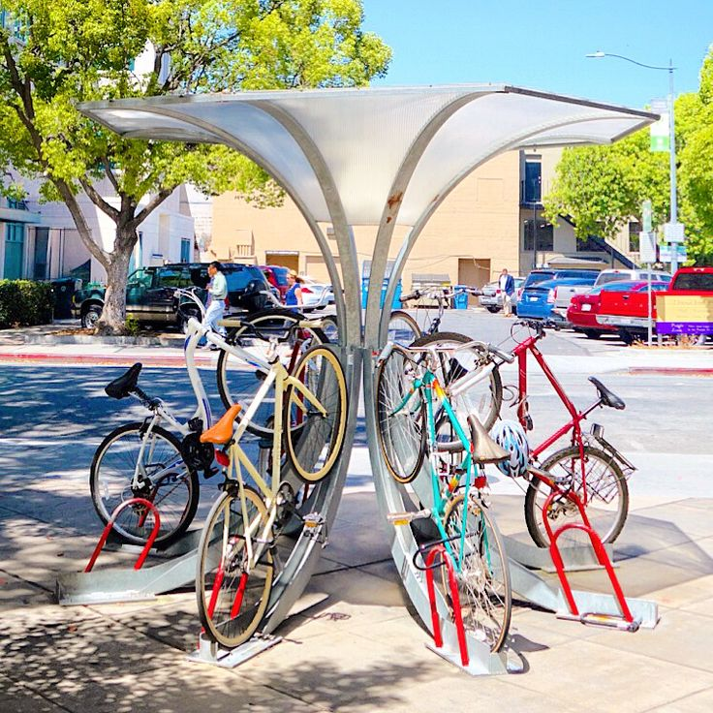
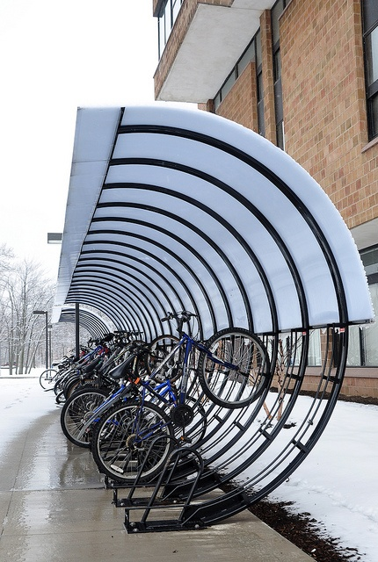
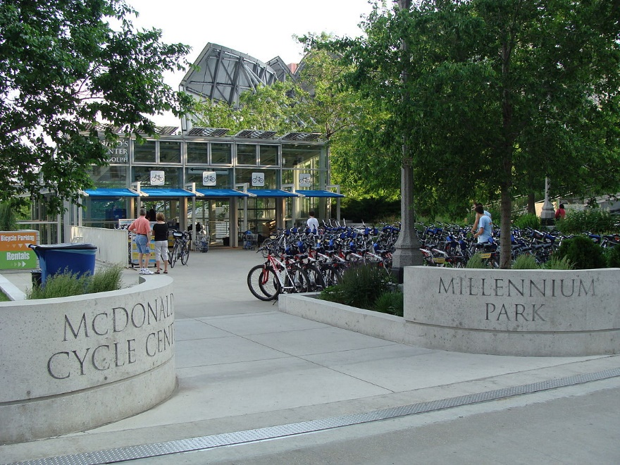
Credit – Bicycle Facilities
Plan
Built Project
Requirements
Meet the following requirements in 90% of all new buildings. The buildings that do not have bicycle storage may not exceed 10% of the total project building floor area.
Lori A. Brown, LEED AP ND – Power Jam Study! Lorisweb.com
59

Slide 60
Credit – Bicycle Facilities
Plan
Built Project
Non-Residential (excluding Retail) Buildings
Provide short-term bicycle storage for at least 2.5% of peak visitors, but no fewer than four storage spaces per building.
Provide long-term bicycle storage for at least 5% of all regular building occupants, but no fewer than four storage spaces per building in addition to the short-term bicycle storage spaces.
Provide at least one on-site shower with changing facility for the first 100 regular building occupants and one additional shower for every 150 regular building occupants thereafter.
Lori A. Brown, LEED AP ND – Power Jam Study! Lorisweb.com
60

Slide 61
Credit – Bicycle Facilities
Plan
Built Project
Multi-unit Residential Buildings
Provide short-term bicycle storage for at least 2.5% of all peak visitors, but no fewer than four storage spaces per building.
Provide long-term bicycle storage for at least 30% of all regular building occupants, but no less than one storage space per residential unit.
Lori A. Brown, LEED AP ND – Power Jam Study! Lorisweb.com
61

Slide 62
Credit – Bicycle Facilities
Plan
Built Project
Retail Buildings
Provide at least two short-term bicycle storage spaces for every 5,000 square feet, but no fewer than two storage spaces per building.
Provide long-term bicycle storage for at least 5% of regular building occupants, but no fewer than two storage spaces per building in addition to the short-term bicycle storage.
Provide at least one on-site shower with changing facility for the first 100 regular building occupants and one additional shower for every 150 regular building occupants thereafter.
Lori A. Brown, LEED AP ND – Power Jam Study! Lorisweb.com
62

Slide 63
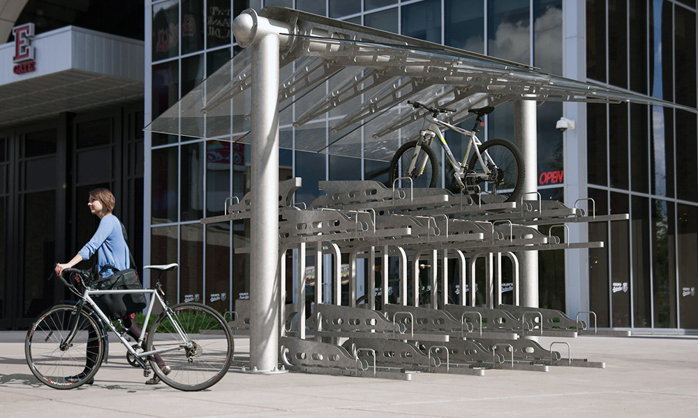
Credit – Bicycle Facilities
Plan
Built Project
Mixed-Use Buildings
Meet the above requirements for the project’s non-residential, multi-unit residential, and retail spaces.
Lori A. Brown, LEED AP ND – Power Jam Study! Lorisweb.com
63

Slide 64
Credit – Bicycle Facilities
Plan
Built Project
For all projects:
Short-term bicycle storage must be within 100 feet walking distance of any main entrance.
Long-term bicycle storage must be within 100 feet walking distance of any functional entry. It must be easily accessible to all building users.
Shower and changing facility requirements may be met by providing the equivalent of free access to on-site health club shower facilities, if the health club can be accessed without going outside.
Lori A. Brown, LEED AP ND – Power Jam Study! Lorisweb.com
64

Slide 65
Credit – Bicycle Facilities
Plan
Built Project
Additionally, meet the requirements of at least one of the following two options.
Option 1. Bikable Location (1 point)
Locate the project such that the project boundary is within ¼ mile bicycling distance of an existing bicycle network that connects to at least one of the following.
at least 10 diverse uses (see Appendix 1);
a school or employment center, if the project total floor area is 50% or more residential; or
a bus rapid transit stop, light or heavy rail station, commuter rail station, or ferry terminal.
All destinations must be within a 3-mile bicycling distance of the project boundary.
AND/OR
Lori A. Brown, LEED AP ND – Power Jam Study! Lorisweb.com
65

Slide 66
Credit – Bicycle Facilities
Plan
Built Project
Option 2. Bicycle Network (1 point)
Design the project such that at least 50% of dwelling units and nonresidential use entrances are located on an existing or planned bicycle network extending at least 3 continuous miles.
Within those 3 miles, the network must connect to one of the following:
a school;
an employment center; or
at least 10 diverse uses (see Appendix 1).
Lori A. Brown, LEED AP ND – Power Jam Study! Lorisweb.com
66

Slide 67
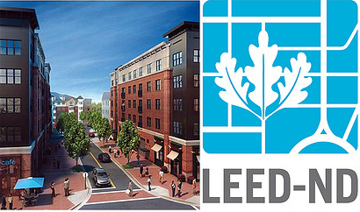
Credit – Housing and Jobs Proximity
Plan
Built Project
Intent
To encourage balanced communities with a proximate housing and employment opportunities.
Lori A. Brown, LEED AP ND – Power Jam Study! Lorisweb.com
67

Slide 68
Credit – Housing and Jobs Proximity
Plan
Built Project
Requirements
Option 1. Project with Affordable Residential Component (3 points)
Include a residential component equaling at least 30% of the project’s total building floor area (exclusive of parking structures), and locate or design the project such that its geographic center (or boundary if the project exceeds 500 acres [200 hectares]) is within a ½-mile walking distance of existing full-time equivalent jobs whose number equals or exceeds the number of dwelling units in the project.
Satisfy the requirements necessary to earn at least 1 point under NPD Credit Housing Types and Affordability, Option 2, Affordable Housing.
Lori A. Brown, LEED AP ND – Power Jam Study! Lorisweb.com
68

Slide 69
Credit – Housing and Jobs Proximity
Plan
Built Project
Requirements
Option 2. Project with Residential Component (2 points)
Include a residential component equaling at least 30% of the project’s total building floor area (exclusive of parking structures) and locate or design the project such that its geographic center (or boundary if the project exceeds 500 acres [200 hectares]) is within a ½-mile walking distance of existing full-time equivalent jobs whose number equals or exceeds the number of dwelling units in the project.
Lori A. Brown, LEED AP ND – Power Jam Study! Lorisweb.com
69

Slide 70
Credit – Housing and Jobs Proximity
Plan
Built Project
Requirements
Option 3. Infill Project with Nonresidential Component (1 point)
Include a nonresidential component equaling at least 30% of the project’s total building floor area (exclusive of parking structures) and locate on an infill site whose geographic center (or boundary if the project exceeds 500 acres [200 hectares]) is within a ½-mile walking distance of an existing rail transit, ferry, or tram stop and within a ½-mile walking distance of existing dwelling units whose number equals or exceeds 50% of the number of new full-time equivalent jobs located in the project.
Lori A. Brown, LEED AP ND – Power Jam Study! Lorisweb.com
70

Slide 71
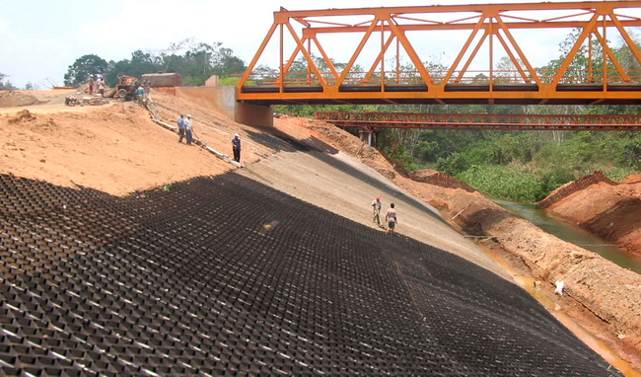
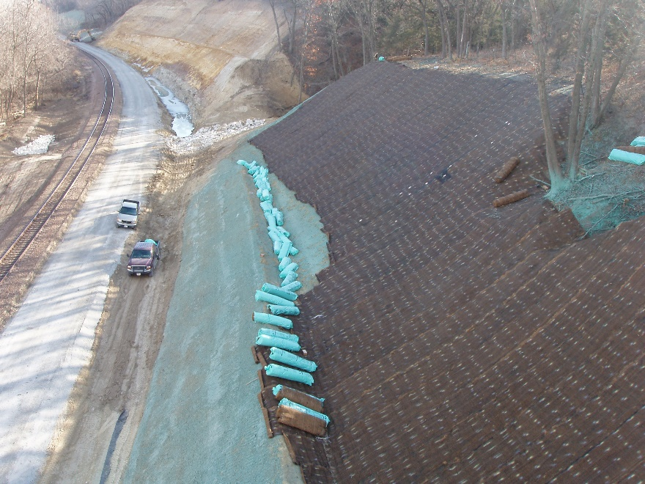
Credit – Steep Slope Protection
Plan
Built Project
Intent
To minimize erosion, protect habitat, and reduce stress on natural water systems by preserving steep slopes in a natural, vegetated state.
Lori A. Brown, LEED AP ND – Power Jam Study! Lorisweb.com
71

Slide 72
Credit – Steep Slope Protection
Plan
Built Project
Requirements
The following requirements apply to projects sites that have slopes greater than 15%.
Ensure that the share of the development footprint on existing slopes less than 15% is greater than the share of the project site with existing slopes greater than 15%.
On any existing, previously developed slopes steeper than 15%, restore the slope area with native plants or noninvasive adapted plants, according to Table 1.
In addition, on any existing, undeveloped slopes steeper than 15%, limit the development area according to Table 1.
Lori A. Brown, LEED AP ND – Power Jam Study! Lorisweb.com
72

Slide 73
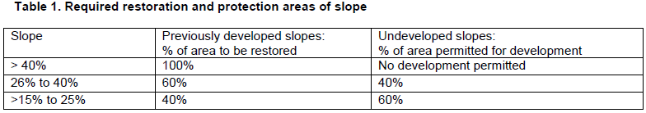
Credit – Steep Slope Protection
Plan
Built Project
For undeveloped slopes steeper than 40%, do not disturb portions of the project site within 50 feet horizontally of the top of the slope and 75 feet horizontally from the toe of the slope.
Develop covenants, conditions, and restrictions (CC&Rs), development agreements, or other binding documents that will protect all steep slopes in perpetuity.
Lori A. Brown, LEED AP ND – Power Jam Study! Lorisweb.com
73

Slide 74
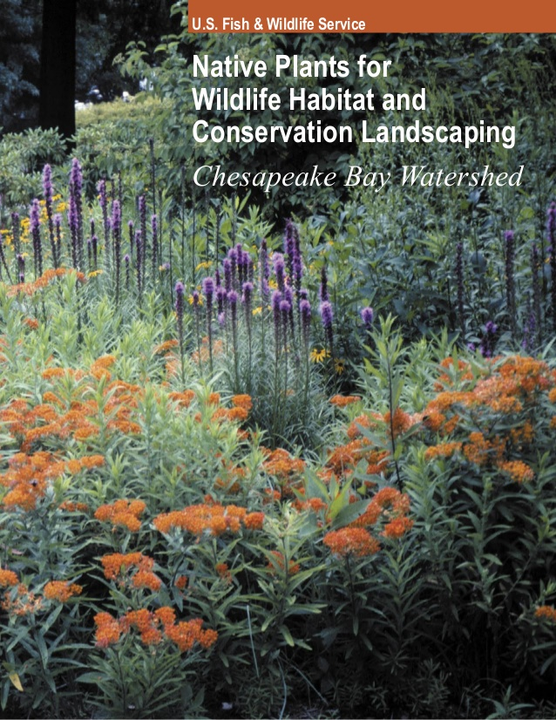
Credit – Site Design for Habitat or Wetland and Water Body Conservation
Plan
Built Project
Intent
To conserve native plants, wildlife habitat, wetlands, and water bodies.
Lori A. Brown, LEED AP ND – Power Jam Study! Lorisweb.com
74

Slide 75
Credit – Site Design for Habitat or Wetland and Water Body Conservation
Plan
Built Project
Requirements
Case 1. Sites without Significant Habitat or Wetlands and Water Bodies (1 point)
Locate the project on a site that does not have significant habitat, as defined in Case 2 of this credit, and is not within 100 feet of such habitat.
Fulfill the requirements of Option 1 or 2(a) under SLL Prerequisite Wetland and Water Body Conservation.
Lori A. Brown, LEED AP ND – Power Jam Study! Lorisweb.com
75

Slide 76
Credit – Site Design for Habitat or Wetland and Water Body Conservation
Plan
Built Project
Case 2. Sites with Habitat or Wetlands or Water Bodies (1 point)
Meet the requirements of Option 1 or Option 2.
Option 1. Sites with Significant Habitat
Work with both the state’s Natural Heritage Program and the state fish and wildlife agency (or local equivalent agency for projects outside the U.S.) to delineate identified significant habitat on the site. Do not disturb significant habitat or portions of the site within an appropriate buffer around the habitat.
The geographic extent of the habitat and buffer must be identified by a qualified biologist, a nongovernmental conservation organization, or the appropriate state, regional, or local agency.
Lori A. Brown, LEED AP ND – Power Jam Study! Lorisweb.com
76

Slide 77
Credit – Site Design for Habitat or Wetland and Water Body Conservation
Plan
Built Project
Protect significant habitat and its identified buffers from development by donating or selling the land, or a conservation easement on the land, to an accredited land trust, conservation organization, or relevant government agency (a deed covenant is not sufficient to meet this requirement) for the purpose of long-term conservation.
Lori A. Brown, LEED AP ND – Power Jam Study! Lorisweb.com
77

Slide 78
Credit – Site Design for Habitat or Wetland and Water Body Conservation
Plan
Built Project
Identify and commit to ongoing management activities, along with parties responsible for management and funding available, such that habitat is maintained in preproject condition or better for a minimum of three years after the project is built out.
The requirement for identifying ongoing management activities may also be met by earning SLL Credit Long-Term Conservation Management of Habitat or Wetlands and Water Bodies.
Lori A. Brown, LEED AP ND – Power Jam Study! Lorisweb.com
78

Slide 79
Credit – Site Design for Habitat or Wetland and Water Body Conservation
Plan
Built Project
Significant habitat for this credit is as follows:
Endangered species acts. Habitat for species that are listed or are candidates for listing under state or national endangered species acts, habitat for species of special concern in the state, and habitat for species or ecological communities classified as GH, G1, G2, G3, S1, or S2 by NatureServe;
Locally or regionally significant habitat. Locally or regionally significant habitat of any size, or patches of predominantly native vegetation at least 150 acres (60 hectares) (even if part of the area lies outside the project boundary); and
Habitat flagged for conservation. Habitat flagged for conservation under a regional or state conservation or green infrastructure plan.
OR
Lori A. Brown, LEED AP ND – Power Jam Study! Lorisweb.com
79

Slide 80
Credit – Site Design for Habitat or Wetland and Water Body Conservation
Plan
Built Project
Option 2. Sites with Wetlands and Water Bodies (1 point)
Design the project to conserve 100% of all water bodies, wetlands, land within 100 feet of water bodies, and land within 50 feet of wetlands on the site.
Using a qualified biologist, conduct an assessment, or compile existing assessments, showing the extent to which those water bodies or wetlands provide (1) water quality maintenance; (2) wildlife habitat; and (3) hydrologic function maintenance, including flood protection.
Lori A. Brown, LEED AP ND – Power Jam Study! Lorisweb.com
80

Slide 81
Credit – Site Design for Habitat or Wetland and Water Body Conservation
Plan
Built Project
Assign appropriate buffers, measuring not less than 100 feet for water bodies and 50 feet for wetlands, based on the functions provided, contiguous soils and slopes, and contiguous land uses.
Do not disturb wetlands, water bodies, or their buffers, and protect them from development by donating or selling the land, or a conservation easement on the land, to an accredited land trust, conservation organization, or relevant government agency (a deed covenant is not sufficient to meet this requirement) for the purpose of long-term conservation.
Lori A. Brown, LEED AP ND – Power Jam Study! Lorisweb.com
81

Slide 82
Credit – Site Design for Habitat or Wetland and Water Body Conservation
Plan
Built Project
Identify and commit to ongoing management activities, along with parties responsible for management and funding available, such that habitat is maintained in preproject condition or better for a minimum of three years after the project is built out.
The requirement for identifying ongoing management activities may also be met by earning SLL Credit Long-Term Conservation Management of Habitat or Wetlands and Water Bodies.
The project does not meet the requirements if it degrades habitat for species identified in endangered species acts or habitat flagged for conservation in Option 1.
Lori A. Brown, LEED AP ND – Power Jam Study! Lorisweb.com
82

Slide 83
Credit – Site Design for Habitat or Wetland and Water Body Conservation
Plan
Built Project
For All Projects
The following features are not considered wetlands, water bodies, or buffer land that must be protected:
previously developed land;
man-made water bodies (such as industrial mining pits, concrete-lined canals, or rainwater retention ponds) that lack natural edges and floors or native ecological communities in the water and along the edge;
man-made linear wetlands that result from the interruption of natural drainages by existing rights-of-way; and
wetlands that were created incidentally by human activity and have been rated “poor” or all measured wetland functions, as assessed by a qualified biologist using a method that is accepted by state or regional permitting agencies.
Lori A. Brown, LEED AP ND – Power Jam Study! Lorisweb.com
83

Slide 84
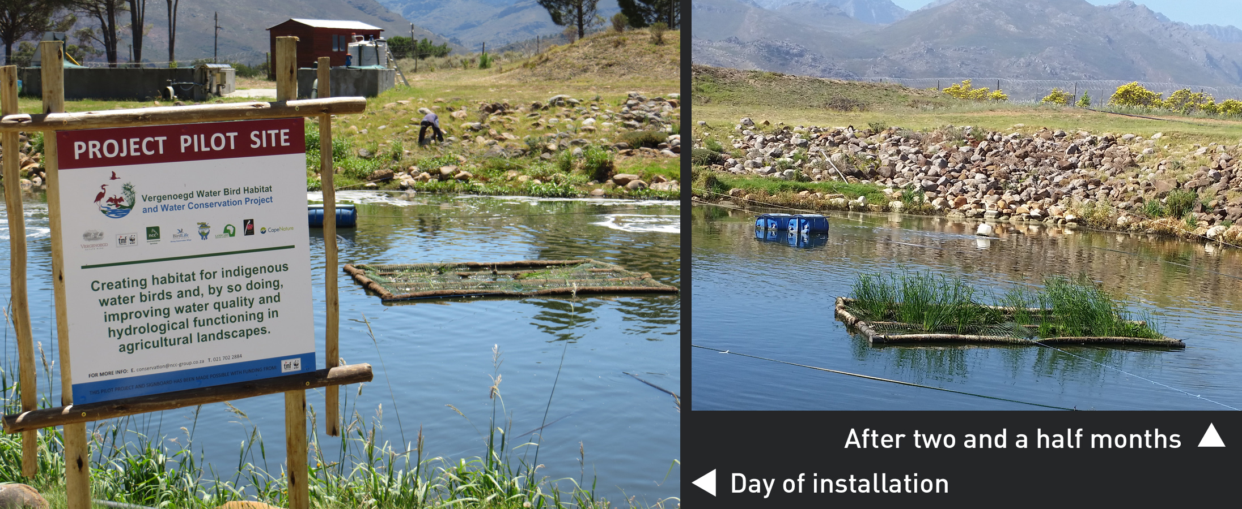
Credit – Restoration of Habitat or Wetlands and Water Bodies
Plan
Built Project
Intent
To restore native plants, wildlife habitat, wetlands, and water bodies harmed by previous human activities.
Lori A. Brown, LEED AP ND – Power Jam Study! Lorisweb.com
84

Slide 85
Credit – Restoration of Habitat or Wetlands and Water Bodies
Plan
Built Project
Requirements
Using only native plants, restore predevelopment native ecological communities, water bodies, or wetlands on the project site in an area equal to or greater than 10% of the development footprint.
Work with a qualified biologist to ensure that restored areas will have the native species assemblages, hydrology, and other habitat characteristics that likely occurred in predevelopment conditions.
Lori A. Brown, LEED AP ND – Power Jam Study! Lorisweb.com
85

Slide 86
Credit – Restoration of Habitat or Wetlands and Water Bodies
Plan
Built Project
Protect such areas from development by donating or selling the land, or a conservation easement on the land, to an accredited land trust, conservation organization or relevant government agency (a deed covenant is not sufficient to meet this requirement) for the purpose of long-term conservation.
Lori A. Brown, LEED AP ND – Power Jam Study! Lorisweb.com
86

Slide 87
Credit – Restoration of Habitat or Wetlands and Water Bodies
Plan
Built Project
Identify and commit to ongoing management activities, along with parties responsible for management and funding available, so that restored areas are maintained for a minimum of three years after the project is built out or the restoration is completed, whichever is later.
The requirement for identifying ongoing management activities may also be met by earning SLL Credit Long-Term Conservation Management of Habitat or Wetlands and Water Bodies.
The project does not meet the requirements if it has negative effects on habitat for species identified in endangered species acts or habitat flagged for conservation in Option 1 of SLL Credit Site Design for Habitat or Wetland and Water Body Conservation.
Lori A. Brown, LEED AP ND – Power Jam Study! Lorisweb.com
87

Slide 88
Credit – Restoration of Habitat or Wetlands and Water Bodies
Plan
Built Project
Requirements
Using only native plants, restore predevelopment native ecological communities, water bodies, or wetlands on the project site in an area equal to or greater than 10% of the development footprint.
Work with a qualified biologist to ensure that restored areas will have the native species assemblages, hydrology, and other habitat characteristics that likely occurred in predevelopment conditions. Protect such areas from development by donating or selling the land, or a conservation easement on the land, to an accredited land trust, conservation organization or relevant government agency (a deed covenant is not sufficient to meet this requirement) for the purpose of long-term conservation.
Identify and commit to ongoing management activities, along with parties responsible for management and funding available, so that restored areas are maintained for a minimum of three years after the project is built out or the restoration is completed, whichever is later. The requirement for identifying ongoing management activities may also be met by earning SLL Credit Long-Term Conservation Management of Habitat or Wetlands and Water Bodies.
The project does not meet the requirements if it has negative effects on habitat for species identified in endangered species acts or habitat flagged for conservation in Option 1 of SLL Credit Site Design for Habitat or Wetland and Water Body Conservation.
Lori A. Brown, LEED AP ND – Power Jam Study! Lorisweb.com
88

Slide 89
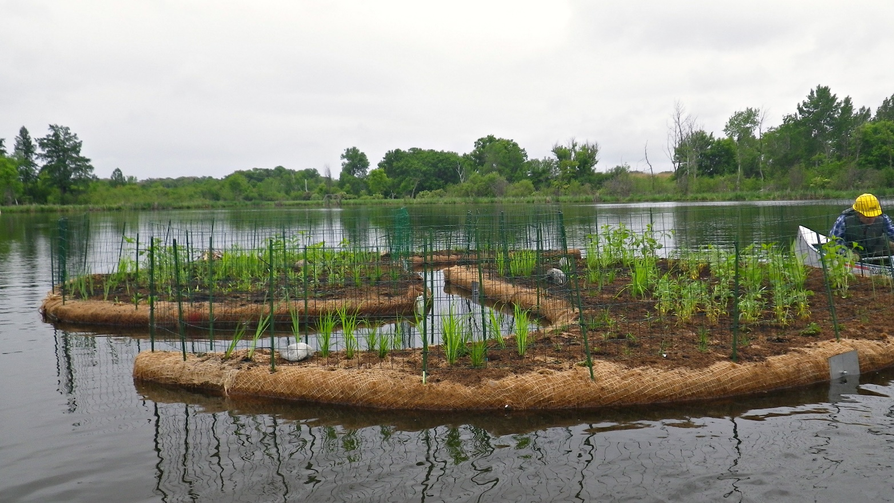
Credit – Long-Term Conservation Management of Habitat or Wetlands and Water Bodies
Plan
Built Project
Intent
To conserve native plants, wildlife habitat, wetlands, and water bodies.
Lori A. Brown, LEED AP ND – Power Jam Study! Lorisweb.com
89

Slide 90
Credit – Long-Term Conservation Management of Habitat or Wetlands and Water Bodies
Plan
Built Project
Requirements
Create and commit to implementing a long-term (at least 10-year) management plan for existing or recently restored on-site native habitats, water bodies, or wetlands and their buffers, and create a guaranteed funding source for management.
Involve a qualified biologist or a professional from a natural resources agency or natural resources consulting firm in writing the management plan and conducting or evaluating the ongoing management.
Lori A. Brown, LEED AP ND – Power Jam Study! Lorisweb.com
90

Slide 91
Credit – Long-Term Conservation Management of Habitat or Wetlands and Water Bodies
Plan
Built Project
The plan must include biological objectives consistent with habitat or water resource conservation, and it must identify the following:
procedures and personnel for maintaining the conservation areas;
estimated implementation costs and funding sources; and
any threats that the project poses for habitat or water resources within conservation areas (e.g., introduction of exotic species, intrusion of residents in habitat areas) and measures to substantially reduce those threats.
The project does not meet the requirements if it has negative effects on habitat for species identified in endangered species acts or habitat flagged for conservation in Option 1 of SLL Credit Site Design for Habitat or Wetland and Water Body Conservation.
Lori A. Brown, LEED AP ND – Power Jam Study! Lorisweb.com
91

Slide 92



