Slide 1

Fundamentals of LEED v4 for
Neighborhood Development
Exam Preparation
Lori A. Brown, LEED AP BD+C – Power Jam Study! Lorisweb.com
1

Slide 2
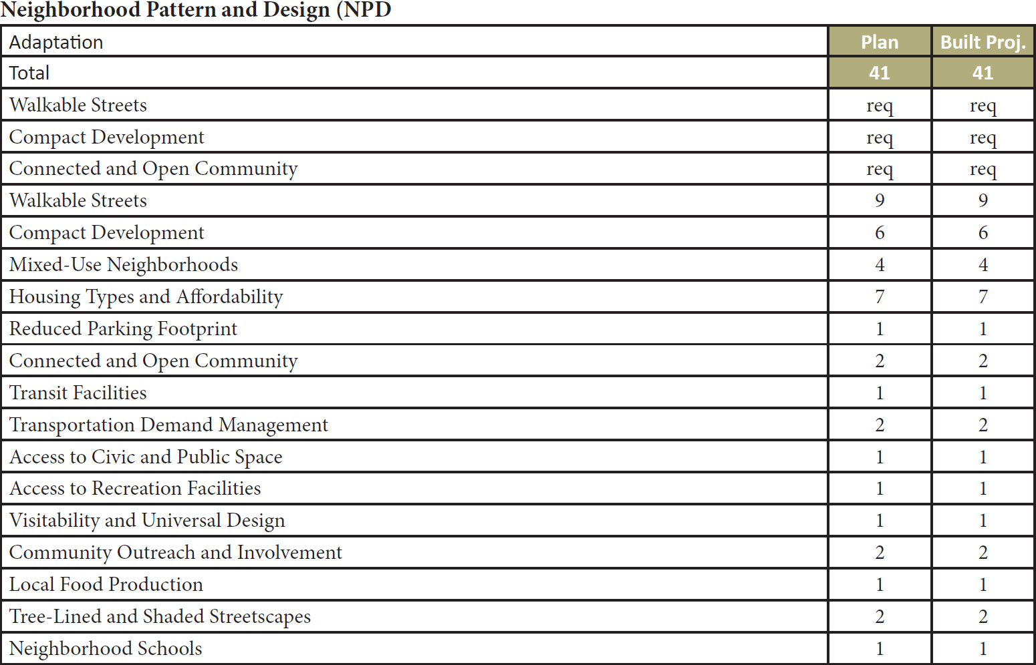
Lori A. Brown, LEED AP BD+C – Power Jam Study! Lorisweb.com
2

Slide 3

Lori A. Brown, LEED AP BD+C – Power Jam Study! Lorisweb.com
3

Slide 4

Prerequisite – Walkable Streets
Plan
Built Project
Intent
To promote transportation efficiency and reduce vehicle distance traveled. To improve public health by providing safe, appealing, and comfortable street environments that encourage daily physical activity and avoid pedestrian injuries.
Lori A. Brown, LEED AP ND – Power Jam Study! Lorisweb.com
4

Slide 5
Prerequisite – Walkable Streets
Plan
Built Project
Requirements
Design and build the project to achieve all of the following:
90% of new buildings have a functional entry onto the circulation network or other public space, such as a park or plaza, but not a parking lot. Whether opening to the circulation network or other public space, the functional entry must be connected to a sidewalk or equivalent provision for walking. If the public space is a square, park, or plaza, it must be at least 50 feet deep, measured at a point perpendicular to each entry.
Lori A. Brown, LEED AP ND – Power Jam Study! Lorisweb.com
5

Slide 6
Prerequisite – Walkable Streets
Plan
Built Project
At least 15% of the block length of the existing and new circulation networks within and bordering the project has a minimum building-height-to-street-centerline ratio of 1:1.5 (i.e., a minimum of 1 foot of building height for every 1.5 feet of width from street centerline to building façade). Alleys may be omitted from the calculations.
Projects that border a part of the circulation network must meet only their proportional share of the height-to-width ratio (i.e., only on the project side of the circulation network).
Building height is measured to eaves or, for a flat-roof structure, to the rooftop. For buildings with multiple heights or widths, use average heights or widths weighted by each portion’s share of the total height or width.
Lori A. Brown, LEED AP ND – Power Jam Study! Lorisweb.com
6

Slide 7
Prerequisite – Walkable Streets
Plan
Built Project
Continuous sidewalks or equivalent all-weather routes for walking are provided along both sides of 90% of the circulation network block length within the project, including the project side of circulation network bordering the project. Bicycle- and pedestrian-only paths meet this requirement. New sidewalks must be at least 8 feet wide on retail or mixed-use blocks and at least 4 feet wide on all other blocks.
Lori A. Brown, LEED AP ND – Power Jam Study! Lorisweb.com
7

Slide 8
Prerequisite – Walkable Streets
Plan
Built Project
No more than 20% of the block length of the circulation network within the project is faced directly by garage and service bay openings. Alleys may be omitted from the calculations.
Lori A. Brown, LEED AP ND – Power Jam Study! Lorisweb.com
8

Slide 9
Prerequisite – Walkable Streets
Plan
Built Project
Portions of projects containing historic buildings or contributing buildings in a designated historic district subject to review by a local historic preservation entity are exempt from (b), (c), and (d) if approval for compliance is not granted.
Portions of projects containing historic buildings or contributing buildings in historic districts listed in or eligible for listing in a state provincial, or regional register, or the National Register of Historic Places that are subject to review by a state historic preservation office or the National Park Service are exempt from (b), (c), and (d) if approval for compliance is not granted.
Lori A. Brown, LEED AP ND – Power Jam Study! Lorisweb.com
9

Slide 10
Prerequisite – Compact Development
Plan
Built Project
Intent
To conserve land. To promote livability, walkability, and transportation efficiency and reduce vehicle distance traveled. To leverage and support transit investments. To improve public health by encouraging daily physical activity.
Lori A. Brown, LEED AP ND – Power Jam Study! Lorisweb.com
10

Slide 11
Prerequisite – Compact Development
Plan
Built Project
Requirements
Design and build the project to meet the densities specified below.
Minimum densities must be met for both (1) the entire project at full build-out and (2) the portion of the project that will be built within five years of the date that the first new building of any type is occupied.
Lori A. Brown, LEED AP ND – Power Jam Study! Lorisweb.com
11

Slide 12
Prerequisite – Compact Development
Plan
Built Project
Case 1. Projects with Access to Quality Transit
For projects with existing or planned transit service (i.e., service with the funding commitments as specified in SLL Prerequisite Smart Location) that meets or exceeds the 2-point threshold in SLL Credit Access to Quality Transit, build at the following densities, based on the walking distances to the transit service specified in that SLL credit:
for residential components located within the walking distances: 12 or more dwelling units per acre (30 DU per hectare) of buildable land available for residential uses;
for residential components falling outside the walking distances: 7 or more dwelling units per acre (17.5 DU per hectare) of buildable land available for residential uses;
for nonresidential components located within the walking distances: 0.80 or higher floor-area ratio (FAR) for the buildable land available for nonresidential uses; and
for nonresidential components falling outside the walking distances: 0.50 or higher FAR for the buildable land available for nonresidential uses.
If the project location is served by a transit agency whose guidelines for minimum service densities are greater than the densities required by this prerequisite, the project must achieve those service densities instead.
Lori A. Brown, LEED AP ND – Power Jam Study! Lorisweb.com
12

Slide 13
Prerequisite – Compact Development
Plan
Built Project
Case 2. All Other Projects
Build any residential components of the project at a density of 7 or more dwelling units per acre (17.5 DU per hectare) of buildable land available for residential uses.
Build any nonresidential components of the project at a density of 0.50 or higher FAR for the buildable land available for nonresidential uses.
Lori A. Brown, LEED AP ND – Power Jam Study! Lorisweb.com
13

Slide 14
Prerequisite – Compact Development
Plan
Built Project
For All Projects
Density calculations include all planned and existing buildings within the project boundary, excluding those portions of parking structures devoted exclusively to parking.
If the residential component of the project meets the minimum density requirement but the nonresidential component does not, or vice versa, include only the qualifying density.
Use that component’s dwelling units or nonresidential floor area in the numerator and the total buildable land area in the denominator.
If the resulting density meets the minimum requirement, the prerequisite is achieved.
Lori A. Brown, LEED AP ND – Power Jam Study! Lorisweb.com
14

Slide 15
Prerequisite – Connected and Open Community
Plan
Built Project
Intent
To promote projects that have high levels of internal connectivity and are well connected to the community. To encourage development within existing communities that promote transportation efficiency through multimodal transportation. To improve public health by encouraging daily physical activity.
Lori A. Brown, LEED AP ND – Power Jam Study! Lorisweb.com
15

Slide 16
Prerequisite – Connected and Open Community
Plan
Built Project
Requirements
Meet the requirements of Case 1 if the project has no circulation network intersections within the project boundary and is five acres or less in size.
All other projects must meet Case 2.
Lori A. Brown, LEED AP ND – Power Jam Study! Lorisweb.com
16

Slide 17
Prerequisite – Connected and Open Community
Plan
Built Project
Case 1. Surrounding Connectivity
Locate the project such that the connectivity within ¼ mile of the project boundary is at least 90 intersections per square mile.
Any part of the circulation network that is counted toward the connectivity requirement must be available for general public use and not gated.
Gated areas are not considered available for public use, with the exception of education and health care campuses and military bases where gates are used for security purposes.
Additionally, any circulation network within the project must be available for general public use and not gated.
Lori A. Brown, LEED AP ND – Power Jam Study! Lorisweb.com
17

Slide 18
Prerequisite – Connected and Open Community
Plan
Built Project
Case 2. Internal Connectivity
Design and build the project such that its internal connectivity is at least 140 intersections per square mile.
Any part of the circulation network counted toward the connectivity requirement must be available for general public use at all times and not gated.
Additionally, no more than 10% of the project area may be accessed via circulation network that is gated.
Lori A. Brown, LEED AP ND – Power Jam Study! Lorisweb.com
18

Slide 19
Prerequisite – Connected and Open Community
Plan
Built Project
Education campuses, health care campuses, and military bases where gates are used for security purposes are exempt from the 10% limit, and intersections within those projects may be counted toward the connectivity requirement.
Design and build the project with at least one through-connection (of the circulation network) intersecting or terminating at the project boundary at least every 800 feet, or at existing abutting intervals and intersections of the circulation network, whichever is the shorter distance.
Lori A. Brown, LEED AP ND – Power Jam Study! Lorisweb.com
19

Slide 20
Prerequisite – Connected and Open Community
Plan
Built Project
These requirements do not apply to portions of the boundary where connections cannot be made because of physical obstacles, such as prior platting of property, construction of existing buildings or other barriers, slopes steeper than 15%, wetlands and water bodies, railroad and utility rights-of-way, existing limited-access motor vehicle rights-of-way, and parks and dedicated open space.
Lori A. Brown, LEED AP ND – Power Jam Study! Lorisweb.com
20

Slide 21
Credit – Walkable Streets
Plan
Built Project
Intent
To promote transportation efficiency and reduce vehicle distance traveled. To improve public health by providing safe, appealing, and comfortable street environments that encourage daily physical activity and avoid pedestrian injuries.
Lori A. Brown, LEED AP ND – Power Jam Study! Lorisweb.com
21

Slide 22
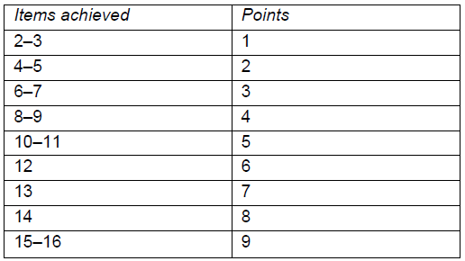
Credit – Walkable Streets
Plan
Built Project
Requirements
A project may earn a maximum of 9 points, awarded according to Table 1.
Lori A. Brown, LEED AP ND – Power Jam Study! Lorisweb.com
22

Slide 23
Credit – Walkable Streets
Plan
Built Project
Façades and Entries
At least 80% of the total linear distance of building façades facing the circulation network in the project is no more than 25 feet from the property line.
At least 50% of the total linear distance of building façades facing the circulation network in the project is no more than 18 feet from the property line.
At least 50% of the total linear distance of mixed-use and nonresidential building façades facing the circulation network in the project is within 1 foot of a sidewalk or equivalent walking route.
Functional entries to the building occur at an average of 75 feet or less along nonresidential or mixed-use buildings or blocks.
Functional entries to the building occur at an average of 30 feet or less along nonresidential or mixed-use buildings or blocks
Items (d) and (e) are cumulative.
Lori A. Brown, LEED AP ND – Power Jam Study! Lorisweb.com
23

Slide 24
Credit – Walkable Streets
Plan
Built Project
Ground-Level Use and Parking
All ground-level retail, service, and trade uses that face a public space have clear glass on at least 60% of their façades between 3 and 8 feet above grade.
If a façade extends along a sidewalk, no more than 40% of its length or 50 feet, whichever is less, is blank (without doors or windows).
Any ground-level retail, service, or trade windows facing the circulation network must be kept visible (unshuttered) at night; this must be stipulated in covenants, conditions, and restrictions (CC&Rs) or other binding documents .
Lori A. Brown, LEED AP ND – Power Jam Study! Lorisweb.com
24

Slide 25
Credit – Walkable Streets
Plan
Built Project
On-street parking is provided on at least 70% of both sides of the block length of all new and existing motorized portions of the circulation network, including the project side of bordering circulation network. The percentage of on-street parking is calculated by dividing the length of street designated for parking by the total length of the curb along each street, including curb cuts, driveways, and intersection radii. Space within the parking lane that is occupied by corner bulb-outs (within 24 feet of an intersection), transit stops, and motorcycle or bicycle parking may be counted as designated for parking in this calculation. Alleys may be exempted.
Lori A. Brown, LEED AP ND – Power Jam Study! Lorisweb.com
25

Slide 26
Credit – Walkable Streets
Plan
Built Project
Continuous sidewalks or equivalent provisions for walking are available along both sides of the entire circulation network within the project, including the project side of the circulation network bordering the project. Bicycle- and pedestrian-only paths meet this requirement. New sidewalks must be at least 10 feet wide on retail or mixed-use blocks and at least 5 feet wide on all other blocks. Note that these requirements specify wider sidewalks than required by NPD Prerequisite Walkable Streets. Alleys may be exempted.
If the project has ground-floor dwelling units, the principal level of at least 50% of those units has an elevated finished floor at least 24 inches above the sidewalk grade. Below-grade basement spaces and/or accessory dwelling units are exempt from this requirement.
Lori A. Brown, LEED AP ND – Power Jam Study! Lorisweb.com
26

Slide 27
Credit – Walkable Streets
Plan
Built Project
In nonresidential or mixed-use projects, 50% or more of the total number of office buildings includes ground-floor retail along 60% of the length of the street-level façade; 100% of mixed-use buildings include ground-floor retail, live-work spaces, or ground-floor dwelling units along at least 60% of the street-level façade; and all businesses or community services on the ground floor are accessible directly from sidewalks along the circulation network or other public space, such as a square, park, or plaza, but not a parking lot.
Lori A. Brown, LEED AP ND – Power Jam Study! Lorisweb.com
27

Slide 28
Credit – Walkable Streets
Plan
Built Project
At least 40% of the block length of the circulation network within the project has a minimum building-height-to-street-centerline ratio of 1:1.5 (i.e., at least 1 foot (30 centimeters) of building height for every 1.5 feet (45 centimeters) of width from circulation network centerline to building façade). Alleys may be exempted.
Projects that border a part of the circulation network must meet only their proportional share of the height-to-centerline ratio (i.e., only on the project side of the circulation network).
Building height is measured to eaves or, for a flat-roof structure, to the rooftop, and width is measured façade to centerline. For buildings with multiple heights or widths, use average heights or widths weighted by each portion’s share of the total height or width.
Lori A. Brown, LEED AP ND – Power Jam Study! Lorisweb.com
28

Slide 29
Credit – Walkable Streets
Plan
Built Project
Design Speeds for Safe Pedestrian and Bicycle Travel
75% of the length of new residential-only motorized parts of the circulation network within the project is designed for a target speed of no more than 20 mph.
70% of the length of new nonresidential or mixed-use motorized parts of the circulation network within the project is designed for a target speed of no more than 25 mph. A multiway boulevard, with travel lanes separated from access lanes by medians, may apply this requirement to its outer access lanes only (through-lanes are exempt), provided pedestrian crosswalks are installed across the boulevard at intervals no greater than 800 feet.
Lori A. Brown, LEED AP ND – Power Jam Study! Lorisweb.com
29

Slide 30
Credit – Walkable Streets
Plan
Built Project
Sidewalk Intrusions
At-grade crossings with driveways account for no more than 10% of the length of sidewalks within the project.
Lori A. Brown, LEED AP ND – Power Jam Study! Lorisweb.com
30

Slide 31
Credit – Compact Development
Plan
Built Project
Intent
To conserve land and protect farmland and wildlife habitat by encouraging development in areas with existing infrastructure. To promote livability, walkability, and transportation efficiency, and reduce vehicle distance traveled. To improve public health by encouraging daily physical activity.
Lori A. Brown, LEED AP ND – Power Jam Study! Lorisweb.com
31

Slide 32
Credit – Compact Development
Plan
Built Project
Requirements
Design and build the project such that residential and nonresidential components achieve the densities per acre (per hectare) of buildable land listed in Table 1 at build-out or within five years of the date that the first new building of any type is occupied (excluding those portions of parking structures devoted to parking), whichever is lower.
Lori A. Brown, LEED AP ND – Power Jam Study! Lorisweb.com
32

Slide 33
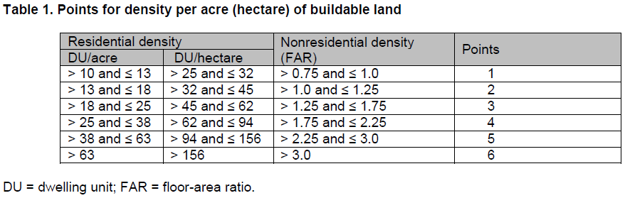
Credit – Compact Development
Plan
Built Project
Lori A. Brown, LEED AP ND – Power Jam Study! Lorisweb.com
33

Slide 34
Credit – Compact Development
Plan
Built Project
The scoring of a mixed-use project is calculated with a weighted average, according to the following steps.
Determine the total floor area of all residential and nonresidential uses.
Calculate the percentage residential and percentage nonresidential of the total floor area.
Determine the density of each component as measured in dwelling units per acre or hectare and floor-area ratio, respectively.
Referring to Table 1, find the appropriate points for the densities of the residential and nonresidential components.
If the points are different, multiply the point value of the residential component by its percentage of the total floor area and multiply the point value of the nonresidential component by its percentage.
Add the two scores.
Lori A. Brown, LEED AP ND – Power Jam Study! Lorisweb.com
34

Slide 35
Credit – Mixed-Use Neighborhoods
Plan
Built Project
Intent
To reduce vehicle distance traveled and automobile dependence, encourage daily walking, biking, and transit use, and support car-free living by providing access to diverse land uses.
Lori A. Brown, LEED AP ND – Power Jam Study! Lorisweb.com
35

Slide 36
Credit – Mixed-Use Neighborhoods
Plan
Built Project
Requirements
Locate or design the project such that 50% of its dwelling units are within a 1/4-mile walking distance of the number of uses (see Appendix 1) listed in Table 1.
For projects with no dwelling units, 50% of dwelling units within a 1/4-mile walking distance of the project boundary must be within a 1/4-mile walking distance of the number of uses within the project specified in Table 1.
The specified number of uses must be in place by the time of 50% occupancy of total building floor area (exclusive of portions of parking structures devoted to parking).
Lori A. Brown, LEED AP ND – Power Jam Study! Lorisweb.com
36

Slide 37
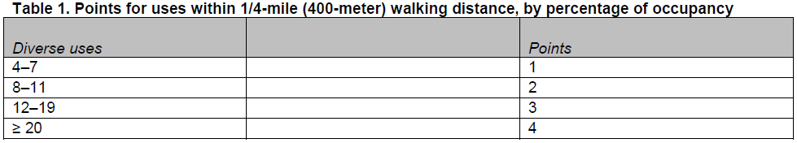
Credit – Mixed-Use Neighborhoods
Plan
Built Project
The following restrictions apply.
A use may be counted as only one use type (e.g., a retail store may be counted only once even if it sells products in several categories).
No more than two uses in each use type may be counted (e.g., if five restaurants are within the required distance, only two may be counted).
The uses accessible to each counted dwelling unit must represent at least two categories.
Lori A. Brown, LEED AP ND – Power Jam Study! Lorisweb.com
37

Slide 38
Credit – Mixed-Use Neighborhoods
Plan
Built Project
For projects with regional-serving retail of 150,000 or more SF only
Additionally, a project that has at least one large retail use (defined as a use totaling 75,000 or more square feet), must also meet at least the 2-point threshold for transit service under SLL Credit Access to Quality Transit.
In this case, planned transit service can be counted.
Each large retail use must be served by at least one transit stop providing trips that qualify under that SLL Credit.
Lori A. Brown, LEED AP ND – Power Jam Study! Lorisweb.com
38

Slide 39
Credit – Mixed-Use Neighborhoods
Plan
Built Project
If transit service is planned but not yet operational, the project must demonstrate one of the following:
The relevant transit agency has a signed full-funding grant agreement with the Federal Transit Administration that includes a revenue operations date for the start of transit service. The revenue operations date must be no later than the day by which 50% of the project’s total building floor area will be occupied.
For bus, streetcar, bus rapid transit, or ferry service, the transit agency must certify that it has an approved budget that includes specifically allocated funds sufficient to provide the planned service at the levels listed above and that service at these levels will begin no later than the day by which 50% of the project’s total building floor area will be occupied.
Lori A. Brown, LEED AP ND – Power Jam Study! Lorisweb.com
39

Slide 40
Credit – Mixed-Use Neighborhoods
Plan
Built Project
For rail service other than streetcars, the transit agency must certify that preliminary engineering for a rail line has begun. In addition, the service must meet either of these two requirements:
A state legislature or local subdivision of the state has authorized the transit agency to expend funds to establish rail transit service that will begin no later than the date by which 50% of the project’s total building floor area will be occupied.
OR
A local government has dedicated funding or reimbursement commitments from future tax revenue for the development of stations, platforms, or other rail transit infrastructure that will serve the project no later than the date by which 50% of the project’s total building floor area will be occupied.
Lori A. Brown, LEED AP ND – Power Jam Study! Lorisweb.com
40

Slide 41
Credit – Housing Types and Affordability
Plan
Built Project
Intent
To promote socially equitable and engaging neighborhoods by enabling residents from a wide range of economic levels, household sizes, and age groups to live in a community.
Lori A. Brown, LEED AP ND – Power Jam Study! Lorisweb.com
41

Slide 42
Credit – Housing Types and Affordability
Plan
Built Project
Requirements
Meet the requirements of one or more of the following options.
Option 1. Diversity of Housing Types (1–3 points)
Include a sufficient variety of housing sizes and types in the project such that the total variety of planned and existing housing within the project achieves a Simpson Diversity Index score greater than 0.5, using the housing categories below.
Projects of less than 125 acres (50.5 hectares) may calculate the Simpson Diversity Index for the area within ¼ mile of the project’s geographic center.
Lori A. Brown, LEED AP ND – Power Jam Study! Lorisweb.com
42

Slide 43
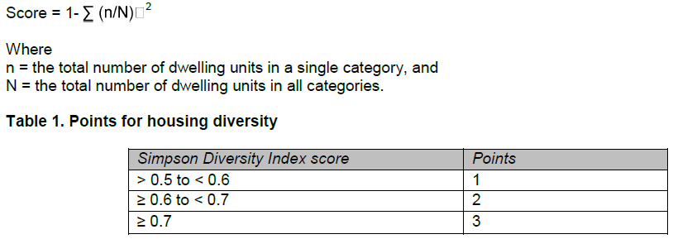
Credit – Housing Types and Affordability
Plan
Built Project
The Simpson Diversity Index calculates the probability that any two randomly selected dwelling units in a project will be of a different type.
Lori A. Brown, LEED AP ND – Power Jam Study! Lorisweb.com
43

Slide 44
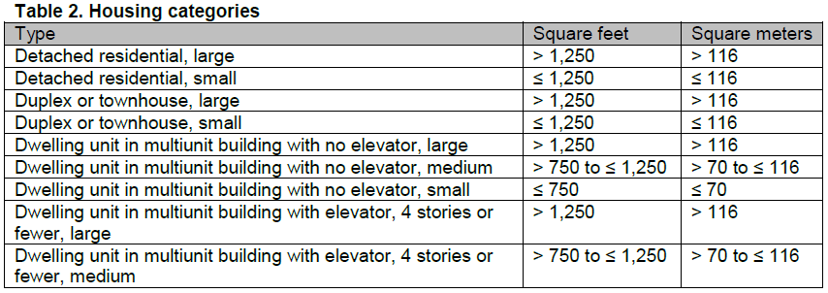
Credit – Housing Types and Affordability
Plan
Built Project
Housing categories are defined by the dwelling unit’s net floor area, exclusive of any garage, as listed in Table 2.
Lori A. Brown, LEED AP ND – Power Jam Study! Lorisweb.com
44

Slide 45
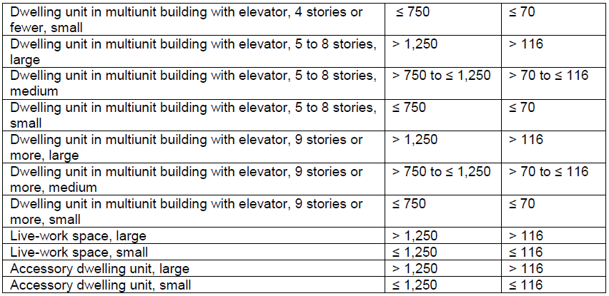
Credit – Housing Types and Affordability
Plan
Built Project
Lori A. Brown, LEED AP ND – Power Jam Study! Lorisweb.com
45

Slide 46
Credit – Housing Types and Affordability
Plan
Built Project
For the purposes of this credit, townhouse and live-work units may have individual ground-level entrances or be within a multiunit or mixed-use building.
Double counting is prohibited; each dwelling may be classified in only one category.
The number of stories in a building is inclusive of the ground floor regardless of its use.
AND/OR
Lori A. Brown, LEED AP ND – Power Jam Study! Lorisweb.com
46

Slide 47
Credit – Housing Types and Affordability
Plan
Built Project
Option 2. Affordable Housing (1–3 points)
Include a proportion of new rental and/or for-sale dwelling units priced for households earning less than the area median income (AMI). Rental units must be maintained at affordable levels for a minimum of 15 years. Existing dwelling units are exempt from requirement calculations. Meet any combination of thresholds in Table 3, up to a maximum of 3 points.
Lori A. Brown, LEED AP ND – Power Jam Study! Lorisweb.com
47

Slide 48
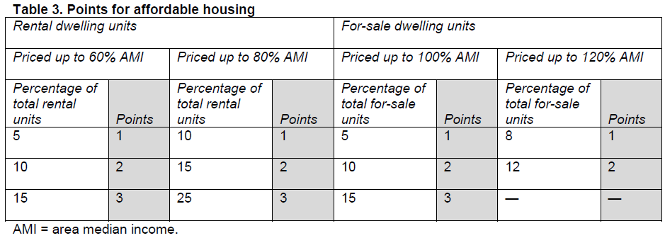
Credit – Housing Types and Affordability
Plan
Built Project
AND/OR
Lori A. Brown, LEED AP ND – Power Jam Study! Lorisweb.com
48

Slide 49
Credit – Housing Types and Affordability
Plan
Built Project
Option 3. Housing Types and Affordable Housing (1 point)
A project may earn an additional point by earning at least 2 points in Option 1 and at least 2 points in Option 2 (at least one of which must be for providing housing at or below 100% AMI).
Lori A. Brown, LEED AP ND – Power Jam Study! Lorisweb.com
49

Slide 50
Credit – Reduced Parking Footprint
Plan
Built Project
Intent
To minimize the environmental harms associated with parking facilities, including automobile dependence, land consumption, and rainwater runoff.
Lori A. Brown, LEED AP ND – Power Jam Study! Lorisweb.com
50

Slide 51
Credit – Reduced Parking Footprint
Plan
Built Project
Requirements
For new nonresidential buildings and multiunit residential buildings, either do not build new off-street parking lots, or locate all new off-street surface parking lots at the side or rear, leaving building frontages facing the circulation network free of surface parking lots (alleys may be exempted).
Lori A. Brown, LEED AP ND – Power Jam Study! Lorisweb.com
51

Slide 52
Credit – Reduced Parking Footprint
Plan
Built Project
Use no more than 20% of the total development footprint area for all new off-street surface parking facilities, with no individual surface parking lot larger than 2 acres (0.8 hectare).
For the purposes of this credit, surface parking facilities include ground-level garages unless they are under habitable building space.
Underground or multistory parking facilities can be used to provide additional spaces.
On-street parking spaces are exempt from this limitation.
Lori A. Brown, LEED AP ND – Power Jam Study! Lorisweb.com
52

Slide 53
Credit – Reduced Parking Footprint
Plan
Built Project
Provide preferred parking for carpool or shared-use vehicle parking spaces equivalent to at least 10% of the total off-street parking spaces for each nonresidential and mixed-use building on the site.
Such parking spaces must be marked and within 200 feet walking distance of entrances to the building served.
Lori A. Brown, LEED AP ND – Power Jam Study! Lorisweb.com
53

Slide 54
Credit – Connected and Open Community
Plan
Built Project
Intent
To conserve land and promote multimodal transportation by encouraging development within existing communities that have high levels of internal connectivity and are well connected to the larger community. To improve public health by encouraging daily physical activity and reducing motor vehicle emissions.
Lori A. Brown, LEED AP ND – Power Jam Study! Lorisweb.com
54

Slide 55
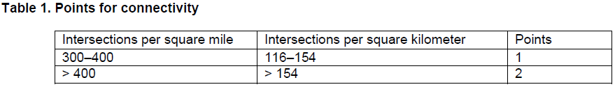
Credit – Connected and Open Community
Plan
Built Project
Requirements
Locate or design the project such that its internal connectivity falls within one of the ranges listed in Table 1. If the project has no internal circulation network, the connectivity within a ¼-mile distance of the project boundary must be used.
Lori A. Brown, LEED AP ND – Power Jam Study! Lorisweb.com
55

Slide 56
Credit – Connected and Open Community
Plan
Built Project
All parts of the circulation network that are counted toward the connectivity requirement must be available for general public use at all times and not gated.
No more than 10% of the project area may be accessed via circulation network that is gated. Education campuses, health care campuses, and military bases where gates are used for security purposes are exempt from the 10% limit, and intersections within those projects may be counted toward the connectivity requirement.
AND
Lori A. Brown, LEED AP ND – Power Jam Study! Lorisweb.com
56

Slide 57
Credit – Connected and Open Community
Plan
Built Project
Design or locate the project such that a through-connection (of the circulation network) intersects or terminates at the project boundary at least every 400 feet or at existing abutting intervals and intersections of the circulation network, whichever is the shorter distance.
Include a pedestrian or bicycle through-connection in at least 90% of any new culs-de-sac. These requirements do not apply to portions of the boundary where connections cannot be made because of physical obstacles, such as prior platting of property, construction of existing buildings or other barriers, slopes steeper than 15%, wetlands and water bodies, railroad and utility rights-of-way, existing limited-access motor vehicle rights-of-way, and parks and dedicated open space.
Lori A. Brown, LEED AP ND – Power Jam Study! Lorisweb.com
57

Slide 58
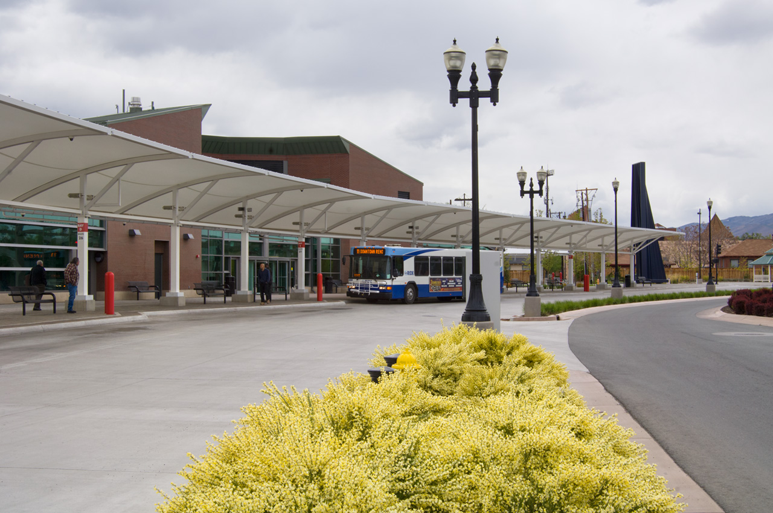
Credit – Transit Facilities
Plan
Built Project
Intent
To encourage transit use and reduce vehicle distance traveled by providing safe, convenient, and comfortable transit waiting areas.
Lori A. Brown, LEED AP ND – Power Jam Study! Lorisweb.com
58

Slide 59
Credit – Transit Facilities
Plan
Built Project
Requirements
Work with the transit agency or agencies serving the project to inventory existing transit stops and new transit stops within the project boundary that will be warranted within two years of project completion (because of either increased ridership on existing service or planned transit).
Lori A. Brown, LEED AP ND – Power Jam Study! Lorisweb.com
59

Slide 60
Credit – Transit Facilities
Plan
Built Project
At those locations,
Confirm that transit facilities will be funded by either the transit agency or the project developer.
Install transit agency-approved shelters and any other required improvements at existing stops. Reserve space for transit facilities or install transit facilities at new stops.
Shelters must be covered, be at least partially enclosed to buffer wind and rain, have seating and illumination, and have signage that display transit schedules and route information.
Lori A. Brown, LEED AP ND – Power Jam Study! Lorisweb.com
60

Slide 61
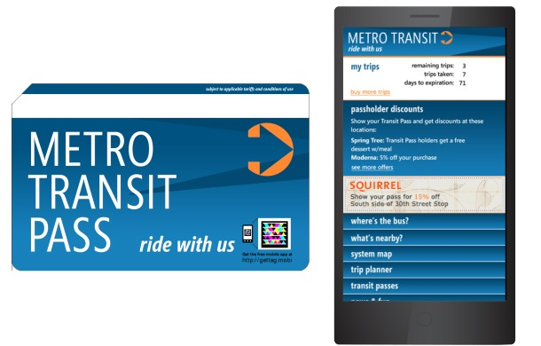
Credit – Transportation Demand Management
Plan
Built Project
Intent
To reduce energy consumption, pollution, and harm to human health from motor vehicles by encouraging multimodal travel.
Lori A. Brown, LEED AP ND – Power Jam Study! Lorisweb.com
61

Slide 62
Credit – Transportation Demand Management
Plan
Built Project
Requirements
Achieve at least two of the following options.
Earn 1 point for every two options, for a maximum of 2 points. For the purposes of this credit, existing buildings and their occupants are exempt from the requirements.
Lori A. Brown, LEED AP ND – Power Jam Study! Lorisweb.com
62

Slide 63
Credit – Transportation Demand Management
Plan
Built Project
Option 1. Transit Passes
Provide transit passes valid for at least one year, subsidized to 100% of regular price, to each resident and employee locating within the project during the first three years of project occupancy (or longer). Publicize the availability of subsidized transit passes to project occupants.
AND/OR
Lori A. Brown, LEED AP ND – Power Jam Study! Lorisweb.com
63

Slide 64
Credit – Transportation Demand Management
Plan
Built Project
Option 2. Developer-Sponsored Transit
Provide year-round, developer-sponsored transit service (vans, shuttles, buses) from at least one central point in the project to other major transit facilities or to other destinations, such as a retail or employment center, with service no less frequent than 45 daily weekday trips and 30 daily weekend trips.
Lori A. Brown, LEED AP ND – Power Jam Study! Lorisweb.com
64

Slide 65
Credit – Transportation Demand Management
Plan
Built Project
The service must begin by the time the project’s total floor area is 20% occupied and must be guaranteed for at least three years beyond project build-out. The occupancy requirement is met when residents are living in 20% of the dwelling units and/or employees are working in 20% of the total nonresidential floor area.
Provide transit stop shelters and bicycle racks adequate to meet projected demand but no less than one shelter and one bicycle rack at each transit stop. Shelters must be covered, be at least partially enclosed to buffer wind and rain, and have seating and illumination. Bicycle racks must have a two-point support system for locking the frame and wheels and must be securely affixed to the ground or a building.
AND/OR
Lori A. Brown, LEED AP ND – Power Jam Study! Lorisweb.com
65

Slide 66
Credit – Transportation Demand Management
Plan
Built Project
Option 3. Vehicle Sharing
Locate the project such that 50% of the dwelling units and nonresidential use entrances are within a ¼-mile walking distance of at least one vehicle in a vehicle-sharing program, as specified below, depending on project size.
If the project has fewer than 100 dwelling units and/or employees, provide one vehicle.
If the project has more than 100 dwelling units and/or employees and has a minimum transit service of 60 daily weekday trips and 40 daily weekend trips, provide at least one additional vehicle and parking space for every 100 dwelling units and/or employees.
If the project has more than 100 dwelling units and/or employees but does not have transit service at the frequencies specified above, provide at least one additional vehicle and parking space for every 200 dwelling units and/or employees.
Lori A. Brown, LEED AP ND – Power Jam Study! Lorisweb.com
66

Slide 67
Credit – Transportation Demand Management
Plan
Built Project
For each vehicle, dedicate one parking space accessible to vehicle-sharing members. Publicize to project occupants the availability and benefits of the vehicle-sharing program. Commit to providing vehicles to the locations for at least two years. If a new vehicle-sharing location is planned, the vehicle-sharing program must begin by the time the project’s total floor area is 20% occupied. The occupancy requirement is met when residents are living in 20% of the dwelling units and/or employees are working in 20% of the total nonresidential floor area.
AND/OR
Lori A. Brown, LEED AP ND – Power Jam Study! Lorisweb.com
67

Slide 68
Credit – Transportation Demand Management
Plan
Built Project
Option 4. Unbundling of Parking and Parking Fees
For 90% of multiunit residential units and/or nonresidential floor area, the associated parking spaces must be sold or rented separately from the dwelling units or nonresidential floor area.
Set parking fees within the project boundary for all off-street parking equal to or greater than the cost of monthly usage for public transit.
Off-street parking in this instance does not include parking devoted to individual, detached residential units.
AND/OR
Lori A. Brown, LEED AP ND – Power Jam Study! Lorisweb.com
68

Slide 69
Credit – Transportation Demand Management
Plan
Built Project
Option 5. Guaranteed Ride Home Program
Major employers within the project must commit to providing a guaranteed ride home program for employees.
A major employer accounts for more than 25% of the workers on the project site.
The program must provide free rides to employees who have carpooled, taken transit, walked, or cycled to work but must leave because of an unexpected personal emergency. Rides may be on taxis, company cars, or rental cars.
AND/OR
Lori A. Brown, LEED AP ND – Power Jam Study! Lorisweb.com
69

Slide 70
Credit – Transportation Demand Management
Plan
Built Project
Option 6. Flexible Work Arrangements
Major employers within the project must commit to promoting and supporting flexible work arrangements with the goal of reducing vehicle trips during peak commuting hours.
A major employer accounts for more than 25% of the workers on the project site.
The employer must develop internal policies that outline the terms under which employees can engage in telework, flextime, compressed work weeks, staggered shifts, or other arrangements. These policies must also describe how the program will be promoted to employees.
Lori A. Brown, LEED AP ND – Power Jam Study! Lorisweb.com
70

Slide 71
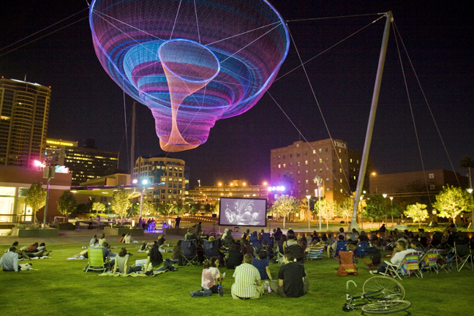
Credit – Access to Civic and Public Spaces
Plan
Built Project
Intent
To provide open space close to work and home that enhances community participation and improves public health.
Lori A. Brown, LEED AP ND – Power Jam Study! Lorisweb.com
71

Slide 72
Credit – Access to Civic and Public Spaces
Plan
Built Project
Requirements
Locate 90% of planned and existing dwelling units and nonresidential use entrances within a ¼ mile walk of at least one civic and passive use space. The spaces must be at least 1/6 acre (0.067 hectare) in area. Spaces less than 1 acre (0.4 hectare) must have a proportion no narrower than 1 unit of width to 4 units of length.
Projects larger than 10 acres must have a median space size of at least 1 acre (0.4 hectare). Spaces over ½ acre (0.2 hectare) that are used to meet the 90% threshold are included in the median calculation.
Lori A. Brown, LEED AP ND – Power Jam Study! Lorisweb.com
72

Slide 73
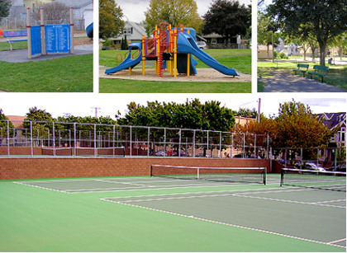
Credit – Access to Recreational Facilities
Plan
Built Project
Intent
To enhance community participation and improve public health by providing recreational facilities close to work and home that facilitate physical activity and social networking.
Lori A. Brown, LEED AP ND – Power Jam Study! Lorisweb.com
73

Slide 74
Credit – Access to Recreational Facilities
Plan
Built Project
Requirements
Locate or design the project so that a publicly accessible outdoor recreation facility at least 1 acre (0.4 hectares) in area, or a publicly accessible indoor recreational facility of at least 25,000 square feet, lies within a ½-mile walking distance of 90% of new and existing dwelling units and nonresidential use entrances.
Outdoor recreation facilities must consist of physical improvements and may include “tot lots,” swimming pools, and sports fields, such as baseball diamonds.
Lori A. Brown, LEED AP ND – Power Jam Study! Lorisweb.com
74

Slide 75
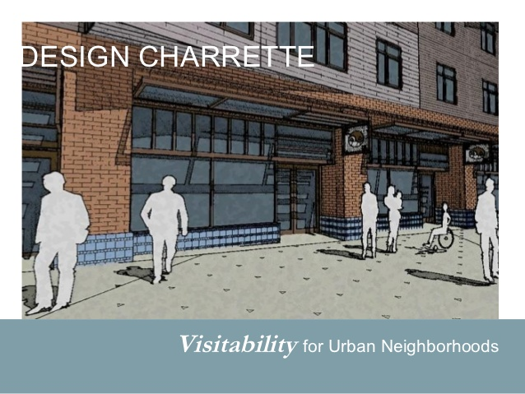
Credit – Visibility and Universal Design
Plan
Built Project
Intent
To increase the proportion of areas usable by a wide spectrum of people, regardless of age or ability.
Lori A. Brown, LEED AP ND – Power Jam Study! Lorisweb.com
75

Slide 76
Credit – Visibility and Universal Design
Plan
Built Project
Requirements
Case 1. Projects with New Dwelling Units (1 point)
Design a minimum of 20% of the new dwelling units (but not less than one dwelling unit per type) in accordance with ICC A117.1, Type C, Visitable Unit, for each of the following residential building types:
detached single-dwelling-unit buildings;
attached single-dwelling-unit buildings; and
buildings with two or three dwelling units.
Each unit must also have a kitchen, living area, bedroom, and full bath on an accessible level.
Lori A. Brown, LEED AP ND – Power Jam Study! Lorisweb.com
76

Slide 77
Credit – Visibility and Universal Design
Plan
Built Project
For multiunit buildings with four or more dwelling units, design a minimum of 20% of the units (but not less than one) to meet the requirements of one of the following options. This category includes mixed-use buildings with dwelling units.
Lori A. Brown, LEED AP ND – Power Jam Study! Lorisweb.com
77

Slide 78
Credit – Visibility and Universal Design
Plan
Built Project
Option 1. Universal Design Features Throughout the Home (1 point)
Throughout the home, include at least five of the following universal design features:
easy-to-grip lever door handles;
easy-to-grip cabinet and drawer loop handles;
easy-to-grip locking mechanisms on doors and windows;
easy-to-grip single-lever faucet handles;
easy-touch rocker or hands-free switches;
motion-detector lighting at entrance, in hallways and stairwells, and in closets, and motion-detector light switches in garages, utility spaces, and basements;
large, high-contrast print for controls, signals, and the house or unit numbers;
a built-in shelf, bench, or table with knee space below, located outside the entry door with weather protection overhead, such as porch or stoop with roof, awning, or other overhead covering;
a minimum 32-inch clear door opening width for all doorways;
tread at the entrance, on stairs, and other areas where slipping is common, with color contrast difference between stair treads and risers; and
interior floor surfaces (e.g., low-pile carpets, hard-surface flooring) that provide easy passage for a wheelchair or walker, with color contrast between floor surfaces and trim; no carpet is permitted in a kitchen, bathroom, or other wet areas of the dwelling unit.
OR
Lori A. Brown, LEED AP ND – Power Jam Study! Lorisweb.com
78

Slide 79
Credit – Visibility and Universal Design
Plan
Built Project
Option 2. Kitchen Features (1 point)
On the main floor of the home (or on another floor, if an elevator or stair lift is provided), provide a kitchen with hard-surface flooring, plumbing with single-lever controls, a 5-foot turning radius, and at least four of the following universal design features:
variable-height (28- to 42-inch) or adjustable work surfaces, such as countertops, sinks, and cooktops;
clear knee space under sink and cooktops (this requirement can be met by installing removable base cabinets or fold-back or self-storing doors), cooktops and ranges with front or side-mounted controls, and wall-mounted ovens at a height to accommodate a seated adult;
a toe kick area at the base of lower cabinets with a minimum height of 9 inches, and full-extension drawers and shelves in at least half (by volume) of the cabinets;
contrasting color treatment between countertops, front edges, and floor;
adjustable-height shelves in wall cabinets; and
glare-free task lighting.
OR
Lori A. Brown, LEED AP ND – Power Jam Study! Lorisweb.com
79

Slide 80
Credit – Visibility and Universal Design
Plan
Built Project
Option 3. Bedroom and Bathroom Features (1 point)
On the main floor of the building (or on another floor, if an elevator or stair lift is provided), include all of the following:
In at least one accessible bedroom,
Size the room to accommodate a twin bed with a 5-foot turning radius around the bed.
Install a clothes closet with a 32-inch clear opening with adjustable-height closet rods and shelves.
Lori A. Brown, LEED AP ND – Power Jam Study! Lorisweb.com
80

Slide 81
Credit – Visibility and Universal Design
Plan
Built Project
In at least one full bathroom on the same floor as the bedroom,
Provide adequate maneuvering space with a 30-by-48-inch clear floor space at each fixture.
Center the toilet 18 inches from any side wall, cabinet, or tub, and allow a 3-foot clear space in front.
Install broad blocking in walls around toilet, tub, and/or shower for future placement and relocation of grab bars.
Provide knee space under the lavatory (this requirement may be met by installing removable base cabinets or fold-back or self-storing doors).
Install a long mirror whose bottom is no more than 36 inches above the finished floor and whose top is at least 72 inches high.
In addition, all bathrooms must have hard-surface flooring, all plumbing fixtures must have single-lever controls, and tubs or showers must have hand-held showerheads.
Lori A. Brown, LEED AP ND – Power Jam Study! Lorisweb.com
81

Slide 82
Credit – Visibility and Universal Design
Plan
Built Project
Case 2. Projects With Noncompliant Routes and No New Dwelling Units (1 point)
This case applies to projects that have no new residential units and are either:
retrofitting existing public rights-of-way or publicly accessible travel routes that are not in compliance with the Americans with Disabilities Act (ADA, for private sector and local and state government facilities) or the Architectural Barriers Act (ABA, for federally funded facilities), or
building new publicly accessible travel routes that are not legally required to meet ADA-ABA accessibility guidelines.
Design, construct, or retrofit 90% of the rights-of-way and travel routes in accordance with the ADA-ABA accessibility guidelines, as applicable, or local equivalent for projects outside the U.S., whichever is more stringent.
Lori A. Brown, LEED AP ND – Power Jam Study! Lorisweb.com
82

Slide 83
Credit – Community Outreach and Involvement
Plan
Built Project
Intent
To encourage responsiveness to community needs by involving the people who live or work in the community in project design and planning and in decisions about how the project should be improved or changed over time.
Lori A. Brown, LEED AP ND – Power Jam Study! Lorisweb.com
83

Slide 84
Credit – Community Outreach and Involvement
Plan
Built Project
Requirements
Option 1. Community Outreach (1 point)
Engage the community in the following ways. Each activity must be led by the development team and be directly related to the LEED ND project.
Lori A. Brown, LEED AP ND – Power Jam Study! Lorisweb.com
84

Slide 85
Credit – Community Outreach and Involvement
Plan
Built Project
Predesign
Meet with adjacent property owners, residents, business owners, and workers; local planning and community development officials; and any current residents or workers at the project site to solicit and document their input on the proposed project before beginning design.
Lori A. Brown, LEED AP ND – Power Jam Study! Lorisweb.com
85

Slide 86
Credit – Community Outreach and Involvement
Plan
Built Project
Preliminary design
Advertise and host at least one open community meeting other than an official public hearing or recurring citizen advisory meeting, to generate comments on the preliminary project design concept. Work directly with community associations and/or the local government to advertise the meeting(s). Collect and summarize comments generated at the meeting(s).
Modify the project’s preliminary design as a direct result of community input, or if modifications are not made, explain why community input did not generate design modifications.
Lori A. Brown, LEED AP ND – Power Jam Study! Lorisweb.com
86

Slide 87
Credit – Community Outreach and Involvement
Plan
Built Project
Ongoing communication
Establish ongoing means for communication between the developer and the community throughout the design and construction phases and, in cases where the developer maintains any control, after construction.
OR
Lori A. Brown, LEED AP ND – Power Jam Study! Lorisweb.com
87

Slide 88
Credit – Community Outreach and Involvement
Plan
Built Project
Option 2. Charrette (2 points)
Comply with Option 1 and conduct a design charrette or interactive workshop of at least two days that is open to the public and includes, at a minimum, participation by a representative group of nearby property owners, residents, business owners, and workers in the preparation of conceptual project plans and drawings.
OR
Lori A. Brown, LEED AP ND – Power Jam Study! Lorisweb.com
88

Slide 89
Credit – Community Outreach and Involvement
Plan
Built Project
Option 3. Endorsement Program (2 points)
Comply with Option 1 and obtain an endorsement from an ongoing local or regional nongovernmental program that systematically reviews and endorses smart growth development projects under a rating or jury system.
Lori A. Brown, LEED AP ND – Power Jam Study! Lorisweb.com
89

Slide 90
Credit – Local Food Production
Plan
Built Project
Intent
To promote the environmental and economic benefits of community-based food production and improve nutrition through better access to fresh produce.
Lori A. Brown, LEED AP ND – Power Jam Study! Lorisweb.com
90

Slide 91
Credit – Local Food Production
Plan
Built Project
Requirements
Establish covenants, conditions, and restrictions (CC&R) or other forms of deed restrictions stating that the growing of produce is not prohibited in project areas, including greenhouses, any portion of residential front, rear, or side yards; or balconies, patios, or rooftops. Greenhouses but not gardens may be prohibited in front yards that face the circulation network.
Meet the requirements of one of the following three options.
Lori A. Brown, LEED AP ND – Power Jam Study! Lorisweb.com
91

Slide 92
Credit – Local Food Production
Plan
Built Project
Option 1. Neighborhood Gardens (1 point)
Dedicate permanent and viable growing space or related facilities (such as greenhouses) within the project as specified in Table 1 (exclusive of existing dwellings). Ensure solar access and provide fencing, watering systems, garden bed enhancements (such as raised beds), secure storage space for tools, and pedestrian access for these spaces. Ensure that the spaces are owned and managed by an entity that includes occupants of the project in its decision making, such as a community group, homeowners association, or public body.
Lori A. Brown, LEED AP ND – Power Jam Study! Lorisweb.com
92

Slide 93
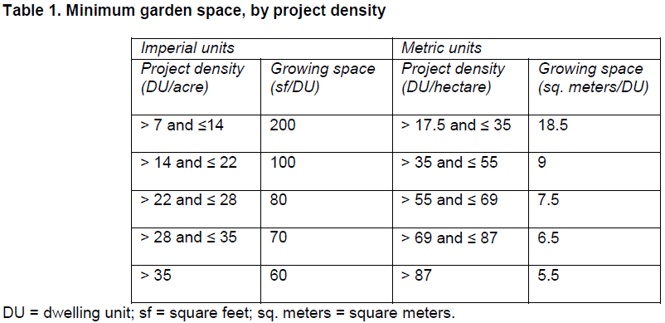
Credit – Local Food Production
Plan
Built Project
An established community garden outside the project boundary but within a ½-mile walking distance of the project’s geographic center can satisfy this option if the garden otherwise meets all the requirements.
OR
Lori A. Brown, LEED AP ND – Power Jam Study! Lorisweb.com
93

Slide 94
Credit – Local Food Production
Plan
Built Project
Option 2. Community-Supported Agriculture (1 point)
Purchase shares in a community-supported agriculture program located within 150 miles of the project site for at least 80% of dwelling units within the project (exclusive of existing dwelling units). Each counted dwelling unit must receive CSA service for at least two years, beginning when it is occupied. Shares must be delivered to a point within 1/2 mile of the project’s geographic center on a regular schedule not less than twice per month at least four months of the year.
OR
Lori A. Brown, LEED AP ND – Power Jam Study! Lorisweb.com
94

Slide 95
Credit – Local Food Production
Plan
Built Project
Option 3. Proximity to Farmers Market (1 point)
Locate the project’s geographic center within a 1/2-mile walking distance of an existing or planned farmers market that is open or will operate at least once weekly for at least five months annually.
Farmers market vendors may sell only items grown within 150 miles of the project site.
A planned farmers market must have firm commitments from farmers and vendors that the market will meet all the above requirements and be in full operation by the time 50% of the project’s total floor area is occupied.
Lori A. Brown, LEED AP ND – Power Jam Study! Lorisweb.com
95

Slide 96
Credit – Tree Lined and Shaded Streetscapes
Plan
Built Project
Intent
To encourage walking and bicycling and discourage speeding. To reduce urban heat island effects, improve air quality, increase evapotranspiration, and reduce cooling loads in buildings.
Lori A. Brown, LEED AP ND – Power Jam Study! Lorisweb.com
96

Slide 97
Credit – Tree Lined and Shaded Streetscapes
Plan
Built Project
Requirements
Option 1. Tree-Lined Blocks (1 point)
Provide trees at intervals of no more than 50 feet (exempting driveways) along at least 60% of the total existing and planned block length within the project, and on the project side of blocks bordering the project, between the vehicle travel way (if there is one) and walkway. Alleys may be exempted from the block length calculations.
AND/OR
Lori A. Brown, LEED AP ND – Power Jam Study! Lorisweb.com
97

Slide 98
Credit – Tree Lined and Shaded Streetscapes
Plan
Built Project
Option 2. Shaded Sidewalks (1 point)
Provide shade from trees or permanent structures over at least 40% of the total length of existing and planned sidewalks within or bordering the project (alleys may be exempted). Trees must provide shade within 10 years of landscape installation. Use the estimated crown diameter to calculate the length of sidewalk shaded.
AND
Lori A. Brown, LEED AP ND – Power Jam Study! Lorisweb.com
98

Slide 99
Credit – Tree Lined and Shaded Streetscapes
Plan
Built Project
For All Projects with Street Tree Plantings
From a registered landscape architect, obtain a determination that planting details are appropriate to growing healthy trees, taking into account tree species, root medium, and width and soil volume of planter strips or wells, and that the selected tree species are not considered invasive in the project context according to USDA or the state agricultural extension service.
Lori A. Brown, LEED AP ND – Power Jam Study! Lorisweb.com
99

Slide 100
Credit – Neighborhood Schools
Plan
Built Project
Intent
To promote community interaction and engagement by integrating schools into the neighborhood. To improve students’ health by encouraging walking and bicycling to school.
Lori A. Brown, LEED AP ND – Power Jam Study! Lorisweb.com
100

Slide 101
Credit – Neighborhood Schools
Plan
Built Project
Requirements
Include in the project a residential component that constitutes at least 30% of the project’s total building floor area, and locate or design the project such that at least 50% of the dwelling units are within a ½-mile walking distance of the functional building entry of an existing or new elementary or middle school or within a 1-mile walking distance of the functional building entry of an existing or new high school.
If the school combines an elementary or middle school with a high school, 50% of the dwelling units must be a ½ mile walking distance of the functional building entry.
Lori A. Brown, LEED AP ND – Power Jam Study! Lorisweb.com
101

Slide 102
Credit – Neighborhood Schools
Plan
Built Project
For any new school, the school authority must commit that the school will be open by the time 50% of the project dwelling units are occupied.
A legally binding warrant committing to open the school by this time must be provided at the time of first building occupancy.
Lori A. Brown, LEED AP ND – Power Jam Study! Lorisweb.com
102

Slide 103
Credit – Neighborhood Schools
Plan
Built Project
Portions of the circulation network within or bordering the project boundary that lead from dwelling units to the school site must have (1) a complete network of sidewalks on both sides and (2) either continuous bicycle lanes or a combination of traffic control and calming measures (alleys may be exempted).
If the school is planned as part of the project, it must be designed such that pedestrians and cyclists can easily reach building entrances without crossing bus zones, parking entrances, and student drop-off areas.
Lori A. Brown, LEED AP ND – Power Jam Study! Lorisweb.com
103

Slide 104
Credit – Neighborhood Schools
Plan
Built Project
New school campuses within the project boundary must not exceed the following limits:
high school (students 15-18 years old), 15 acres (6 hectares);
middle school (students 11-14 years old), 10 acres (4 hectares); and
elementary school (students 6-10 years old), 5 acres (2 hectares).
Schools combining grade levels from more than one category may use the grade level with the higher allowable limits.
Facilities on the school site (e.g., athletic fields, playgrounds, multipurpose interior spaces) for which there is a formal joint-use agreement with another entity may be deducted from the total site area of the school.
Lori A. Brown, LEED AP ND – Power Jam Study! Lorisweb.com
104

Slide 105



