Slide 1

Fundamentals of LEED v4 for
Neighborhood Development
Exam Preparation
Lori A. Brown, LEED AP BD+C – Power Jam Study! Lorisweb.com
1

Slide 2
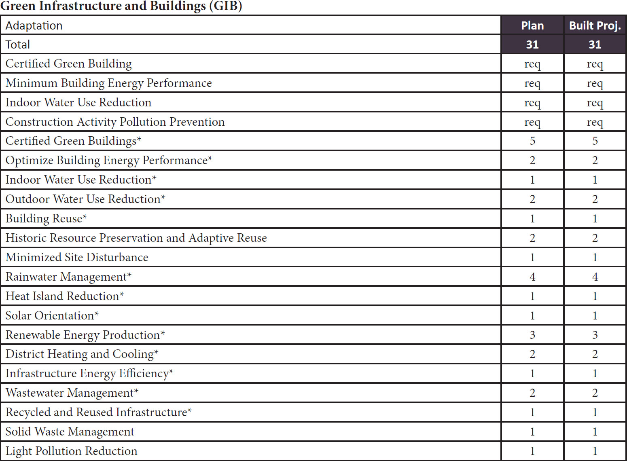
Lori A. Brown, LEED AP BD+C – Power Jam Study! Lorisweb.com
2

Slide 3

Lori A. Brown, LEED AP BD+C – Power Jam Study! Lorisweb.com
3

Slide 4

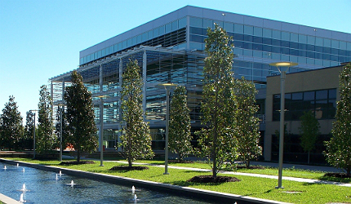
Prerequisite – Certified Green Building
Plan
Built Project
Intent
To encourage the design, construction, and retrofit of buildings using green building practices.
Lori A. Brown, LEED AP ND – Power Jam Study! Lorisweb.com
4

Slide 5
Prerequisite – Certified Green Building
Plan
Built Project
Requirements
Design, construct, or retrofit one whole building within the project to be certified through a LEED rating system (if LEED for Commercial Interiors, 75% of the total building floor area must be certified), or through a green building rating system requiring review by independent, impartial, third-party certifying bodies that have been accredited by an IAF-accredited body to ISO/IEC Guide 65 or, when available, ISO/IEC 17065.
Lori A. Brown, LEED AP ND – Power Jam Study! Lorisweb.com
5

Slide 6
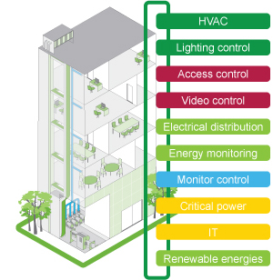
Prerequisite – Minimum Building Energy Performance
Plan
Built Project
Intent
To encourage the design and construction of energy-efficient buildings that reduce air, water, and land pollution and environmental damage from energy production and consumption.
Lori A. Brown, LEED AP ND – Power Jam Study! Lorisweb.com
6

Slide 7
Prerequisite – Minimum Building Energy Performance
Plan
Built Project
Requirements
The requirements apply to 90% of the total building floor area (rounded up to the next whole building) of all nonresidential buildings, mixed-use buildings, and multiunit residential buildings four stories or more constructed as part of the project or undergoing major renovations as part of the project. Each counted building must comply with one of the following options.
Lori A. Brown, LEED AP ND – Power Jam Study! Lorisweb.com
7

Slide 8
Prerequisite – Minimum Building Energy Performance
Plan
Built Project
Option 1. Whole-Building Energy Simulation
Demonstrate an average improvement of 5% for new buildings, 3% for major building renovations, or 2% for core and shell buildings over ANSI/ASHRAE/IESNA Standard 90.1–2010, with errata across all buildings pursuing Option 1.
Multiple buildings may be grouped into a single energy model, provided (1) the building type (new construction, major renovation, or core and shell) is consistent for all buildings included in the energy model, or (2) an average 5% improvement is demonstrated for the entire energy model.
Calculate the baseline building performance according to ANSI/ASHRAE/IESNA Standard 90.1–2010, Appendix G, with errata, using a simulation model.
Lori A. Brown, LEED AP ND – Power Jam Study! Lorisweb.com
8

Slide 9
Prerequisite – Minimum Building Energy Performance
Plan
Built Project
Buildings must meet the minimum percentage savings before taking credit for renewable energy systems.
Each building’s proposed design must meet the following criteria:
compliance with the mandatory provisions of ANSI/ASHRAE/IESNA Standard 90.1–2010, with errata;
inclusion of all energy consumption and costs within and associated with the building project; and
comparison against a baseline building that complies with Standard 90.1–2010, Appendix G, with errata
Lori A. Brown, LEED AP ND – Power Jam Study! Lorisweb.com
9

Slide 10
Prerequisite – Minimum Building Energy Performance
Plan
Built Project
Document the energy modeling input assumptions for unregulated loads. Unregulated loads should be modeled accurately to reflect the actual expected energy consumption of the building.
If unregulated loads are not identical for both the baseline and the proposed building performance rating, and the simulation program cannot accurately model the savings, follow the exceptional calculation method (ANSI/ASHRAE/IESNA Standard 90.1–2010, G2.5).
Alternatively, use the COMNET modeling guidelines and procedures to document measures that reduce unregulated loads.
OR
Lori A. Brown, LEED AP ND – Power Jam Study! Lorisweb.com
10

Slide 11
Prerequisite – Minimum Building Energy Performance
Plan
Built Project
Option 2. Prescriptive Compliance: ASHRAE 50% Advanced Energy Design Guide
Comply with the mandatory and prescriptive provisions of ANSI/ASHRAE/IESNA Standard 90.1–2010, with errata.
Lori A. Brown, LEED AP ND – Power Jam Study! Lorisweb.com
11

Slide 12
Prerequisite – Minimum Building Energy Performance
Plan
Built Project
Comply with HVAC and service water heating requirements applicable to the each building, including equipment efficiency, economizers, ventilation, and ducts and dampers, for the appropriate ASHRAE 50% Advanced Energy Design Guide and climate zone:
ASHRAE 50% Advanced Energy Design Guide for Small to Medium Office Buildings, for office buildings smaller than 100,000 square feet;
ASHRAE 50% Advanced Energy Design Guide for Medium to Large Box Retail Buildings, for retail buildings with 20,000 to 100,000 square feet;
ASHRAE 50% Advanced Energy Design Guide for K–12 School Buildings; or
ASHRAE 50% Advanced Energy Design Guide for Large Hospitals. Over 100,000 square feet
Lori A. Brown, LEED AP ND – Power Jam Study! Lorisweb.com
12

Slide 13
Prerequisite – Minimum Building Energy Performance
Plan
Built Project
Option 3. Prescriptive Compliance: Advanced Buildings Core Performance Guide
Comply with the mandatory and prescriptive provisions of ANSI/ASHRAE/IESNA Standard 90.1–2010, with errata.
Comply with Section 1: Design Process Strategies, Section 2: Core Performance Requirements, and the following three strategies from Section 3: Enhanced Performance Strategies, as applicable. Where standards conflict, follow the more stringent of the two.
3.5 Supply Air Temperature Reset (VAV)
3.9 Premium Economizer Performance
3.10 Variable Speed Control
To be eligible for Option 3, the project must be less than 100,000 square feet.
Note: Healthcare, Warehouse or Laboratory projects are ineligible for Option 3.
AND
Lori A. Brown, LEED AP ND – Power Jam Study! Lorisweb.com
13

Slide 14
Prerequisite – Minimum Building Energy Performance
Plan
Built Project
For new single-family residential buildings and new multiunit residential buildings three stories or fewer, 90% of the buildings must meet the requirements of LEED for Homes v4 EA Prerequisite: Minimum Energy Performance.
Lori A. Brown, LEED AP ND – Power Jam Study! Lorisweb.com
14

Slide 15
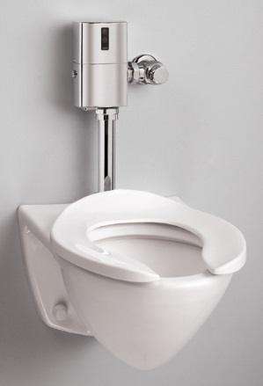
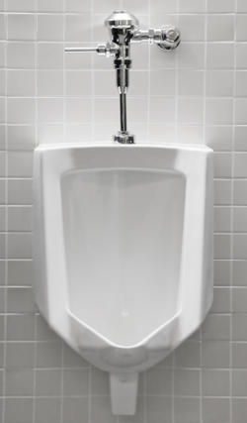
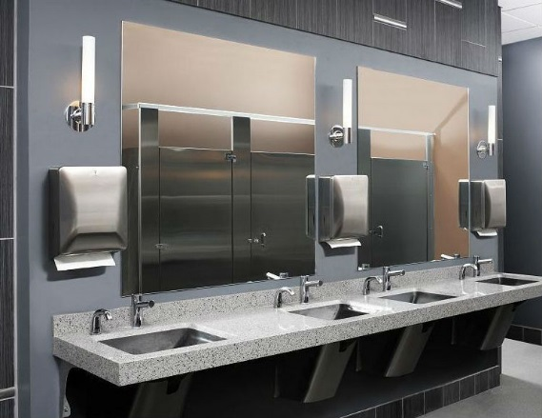
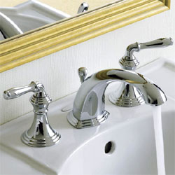
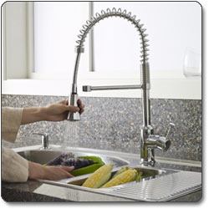
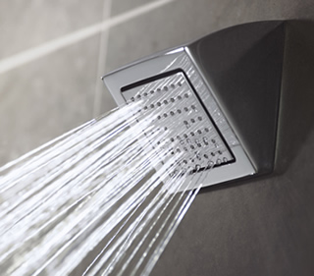

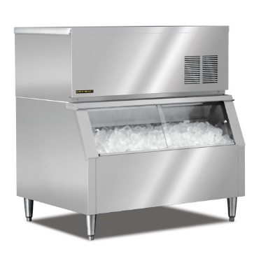
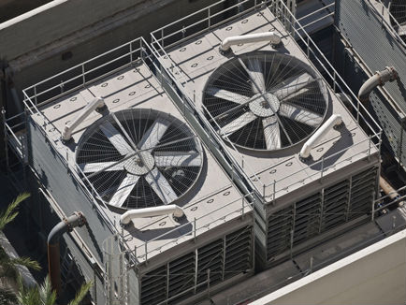
Prerequisite – Indoor Water Use Reduction
Plan
Built Project
Intent
To reduce indoor water consumption.
Lori A. Brown, LEED AP ND – Power Jam Study! Lorisweb.com
15

Slide 16
Prerequisite – Indoor Water Use Reduction
Plan
Built Project
Requirements
Nonresidential Buildings, Mixed-Use Buildings, and Multifamily Residential Buildings Four Stories or More
For new buildings and buildings undergoing major renovations as part of the project, reduce indoor water usage by an average of 20% from a baseline.
All newly installed toilets, urinals, private lavatory faucets, and showerheads that are eligible for labeling must be WaterSense.
Lori A. Brown, LEED AP ND – Power Jam Study! Lorisweb.com
16

Slide 17
Prerequisite – Indoor Water Use Reduction
Plan
Built Project
For the fixtures and fittings listed in Table 1, as applicable to the project scope, reduce water consumption by 20% from the baseline.
Base calculations on the volumes and flow rates shown in Table 1.
The design case is calculated as a weighted average of water usage for the buildings constructed as part of the project based on their floor area.
Lori A. Brown, LEED AP ND – Power Jam Study! Lorisweb.com
17

Slide 18
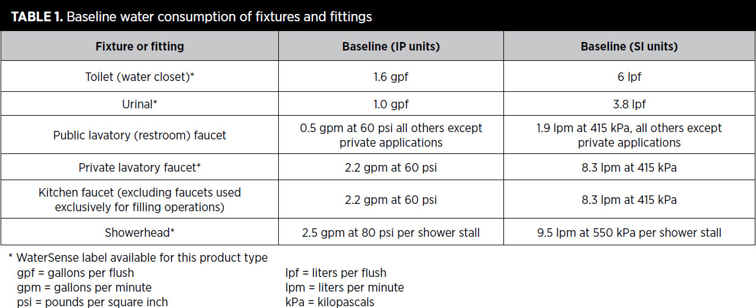
Prerequisite – Indoor Water Use Reduction
Plan
Built Project
Lori A. Brown, LEED AP ND – Power Jam Study! Lorisweb.com
18

Slide 19
Prerequisite – Indoor Water Use Reduction
Plan
Built Project
New Single-Family Residential Buildings and New Multiunit Residential Buildings Three Stories or Fewer
90% of residential buildings must use a combination of fixtures and fittings that would earn 2 points under LEED for Homes v4 WE Credit Indoor Water Use.
Lori A. Brown, LEED AP ND – Power Jam Study! Lorisweb.com
19

Slide 20
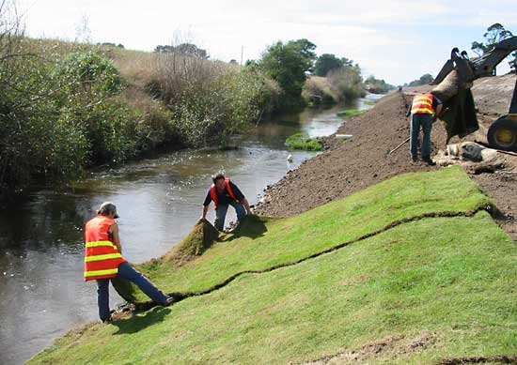
Prerequisite – Construction Activity Pollution Prevention
Plan
Built Project
Intent
To reduce pollution from construction activities by controlling soil erosion, waterway sedimentation, and airborne dust.
Lori A. Brown, LEED AP ND – Power Jam Study! Lorisweb.com
20

Slide 21
Prerequisite – Construction Activity Pollution Prevention
Plan
Built Project
Requirements
Create and implement an erosion and sedimentation control plan for all new construction activities associated with the project. The plan must incorporate best management practices (BMPs) to control erosion and sedimentation in runoff from the entire project site during construction. The BMPs must be selected from EPA’s BMPs for construction and post-construction site runoff control.
Lori A. Brown, LEED AP ND – Power Jam Study! Lorisweb.com
21

Slide 22
Prerequisite – Construction Activity Pollution Prevention
Plan
Built Project
The erosion and sedimentation control plan must list the BMPs employed and describe how the project team will do the following:
preserve vegetation and mark clearing limits;
establish and delineate construction access;
control flow rates;
install sediment controls;
stabilize soils;
prevent soil loss during construction;
stockpile topsoil for reuse;
protect slopes;
protect drain inlets, all rainwater conveyance systems, and receiving water bodies;
stabilize channels and outlets;
control pollutants including dust and particulate matter;
control dewatering;
maintain the BMPs; and
manage the erosion and sedimentation control plan.
Lori A. Brown, LEED AP ND – Power Jam Study! Lorisweb.com
22

Slide 23
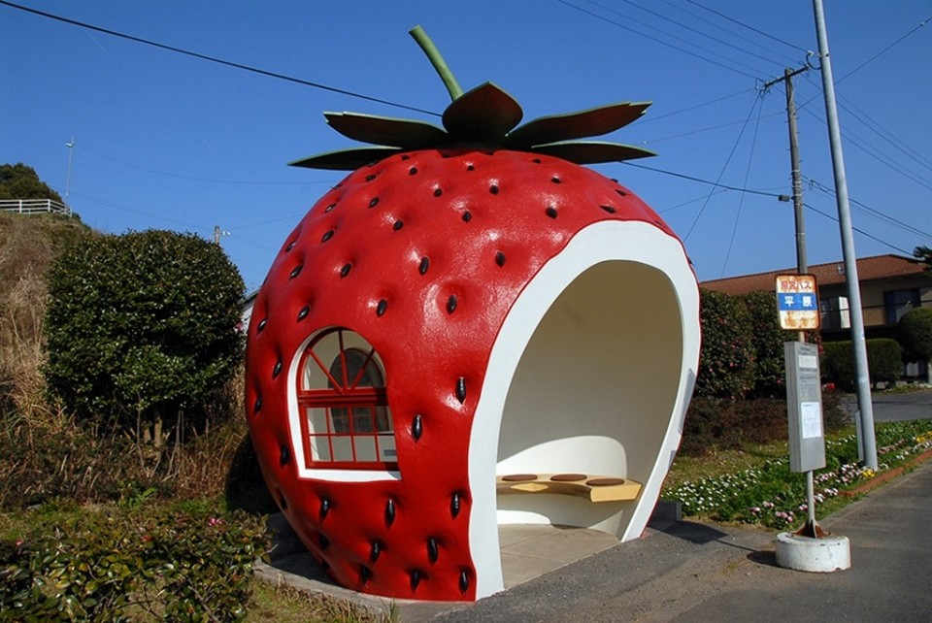
Credit – Certified Green Buildings
Plan
Built Project
Intent
To encourage the design, construction, and retrofit of buildings using green building practices.
Lori A. Brown, LEED AP ND – Power Jam Study! Lorisweb.com
23

Slide 24
Credit – Certified Green Buildings
Plan
Built Project
Requirements
Option 1. Projects with 10 or Fewer Habitable Buildings (1–5 points)
Design, construct, or retrofit one building as part of the project, beyond the prerequisite requirement, to be certified under a LEED green building rating systems (for LEED for Commercial Interiors, 75% of the total building floor area must be certified), or through a green building rating system requiring review by independent, impartial, third-party certifying bodies that have been accredited by an IAF-accredited body to ISO/IEC Guide 65 or, when available, ISO/IEC 17065.
Up to five points may be earned for each additional certified building that is part of the project.
OR
Lori A. Brown, LEED AP ND – Power Jam Study! Lorisweb.com
24

Slide 25
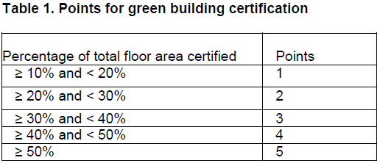
Credit – Certified Green Buildings
Plan
Built Project
Option 2. Projects of All Sizes (1–5 points)
Design, construct, or retrofit a percentage of the total project building floor area, beyond the prerequisite requirement, to be certified under a LEED green building rating systems or through a green building rating system requiring review by independent, impartial, third-party certifying bodies that have been accredited by an IAF-accredited body to ISO/IEC Guide 65 or, when available, ISO/IEC 17065.
Lori A. Brown, LEED AP ND – Power Jam Study! Lorisweb.com
25

Slide 26
Credit – Certified Green Buildings
Plan
Built Project
For All Projects Detached accessory dwelling units must be counted as separate buildings. Accessory dwellings attached to a main building are not counted separately.
Lori A. Brown, LEED AP ND – Power Jam Study! Lorisweb.com
26

Slide 27

Credit – Optimize Building Energy Performance
Plan
Built Project
Intent
To encourage the design and construction of energy-efficient buildings that reduce air, water, and land pollution and adverse environmental effects from energy production and consumption.
Lori A. Brown, LEED AP ND – Power Jam Study! Lorisweb.com
27

Slide 28
Credit – Optimize Building Energy Performance
Plan
Built Project
Requirements
The requirements apply to 90% of the total building floor area (rounded up to the next whole building) of all nonresidential buildings, mixed-use buildings, and multiunit residential buildings four stories or more constructed as part of the project or undergoing major renovations as part of the project.
Each counted building must comply with one of the following efficiency options.
Lori A. Brown, LEED AP ND – Power Jam Study! Lorisweb.com
28

Slide 29
Credit – Optimize Building Energy Performance
Plan
Built Project
Option 1. Whole-Building Energy Simulation (1–2 points)
New buildings must demonstrate an average percentage improvement of 12% (1 point) or 20% (2 points) over ANSI/ASHRAE/IESNA Standard 90.1–2010, with errata. Buildings undergoing major renovations as part of the project must demonstrate an average percentage improvement of 10% (1 point) or 18% (2 points). Core and shell buildings must demonstrate an average percentage improvement of 11% (1 point) or 15% (2 points). To determine percentage improvement, follow the method outlined in GIB Prerequisite Minimum Building Energy Performance.
OR
Lori A. Brown, LEED AP ND – Power Jam Study! Lorisweb.com
29

Slide 30
Credit – Optimize Building Energy Performance
Plan
Built Project
Option 2. Prescriptive Compliance: ASHRAE 50% Advanced Energy Design Guide (2 points)
To be eligible for Option 2, project must comply with all of requirements of Option 2 in GIB Prerequisite Minimum Building Energy Performance.
AND
Comply with the applicable recommendations and standards in Chapter 4, Design Strategies and Recommendations by Climate Zone, for the appropriate ASHRAE 50% Advanced Energy Design Guide and climate zone.
Lori A. Brown, LEED AP ND – Power Jam Study! Lorisweb.com
30

Slide 31
Credit – Optimize Building Energy Performance
Plan
Built Project
ASHRAE 50% Advanced Energy Design Guide for Small to Medium Office Buildings
Building envelope, opaque: roofs, walls, floors, slabs, doors, and continuous air barriers
Building envelope, glazing: vertical fenestration
Interior lighting, including daylighting and interior finishes
Exterior lighting
Plug loads, including equipment and controls
Lori A. Brown, LEED AP ND – Power Jam Study! Lorisweb.com
31

Slide 32
Credit – Optimize Building Energy Performance
Plan
Built Project
ASHRAE 50% Advanced Energy Design Guide for Medium to Large Box Retail Buildings
Building envelope, opaque: roofs, walls, floors, slabs, doors, and vestibules
Building envelope, glazing: fenestration - all orientations
Interior lighting, excluding lighting power density for sales floor
Additional interior lighting for sales floor
Exterior lighting
Plug loads, including equipment choices and controls
Lori A. Brown, LEED AP ND – Power Jam Study! Lorisweb.com
32

Slide 33
Credit – Optimize Building Energy Performance
Plan
Built Project
ASHRAE 50% Advanced Energy Design Guide for K–12 School Buildings
Building envelope, opaque: roofs, walls, floors, slabs, and doors
Building envelope, glazing: vertical fenestration
Interior lighting, including daylighting and interior finishes
Exterior lighting
Plug loads, including equipment choices, controls, and kitchen equipment
Lori A. Brown, LEED AP ND – Power Jam Study! Lorisweb.com
33

Slide 34
Credit – Optimize Building Energy Performance
Plan
Built Project
ASHRAE 50% Advanced Design Guide for Large Hospitals
Building envelope, opaque: roofs, walls, floors, slabs, doors, vestibules, and continuous air barriers
Building envelope, glazing: vertical fenestration
Interior lighting, including daylighting (form or nonform driven) and interior finishes
Exterior lighting
Plug loads, including equipment choices, controls, and kitchen equipment
Lori A. Brown, LEED AP ND – Power Jam Study! Lorisweb.com
34

Slide 35
Credit – Optimize Building Energy Performance
Plan
Built Project
For new single-family residential buildings and new multiunit residential buildings three stories or fewer, 90% of the buildings must reduce absolute estimated annual energy usage by 20% compared with the LEED Energy Budget for each building. Follow the method outlined in LEED v4 for Homes, EA Credit Annual Energy Use.
Lori A. Brown, LEED AP ND – Power Jam Study! Lorisweb.com
35

Slide 36
Credit – Indoor Water Use Reduction
Plan
Built Project
Intent
To reduce indoor water consumption.
Lori A. Brown, LEED AP ND – Power Jam Study! Lorisweb.com
36

Slide 37
Credit – Indoor Water Use Reduction
Plan
Built Project
Requirements
Nonresidential Buildings, Mixed-Use Buildings, and Multifamily Residential Buildings Four Stories or More
For new buildings and buildings undergoing major renovations as part of the project, reduce indoor water usage by an average of 40% from a baseline.
All newly installed toilets, urinals, private lavatory faucets, and showerheads that are eligible for labeling must be WaterSense labeled
Lori A. Brown, LEED AP ND – Power Jam Study! Lorisweb.com
37

Slide 38
Credit – Indoor Water Use Reduction
Plan
Built Project
For fixtures and fittings listed in Table 1, as applicable to the project scope, calculate the baseline water consumption using estimated occupant usage.
The design case is calculated as a weighted average of water usage for the buildings constructed as part of the project, based on their floor area.
Lori A. Brown, LEED AP ND – Power Jam Study! Lorisweb.com
38

Slide 39
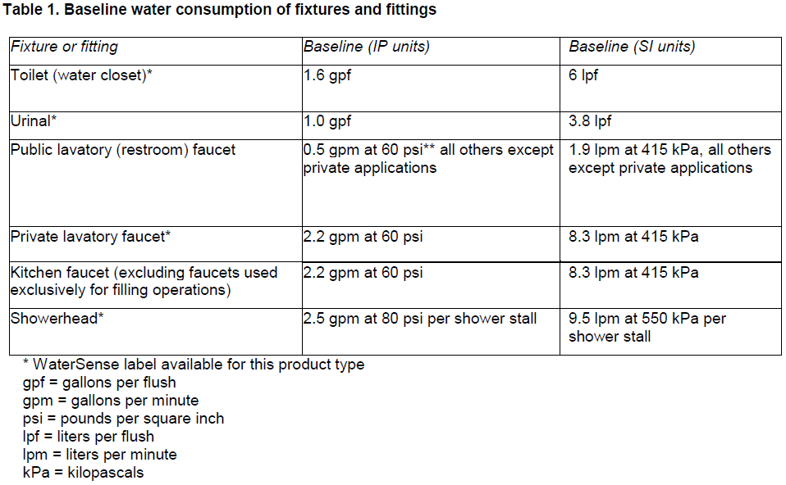
Credit – Indoor Water Use Reduction
Plan
Built Project
Lori A. Brown, LEED AP ND – Power Jam Study! Lorisweb.com
39

Slide 40
Credit – Indoor Water Use Reduction
Plan
Built Project
New Single-Family Residential Buildings and New Multiunit Residential Buildings Three Stories or Fewer
90% of buildings must use a combination of fixtures and fittings that would earn 4 points under LEED v4 for Building Design and Construction: Homes and Multifamily Lowrise v4 WE Credit Indoor Water Use.
Lori A. Brown, LEED AP ND – Power Jam Study! Lorisweb.com
40

Slide 41
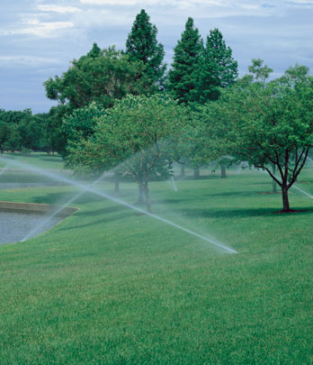
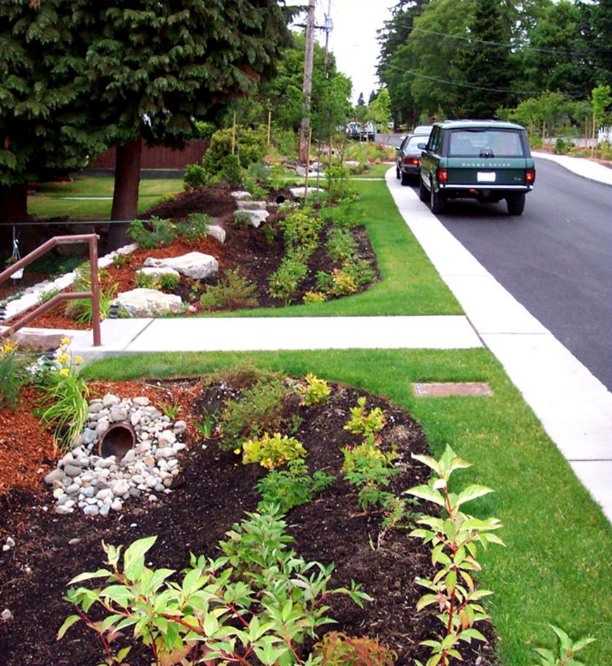
Credit – Outdoor Water Use Reduction
Plan
Built Project
Intent
To reduce outdoor water consumption.
Lori A. Brown, LEED AP ND – Power Jam Study! Lorisweb.com
41

Slide 42
Credit – Outdoor Water Use Reduction
Plan
Built Project
Requirements
Reduce outdoor water use through one of the following options. Nonvegetated surfaces, such as permeable or impermeable pavement, should be excluded from landscape area calculations. Athletic fields and playgrounds (if vegetated) and food gardens may be included or excluded at the project team’s discretion
Lori A. Brown, LEED AP ND – Power Jam Study! Lorisweb.com
42

Slide 43
Credit – Outdoor Water Use Reduction
Plan
Built Project
Option 1. No Irrigation Required (2 points)
Show that the landscape does not require a permanent irrigation system beyond a maximum two-year establishment period.
OR
Lori A. Brown, LEED AP ND – Power Jam Study! Lorisweb.com
43

Slide 44
Credit – Outdoor Water Use Reduction
Plan
Built Project
Option 2. Reduced Irrigation (1–2 points)
Reduce the project’s landscape water requirement (LWR) by at least 30% from the calculated baseline for the site’s peak watering month.
Reductions must first be achieved through plant species selection and irrigation system efficiency as calculated in the Environmental Protection Agency (EPA) WaterSense Water Budget Tool.
Additional reductions beyond 30% may be achieved using any combination of efficiency, alternative water sources, and smart scheduling technologies.
Lori A. Brown, LEED AP ND – Power Jam Study! Lorisweb.com
44

Slide 45
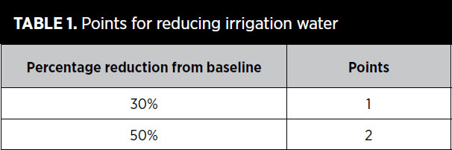
Credit – Outdoor Water Use Reduction
Plan
Built Project
Lori A. Brown, LEED AP ND – Power Jam Study! Lorisweb.com
45

Slide 46
Credit – Building Reuse
Plan
Built Project
Intent
To extend the life cycle of buildings and conserve resources, reduce waste, and reduce environmental harm from materials manufacturing and transport for new buildings.
Lori A. Brown, LEED AP ND – Power Jam Study! Lorisweb.com
46

Slide 47
Credit – Building Reuse
Plan
Built Project
Requirements
Case 1. Five Buildings or Fewer
For projects with five or fewer buildings undergoing major renovations, reuse 50% of one such building, based on surface area.
Calculations must include structural elements (e.g., floors, roof decking) and enclosure materials (e.g., skin, framing).
Exclude from the calculations window assemblies, nonstructural roofing material, and any hazardous materials that are remediated as part of the project.
Lori A. Brown, LEED AP ND – Power Jam Study! Lorisweb.com
47

Slide 48
Credit – Building Reuse
Plan
Built Project
Case 2. More Than Five Buildings
For projects with more than five buildings undergoing major renovations, reuse 20% of the total surface area of such buildings (including structure and enclosure materials, as defined in Case 1).
Lori A. Brown, LEED AP ND – Power Jam Study! Lorisweb.com
48

Slide 49
Credit – Building Reuse
Plan
Built Project
For All Projects Do not demolish any historic buildings or contributing buildings in a historic district, or portions thereof, or alter any cultural landscapes as part of the project.
An exception is granted only with approval from an appropriate review body. For buildings or landscapes listed locally, approval must be granted by the local historic preservation review board, or equivalent.
For buildings or landscapes listed in a state register or in the National Register of Historic Places, approval must appear in a programmatic agreement with the state historic preservation office or National Park Service.
Lori A. Brown, LEED AP ND – Power Jam Study! Lorisweb.com
49

Slide 50
Credit – Historic Resource Preservation and Adaptive Reuse
Plan
Built Project
Intent
To respect local and national landmarks and conserve material and cultural resources by encouraging the preservation and adaptive reuse of historic buildings and cultural landscapes.
Lori A. Brown, LEED AP ND – Power Jam Study! Lorisweb.com
50

Slide 51
Credit – Historic Resource Preservation and Adaptive Reuse
Plan
Built Project
Requirements
This credit is available to projects with at least one historic building, contributing building in a historic district, or cultural landscape on the project site.
Lori A. Brown, LEED AP ND – Power Jam Study! Lorisweb.com
51

Slide 52
Credit – Historic Resource Preservation and Adaptive Reuse
Plan
Built Project
Do not demolish any historic buildings or contributing buildings in a historic district, or portions thereof, or alter any cultural landscapes as part of the project.
An exception is granted only with approval from an appropriate review body. For buildings or landscapes listed locally, approval must be granted by the local historic preservation review board, or equivalent. For buildings or landscapes listed in a state register or in the National Register of Historic Places, approval must appear in a programmatic agreement with the state historic preservation office or National Park Service.
Lori A. Brown, LEED AP ND – Power Jam Study! Lorisweb.com
52

Slide 53
Credit – Historic Resource Preservation and Adaptive Reuse
Plan
Built Project
If any historic building or a contributing building in a historic district in the project site is to be altered (rehabilitated, preserved, or restored), use one of the following approaches for each building, as applicable.
Building subject to local review. Obtain approval, in the form of a certificate of appropriateness, from a local historic preservation commission or architectural review board for any exterior alterations or additions.
Building subject to state or federal review. If the building is subject to review by a state historic preservation office or the National Park Service, the alteration must meet the Secretary of the Interior’s Standards for the Treatment of Historic Properties.
Listed or eligible building not subject to review. If a building is listed or determined eligible but alteration is not subject to local, state, or federal review, include on the project team a preservation professional who meets the U.S. federal qualifications for historic architects or architectural historians. The preservation professional must confirm adherence to the Secretary of the Interior’s Standards for the Treatment of Historic Properties.
Lori A. Brown, LEED AP ND – Power Jam Study! Lorisweb.com
53

Slide 54
Credit – Historic Resource Preservation and Adaptive Reuse
Plan
Built Project
If a cultural landscape is to be rehabilitated, restored, or preserved, do so in accordance with the Guidelines for the Treatment of Cultural Landscapes.
Lori A. Brown, LEED AP ND – Power Jam Study! Lorisweb.com
54

Slide 55
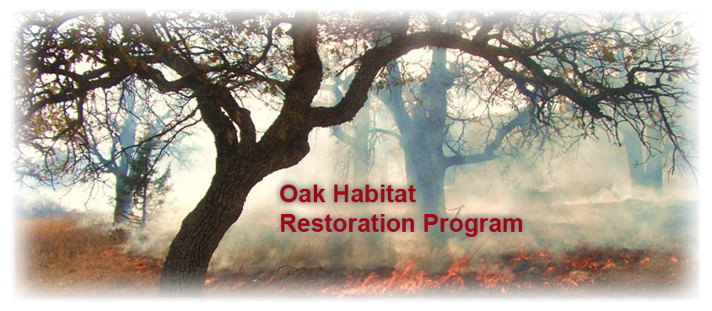
Credit – Minimized Site Disturbance
Plan
Built Project
Intent
To preserve existing noninvasive trees, native plants, and pervious surfaces.
Lori A. Brown, LEED AP ND – Power Jam Study! Lorisweb.com
55

Slide 56
Credit – Minimized Site Disturbance
Plan
Built Project
Requirements
Option 1. Development Footprint on Previously Developed Land (1 point)
Locate 100% of the development footprint and the construction impact zone on previously developed land.
OR
Lori A. Brown, LEED AP ND – Power Jam Study! Lorisweb.com
56

Slide 57
Credit – Minimized Site Disturbance
Plan
Built Project
Option 2. Undeveloped Portion of Project Left Undisturbed (1 point)
Depending on the density of the project, do not develop or disturb a portion of the site that has not been previously developed, exclusive of (1) any land preserved by codified law, (2) a prerequisite of LEED for Neighborhood Development or (3) exempt areas designated as nonbuildable in comprehensive land-use plans.
Lori A. Brown, LEED AP ND – Power Jam Study! Lorisweb.com
57

Slide 58
Credit – Minimized Site Disturbance
Plan
Built Project
Stipulate in covenants, conditions, and restrictions (CC&R) or other binding documents that the undisturbed area will be protected from development by a private or governmental agency for the purpose of long-term conservation. When determining the minimum area to be left undeveloped, mixed-use projects must use the lowest applicable density from Table 1 or use the weighted average methodology in NPD Credit Compact Development. Densities and minimum percentages are as follows:
Lori A. Brown, LEED AP ND – Power Jam Study! Lorisweb.com
58

Slide 59
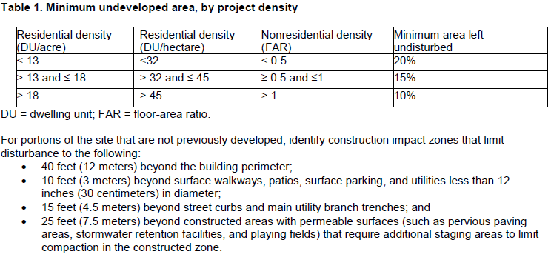
Credit – Minimized Site Disturbance
Plan
Built Project
Lori A. Brown, LEED AP ND – Power Jam Study! Lorisweb.com
59

Slide 60
Credit – Minimized Site Disturbance
Plan
Built Project
For All Projects
Survey the site to identify the following:
trees in good or excellent condition, as determined by an arborist certified by the International Society of Arboriculture (ISA);
any heritage or champion trees of special importance to the community because of their age, size, type, historical association, or horticultural value, as defined by a government forester;
all trees larger than 6 inches in diameter at breast height (dbh, 4 feet 6 inches above ground); and
any invasive plant species that affect trees present on the site, and whether those plants threaten the health of other trees to be preserved on the site, as determined by an ISA-certified arborist or local equivalent professional.
Lori A. Brown, LEED AP ND – Power Jam Study! Lorisweb.com
60

Slide 61
Credit – Minimized Site Disturbance
Plan
Built Project
Preserve the following trees that are also identified as in good or excellent condition:
all heritage or champion trees and trees whose dbh exceeds 50% of the state champion dbh for the species;
a minimum of 75% of all noninvasive trees (including the above) larger than 18 inches dbh; and
a minimum of 25% of all noninvasive trees (including the above) larger than 12 inches dbh if deciduous and 6 inches dbh if coniferous.
Lori A. Brown, LEED AP ND – Power Jam Study! Lorisweb.com
61

Slide 62
Credit – Minimized Site Disturbance
Plan
Built Project
Tree condition ratings must be determined by an ISA-certified arborist using ISA-approved assessment measures or by a local equivalent professional utilizing an equivalent methodology.
Develop a plan, in consultation with and approved by an ISA-certified arborist or equivalent, for the health of the trees, including fertilization and pruning, and for their protection during construction.
Lori A. Brown, LEED AP ND – Power Jam Study! Lorisweb.com
62

Slide 63
Credit – Minimized Site Disturbance
Plan
Built Project
If an ISA-certified arborist or local equivalent professional has determined that any trees to be preserved are threatened by invasive vegetation, develop a plan to reduce the invasive vegetation.
Stipulate in codes, covenants, and restrictions or other binding documents that the undisturbed area of the preserved trees will be protected from development by a private or governmental agency for the purpose of long-term conservation.
Lori A. Brown, LEED AP ND – Power Jam Study! Lorisweb.com
63

Slide 64
Credit – Rainwater Management
Plan
Built Project
Intent
To reduce runoff volume and improve water quality by replicating the natural hydrology and water balance of the site, based on historical conditions and undeveloped ecosystems in the region.
Lori A. Brown, LEED AP ND – Power Jam Study! Lorisweb.com
64

Slide 65
Credit – Rainwater Management
Plan
Built Project
Requirements
In a manner best replicating natural site hydrology processes, manage on site the runoff from the developed site for the percentile of regional or local rainfall events listed in Table 1, using low-impact development (LID) and green infrastructure.
Use daily rainfall data and the methodology in the U.S. Environmental Protection Agency (EPA) Technical Guidance on Implementing the Stormwater Runoff Requirements for Federal Projects under Section 438 of the Energy Independence and Security Act to determine the percentile amounts listed in Table 1. The percentile rainfall event indicates the total volume to be retained on site.
Lori A. Brown, LEED AP ND – Power Jam Study! Lorisweb.com
65

Slide 66
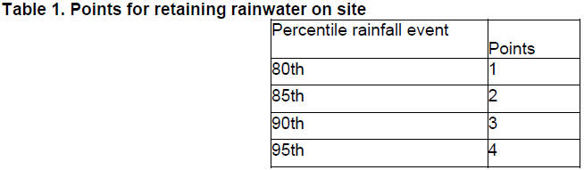
Credit – Rainwater Management
Plan
Built Project
Lori A. Brown, LEED AP ND – Power Jam Study! Lorisweb.com
66

Slide 67
Credit – Rainwater Management
Plan
Built Project
Projects that earn at least 2 points under this credit may earn an additional point if the site meets one of the following criteria.
The project is located on a previously developed site.
The project achieves 1 point in SLL Credit Brownfield Remediation.
The project is designed to be transit ready by achieving at least 2 points each under NPD Credit Walkable Streets, NPD Credit Compact Development, and NPD Credit Mixed-Use Neighborhoods.
Lori A. Brown, LEED AP ND – Power Jam Study! Lorisweb.com
67

Slide 68
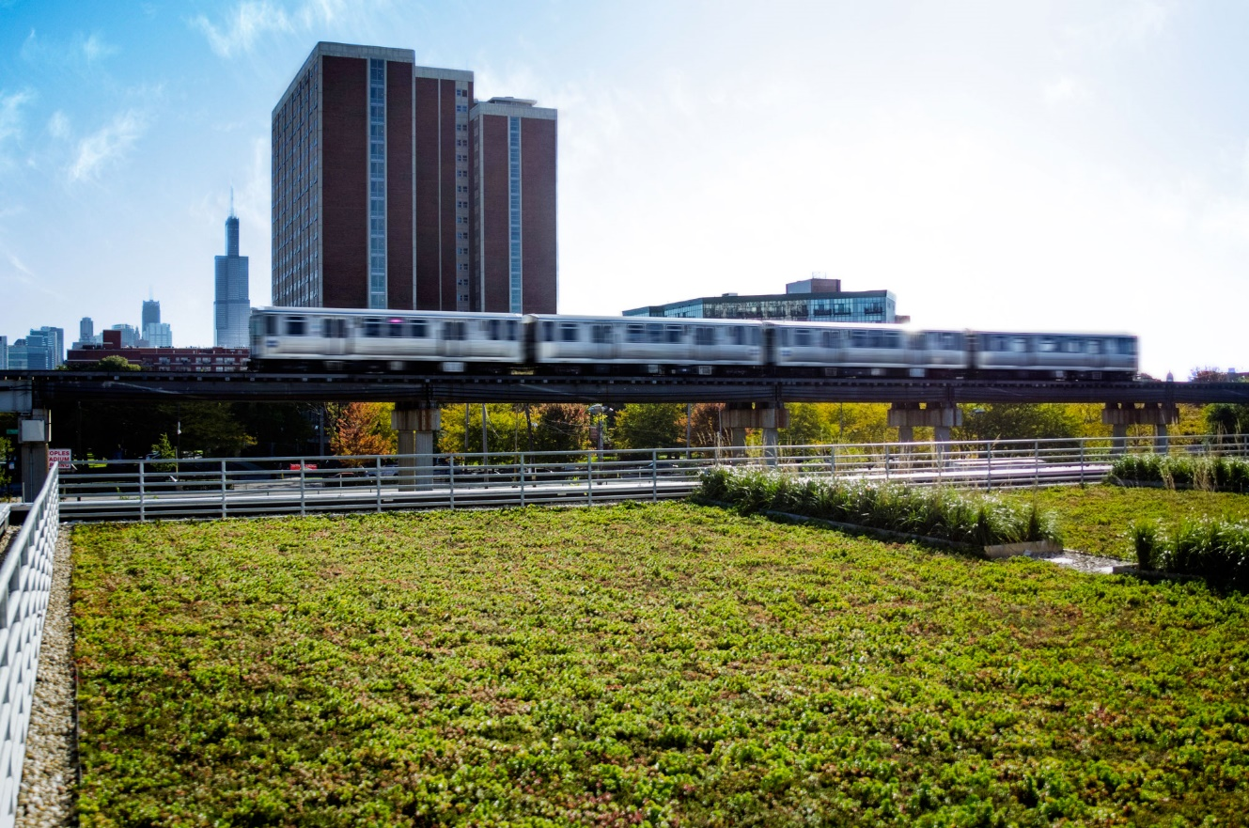
Credit – Heat Island Reduction
Plan
Built Project
Intent
To minimize effects on microclimates and human and wildlife habitats by reducing heat islands.
Lori A. Brown, LEED AP ND – Power Jam Study! Lorisweb.com
68

Slide 69
Credit – Heat Island Reduction
Plan
Built Project
Requirements
Option 1. Nonroof (1 point)
Use any combination of the following strategies for 50% of the nonroof site paving (including roads, sidewalks, courtyards, parking lots, parking structures, and driveways).
Use the existing plant material or install plants that provide shade over the paving areas on the site within 10 years of plant material installation.
Install and plant planters, either at grade or raised. Plant material cannot include artificial turf.
Provide shade with structures covered by energy generation systems, such as solar thermal collectors, photovoltaics, and wind turbines, that produce energy used to offset some nonrenewable resource use.
Provide shade with architectural devices or structures that have a three-year aged solar reflectance (SR) value of at least 0.28. If three-year aged value information is not available, use materials with an initial SR of at least 0.33 at installation,
Provide shade with vegetated structures.
Use paving materials with a three-year aged solar reflectance (SR) value of at least 0.28. If three-year aged value information is not available, use materials with an initial SR of at least 0.33 at installation.
Use an open-grid pavement system (at least 50% unbound).
OR
Lori A. Brown, LEED AP ND – Power Jam Study! Lorisweb.com
69

Slide 70
Credit – Heat Island Reduction
Plan
Built Project
Option 2. High-Reflectance and Vegetated Roofs (1 point)
Use roofing materials that have an SRI equal to or greater than the values in Table 1. Meet the three-year aged SRI value (if three-year aged value information is not available, use materials that meet the initial SRI value) for a minimum of 75% of the roof area of all new buildings within the project, or install a vegetated (“green”) roof for at least 75% of the roof area of all new buildings within the project. Combinations of SRI-compliant and vegetated roofs can be used, provided they satisfy the equation in Option 3.
Lori A. Brown, LEED AP ND – Power Jam Study! Lorisweb.com
70

Slide 71
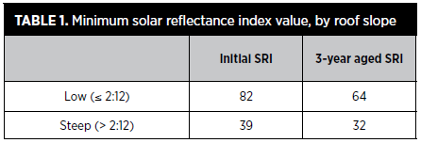
Credit – Heat Island Reduction
Plan
Built Project
Option 2. High-Reflectance and Vegetated Roofs (1 point)
Use roofing materials that have an SRI equal to or greater than the values in Table 1. Meet the three-year aged SRI value (if three-year aged value information is not available, use materials that meet the initial SRI value) for a minimum of 75% of the roof area of all new buildings within the project, or install a vegetated (“green”) roof for at least 75% of the roof area of all new buildings within the project. Combinations of SRI-compliant and vegetated roofs can be used, provided they satisfy the equation in Option 3.
Lori A. Brown, LEED AP ND – Power Jam Study! Lorisweb.com
71

Slide 72

Credit – Heat Island Reduction
Plan
Built Project
Option 3. Mixed Nonroof and Roof Measures (1 point)
Use any of the strategies listed under Options 1 and 2 that in combination meet the following criterion:
Lori A. Brown, LEED AP ND – Power Jam Study! Lorisweb.com
72

Slide 73
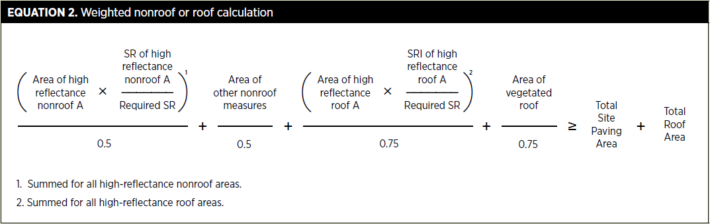
Credit – Heat Island Reduction
Plan
Built Project
Alternatively, an SRI and SR weighted average approach may be used to calculate compliance.
Lori A. Brown, LEED AP ND – Power Jam Study! Lorisweb.com
73

Slide 74
Credit – Solar Orientation
Plan
Built Project
Intent
To encourage energy efficiency by creating optimum conditions for the use of passive and active solar strategies.
Lori A. Brown, LEED AP ND – Power Jam Study! Lorisweb.com
74

Slide 75
Credit – Solar Orientation
Plan
Built Project
Requirements
Option 1. Block Orientation (1 point)
This option is for projects that earn at least 2 points under NPD Credit Compact Development.
Design and orient the project or locate the project on existing blocks such that one axis of 75% or more of the blocks is within ±15 degrees of geographical east-west, and the east-west lengths of those blocks are at least as long as the north-south lengths.
OR
Lori A. Brown, LEED AP ND – Power Jam Study! Lorisweb.com
75

Slide 76
Credit – Solar Orientation
Plan
Built Project
Option 2. Building Orientation (1 point)
Design and orient 75% or more of the project’s total building floor area (excluding existing buildings) such that one axis of each qualifying building is at least 1.5 times longer than the other, and the longer axis is within 15 degrees of geographical east-west. The length-to-width ratio applies only to walls enclosing conditioned spaces; walls enclosing unconditioned spaces, such as garages, arcades, or porches, cannot contribute to credit achievement. The surface area of equator-facing vertical surfaces and slopes of roofs of buildings counting toward credit achievement must not be more than 25% shaded at the time of initial occupancy, measured at noon on the winter solstice.
Lori A. Brown, LEED AP ND – Power Jam Study! Lorisweb.com
76

Slide 77
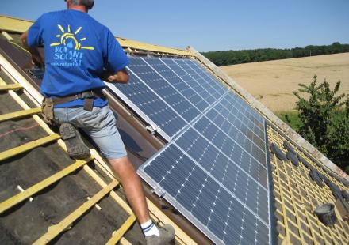
Credit – Renewable Energy Production
Plan
Built Project
Intent
To reduce the environmental and economic harms associated with fossil fuel energy by increasing self-supply of renewable energy.
Lori A. Brown, LEED AP ND – Power Jam Study! Lorisweb.com
77

Slide 78
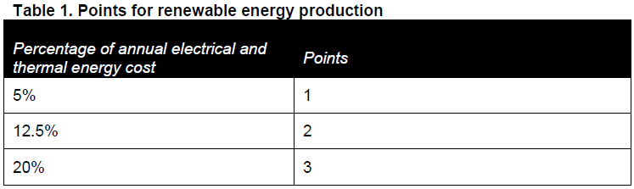
Credit – Renewable Energy Production
Plan
Built Project
Requirements
Incorporate on-site nonpolluting renewable energy generation, such as solar, wind, geothermal, small-scale or micro-hydroelectric, or biomass, with production capacity of at least 5% of the project’s annual electrical and thermal energy cost (exclusive of existing buildings).
Points are awarded according to Table 1.
Lori A. Brown, LEED AP ND – Power Jam Study! Lorisweb.com
78

Slide 79
Credit – District Heating and Cooling
Plan
Built Project
Intent
To encourage the development of energy-efficient neighborhoods by employing district heating and cooling strategies that reduce energy use and energy-related environmental harms.
Lori A. Brown, LEED AP ND – Power Jam Study! Lorisweb.com
79

Slide 80
Credit – District Heating and Cooling
Plan
Built Project
Requirements
Incorporate a district heating and/or cooling system for space conditioning and/or water heating of new buildings (at least two buildings total) such that at least 80% of the project’s annual heating and/or cooling consumption is provided by the district plant. Single-family residential buildings and existing buildings of any type may be excluded from the calculation.
Lori A. Brown, LEED AP ND – Power Jam Study! Lorisweb.com
80

Slide 81
Credit – District Heating and Cooling
Plan
Built Project
Each system component that is addressed by ANSI/ASHRAE/IESNA Standard 90.1–2010 must have an overall efficiency performance at least 10% better than that specified by the standard’s prescriptive requirements. Additionally, annual district pumping energy consumption that exceeds 2.5% of the annual thermal energy output of the heating and cooling plant must be offset by increases in the component’s efficiency beyond the 10% improvement.
Lori A. Brown, LEED AP ND – Power Jam Study! Lorisweb.com
81

Slide 82
Credit – District Heating and Cooling
Plan
Built Project
If a combined heat and power (CHP) system is used to comply with the credit requirements, show equivalence by demonstrating that energy consumption savings from the CHP plant at least equal the energy savings that would result from using a conventional district energy system with components that are 10% better than ANSI/ASHRAE/IESNA Standard 90.1–2010. When determining equivalency, take into account the pumping energy as described above.
Lori A. Brown, LEED AP ND – Power Jam Study! Lorisweb.com
82

Slide 83
Credit – Infrastructure Energy Efficiency
Plan
Built Project
Intent
To reduce the environmental harms from energy used for operating public infrastructure.
Lori A. Brown, LEED AP ND – Power Jam Study! Lorisweb.com
83

Slide 84
Credit – Infrastructure Energy Efficiency
Plan
Built Project
Requirements
Design, purchase, or work with the municipality to install all new infrastructure (e.g., traffic lights, street lights, water and wastewater pumps) to achieve a 15% annual energy reduction below an estimated baseline energy use for this infrastructure. When determining the baseline, assume the use of lowest first-cost infrastructure items.
Lori A. Brown, LEED AP ND – Power Jam Study! Lorisweb.com
84

Slide 85
Credit – Wastewater Management
Plan
Built Project
Intent
To reduce pollution from wastewater and encourage water reuse.
Lori A. Brown, LEED AP ND – Power Jam Study! Lorisweb.com
85

Slide 86
Credit – Wastewater Management
Plan
Built Project
Requirements
Design and construct the project to retain on-site at least 25% of the average annual wastewater generated by the project (excluding any existing buildings), and reuse that wastewater to replace potable water.
Lori A. Brown, LEED AP ND – Power Jam Study! Lorisweb.com
86

Slide 87
Credit – Wastewater Management
Plan
Built Project
Provide on-site treatment to a quality required by state and local regulations for the proposed reuse, whichever is more stringent.
Lori A. Brown, LEED AP ND – Power Jam Study! Lorisweb.com
87

Slide 88
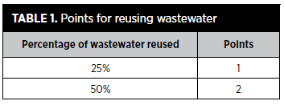
Credit – Wastewater Management
Plan
Built Project
Calculate the percentage of wastewater diverted and reused by determining the total wastewater flow, using the design case from GIB Prerequisite Indoor Water Use Reduction and adding wastewater flow from residential buildings, then determining how much of that volume is reused on site.
Lori A. Brown, LEED AP ND – Power Jam Study! Lorisweb.com
88

Slide 89
Credit – Recycled and Reused Infrastructure
Plan
Built Project
Intent
To avoid the environmental consequences of extracting and processing virgin materials by using recycled and reclaimed materials.
Lori A. Brown, LEED AP ND – Power Jam Study! Lorisweb.com
89

Slide 90
Credit – Recycled and Reused Infrastructure
Plan
Built Project
Requirements
Use materials for new infrastructure such that the sum of the postconsumer recycled content, on-site reused materials, and one-half of the preconsumer recycled content constitutes at least 50% of the total mass of infrastructure materials.
Lori A. Brown, LEED AP ND – Power Jam Study! Lorisweb.com
90

Slide 91
Credit – Recycled and Reused Infrastructure
Plan
Built Project
Count materials in all of the following infrastructure items, as applicable:
roadways, parking lots, sidewalks, unit paving, and curbs;
water retention tanks and vaults;
base and sub-base materials for the above; and
rainwater, sanitary sewer, steam energy distribution, and water piping.
Recycled content is defined in accordance with ISO/IEC 14021, Environmental Labels and Declaration, Self-Declared Environmental Claims (Type II environmental labeling).
Lori A. Brown, LEED AP ND – Power Jam Study! Lorisweb.com
91

Slide 92
Credit – Solid Waste Management
Plan
Built Project
Intent
To reduce the volume of waste deposited in landfills and promote the proper disposal of hazardous waste.
Lori A. Brown, LEED AP ND – Power Jam Study! Lorisweb.com
92

Slide 93
Credit – Solid Waste Management
Plan
Built Project
Requirements
Meet at least four of the following five requirements and publicize their availability and benefits.
Include as part of the project at least one recycling or reuse station, available to all project occupants, dedicated to the separation, collection, and storage of materials for recycling; or locate the project in a local government jurisdiction that provides recycling services. The recycling must cover at least paper, corrugated cardboard, glass, plastics, and metals.
Lori A. Brown, LEED AP ND – Power Jam Study! Lorisweb.com
93

Slide 94
Credit – Solid Waste Management
Plan
Built Project
Include as part of the project at least one drop-off point, available to all project occupants, for potentially hazardous office or household wastes and establish a plan for postcollection disposal or use; or locate the project in a local government jurisdiction that provides collection services. Examples of potentially hazardous wastes include paints, solvents, oil, mercury-containing lamps, electronic waste, and batteries
Lori A. Brown, LEED AP ND – Power Jam Study! Lorisweb.com
94

Slide 95
Credit – Solid Waste Management
Plan
Built Project
Include as part of the project at least one compost station or location, available to all project occupants, dedicated to the collection and composting of food and yard wastes, and establish a plan for postcollection use; or locate the project in a local government jurisdiction that provides composting services.
Lori A. Brown, LEED AP ND – Power Jam Study! Lorisweb.com
95

Slide 96
Credit – Solid Waste Management
Plan
Built Project
On every mixed-use or nonresidential block or at least every 800 feet, whichever is shorter, include recycling containers either adjacent to or integrated into the design of other receptacles.
Lori A. Brown, LEED AP ND – Power Jam Study! Lorisweb.com
96

Slide 97
Credit – Solid Waste Management
Plan
Built Project
Recycle, reuse, or salvage at least 50% of nonhazardous construction, demolition, and renovation debris. Calculations can be done by weight or volume but must be consistent throughout. Develop and implement a construction waste management plan that identifies the materials to be diverted from disposal and specifies whether the materials will be stored on site or commingled. Reused or recycled asphalt, brick, and concrete (ABC) can account for no more than 75% of the diverted waste total. Excavated soil, land-clearing debris, alternative daily cover (ADC), and materials contributing toward GIB Credit Building Reuse do not qualify for this credit.
Lori A. Brown, LEED AP ND – Power Jam Study! Lorisweb.com
97

Slide 98
Credit – Light Pollution Reduction
Plan
Built Project
Intent
To increase night sky access, improve nighttime visibility, and reduce the consequences of development for wildlife and people.
Lori A. Brown, LEED AP ND – Power Jam Study! Lorisweb.com
98

Slide 99
Credit – Light Pollution Reduction
Plan
Built Project
Requirements
Meet the Light Pollution Reduction requirements for the following:
One option in Exterior Lighting for Residential Areas
Exterior Lighting for Circulation Network
Uplight and light trespass requirements in Exterior Lighting for All Other Areas
Covenants, Conditions, and Restrictions.
Lori A. Brown, LEED AP ND – Power Jam Study! Lorisweb.com
99

Slide 100
Credit – Light Pollution Reduction
Plan
Built Project
Divide the project into model lighting ordinance (MLO) lighting zones LZ0 to LZ4 based on site-specific characteristics using the definitions of lighting zones provided in the Illuminating Engineering Society and International Dark Sky Association (IES/IDA) MLO User Guide.
Meet the requirements below for each lighting zone within the project.
Lori A. Brown, LEED AP ND – Power Jam Study! Lorisweb.com
100

Slide 101
Credit – Light Pollution Reduction
Plan
Built Project
Site Zone Classifications
Lori A. Brown, LEED AP ND – Power Jam Study! Lorisweb.com
101

Slide 102
Credit – Light Pollution Reduction
Plan
Built Project
Exterior Lighting for Residential Areas
Meet either Option 1 or Option 2 for all exterior lighting in new residential construction and residential buildings undergoing major renovations. Existing residential construction is exempt. Projects may use different options for uplight and light trespass.
Option 1. BUG Rating Method
Each fixture must have a backlight-uplight-glare (BUG) rating (as defined in IES TM-15-11, Addendum A) of no more than B2-U2-G2.
OR
Option 2. Calculation Method
Meet the requirements of Option 2 in Exterior Lighting for All Other Areas, below.
Lori A. Brown, LEED AP ND – Power Jam Study! Lorisweb.com
102

Slide 103
Credit – Light Pollution Reduction
Plan
Built Project
Exterior Lighting for Circulation Network
For any portions of the circulation network not governed by national, state, or other superseding regulations, do not install street lighting unless conditions warrant the need for street lighting.
New and existing street lighting luminaires must not emit any light above 90 degrees (horizontal), based on the photometric characteristics of each luminaire when mounted in the same orientation and tilt as specified in the project design or as currently installed.
Lori A. Brown, LEED AP ND – Power Jam Study! Lorisweb.com
103

Slide 104
Credit – Light Pollution Reduction
Plan
Built Project
Exception for ornamental luminaires: Using the lowest MLO lighting zone for immediately adjacent properties, meet the requirements of the IES/IDA MLO, Table H.
AND
Lori A. Brown, LEED AP ND – Power Jam Study! Lorisweb.com
104

Slide 105
Credit – Light Pollution Reduction
Plan
Built Project
Exterior Lighting for All Other Areas
Use either the BUG method (Option 1) or the calculation method (Option 2) to meet uplight and light trespass requirements. Projects may use different options for uplight and light trespass.
Lori A. Brown, LEED AP ND – Power Jam Study! Lorisweb.com
105

Slide 106
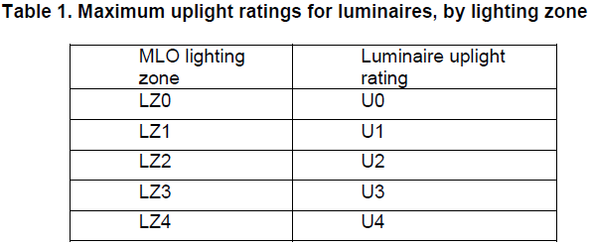
Credit – Light Pollution Reduction
Plan
Built Project
Uplight
Option 1. BUG Rating Method
Do not exceed the following luminaire uplight ratings, based on the specific light source installed in the luminaire as defined in IES TM-15-11, Addendum A.
Lori A. Brown, LEED AP ND – Power Jam Study! Lorisweb.com
106

Slide 107
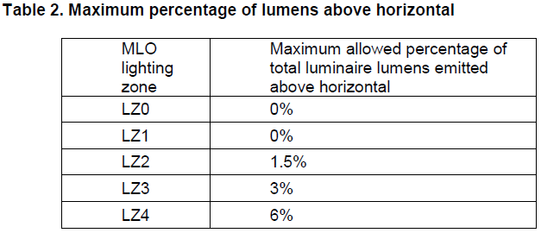
Credit – Light Pollution Reduction
Plan
Built Project
Option 2. Calculation Method
Do not exceed the following maximum percentages of total lumens emitted above horizontal.
Lori A. Brown, LEED AP ND – Power Jam Study! Lorisweb.com
107

Slide 108
Credit – Light Pollution Reduction
Plan
Built Project
Light Trespass
Option 1. BUG Rating Method
Do not exceed the following luminaire backlight and glare ratings (based on the specific light source installed in the luminaire) as defined in IES TM-15-11, Addendum A, based on the mounting location and distance from the lighting boundary.
Lori A. Brown, LEED AP ND – Power Jam Study! Lorisweb.com
108

Slide 109
Credit – Light Pollution Reduction
Plan
Built Project
Light Trespass
Option 1. BUG Rating Method
Do not exceed the following luminaire backlight and glare ratings (based on the specific light source installed in the luminaire) as defined in IES TM-15-11, Addendum A, based on the mounting location and distance from the lighting boundary.
Lori A. Brown, LEED AP ND – Power Jam Study! Lorisweb.com
109

Slide 110
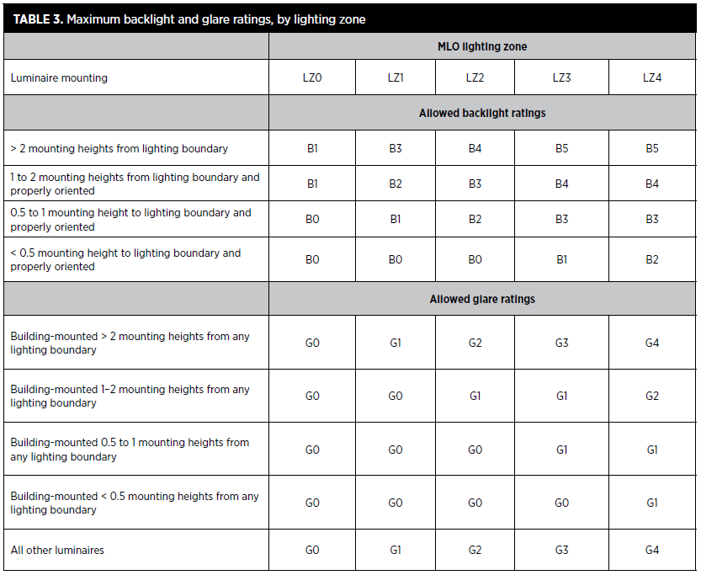
Credit – Light Pollution Reduction
Plan
Built Project
Lori A. Brown, LEED AP ND – Power Jam Study! Lorisweb.com
110

Slide 111
Credit – Light Pollution Reduction
Plan
Built Project
A lighting boundary (or boundaries) is defined as the perimeter of each lighting zone within the project boundary. A lighting boundary can be modified under the following conditions:
When the property line is adjacent to a public area that is a walkway, bikeway, plaza, or parking lot, the lighting boundary may be moved to 5 feet beyond the property line;
When the property line is adjacent to a public street, alley, or transit corridor, the lighting boundary may be moved to the center line of that street, alley, or corridor;
When there are additional properties owned by the same entity that are contiguous to the property, or properties, that the LEED project is within and have the same or higher MLO lighting zone designation as the LEED project, the lighting boundary may be expanded to include those properties.
Lori A. Brown, LEED AP ND – Power Jam Study! Lorisweb.com
111

Slide 112
Credit – Light Pollution Reduction
Plan
Built Project
Orient all luminaires less than two mounting heights from the lighting boundary such that the backlight points toward the nearest lighting boundary line. Building-mounted luminaires with the backlight oriented toward the building are exempt from the backlight rating requirement.
Lori A. Brown, LEED AP ND – Power Jam Study! Lorisweb.com
112

Slide 113
Credit – Light Pollution Reduction
Plan
Built Project
Option 2. Calculation Method
Do not exceed the following vertical illuminances at the lighting boundary of each lighting zone in the project (use the definition of lighting boundary in Option 1). Calculation points may be no more than 5 feet apart. Vertical illuminances must be calculated on vertical planes running parallel to the lighting boundary, with the normal to each plane oriented toward the property and perpendicular to the lighting boundary, extending from grade level to 33 feet above the height of the highest luminaire.
Lori A. Brown, LEED AP ND – Power Jam Study! Lorisweb.com
113

Slide 114
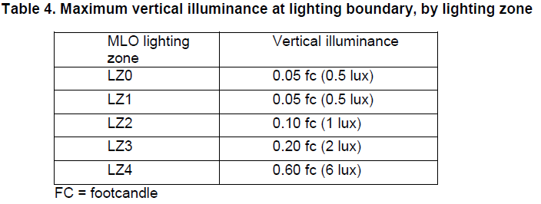
Credit – Light Pollution Reduction
Plan
Built Project
Lori A. Brown, LEED AP ND – Power Jam Study! Lorisweb.com
114

Slide 115
Credit – Light Pollution Reduction
Plan
Built Project
Exemptions from Uplight and Light Trespass Requirements
The following exterior lighting is exempt from the requirements, provided it is controlled separately from the nonexempt lighting:
specialized signal, directional, and marker lighting for transportation;
internally illuminated signage;
lighting that is used solely for façade and landscape lighting in MLO lighting zones 3 and 4 and is automatically turned off from midnight until 6 a.m.;
lighting that is integral to other equipment or instrumentation that has been installed by the equipment or instrumentation manufacturer;
lighting for theatrical purposes for stage, film, and video performances;
street lighting;
hospital emergency departments, including associated helipads; and
lighting for the national flag in MLO lighting zones 2, 3, or 4.
Lori A. Brown, LEED AP ND – Power Jam Study! Lorisweb.com
115

Slide 116
Credit – Light Pollution Reduction
Plan
Built Project
Covenants, Conditions, and Restrictions
Establish covenants, conditions, and restrictions (CC&R) or other binding documents that require continued adherence to the above requirements.
Lori A. Brown, LEED AP ND – Power Jam Study! Lorisweb.com
116

Slide 117



