Slide 1

Fundamentals of LEED v4 for
Neighborhood Development
Exam Preparation
Lori A. Brown, LEED AP BD+C – Power Jam Study! Lorisweb.com
1

Slide 2

Lori A. Brown, LEED AP BD+C – Power Jam Study! Lorisweb.com
2

Slide 3

Innovation
Lori A. Brown, LEED AP BD+C – Power Jam Study! Lorisweb.com
3

Slide 4

Credit Innovation
Intent
To encourage projects to achieve exceptional or innovative performance.
Lori A. Brown, LEED AP BD+C – Power Jam Study! Lorisweb.com
4

Slide 5
Credit Innovation
Requirements
Project teams can use any combination of innovation, pilot, and exemplary performance strategies.
Option 1. Innovation (1 point)
Achieve significant, measurable environmental performance using a strategy not addressed in the LEED green building rating system.
Identify the following:
the intent of the proposed innovation credit;
proposed requirements for compliance;
proposed submittals to demonstrate compliance; and
the design approach or strategies used to meet the requirements.
Lori A. Brown, LEED AP BD+C – Power Jam Study! Lorisweb.com
5

Slide 6
Credit Innovation
AND/OR
Option 2. Pilot (1 point)
Achieve one pilot credit from USGBC’s LEED Pilot Credit Library.
Lori A. Brown, LEED AP BD+C – Power Jam Study! Lorisweb.com
6

Slide 7
Credit Innovation
AND/OR
Option 3. Additional Strategies
Innovation (1-3 points)
Defined in Option 1 above.
Pilot (1-3 points)
Meet the requirements of Option 2.
Exemplary Performance (1–2 points)
Achieve exemplary performance in an existing LEED v4 prerequisite or credit that allows exemplary performance, as specified in the LEED Reference Guide, v4 edition.
An exemplary performance point is typically earned for achieving double the credit requirements or the next incremental percentage threshold.
Lori A. Brown, LEED AP BD+C – Power Jam Study! Lorisweb.com
7

Slide 8





Credit Innovation
Innovation (1 to 3 points)
Points can also be earned by achieving selected credits from other LEED rating systems.
Lori A. Brown, LEED AP BD+C – Power Jam Study! Lorisweb.com
8

Slide 9
Credit Innovation
Innovation (1 to 3 points)
IN Credits awarded to one project does not automatically constitute approval for a similar strategy in a future project.
IN Credits are not awarded for the use of a particular product or design strategy if the technology aids in the achievement of an existing LEED credit.
Project team must sufficiently document the achievement using the LEED credit equivalence process.
Lori A. Brown, LEED AP BD+C – Power Jam Study! Lorisweb.com
9

Slide 10

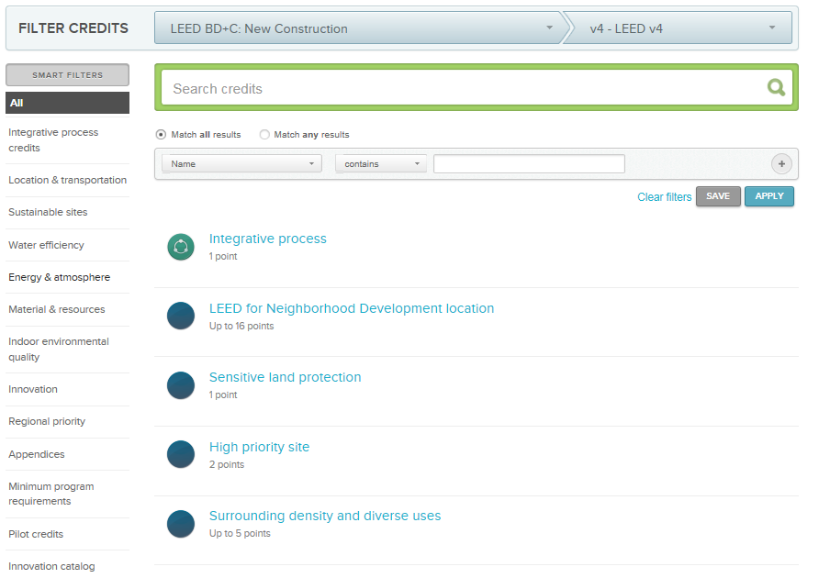
Credit Innovation
Innovation (1 to 3 points)
Online Innovation database
Lori A. Brown, LEED AP BD+C – Power Jam Study! Lorisweb.com
10

Slide 11
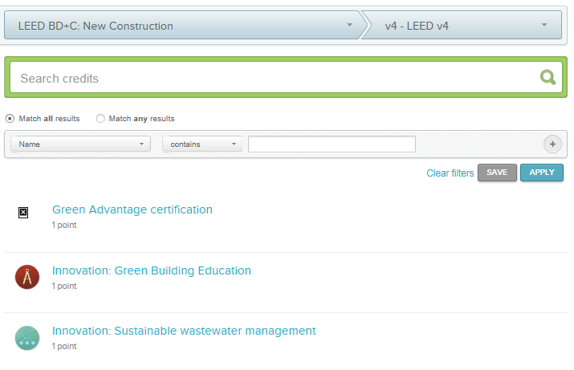
Credit Innovation
Innovation (1 to 3 points)
Online Innovation database
Lori A. Brown, LEED AP BD+C – Power Jam Study! Lorisweb.com
11

Slide 12
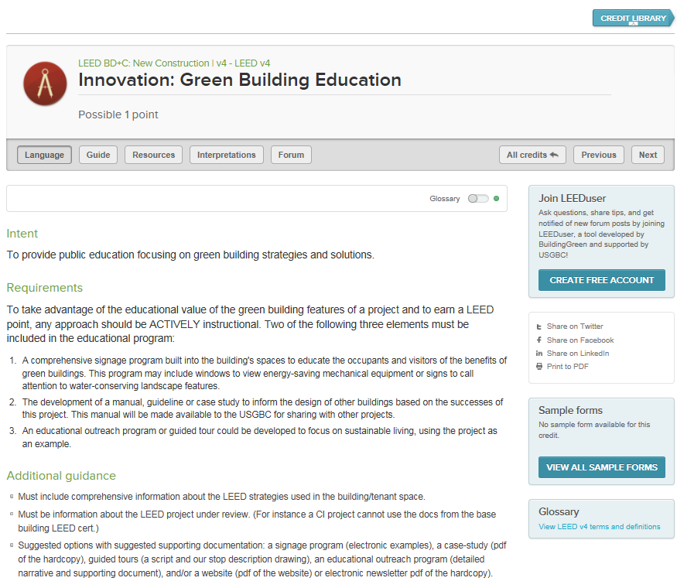
Credit Innovation
Lori A. Brown, LEED AP BD+C – Power Jam Study! Lorisweb.com
12

Slide 13
Innovation (IN)
Innovation (1 to 3 points)
Examples:
  Educational Outreach Program
  Green Housekeeping
  High Volume Fly Ash
  ISO 14040 Life-Cycle Assessment
  Waste Management and Diversion Programs
  Low-Emitting Furniture & Furnishings
  Organic Landscaping and Integrated Pest Management Program
Lori A. Brown, LEED AP BD+C – Power Jam Study! Lorisweb.com
13

Slide 14

Credit Innovation
Pilot (1 to 3 points)
Achieve one pilot credit from USGBC’s LEED Pilot Credit Library
Select Credit
Register Pilot Credit
Implement
Provide Feedback
Document Credit
http://www.usgbc.org/pilotcredits
Lori A. Brown, LEED AP BD+C – Power Jam Study! Lorisweb.com
14

Slide 15
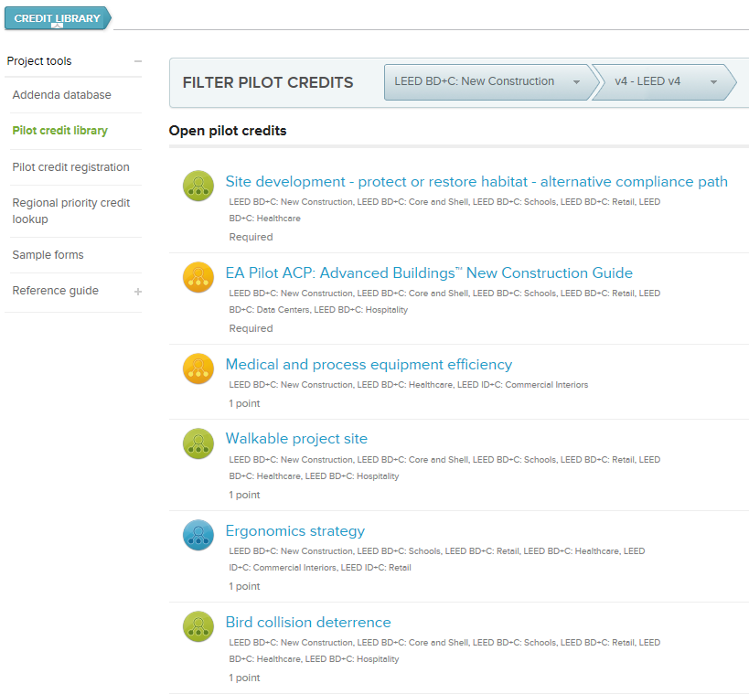
Credit Innovation
Lori A. Brown, LEED AP BD+C – Power Jam Study! Lorisweb.com
15

Slide 16
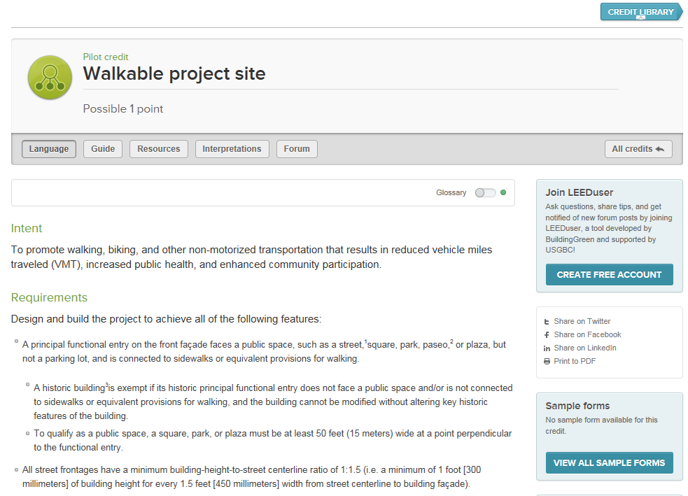
Credit Innovation
Lori A. Brown, LEED AP BD+C – Power Jam Study! Lorisweb.com
16

Slide 17


Credit Innovation
Exemplary Performance (1 to 2 points)
Achieve exemplary performance in an existing LEED v4 prerequisite or credit that allows exemplary performance, as specified in the LEED Reference Guide, v4 edition.
An exemplary performance point is typically earned for achieving double the credit requirements or the next incremental percentage threshold.
Lori A. Brown, LEED AP BD+C – Power Jam Study! Lorisweb.com
17

Slide 18

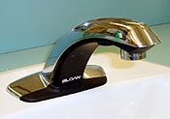
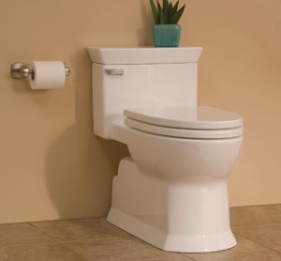
Credit Innovation
Exemplary Performance Example:
WE Credit Indoor Water Use Reduction
Percentage Points
20% Required
25% 1
30% 2
35% 3
40% 4
45% 5 (S, R, HOS, HC)
50% 6
≥ 55% 1 [IN Credit Innovation]
Lori A. Brown, LEED AP BD+C – Power Jam Study! Lorisweb.com
18

Slide 19

Credit Innovation
Exemplary Performance Example:
EA Credit Optimize Energy Performance
New Construction
Percentage Points
6% 1
8% 2
10% 3
12% 4
14% 5
.
.
50% 18
≥ 54% 1 [IN Credit Innovation]
Lori A. Brown, LEED AP BD+C – Power Jam Study! Lorisweb.com
19

Slide 20
Credit Innovation
Exemplary Performance Example:
MR Credit Construction and Demolition Waste Management
Option 1. Diversion (1–2 points)
Path 1. Divert 50% and Three Material Streams (1 point); or
Path 2. Divert 75% and Four Material Streams (2 points)
AND
Option 2. Reduction of Total Waste Material (2 points)
Do not generate more than 2.5 pounds of construction waste per square foot of the building’s floor area.
Lori A. Brown, LEED AP BD+C – Power Jam Study! Lorisweb.com
20

Slide 21
Credit Innovation
Exemplary Performance Credits:
LT Credit High Priority Site
LT Credit Access to Quality Transit
LT Credit Reduced Parking Footprint
SS Credit Site Development - Protect or Restore Habitat
SS Credit Rainwater Management
SS Credit Heat Island Reduction
SS Credit Places of Respite
WE Credit Indoor Water Use Reduction
EA Credit Optimize Energy Performance
EA Credit Renewable Energy Production, except CS
MR Credit Building Life-Cycle Impact Reduction
MR Credit BPD&O – Environmental Product Declarations
MR Credit BPD&O – Sourcing of Raw Materials
MR Credit BPD&O – Material Ingredients
MR Credit Furniture and Medical Furnishings
MR Credit Construction and Demolition Waste Management
EQ Credit Enhanced Indoor Air Quality Strategies
EQ Credit Low-Emitting Materials
EQ Credit Quality Views
Lori A. Brown, LEED AP BD+C – Power Jam Study! Lorisweb.com
21

Slide 22
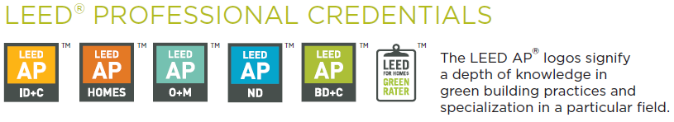
Credit LEED Accredited Professional
Intent
To encourage the team integration required by a LEED project and to
streamline the application and certification process.
Lori A. Brown, LEED AP BD+C – Power Jam Study! Lorisweb.com
22

Slide 23

Credit LEED Accredited Professional
Requirements
At least one principal participant of the project team must be a
LEED Accredited Professional (AP) with a specialty appropriate for the project.
1 point for having one LEED AP with specialty on the project.
No additional points for having more than one LEED AP with specialty on the project.
Lori A. Brown, LEED AP BD+C – Power Jam Study! Lorisweb.com
23

Slide 24

Credit LEED Accredited Professional
Requirements
LEED APs without specialty (legacy LEED APs) do not qualify for this credit.
LEED AP
Lori A. Brown, LEED AP BD+C – Power Jam Study! Lorisweb.com
24

Slide 25
Credit LEED Accredited Professional
Required Documentation
Full Name and Specialty Credential of LEED AP
Lori A. Brown, LEED AP BD+C – Power Jam Study! Lorisweb.com
25

Slide 26
Credit LEED Accredited Professional
Maintaining a LEED Credential
The LEED AP with specialty credential can be maintained through either of the following methods:
Retaking and passing the LEED accreditation exam
Earning 30 continuing education hours per credentialing period
CMP = Credential Maintenance Program
My Account, Credentials (USGBC Web site)
Lori A. Brown, LEED AP BD+C – Power Jam Study! Lorisweb.com
26

Slide 27
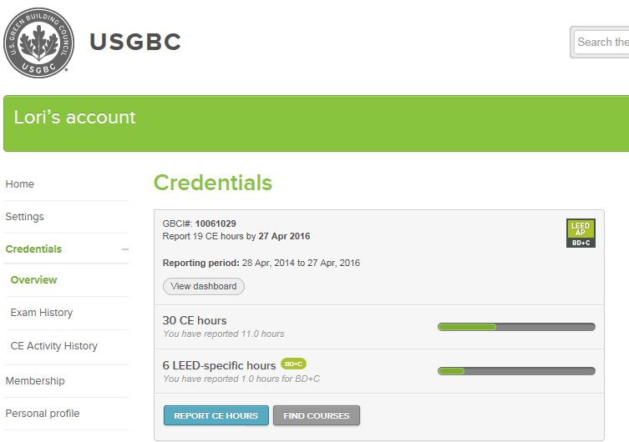
Credit LEED Accredited Professional
Lori A. Brown, LEED AP BD+C – Power Jam Study! Lorisweb.com
27

Slide 28
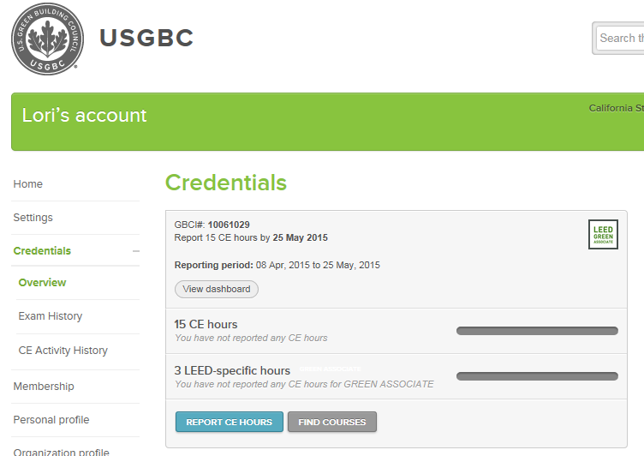
Credit LEED Accredited Professional
Lori A. Brown, LEED AP BD+C – Power Jam Study! Lorisweb.com
28

Slide 29

REGIONAL PRIORITY
Credit Regional Priority: Specific Credit 1
Credit Regional Priority: Specific Credit 1
Credit Regional Priority: Specific Credit 1
Credit Regional Priority: Specific Credit 1
Total Points 4
Lori A. Brown, LEED AP BD+C – Power Jam Study! Lorisweb.com
29

Slide 30
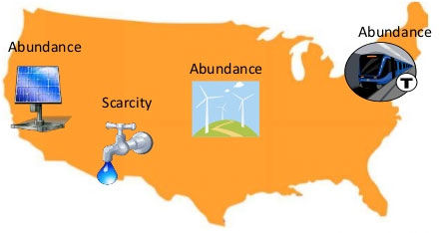
RP Credit Regional Priority: Specific Credit
NC, CS, S, R, DC, WDC, HOS, HC
Intent
To provide an incentive for the achievement of credits that address
geographically specific environmental, social equity, and public health
priorities.
Lori A. Brown, LEED AP BD+C – Power Jam Study! Lorisweb.com
30

Slide 31
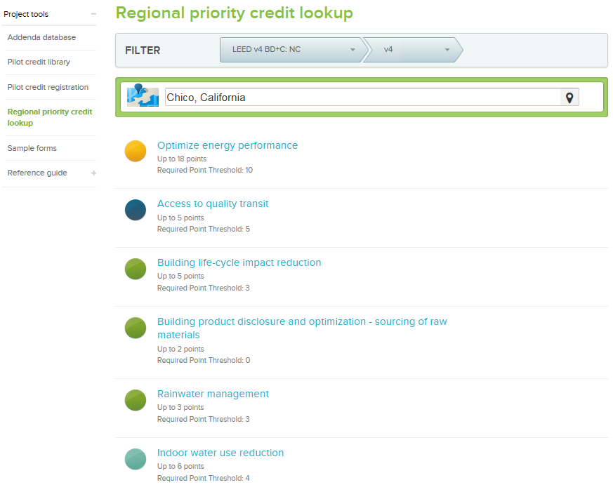
RP Credit Regional Priority: Specific Credit
NC, CS, S, R, DC, WDC, HOS, HC
Requirements
Earn up to four of the six Regional Priority credits.
These credits have been identified by the USGBC regional councils and chapters as having additional regional importance for the project’s region.
Lori A. Brown, LEED AP BD+C – Power Jam Study! Lorisweb.com
31

Slide 32
RP Credit Regional Priority: Specific Credit
NC, CS, S, R, DC, WDC, HOS, HC
Requirements
A database of Regional Priority credits and their geographic applicability is available on the USGBC website, http://www.usgbc.org/rpc
Select:
Rating System
Version
Country or Region
City, State (Location) or Zip Code (U.S.) can be used
One point is awarded for each Regional Priority credit achieved, up to a maximum of four.
Lori A. Brown, LEED AP BD+C – Power Jam Study! Lorisweb.com
32

Slide 33
RP Credit Regional Priority: Specific Credit
NC, CS, S, R, DC, WDC, HOS, HC
Required Documentation
No additional documentation is required to earn Regional Priority credits.
Document compliance for the selected credits, and the related
RP bonus points for their achievement will be awarded automatically.
Lori A. Brown, LEED AP BD+C – Power Jam Study! Lorisweb.com
33

Slide 34



