Slide 1
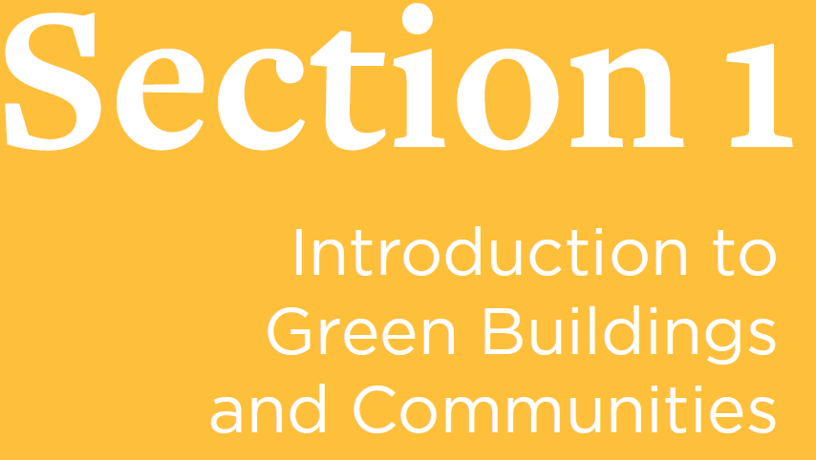

Slide 2
Our built environment is all around us; it provides the setting for all our lives' events, big and small. And whether we notice it or not, our built environment plays a huge role in our natural environment, our economic environment, and our cultural environment. The built environment provides a context for facing and addressing humankind's greatest contemporary challenges.
Green building can help us create more vital communities, more healthful indoor and outdoor spaces, and stronger connections to nature.
built environment any environment that is man made and provides a structure for human activity.
green building encompasses planning, design, construction, operations, and ultimately end-of-life recycling or renewal of structures. Green building pursues solutions that represent a healthy and dynamic balance between environmental, social, and economic benefits.
sustainability meeting the needs of the present without compromising the ability of future generations to meet their own needs. (Brundtland Commission)

Slide 3
Why is green building necessary? Buildings and communities, including the resources used to create them and the energy, water, and materials needed to operate them, have a significant effect on the environment and human health.
In the United States, buildings account for:
• 14% of potable water consumption!
• 30% of waste output
• 40% of raw materials use
• 38% of carbon dioxide emissions
• 24% to 50% of energy use
• 72% of electricity consumption

Slide 4
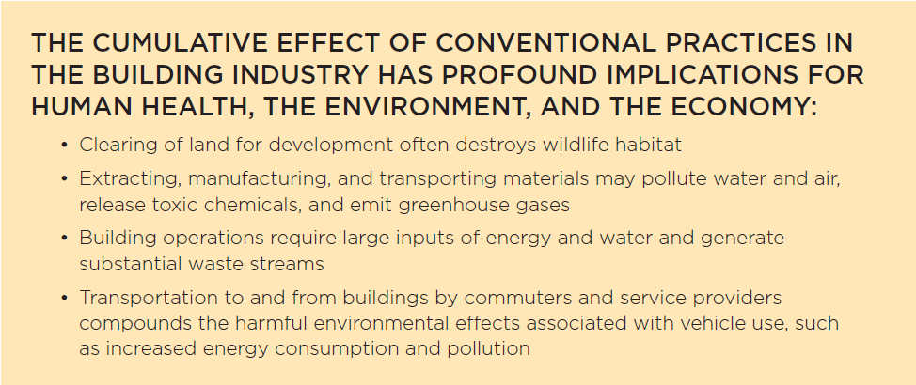
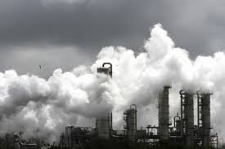
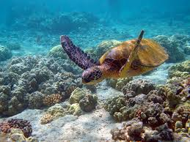
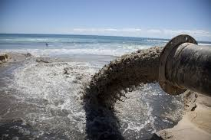

Slide 5
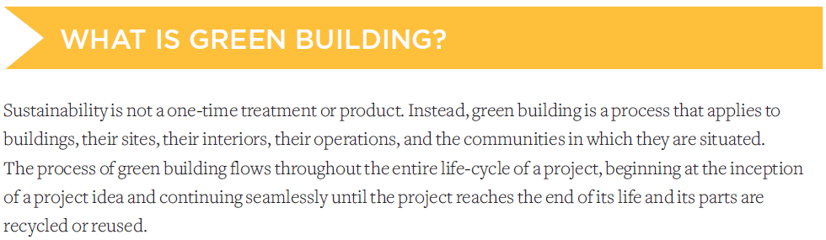
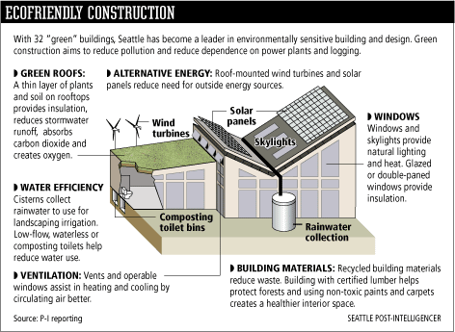

Slide 6

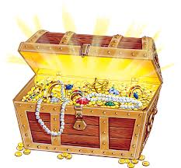
Save energy
Use less water
Generate less waste
Provide more healthful, more comfortable indoor environments

Slide 7
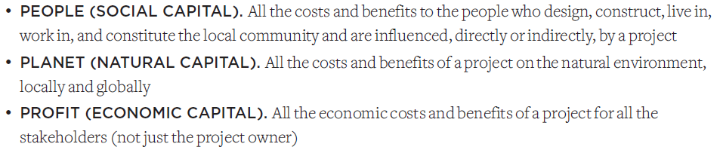
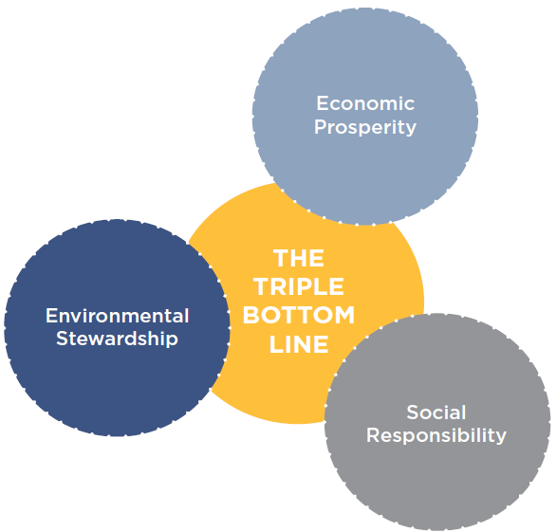
Triple Bottom Line

Slide 8
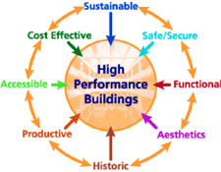
Green building is about finding the best combination of solutions to create built environments that seamlessly integrate the best of the old and the new in intelligent and creative ways.

Slide 9


The mission of USGBC is “to transform the way buildings and communities are designed, built and operated, enabling an environmentally and socially responsible, healthy, and prosperous environment that improves the quality of life.”
USGBC supports achievement of this mission through education
programs, advocacy, research, an extensive network of local chapters, and the LEED green building program.

Slide 10
The goal of LEED is market transformation—to fundamentally change how we design, build, and operate buildings and communities—through certification that honors levels of achievement in areas such as:
Energy Savings
Water Efficiency
CO₂ Emissions Reduction
Improved Indoor Environmental Quality
Stewardship of Resources

Slide 11
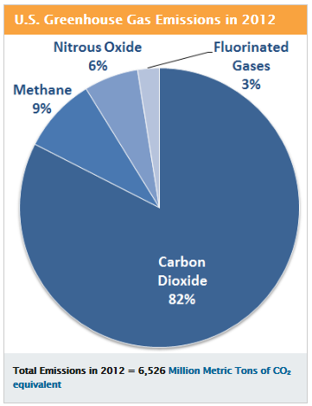
The built environment, including buildings and transportation systems, accounts for more than two-thirds of all greenhouse gas emissions.

Slide 12
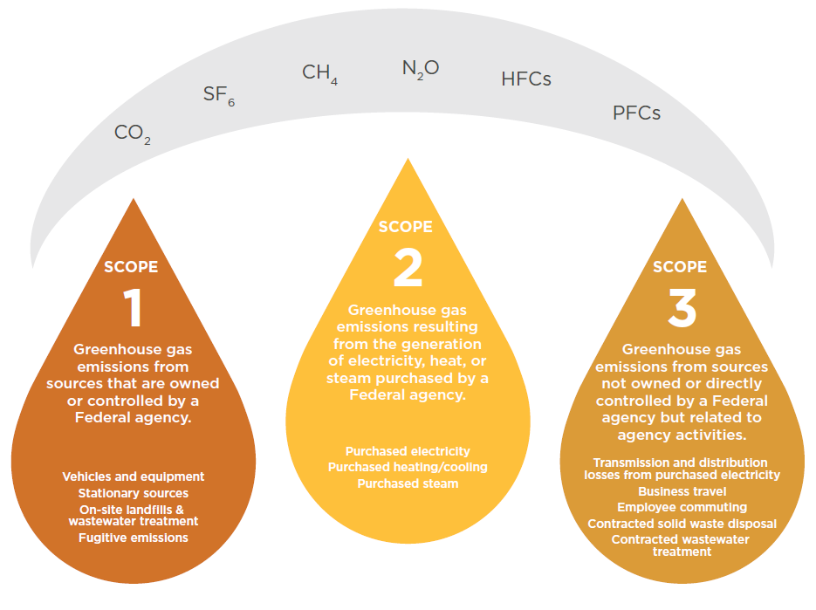
Greenhouse gas emissions come from many components of the built
environment, including building systems and energy use, transportation, water use and treatment, landcover change, materials, and construction.

Slide 13
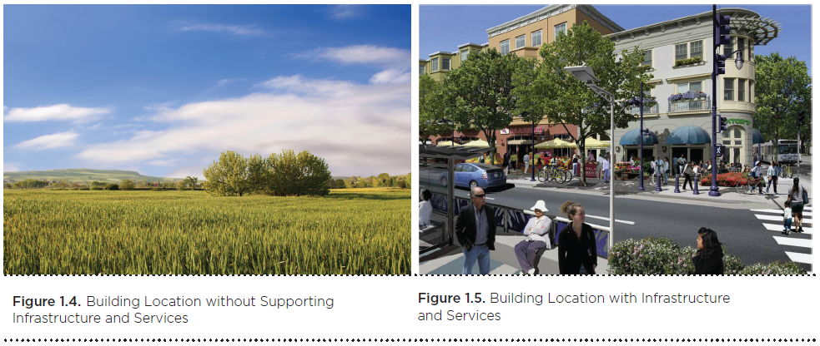
By improving the efficiency of buildings and communities, we can significantly reduce greenhouse gas emissions.

Slide 14
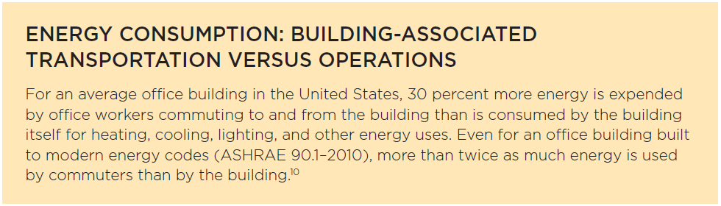

Slide 15
Continuous Monitoring and Verification
Build in Resilience
Commissioning is the process of verifying and documenting that a building and all its systems and assemblies are planned, designed, installed, tested, operated, and maintained to meet the owner’s project requirements.
Adaptive reuse is the practice of redesigning and using a structure for a use that is significantly different from the building’s original use.
Alternative Transportation – including walking and bicycle riding
Buildings that protect the history and character of a place also promote sustainability.

Slide 16
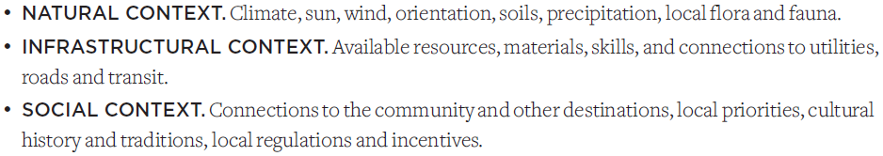
Selecting a location is one of the earliest decisions made in a project, and this decision defines many of the opportunities and constraints that the project team will encounter.
It can determine whether a project can take advantage of sunlight, have access to public transportation and other services, and protect habitats.

Slide 17
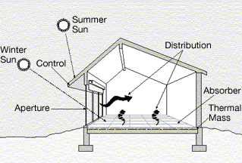
passive design planning with the intent of capturing sunlight, wind or other natural forces for light, heating, and cooling.

Slide 18
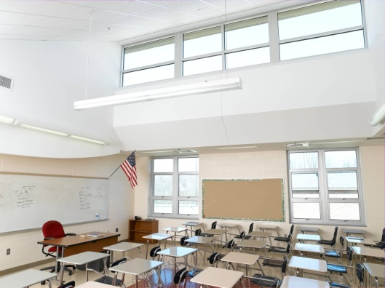
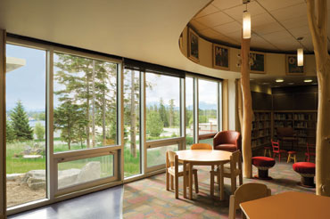
daylighting the controlled admission of natural light into a space, used to reduce or eliminate electric lighting.

Slide 19
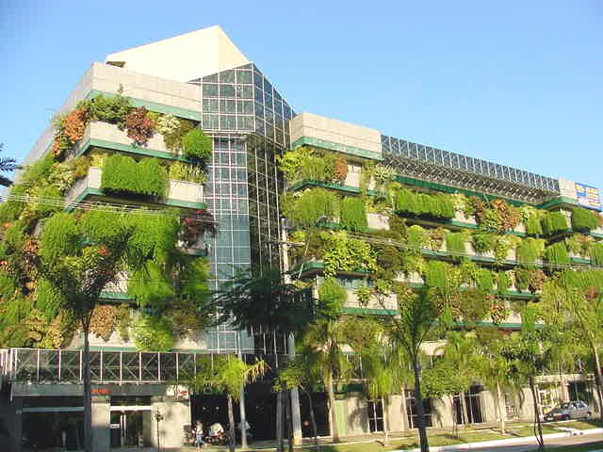
A landmark study by the firm Davis Langdon found no significant difference between the average cost of a LEED-certified building and other new construction in the same category: there are expensive green
buildings, and there are expensive conventional buildings.
Certification as a green building was not a significant indicator of construction cost.

Slide 20
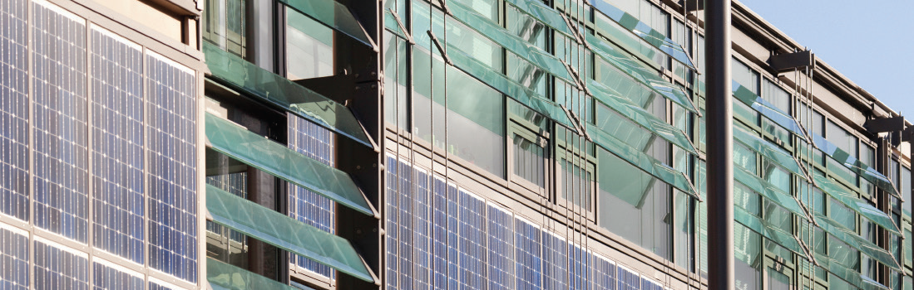
Regenerative Design
Regenerative projects support the health of the local community and regional ecosystems, generate electricity and send the excess to the grid, return water to the hydrologic system cleaner than it was before
use, serve as locations for food production and community networking, regenerate biodiversity, and promote many other relationships that link the projects to the whole system of life around them.

Slide 21
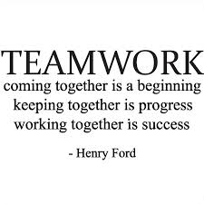
Green building requires new skills and new knowledge, as well as new attitudes and new mindsets.
The green building process is interdisciplinary, iterative, and collaborative.
Teamwork and critical thinking are valued.

Slide 22
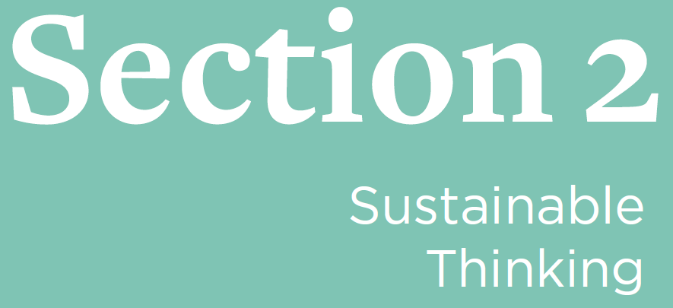

Slide 23
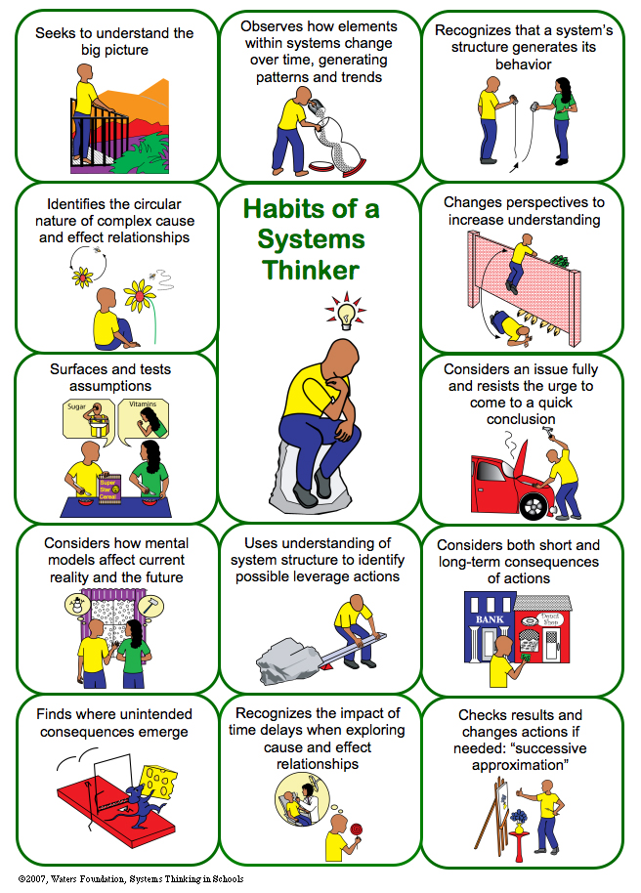
Three major concepts that are integral to green building and sustainability:
Systems thinking
Life cycle thinking
Integrated processes

Slide 24

System an assemblage of parts that interact in a series of relationships to form a complex whole, which serves particular functions of purposes.

Slide 25
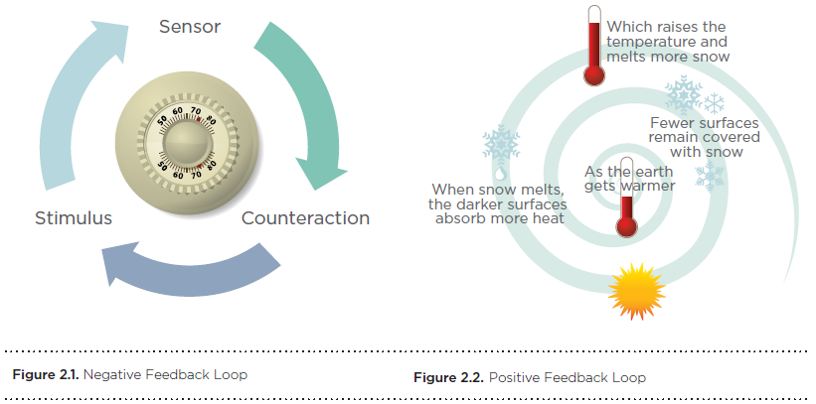
The concept of feedback loops helps explain how systems work.

Slide 26
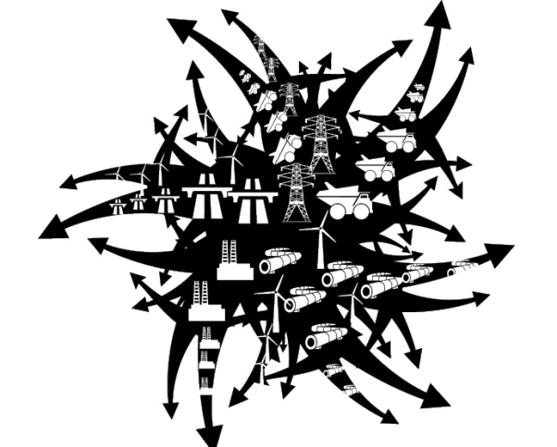
The concept of feedback loops helps explain how systems work.
Unchecked, positive feedback loops can create chaos in a system.

Slide 27
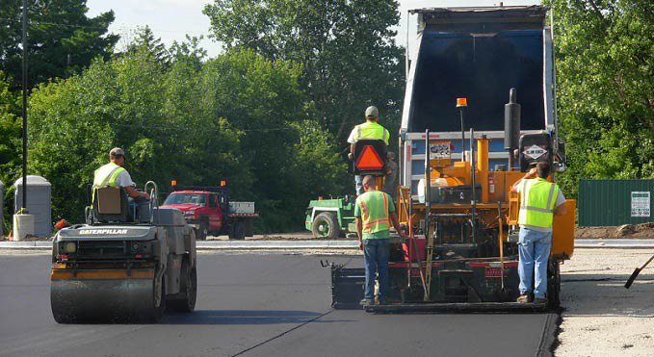
Example:
heat island effect the absorption of heat by hardscapes, such as dark, nonreflective pavement and buildings, and its radiation to surrounding areas. Particularly in urban areas, other sources may include vehicle exhaust, air-conditioners, and street equipment; reduced airflow from tall buildings and narrow streets exacerbates the effect.

Slide 28
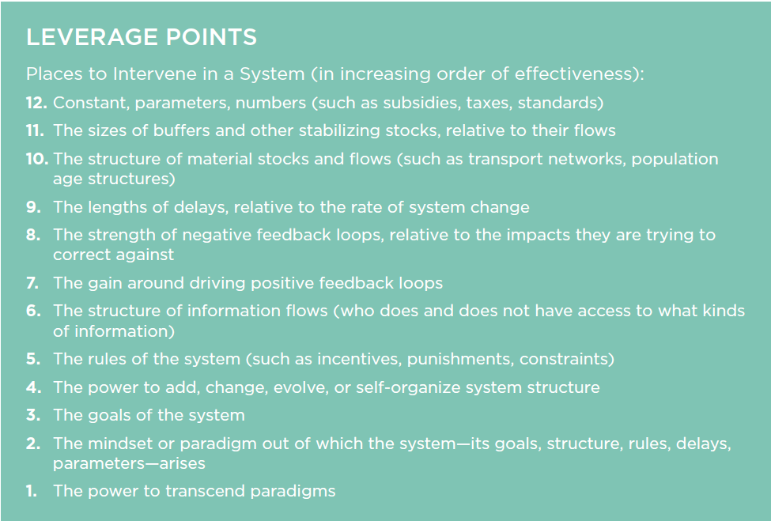
leverage point a point in a system where a small intervention can yield large changes

Slide 29
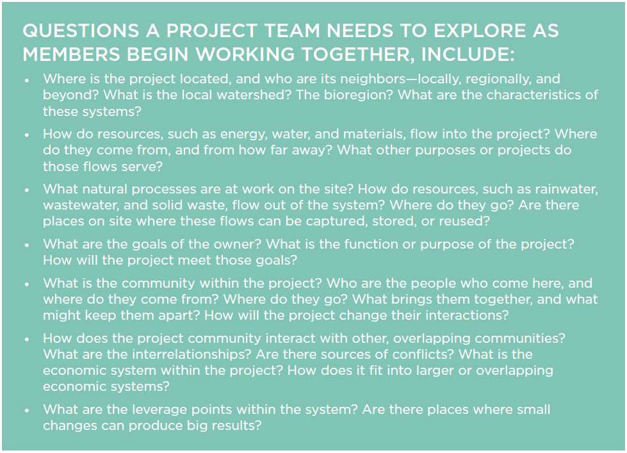

Slide 30
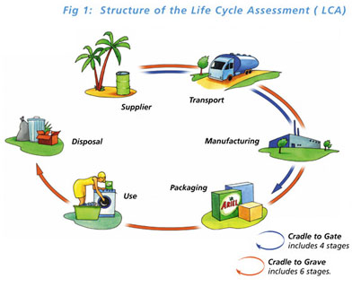
What is LCA?
Life Cycle Assessment (LCA) is a tool used to evaluate the potential environmental impact of a product, process or activity throughout its entire life cycle by quantifying the use of resources ("inputs" such as energy, raw materials, water) and environmental emissions ("outputs" to air, water and soil) associated with the system that is being evaluated.

Slide 31
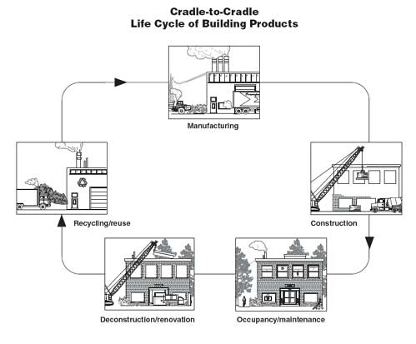
http://www.fs.fed.us/t-d/pubs/htmlpubs/htm08732839/page02.htm

Slide 32
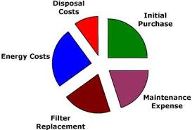
http://storyofstuff.org/
What is LCC?
Life Cycle Costing (LCC) a process of costing that looks at both purchase and operating costs as well as relative savings over the life of the building or product.

Slide 33
An integrative process comprises three phases:
The first—discovery—is also the most important and can be seen as an expansion of what is conventionally called predesign. Actions taken during discovery are essential to achieving a project’s environmental goals cost-effectively.
The second phase, design and construction, begins with what is conventionally called schematic design. Unlike its conventional counterpart, however, in the integrative process, design will incorporate all of the collective understandings of system interactions that were found during discovery.
The third phase is the period of occupancy, operations, and performance feedback. Here, the integrative process measures performance and sets up feedback mechanisms.

Slide 34
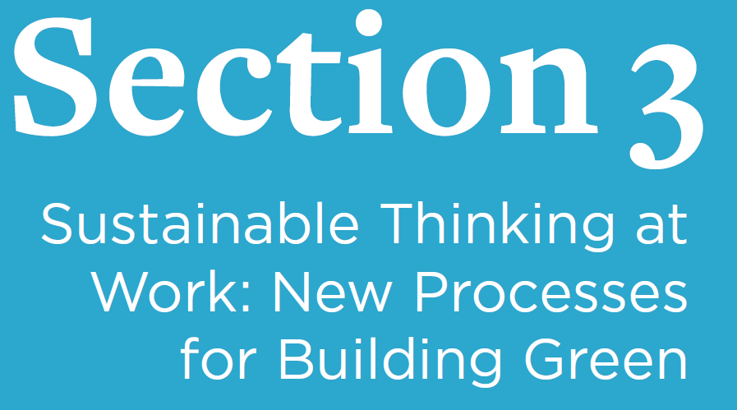

Slide 35
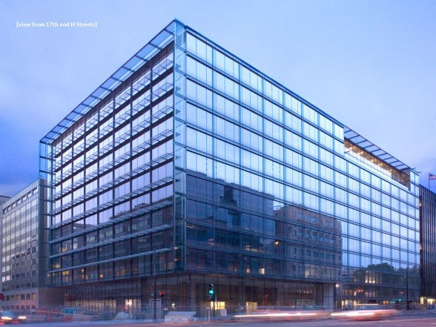
Green Building requires a new way of thinking and approaching the design, construction, operation, and renovation of buildings and communities.
PNC Place Washington, DC

Slide 36
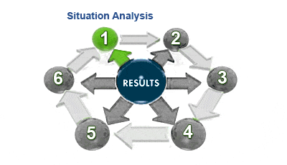
Process
A good process is essential to good outcomes.

Slide 37
Get in early

Slide 38
Pre-Design
Develop a Clear Statement of the Project's Vision
Define the Green Goals of the Building
Set Priorities
Select the project team
Research green technologies and strategies
Define green building budget items
Review applicable laws and standards
Design
Develop a project budget that covers green building measures
Test and select green technologies and strategies
Check costs
Finalize design decisions

Slide 39
Traditional Building Design Timeline
Design
Construction Documents (CDs) (Plans, Specifications, Contracts, etc.)
Bidding process
Construction
Commissioning and turnover
Occupancy
Integrated Project Delivery (IPD) Timeline
Pre-Design
Design
Construction plans
Bidding process
Construction
Commission the building
Occupancy and Retro commissioning

Slide 40
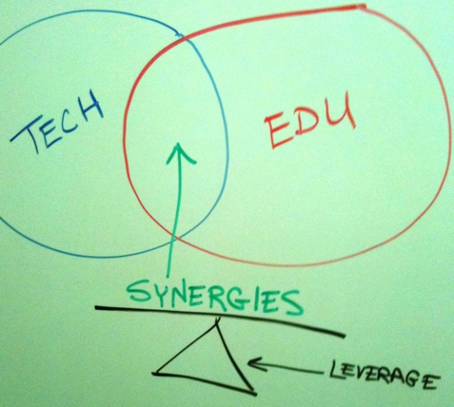
Look Beyond First Costs to Long Term Savings
This new process doesn't typically cost more, but it does shift costs earlier.
Synergies are actions that complement each other, creating a whole greater than the sum of its parts.
The savings are often reflected in life cycle costing (LCC).

Slide 41
Construction Costs
Soft Costs
Architectural, legal, financing, engineering fees and other costs incurred before and after construction
Hard Costs
Directly related to improving real property
First Costs
The sum of the initial expenditures involved in capitalizing a property; includes items such as transportation, installation, preparation for service, as well as other related costs.

Slide 42
Construction Costs
Life Cycle Costs (LCC)
A measurement of the total cost of using equipment or a product over the entire time of service of the equipment or product; includes initial, operating, and maintenance costs.
Life-Cycle Analysis (LCA)
A life cycle analysis (LCA, also known as life cycle assessment, ecobalance, and cradle-to-grave analysis) is the investigation and evaluation of the environmental impacts of a given product or service caused or necessitated by its existence.

Slide 43
Construction Costs
Simple Payback
Example - HVAC System
$10,000 – First Cost Or $15,000 – First Cost
$1,500/YR in Energy Cost Savings
Calculate Simple Payback: $5,000/$1,500 = 3.33 Yrs
Design team should use “Life-Cycle Costs” and “Life-Cycle Cost Analysis” instead of “First Cost” Value Engineering.

Slide 44
Include and Collaborate

Slide 45
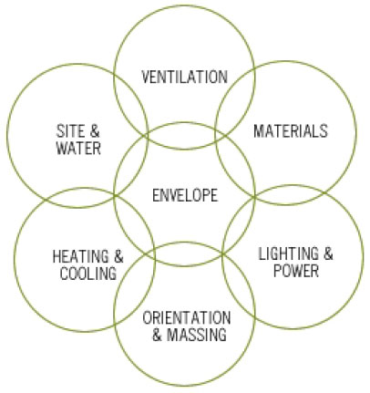
Whole Building Design

Slide 46
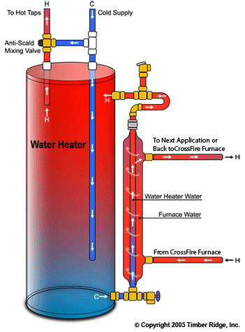
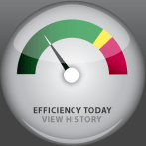
Follow Through
The green building process does not end when the project team hands the site over to the owner, facility manager, or tenant.
Follow-through is needed at all stages to ensure that the strategies and technologies are maintained or adapted as necessary to remain effective.

Slide 47
charrette intense workshops designed to produce specific deliverables.
At least one initial strategy meeting or LEED “charette” generally held at the beginning of the project.
Charrettes assist in establishing green goals.
Goal – to develop possible design and strategies for greening a space
Deliverables
The typical deliverables from the initial strategy meeting are:
LEED certification goal (certification level)
LEED scorecard that shows the targeted credits for pursuit (Project Checklist)

Slide 48
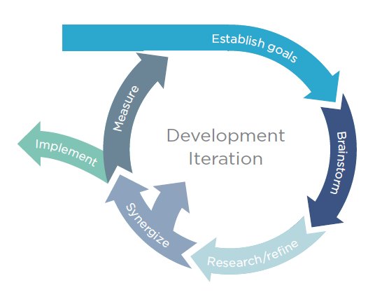
An iterative process is circular and repetitive. It provides opportunities for setting goals and checking each idea against those goals.

Slide 49
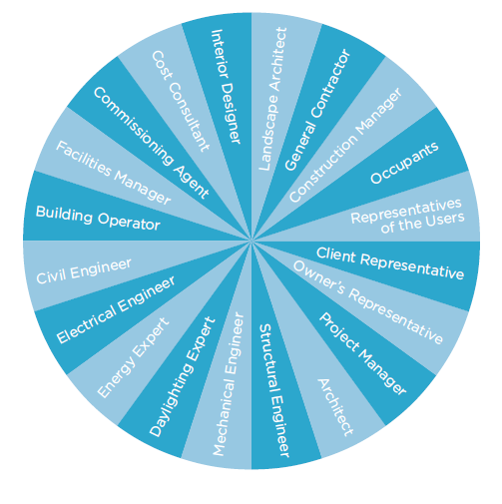
Members of an integrated team.

Slide 50
Clear goals articulate what the project will be designed to accomplish, by:
Making sure that the vision is clear
Providing a frame of reference for the whole project
Defining the sustainability targets and keeping the project on track to meet them
Goals Assessments and Measurements
■S = Specific Metrics
■M = Measurable ➔ Qualitative
■A = Attainable ➔ Quantitative
■R = Realistic
■T = Timely

Slide 51
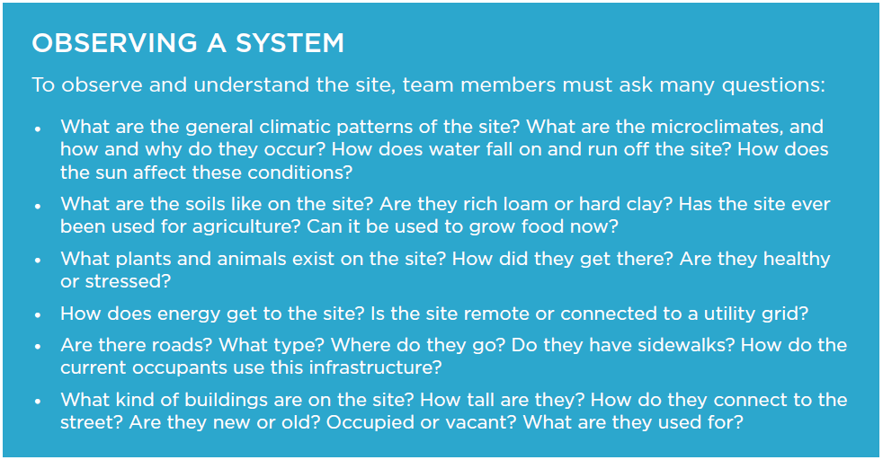

Slide 52

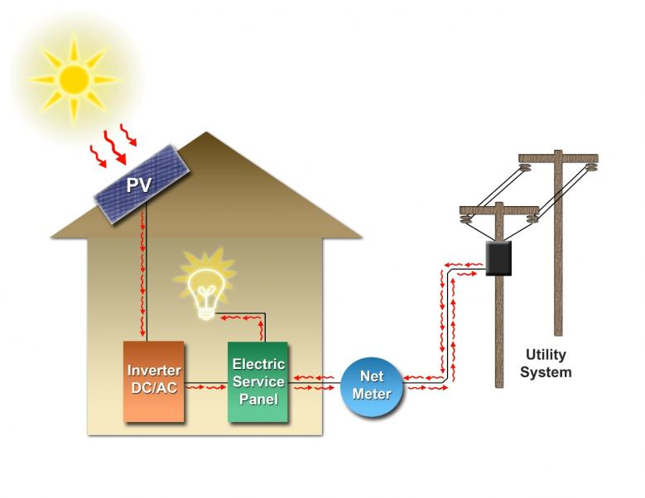
Sustainable design requires thinking methodically through the types of strategies for each aspect of the system and evaluating alternatives against project goals through an iterative process.

Slide 53
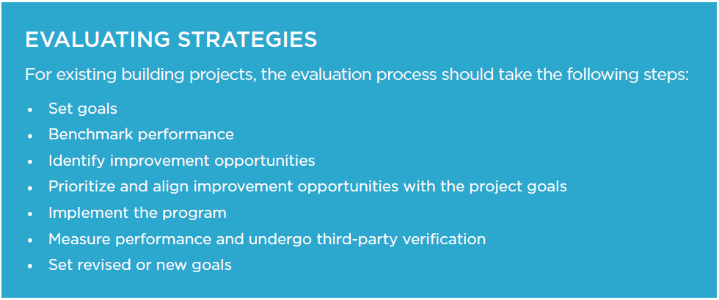

Slide 54
Once the planning and design phases are complete, it is time to think through each step of implementation and anticipate where problems might arise and compromise the project’s commitment to sustainability.
This upfront planning can help keep a project on schedule and on budget while protecting the project goals.

Slide 55
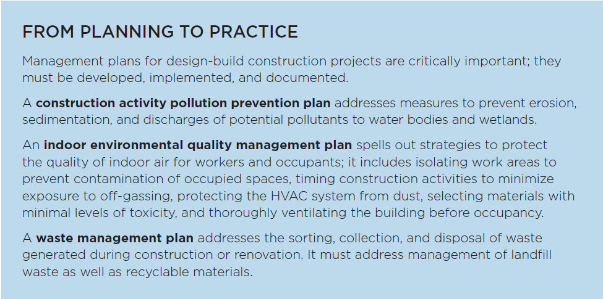

Slide 56
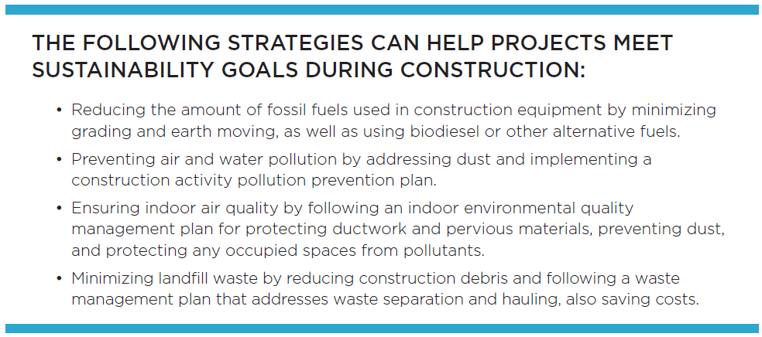
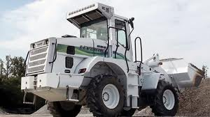
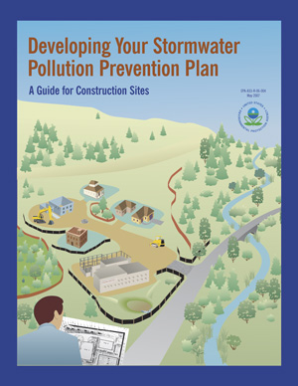

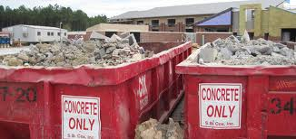

Slide 57
Documentation
Documentation during the implementation phase might include change orders, chain-of-custody letters to verify that materials came from a sustainable source, waste hauling tickets, updated or revised construction management plans, commissioning or retrocommissioning reports, or other LEED documents.

Slide 58
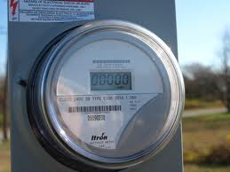
The construction and operations of green building and neighborhood projects are never really complete.
Daily life in any building or community requires on-going delivery or production of resources, as well as routine maintenance and upkeep.
On-going measurement and verification are essential to identifying opportunities for improvement.

Slide 59
Consider Implementing:
Retrocommissioning
Energy and water audits
Solid waste audits
Occupant surveys, including thermal comfort and transportation analysis
Green purchasing and green housekeeping program assessments

Slide 60





Slide 61


Slide 62

About USGBC and LEED
The U.S. Green Building Council (USGBC) and its community are
changing the way buildings and communities are designed, built
and operated.
USGBC believes in better buildings: places that complement our
environment and enhance our communities; places that give
people better, brighter, healthier spaces to live, work and play.

Slide 63
USGBC is transforming the building landscape in a number of ways.
ADVOCACY
COMMUNITY
EDUCATION
GREENBUILD INTERNATIONAL CONFERENCE AND EXPO
LEED® GREEN BUILDING PROGRAM

Slide 64
LEED Rating Systems
Comprehensive and flexible, LEED is applicable to buildings at any stage in their life-cycles.
Through a consensus-based process, the rating systems are continually evaluated and regularly updated to respond to new technologies
and policies and to changes in the built environment.
In this way, as yesterday’s innovation becomes today’s standard of practice, USGBC and LEED continue to push forward market transformation.

Slide 65


Slide 66


Slide 67
Rating System Structure
The LEED rating systems consist of prerequisites and credits.
Prerequisites are required elements or green building strategies that must be included in any LEED-certified project.
Credits are optional elements— strategies that projects can elect to pursue to gain points toward LEED certification.
Achieving LEED certification requires satisfying all prerequisites and earning a minimum number of credits.

Slide 68
Rating System Categories
LOCATION AND TRANSPORTATION.LEED emphasizes location and transportation issues by rewarding development that preserves environmentally sensitive places and takes advantage of existing infrastructure, community resources, and transit. It encourages access to open space for walking, physical activity, and time spent outdoors. Credits also encourage smart transportation choices and access to a diversity of uses.

Slide 69
Rating System Categories
SUSTAINABLE SITES. Choosing a building’s site and managing that site during construction are important considerations for a project’s sustainability. LEED credits addressing sustainable sites
discourage development of previously undeveloped land and damage to ecosystems and waterways; they encourage regionally appropriate landscaping, control of rainwater runoff, and reduced erosion, light pollution, heat island effect, and construction-related pollution.

Slide 70
Rating System Categories
WATER EFFICIENCY. Buildings are major users of our potable water supply. The goal of credits addressing water efficiency is to encourage smarter use of water, inside and out. Water reduction is typically achieved through more efficient appliances, fixtures, and fittings inside and water-wise landscaping outside.

Slide 71
Rating System Categories
ENERGY AND ATMOSPHERE. LEED encourages a wide variety of strategies to address energy consumption, including commissioning; energy use monitoring; efficient design and construction; efficient appliances, systems, and lighting; demand response, and the use of renewable and clean sources of energy, generated on-site or off-site.

Slide 72
Rating System Categories
MATERIALS AND RESOURCES. During both construction and operations, buildings generate large amounts of waste and use tremendous volumes of materials and resources. These credits encourage the selection of sustainably grown, harvested, produced, and transported products and materials. They promote the use of life-cycle assessment to holistically evaluate materials and the disclosure and optimization of material chemical ingredients.

Slide 73
Rating System Categories
INDOOR ENVIRONMENTAL QUALITY. The average American spends about 90% of the day indoors, where pollutant concentrations may be two to 100 times higher than outdoor levels. Thus indoor air quality can be significantly worse than outside. LEED credits promote strategies that can improve indoor air, provide access to natural daylight and views, and improve acoustics.

Slide 74
Rating System Categories
INNOVATION. LEED promotes innovation by offering points for improving a building’s performance well beyond what is required by the credits or for incorporating green building ideas that are not specifically addressed elsewhere in the rating system. This credit category also rewards the inclusion of a LEED Accredited Professional on the project team.

Slide 75
Rating System Categories
REGIONAL PRIORITY. USGBC’s regional councils, chapters, and affiliates have identified the environmental concerns that are most important for every region of the country, and LEED credits that address those local priorities have been selected for each region. A project team that earns a regional priority credit earns one bonus point in addition to any points awarded for that credit.

Slide 76
Rating System Categories
LEED for Neighborhood Development is organized around three main categories, focusing on where, what, and how to build green at a community scale.
SMART LOCATION AND LINKAGE. This section of the rating system provides guidance on where the project is built, encouraging the selection of sites with existing services and transit.
NEIGHBORHOOD PATTERN AND DESIGN. Neighborhoods should be compact, complete, connected, and convivial. The intent of credits in this category is to create environments that are walkable, vibrant with mixed-use establishments, and connected to the larger community.
GREEN INFRASTRUCTURE AND BUILDINGS. This category focuses on measures that can reduce the environmental harms associated with the construction and operation of buildings and infrastructure within neighborhoods, with a goal of not just reducing the environmental consequences, but also enhancing the natural environment.

Slide 77
Additionally, LEED emphasizes the critical role of the integrative process and ongoing performance monitoring across all phases and project types.

Slide 78


Slide 79
LEED rating systems have 100 base points plus six Innovation points and four Regional Priority points, for a total of 110 points.
The level of certification is determined according to the following scale:
• Certified, 40–49 points
• Silver, 50–59 points
• Gold, 60–79 points
• Platinum, 80+ points

Slide 80
RATING SYSTEM DEVELOPMENT AND EVOLUTION
Since its launch in 2000, LEED has been evolving to address new markets and building types, advances in practice and technology, and greater understanding of the environmental and human health impacts of the
built environment.
These ongoing improvements to LEED are based on principles of transparency, openness, and inclusiveness involving volunteer committees and working groups, as well as USGBC staff, and are approved by a membership-wide vote.

Slide 81
CREDIT WEIGHTINGS
The LEED rating system has always been implicitly weighted by virtue of the different point values assigned to each credit and category.
These weightings continue to evolve with the rating system as market
conditions, user requirements, scientific understanding and public policy change.
The weightings ensure that LEED assigns higher point values to the credits with the strongest relationship to the impact categories
of greatest concern.

Slide 82

CREDIT WEIGHTINGS

Slide 83
GREEN BUILDING CODES, STANDARDS, AND RATING SYSTEMS
A landmark national effort to codify green building practices into adoptable, adaptable and enforceable green building codes has produced regulatory documents that are now available as an overlay to more traditional building codes.
The International Green Construction Code (IGCC), including ASHRAE Standard 189.1 as an alternate path to compliance, is a widely supported and first-of-its-kind regulatory framework that recognizes an entire set of risks not otherwise addressed in the codes.

Slide 84
PROJECT CERTIFICATION
LEED certification provides independent, third-party verification that a building project meets the highest green building and performance measures.

Slide 85
PROJECT REGISTRATION
The LEED process begins with registration. The project team submits a registration form and a fee to GBCI.
It is helpful if the project administrator—the team member who registers the project—has previous green building and LEED project experience; ideally, he or she is a LEED Accredited Professional.

Slide 86
PROJECT REGISTRATION
Once registered, the team receives information, tools, and communications that will help guide the certification process.
All project activity, including registration and credit compliance documentation, is completed in LEED Online, a data collection portal through which the team uploads information about the project.
This site provides credit templates to be completed and signed by a specified member of the team.

Slide 87
APPLICATION PREPARATION
Each LEED credit and prerequisite has documentation requirements that must be completed as part of the application process.
The project team selects the credits it has chosen to pursue and when the necessary documentation, including required information and calculations, has been assembled, the project team uploads the materials to LEED Online.

Slide 88
SUBMISSION
When the team is ready for its application to be reviewed, the project administrator submits the appropriate fee and documentation.
For LEED BD+C and ID+C projects, the team can wait to submit documentation until the building project is complete, or the team can seek review of its design-related prerequisites and credits before completion, and then apply for construction-related credits after the project is finished.

Slide 89
APPLICATION REVIEW
Whether the design and construction credits are submitted together or separately, each credit undergoes one preliminary review.
The certification reviewer may request additional information or clarification.
The team then submits final documentation.
After the final review, a team may appeal any adverse decisions on individual credits for an additional fee.

Slide 90
CERTIFICATION
Certification is the final step in the LEED review process.
Once the final application review is complete, the project team can either accept or appeal the final decision.
LEED-certified projects receive formal certificates of recognition, a plaque, and tips for marketing the achievement.
Projects may be included in USGBC’s online LEED Project Directory of registered and certified projects.

Slide 91
PROJECT CREDIT INTERPRETATION RULINGS
Project credit interpretation rulings (Project CIRs), administered by GBCI, allow teams to obtain technical guidance on how LEED requirements pertain to their projects.
Project CIRs do not guarantee credit award; the project applicant must still demonstrate and document achievement during the LEED certification application process. The ruling remains confidential and generally applies only to the one project.

Slide 92
LEED INTERPRETATIONS
LEED Interpretations, however, are precedent setting; project teams are required to adhere to all LEED Interpretations posted before their registration date.
These are posted publicly in the online Addenda database.

Slide 93
LEED PROFESSIONAL CREDENTIALS
LEED professionals demonstrate current knowledge of green building technologies, best practices, and the rapidly evolving LEED rating systems.
LEED GREEN ASSOCIATE validates basic understanding of green building and the professional field, as gained through experience in sustainability and green building or related educational experience
LEED ACCREDITED PROFESSIONAL demonstrates a deep familiarity with the LEED rating systems developed through active participation in and contribution to a LEED-registered project
LEED FELLOW distinguishes professional leadership, contribution to the standards of practice and body of knowledge, and continual improvement in the field

Slide 94
Credential Maintenance Program
To keep their credentials current, professionals must meet continuing education requirements that help them grow their knowledge base, stay current with best practices, and demonstrate that their expertise is
meaningful in a rapidly transforming marketplace.
LEED Green Associate – 15 Hours Biannually
LEED AP with Specialty – 30 Hours Biannually

Slide 95



