Slide 1

Introduction to Green Buildings and Communities
LCCG
Section 1

Slide 2
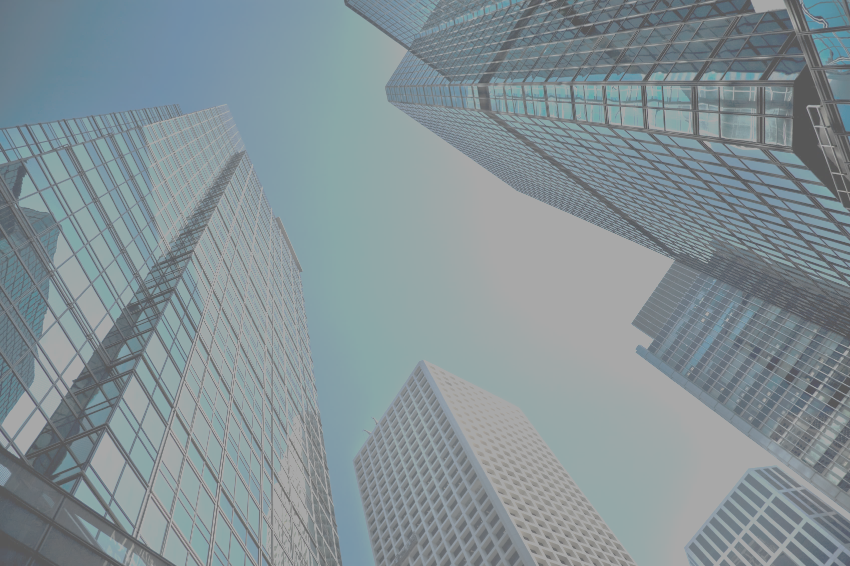
Introduction to Green Buildings and Communities
LCCG
Section 1
The Built Environment
built environment refers to the man-made surroundings that provide the setting for human activity, ranging in scale from buildings and parks or green space to neighborhoods and cities that can often include their supporting infrastructure, such as water supply or energy networks.

Slide 3
Why is green building necessary?
Buildings and communities, including the resources used to create them and the energy, water, and materials needed to operate them, have a significant effect on the environment and human health.
In the United States, buildings account for:
• 14% of potable water consumption!
• 30% of waste output
• 40% of raw materials use
• 38% of carbon dioxide emissions
• 24% to 50% of energy use
• 72% of electricity consumption

Slide 4
Why is green building necessary?
Buildings and communities, including the resources used to create them and the energy, water, and materials needed to operate them, have a significant effect on the environment and human health.
In the United States, buildings account for:
• 14% of potable water consumption!
• 30% of waste output
• 40% of raw materials use
• 38% of carbon dioxide emissions
• 24% to 50% of energy use
• 72% of electricity consumption

Slide 5
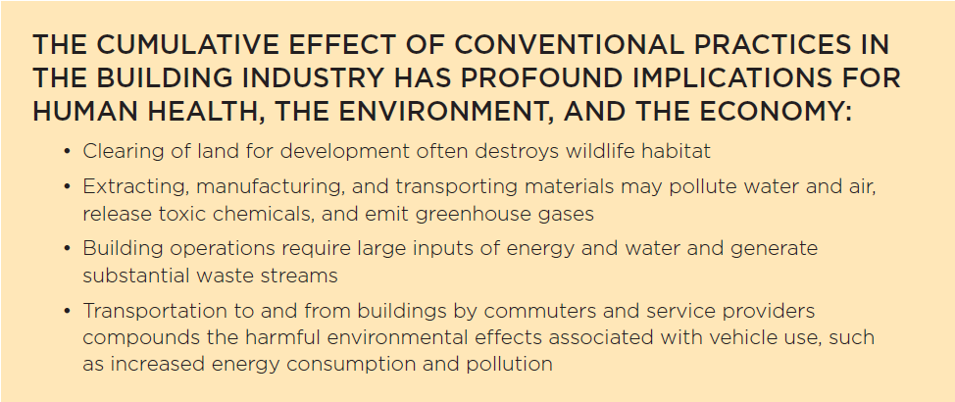
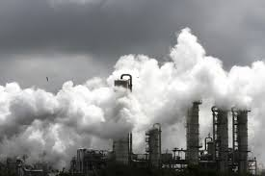
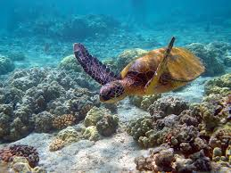
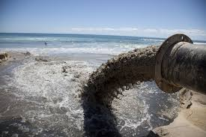

Slide 6

New Buildings Institute
A study by the New Buildings Institute found that in green buildings, average energy use intensities (energy consumed per unit of floor space) are 24% lower than in typical buildings.
ENERGY USE INTENSITY (kBtu/sf/yr)

Slide 7

Green building is a process that applies to:
Buildings
Sites
Interiors
Operations
Communities

Slide 8
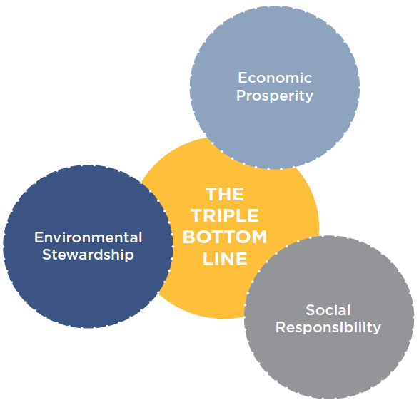
Triple Bottom Line
PEOPLE (SOCIAL CAPITAL). All the costs and benefits to the people who design, construct, live in, work in, and constitute the local community and are influenced, directly or indirectly, by a project
PLANET (NATURAL CAPITAL). All the costs and benefits of a project on the natural environment, locally and globally
PROFIT (ECONOMIC CAPITAL). All the economic costs and benefits of a project for all the stakeholders (not just the project owner)

Slide 9

U.S. Environmental Protection Agency (EPA)
Found that people in the United States spend, on average, 90% of their time indoors.

Slide 10
Indoor Air Quality in Offices and Other Large Buildings
Many office buildings have significant air pollution sources.
Inadequately ventilated.
Mechanical ventilation systems may not be designed or operated to provide adequate amounts of outdoor air.
People generally have less control over the indoor environment in their offices than they do in their homes. As a result, there has been an increase in the incidence of reported health problems.

Slide 11
Green Buildings are Healthier
Occupants of green buildings are typically exposed to far lower levels of indoor pollutants and have significantly greater satisfaction with air quality and lighting than occupants of conventional buildings.
Research conducted at Carnegie Mellon University shows that these benefits can translate into a 2% to 16% increase in workers’ and students’ productivity.
Even small increases in productivity can dramatically increase the value of a building.

Slide 12
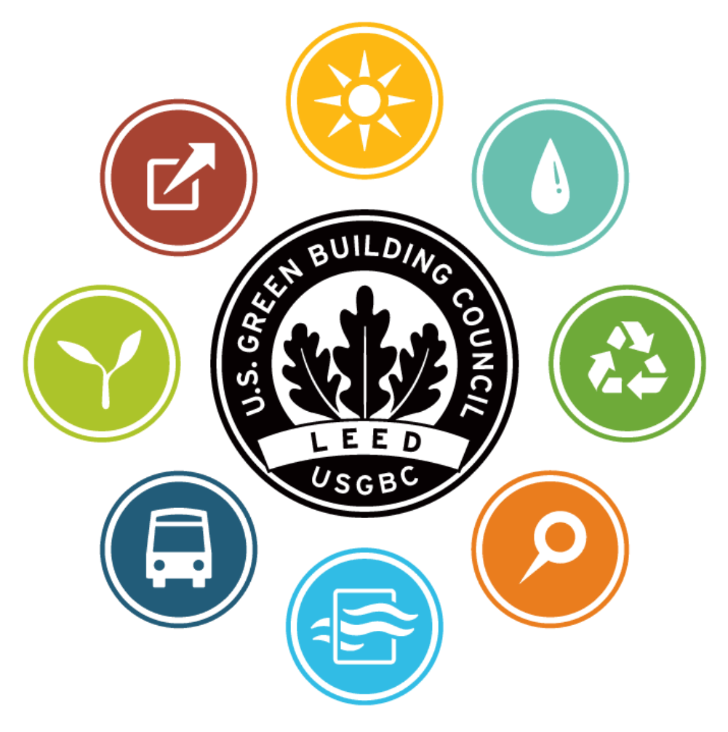
USGBC Mission
“to transform the way buildings and communities are designed, built and operated, enabling an environmentally and socially responsible, healthy, and prosperous environment that improves the quality of life.”

Slide 13

USGBC Programs
Education programs
Advocacy
Research
Community - Network of local chapters
GreenBuild International Conference and Expo
LEED Green Building Program

Slide 14
The Goal of LEED is Market Transformation—
To fundamentally change how we design, build, and operate buildings and communities—through certification that honors levels of achievement in areas such as:
Energy Savings
Water Efficiency
CO₂ Emissions Reduction
Improved Indoor Environmental Quality
Stewardship of Resources

Slide 15
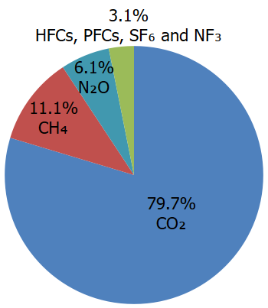
Green House Gas (GHG)
The built environment, including buildings and transportation systems, accounts for more than two-thirds of all greenhouse gas emissions.
https://www.epa.gov/ghgemissions/overview-greenhouse-gases

Slide 16
Where Do GHG Emissions Come From?
Building systems and energy use
Transportation
Water use and treatment
Landcover change
Materials
Construction
By improving the efficiency of buildings and communities, we can significantly reduce greenhouse gas emissions.

Slide 17
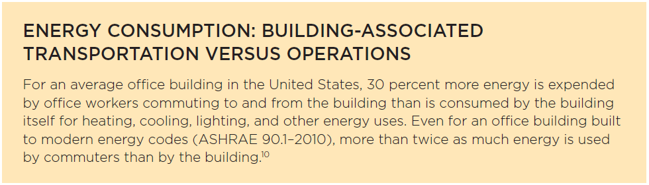

Slide 18
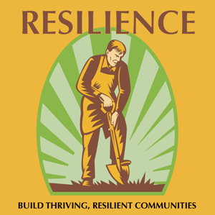
Green Projects
Continuous Monitoring - Identify Needed Improvements
Adapt to Changes - Build in Resilience
Maintain the Buildings Performance at the Highest Level

Slide 19
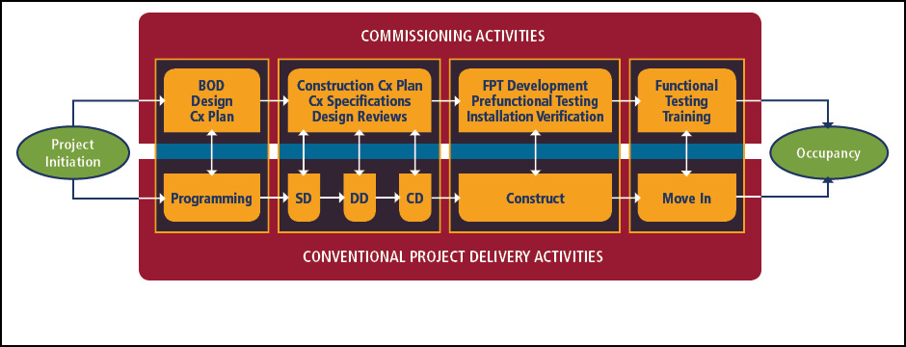
Commissioning
Process of verifying and documenting that a building and all its systems and assemblies are planned, designed, installed, tested, operated, and maintained to meet the owner’s project requirements.

Slide 20
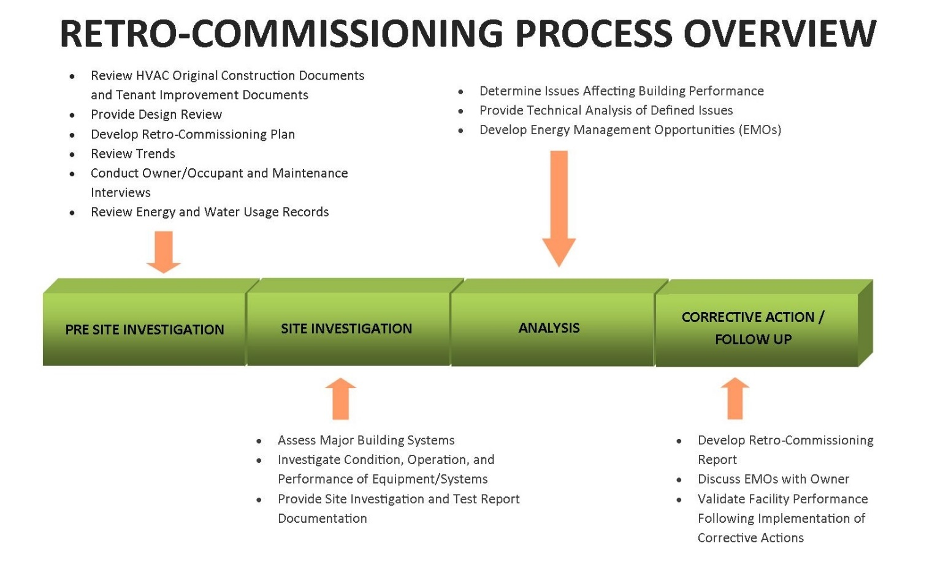
Retrocommissioning
A tune-up that identifies inefficiencies and restores high levels of performance.

Slide 21
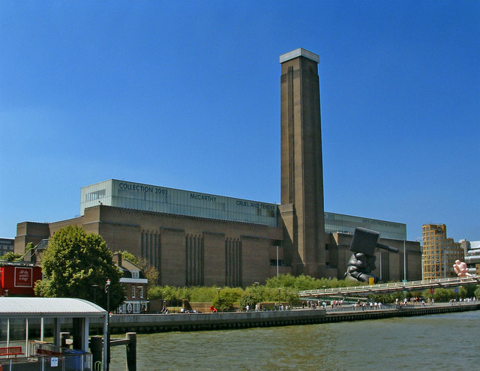
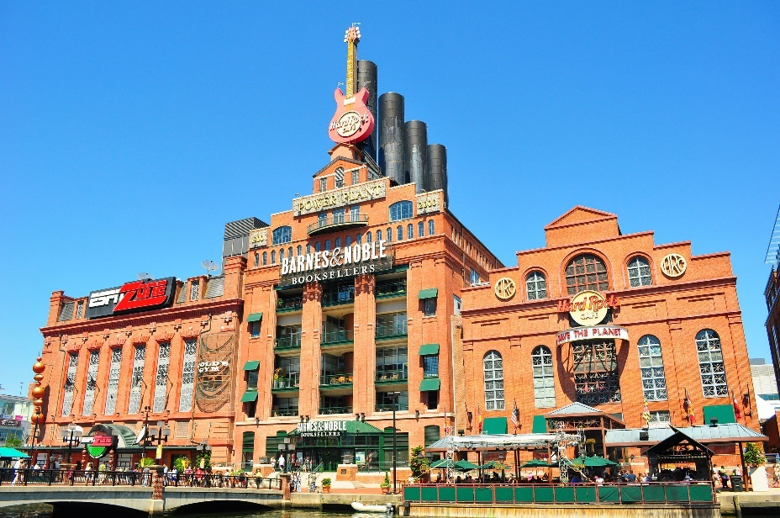
Adaptive Reuse
Adaptive reuse is the practice of redesigning and using a structure for a use that is significantly different from the building’s original use.
Reduces the need for extracting materials for a new building and disposing of demolition waste.
Reuses a site that is already served by infrastructure and avoids the conversion of farmland or forest to development.

Slide 22
Community Issues
Access to site by mass transit and pedestrian or bicycle paths.
  Availability of public transportation is essential for reducing carbon emissions.
  Bicycling and walking, depend on the proximity of destinations, connectivity of the community, and design of surroundings.
  Roads that are designed for only motor vehicles do not provide the flexibility or adaptability of a transportation network designed for diverse travel modes.

Slide 23
Community Issues
Attention to culture and history of community
  Buildings that protect the history and character of a place also promote sustainability.
  A project team can take advantage of the community’s past by reusing materials with historic value.
  Linking the present with the past reinforces a sense of place and helps create attractive communities with viable commercial centers.
  Sustainable design ensures that buildings and communities will survive and thrive for generations, no matter what the future holds.

Slide 24
Community Issues
Climatic characteristics as they affect design of building or building materials
Local incentives, policies, regulations that promote green design
Infrastructure in community to handle demolition waste recycling
Regional availability of environmental products and expertise

Slide 25
Location
NATURAL CONTEXT. Climate, sun, wind, orientation, soils, precipitation, local flora and fauna.
INFRASTRUCTURAL CONTEXT. Available resources, materials, skills, and connections to utilities, roads and transit.
SOCIAL CONTEXT. Connections to the community and other destinations, local priorities, cultural history and traditions, local regulations and incentives.
Selecting a location is one of the earliest decisions made in a project, and this decision defines many of the opportunities and constraints that the project team will encounter.
It can determine whether a project can take advantage of sunlight, have access to public transportation and other services, and protect habitats.

Slide 26
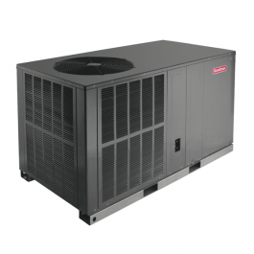
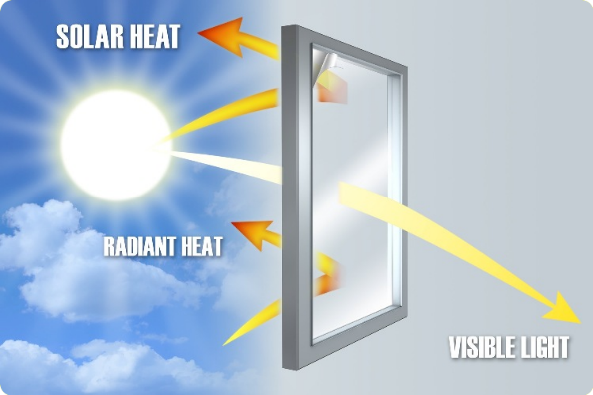
Design
Green building should be integrated into the design process as early as possible.
Example: Specification of more costly, high-performance windows may allow for the use of a smaller, lower-cost heating, ventilation, and air-conditioning (HVAC) system.

Slide 27
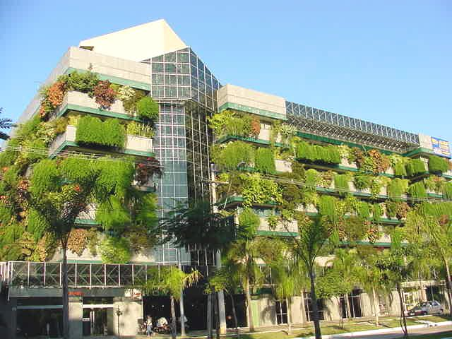
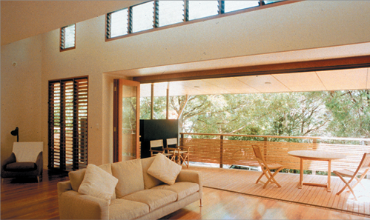
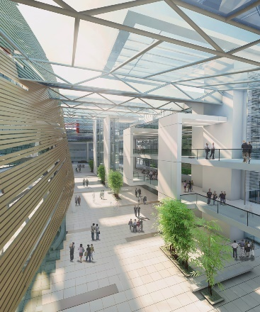
Green Buildings
A landmark study by the firm Davis Langdon found no significant difference between the average cost of a LEED-certified building and other new construction in the same category: there are expensive green buildings, and there are expensive conventional buildings.
Certification as a green building was not a significant indicator of construction cost.

Slide 28
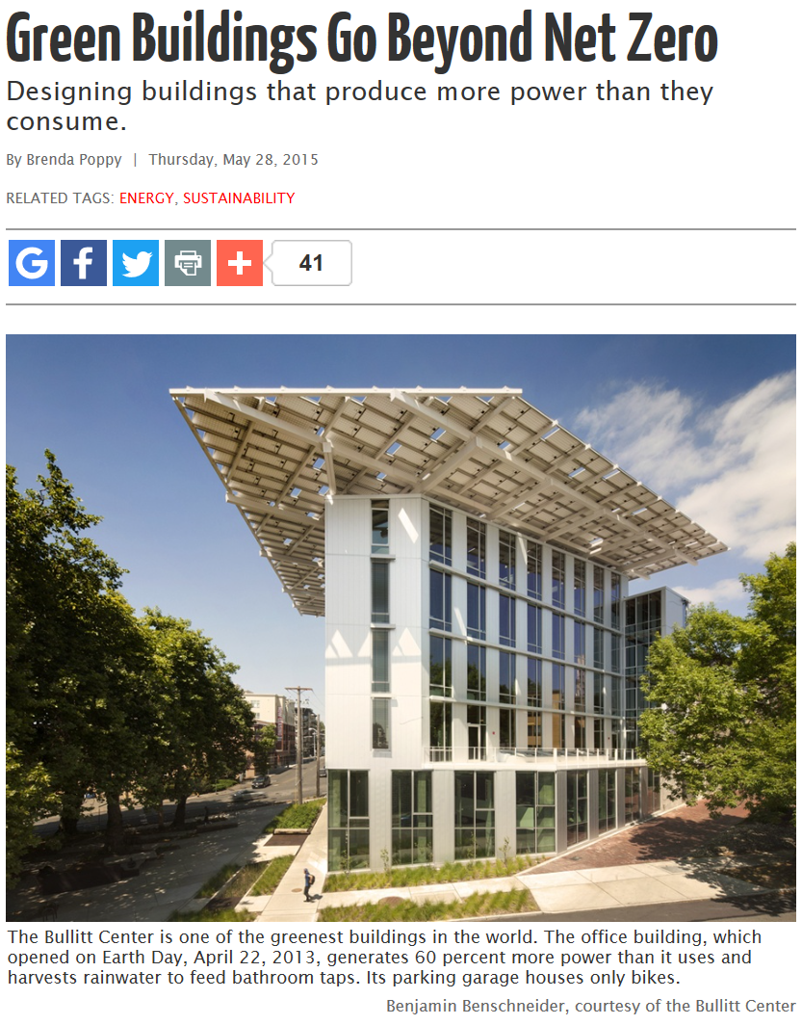

Slide 29
A 2007 public opinion survey conducted by World Business Council for Sustainable Development found that respondents believed, on average, that green features added 17% to the cost of a building, whereas a study of 146 green buildings found an actual average marginal cost of less than 2%.
Green building - significant predictor of tangible improvements in building performance, and those improvements have considerable value.
Studies have shown that certified green buildings command significantly higher rents.

Slide 30
A University of California–Berkeley study analyzed 694 certified green buildings and compared them with 7,489 other office buildings, each located within a quarter-mile of a green building in the sample.
The researchers found that, on average, certified green office buildings rented for 2% more than comparable nearby buildings.
After adjusting for occupancy levels, they identified a 6% premium for certified buildings. The researchers calculated that at prevailing capitalization rates, this adds more than $5 million to the market value of each property.

Slide 31
Regenerative Design
Support the health of the local community and regional ecosystems
Generate electricity and send the excess to the grid
Return water to the hydrologic system cleaner
Serve as locations for food production and community networking
Regenerate biodiversity
Promote many other relationships that link the projects to the whole system of life around them.

Slide 32
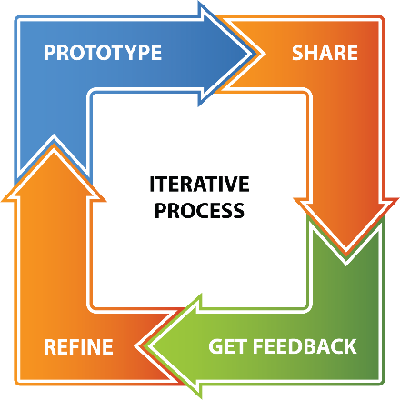
Green Building Process
Requires new skills and new knowledge, as well as new attitudes and new mindsets.
The green building process is interdisciplinary, iterative, and collaborative.

Slide 33

Teamwork
Teamwork and critical thinking are valued.

