Slide 1
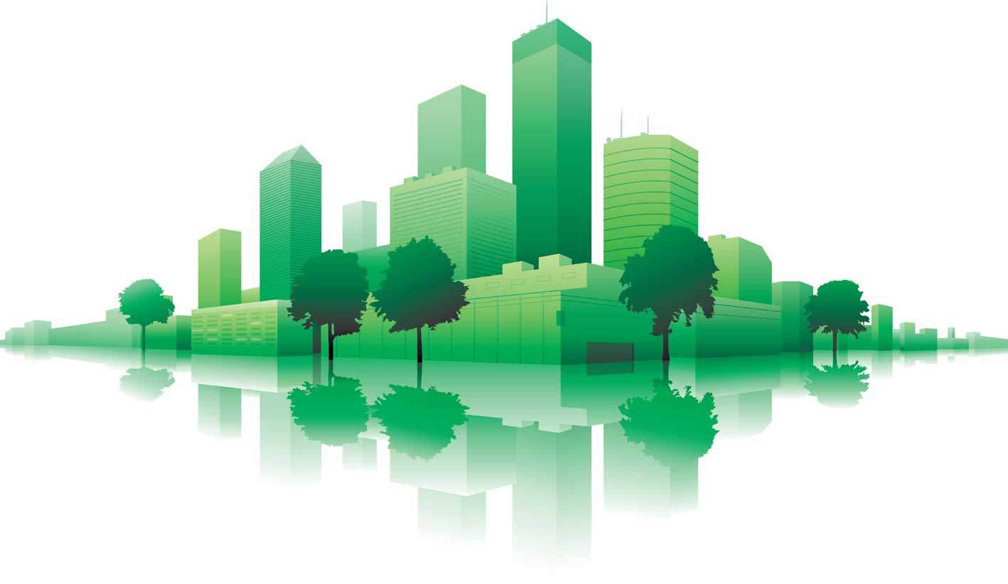
About USGBC and LEED
LEED Core Concepts Guide
Section 5

Slide 2
U.S. Green Building Council (USGBC) http://usgbc.org
The U.S. Green Building Council (USGBC) is committed to transforming the way our buildings are designed, constructed and operated through LEED — the top third-party verification system for sustainable structures around the world.

Slide 4
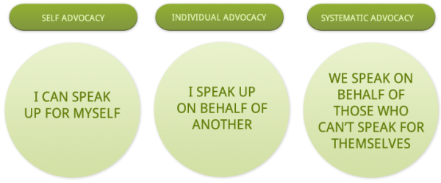
Advocacy
USGBC is accelerating the uptake of policies and initiatives that enable and encourage market transformation toward a sustainable built environment.

Slide 5
Community
USGBC is a movement of community leaders, professionals, businesses, and innovators working to accomplish a single bold vision: healthy, efficient and equitable buildings and communities for all.

Slide 6
Community
USGBC community membership
For individuals, USGBC communities provide local opportunities for active involvement and leadership through learning, networking and other professional development activities.
Communities also raise awareness of green building through outreach and advocacy in that area. Find your local USGBC community.

Slide 7
Community
USGBC national membership
For companies and organizations, USGBC national membership is offered at four levels: Organizational, Silver, Gold and Platinum.
We understand every organization has different needs, so we provide every member with the same core benefits and the flexibility to choose the package best suited to your organization.

Slide 8
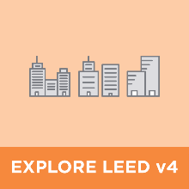
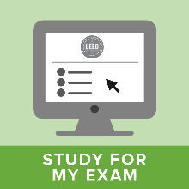
Education
http://www.usgbc.org/education-at-usgbc

Slide 9
Greenbuild International Conference and Expo
https://greenbuildexpo.com

Slide 10
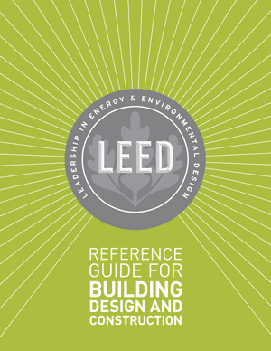
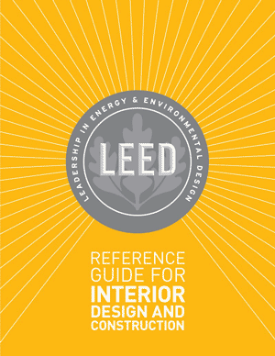
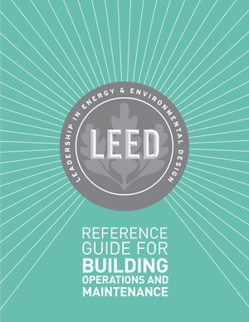
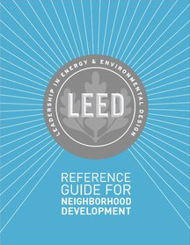
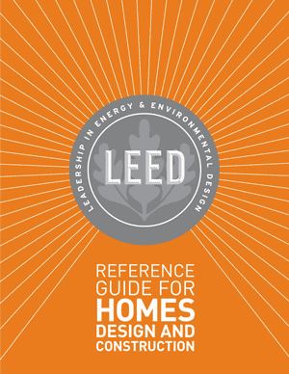
LEED Green Building Program
USGBC’s Leadership in Energy and Environmental Design (LEED) program is a third-party green building certification program.

Slide 11
All buildings in. LEED is flexible enough to apply to all project types.
LEED was developed to address all buildings everywhere, regardless of where they are in their life cycle.
From hospitals to data centers, from historical buildings to those still in the design phase, there is a LEED for every building.

Slide 12
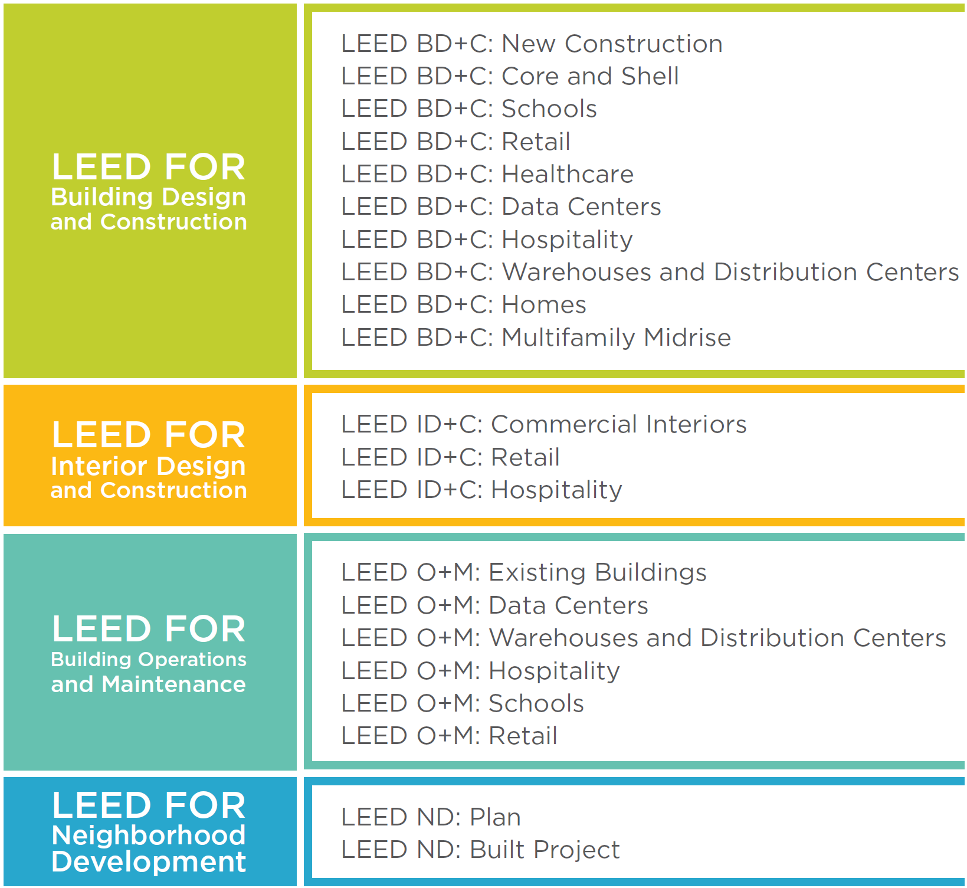
Adaptations

Slide 13
LEED Rating Systems
USGBC’s Leadership in Energy and Environmental Design (LEED) program is a third-party green building certification program and an international symbol of excellence in the design, construction, and operation of high-performance green buildings and neighborhoods.
It encourages and accelerates adoption of sustainable building and community development practices through the creation and implementation of a green building benchmark that is voluntary, consensus based, and market driven.

Slide 14
Rating System Structure
Prerequisites
Required elements or green building strategies that must be included in any LEED-certified project.
Establish a minimum level of sustainability.
Credits
Optional elements—strategies that projects can elect to pursue to gain points toward LEED certification.

Slide 15
Rating System Structure
Achieving LEED certification requires:
Meet the Minimum Program Requirements (MPRs)
Satisfy all prerequisites
Earn a minimum number of credits for the desired level of certification

Slide 16
Bonus Categories
100 Base Points + 10 Bonus Points

Slide 24
LEED v4 Credit Categories
Location and Transportation (LT)
Sustainable Sites (SS)
Water Efficiency (WE)
Energy and Atmosphere (EA)
Materials and Resources (MR)
Indoor Environmental Quality (EQ)
Innovation (IN)
Regional Priority (RP)
LEED for Neighborhood Development
Smart Location and Linkages (SLL)
Neighborhood Pattern and Design (NPD)
Green Buildings and Infrastructure (GBI)

Slide 25
Location and Transportation (LT)
LEED emphasizes location and transportation issues by rewarding development that preserves environmentally sensitive places and takes advantage of existing infrastructure, community resources, and transit.
It encourages access to open space for walking, physical activity, and time spent outdoors.
Credits also encourage smart transportation choices and access to a diversity of uses.

Slide 26
Sustainable Sites (SS)
Choosing a building’s site and managing that site during construction are important considerations for a project’s sustainability.
LEED credits addressing sustainable sites discourage development of previously undeveloped land and damage to ecosystems and waterways;
they encourage regionally appropriate landscaping, control of rainwater runoff, and reduced erosion, light pollution, heat island effect, and construction-related pollution.

Slide 27
Water Efficiency (WE)
Buildings are major users of our potable water supply. The goal of credits addressing water efficiency is to encourage smarter use of water, inside and out.
Water reduction is typically achieved through more efficient appliances, fixtures, and fittings inside and water-wise landscaping outside.

Slide 28
Energy and Atmosphere (EA)
LEED encourages a wide variety of strategies to address energy consumption, including
commissioning;
energy use monitoring;
efficient design and construction;
efficient appliances, systems, and lighting;
demand response, and
the use of renewable and clean sources of energy, generated on-site or off-site.

Slide 29
Materials and Resources (MR)
During both construction and operations, buildings generate large amounts of waste and use tremendous volumes of materials and resources.
These credits encourage the selection of sustainably grown, harvested, produced, and transported products and materials.
They promote the use of life-cycle assessment to holistically evaluate materials and the disclosure and optimization of material chemical ingredients.

Slide 30
Indoor Environmental Quality (EQ)
The average American spends about 90% of the day indoors, where pollutant concentrations may be two to 100 times higher than outdoor levels. Thus indoor air quality can be significantly worse than outside.
LEED credits promote strategies that can improve indoor air,
provide access to natural daylight and views, and
improve acoustics.

Slide 31
Innovation (IN)
LEED promotes innovation by offering points for improving a building’s performance well beyond what is required by the credits or for incorporating green building ideas that are not specifically addressed elsewhere in the rating system.
This credit category also rewards the inclusion of a LEED Accredited Professional on the project team.

Slide 32
Regional Priority (RP)
USGBC’s regional councils, chapters, and affiliates have identified the environmental concerns that are most important for every region of the country, and LEED credits that address those local priorities have been selected for each region.
A project team that earns a regional priority credit earns one bonus point in addition to any points awarded for that credit.

Slide 33
LEED for Neighborhood Development is organized around three main categories, focusing on where, what, and how to build green at a community scale.
Smart Location and Linkages (SLL)
This section of the rating system provides guidance on where the project is built, encouraging the selection of sites with existing services and transit.
Neighborhood Pattern and Design (NPD)
Neighborhoods should be compact, complete, connected, and convivial. The intent of credits in this category is to create environments that are walkable, vibrant with mixed-use establishments, and connected to the larger community.
Green Infrastructure and Buildings (GIB)
This category focuses on measures that can reduce the environmental harms associated with the construction and operation of buildings and infrastructure within neighborhoods, with a goal of not just reducing the environmental consequences, but also enhancing the natural environment.

Slide 34
Rating System Structure
LEED rating systems have 100 base points plus six Innovation points and four Regional Priority points, for a total of 110 points.
The level of certification is determined according to the following scale:
Certified 40–49 points
Silver 50–59 points
Gold 60–79 points
Platinum 80+ points

Slide 35
Integrative Process
An integrative process is a comprehensive approach to building systems and equipment. Project team members look for synergies among systems and components, the mutual advantages that can help achieve high levels of building performance, human comfort, and environmental benefits.
The process should involve rigorous questioning and coordination and challenge typical project assumptions.
Team members collaborate to enhance the efficiency and effectiveness of every system.

Slide 36
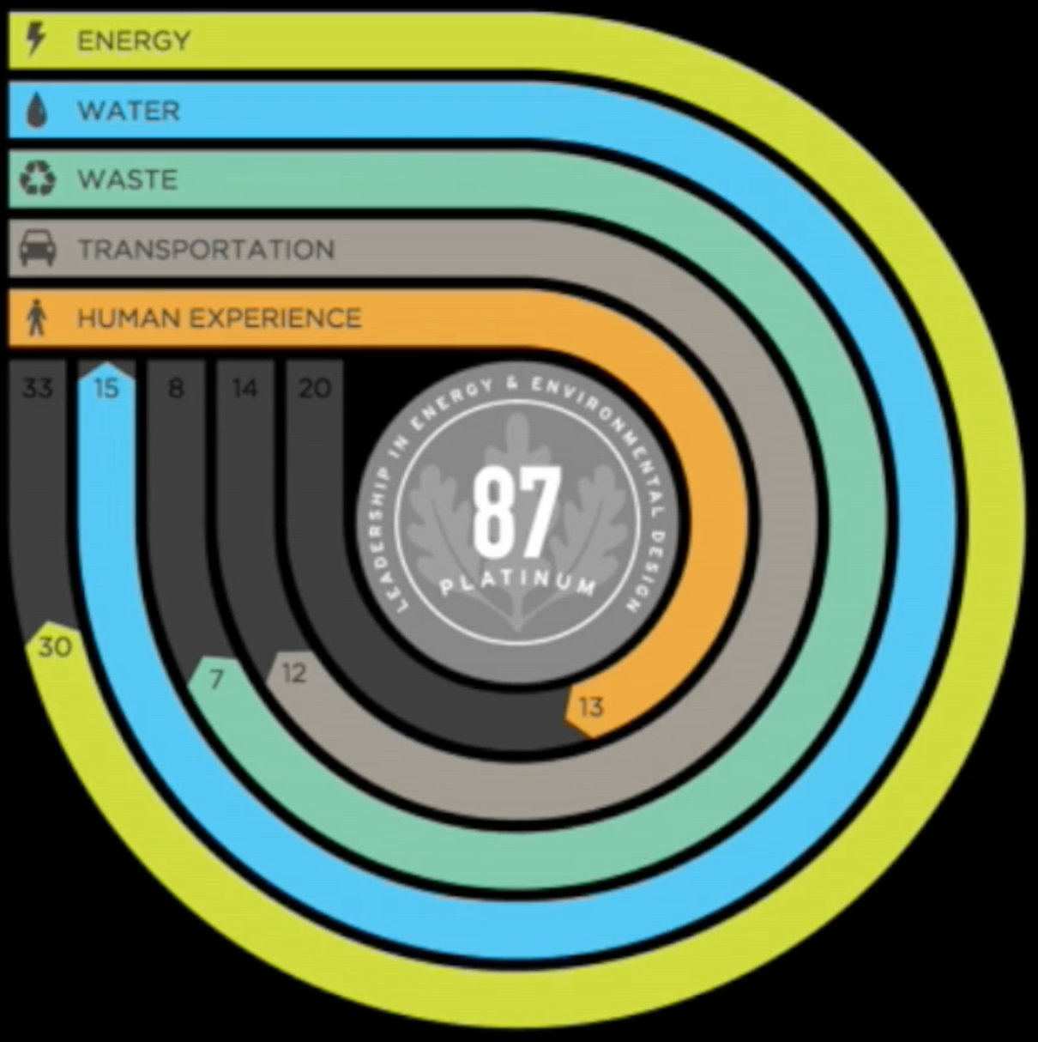
Ongoing Performance Monitoring
LEED Dynamic Plaque

Slide 37
Rating System Development and Evolution
Ongoing improvements to LEED are based on principles of transparency, openness, and inclusiveness involving volunteer committees and working groups, as well as USGBC staff, and are approved by a membership-wide vote.
LEED is continually improved through the correction and clarification of credit language. These updates are published as quarterly addenda and include LEED interpretations.

Slide 38
Rating System Development and Evolution
Addenda http://www.usgbc.org/leed-interpretations
What are Addenda?
Answer
Addenda incorporate changes, improvements to LEED rating systems and reference guides to help clarify, correct, interpret or provide alternative language. Addenda are subject to USGBC committee review and are published frequently.

Slide 39
Rating System Development and Evolution
Addenda
How often are Addenda published?
Answer
Addenda are published as frequently as quarterly, with the first quarterly release occurring January 1st.

Slide 40
Rating System Development and Evolution
Addenda
Does my project have to follow the Addenda?
Answer
Project teams must follow Addenda published prior to their project’s registration date. It’s strongly recommended that project teams also follow Addenda published after their registration date.

Slide 41
Rating System Development and Evolution
LEED Interpretation
What is a LEED Interpretation?
Answer
LEED Interpretations are official answers to formal technical inquiries about implementing LEED on a project. They help project teams understand how their projects can meet LEED requirements and provide clarity on existing options.

Slide 42
Rating System Development and Evolution
LEED Interpretations are:
Precedent-setting: LEED Interpretations can be used by any project certifying under an applicable rating system. All project teams are required to adhere to all LEED Interpretations posted before their registration date. This also applies to other addenda. Adherence to rulings posted after a project registers is optional, but strongly encouraged.
Published online: LEED Interpretations will be published in a database.
Subject to consensus-based review: LEED Interpretations undergo review by USGBC member-selected volunteer LEED committees.

Slide 43
Rating System Development and Evolution
What is a Project Credit Interpretation Ruling (CIR)?
Answer
The Project Credit Interpretation Ruling (CIR) process is designed to allow Project Teams to obtain technical guidance on how LEED requirements including Minimum Program Requirements (MPR), Prerequisites, and Credits pertain to their projects.

Slide 44
Rating System Development and Evolution
What is the difference between a LEED Interpretation and a Project Credit Interpretation Ruling (CIR)?
Answer
LEED Interpretations are similar to Project CIRs but they are precedent setting as the results can be applied to all future LEED projects.

Slide 45
Rating System Development and Evolution
How do I submit a formal inquiry — i.e. a Project Credit Interpretation Ruling (CIR) or LEED Interpretation (LI)?
Answer
Although full functionality for formal inquiries is still under development, Project CIRs & LIs may now be submitted through LEED Online. View our instructions and please refer to the fees website for information on Project CIR fees.

Slide 46
Rating System Development and Evolution
Pilot Credits http://www.usgbc.org/pilotcredits
Pilot credits are a testing area for new ideas in LEED.
Credit can be earned in the Innovation category, or, for Pilot ACPs, the pilot can be used to replace an existing credit.

Slide 47
Rating System Development and Evolution
Pilot Credit Library
Open ACP Pilot Credits
Open Pilot Credits
Closed Pilot Credits

Slide 48
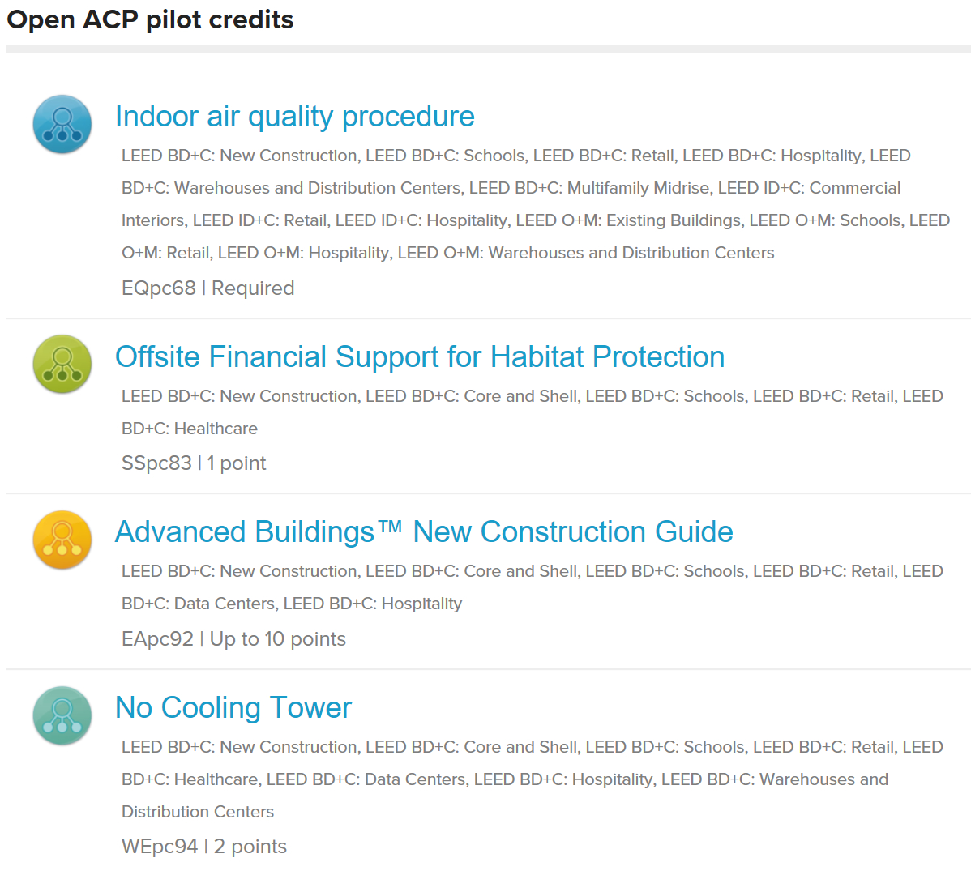
Rating System Development and Evolution

Slide 49
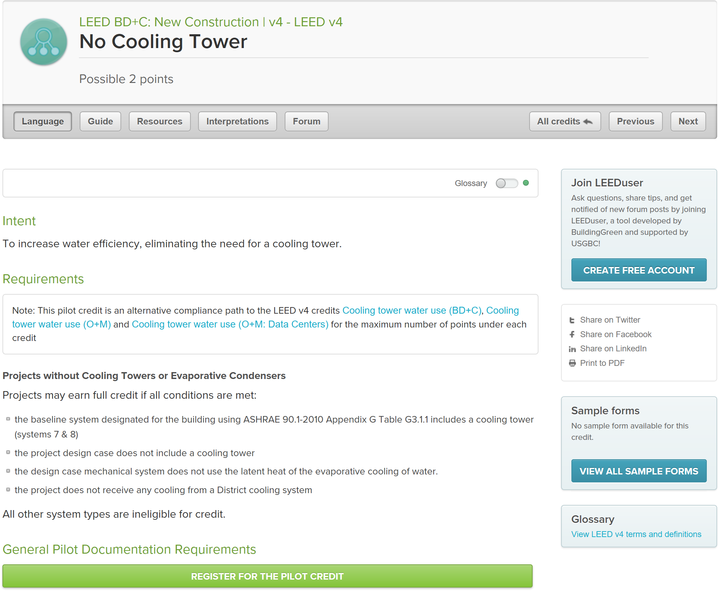

Slide 50
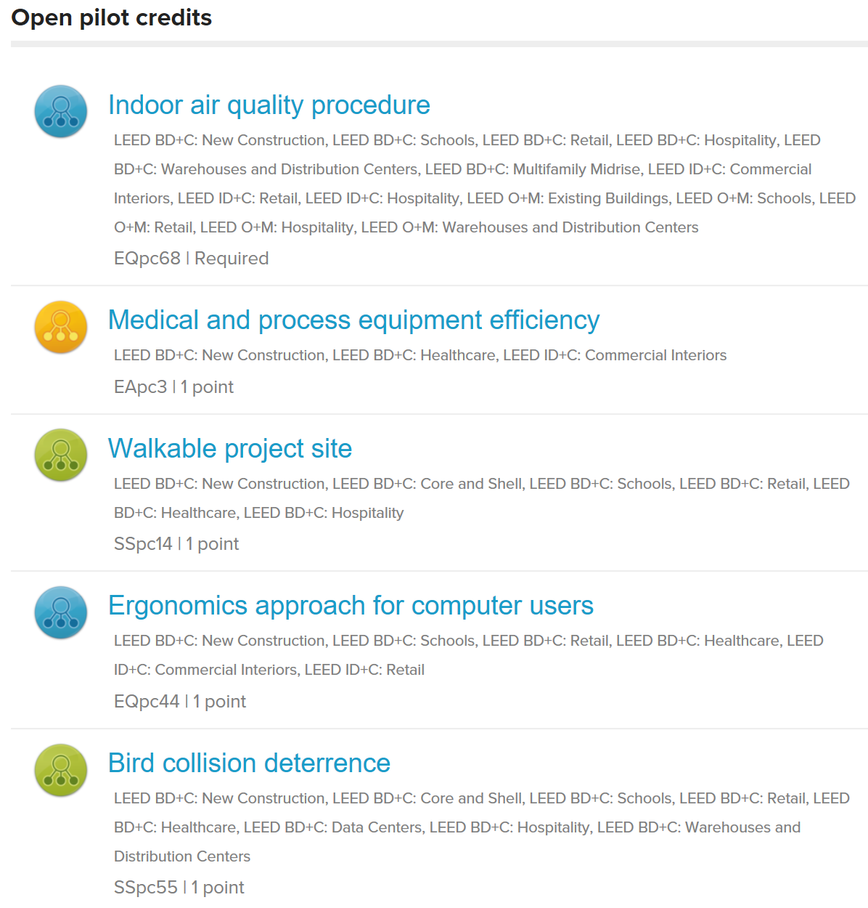
Rating System Development and Evolution

Slide 51
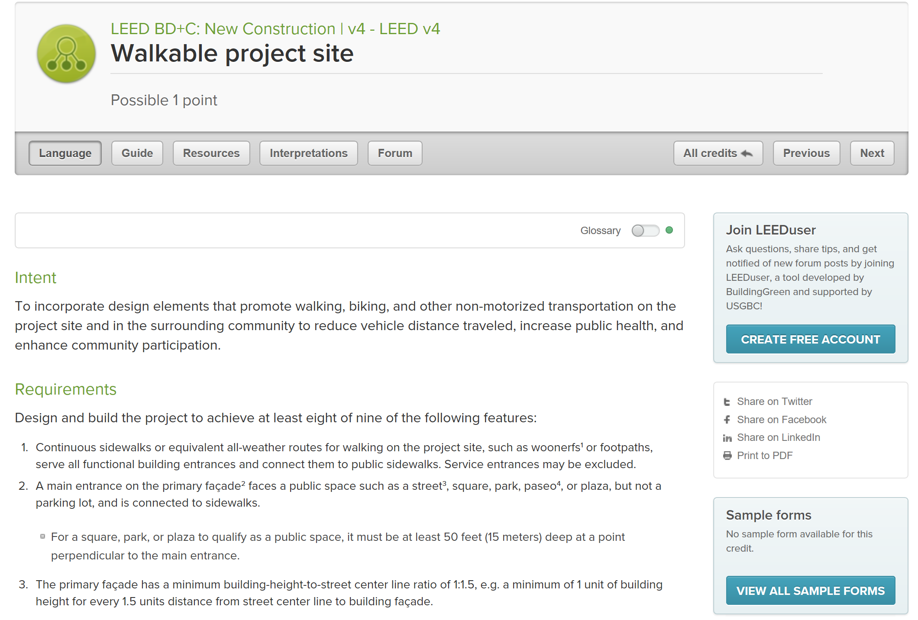

Slide 52
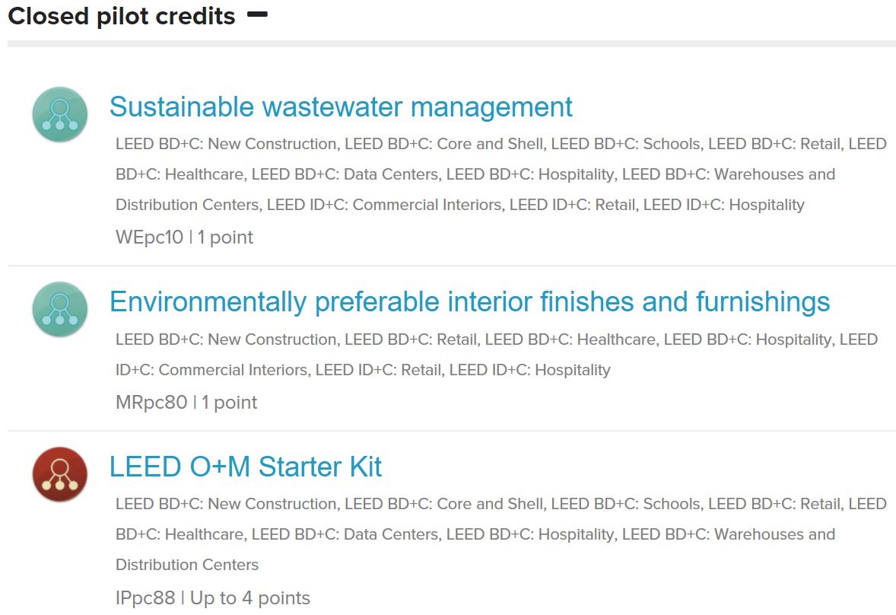
Rating System Development and Evolution

Slide 53
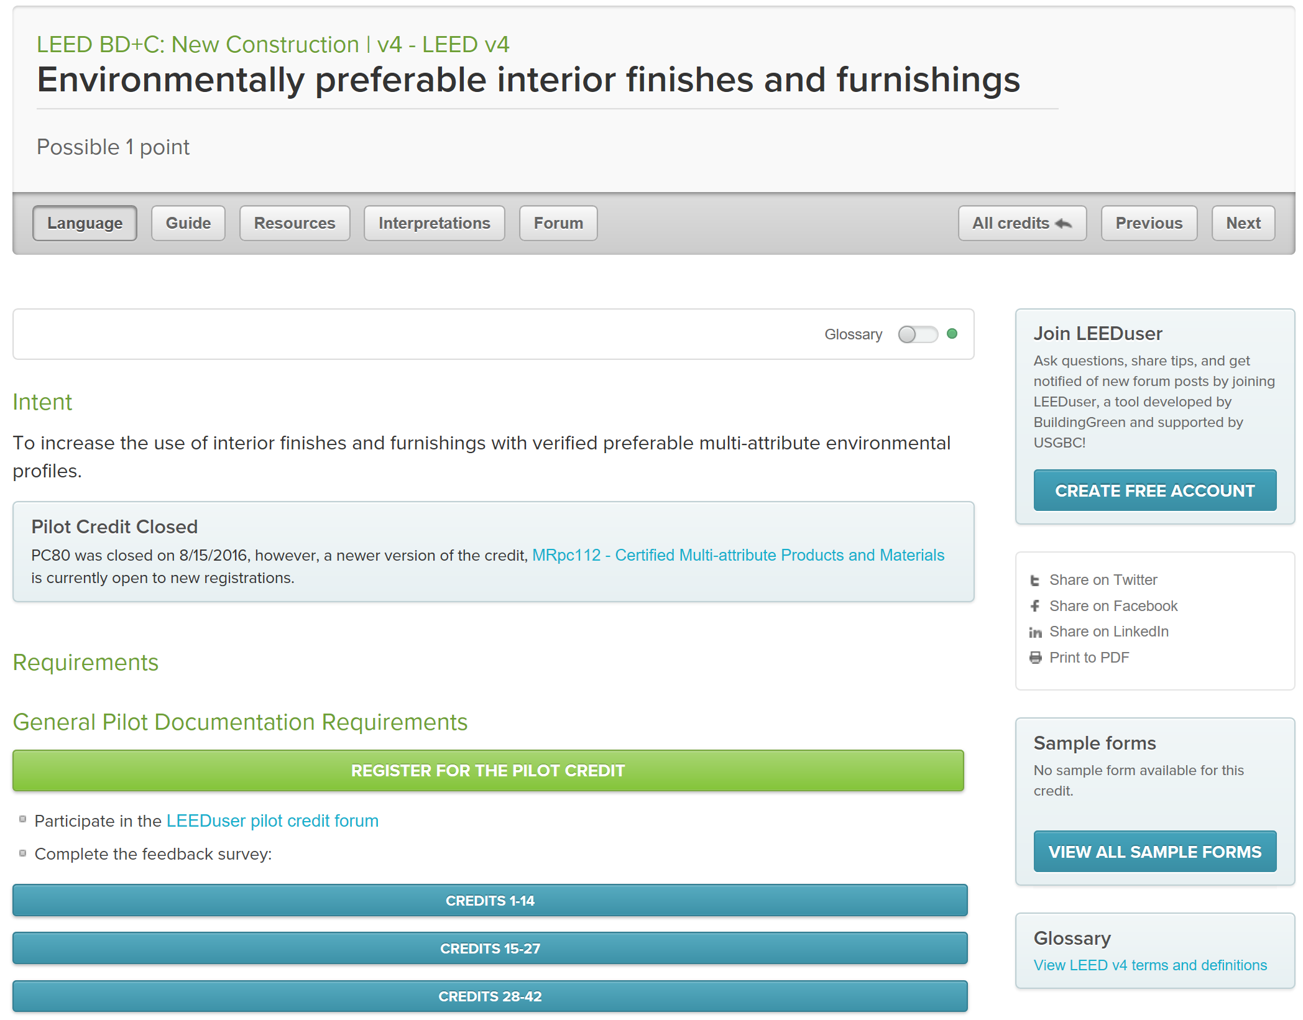

Slide 54
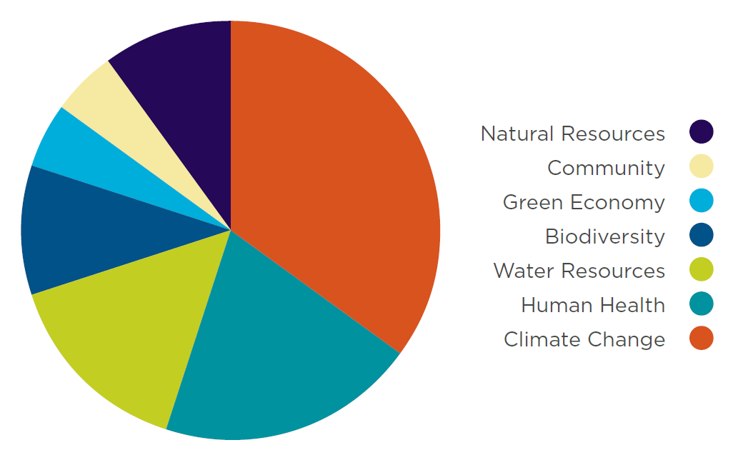
Credit Weightings
The weightings ensure that LEED assigns higher point values to the credits with the strongest relationship to the impact categories of greatest concern.

Slide 55
Credit Weightings
LEED Impact Categories
“What should a LEED project accomplish?”
Reverse Contribution to Global Climate Change
Enhance Individual Human Health and Well-Being
Protect and Restore Water Resources
Protect, Enhance and Restore Biodiversity and Ecosystem Services
Promote Sustainable and Regenerative Material Resources Cycles
Build a Greener Economy
Enhance Social Equity, Environmental Justice, and Community Quality of Life

Slide 56
Green Building Codes, Standards, and Rating Systems
California Green Building Code (CALGreen Code)
http://www.bsc.ca.gov/Home/CALGreen.aspx
The California Green Building Standards Code (CALGreen Code) is Part 11 of the California Building Standards Code (Title 24) and is the first statewide "green" building code in the US.

Slide 57
Green Building Codes, Standards, and Rating Systems
International Green Construction Code (IGCC)
http://www.iccsafe.org/codes-tech-support/international-green-construction-code-igcc/international-green-construction-code/
The International Green Construction Code (IGCC), including ASHRAE Standard 189.1 as an alternate path to compliance, is a widely supported and first-of-its-kind regulatory framework that recognizes an entire set of risks not otherwise addressed in the codes.

Slide 58
Project Certification
LEED certification provides independent, third-party verification that a building project meets the highest green building and performance measures.
Early in the development of a project, the integrated project team needs to determine the project’s goals, the level of certification to pursue, and the credits that will help them achieve it.

Slide 59
Project Certification
LEED certification involves four main steps:
Register your project by completing key forms and submitting payment.
Apply for LEED certification by submitting your completed certification application through LEED Online and paying a certification review fee.
Review. Your LEED application is reviewed by GBCI.
Certify. Receive the certification decision. If you’ve earned LEED certification: congratulations!

Slide 60
Project Certification
Project Registration
The LEED process begins with registration. The project team submits a registration form and a fee to GBCI.
It is helpful if the project administrator—the team member who registers the project—has previous green building and LEED project experience; ideally, he or she is a LEED Accredited Professional with Specialty.
Once registered, the team receives information, tools, and communications that will help guide the certification process.
All project activity, including registration and credit compliance documentation, is completed in LEED Online, a data collection portal through which the team uploads information about the project. This site provides credit templates to be completed and signed by a specified member of the team.

Slide 61
Project Certification
Application Preparation
Each LEED credit and prerequisite has documentation requirements that must be completed as part of the application process.
The project team selects the credits it has chosen to pursue and when the necessary documentation, including required information and calculations, has been assembled, the project team uploads the materials to LEED Online.

Slide 62
Project Certification
Submission
When the team is ready for its application to be reviewed, the project administrator submits the appropriate fee and documentation.
For LEED BD+C and ID+C projects, the team can wait to submit documentation until the building project is complete, or the team can seek review of its design-related prerequisites and credits before completion, and then apply for construction-related credits after the project is finished.

Slide 63
Project Certification
Application Review
Whether the design and construction credits are submitted together or separately, each credit undergoes one preliminary review.
The certification reviewer may request additional information or clarification.
The team then submits final documentation. After the final review, a team may appeal any adverse decisions on individual credits for an additional fee.

Slide 64
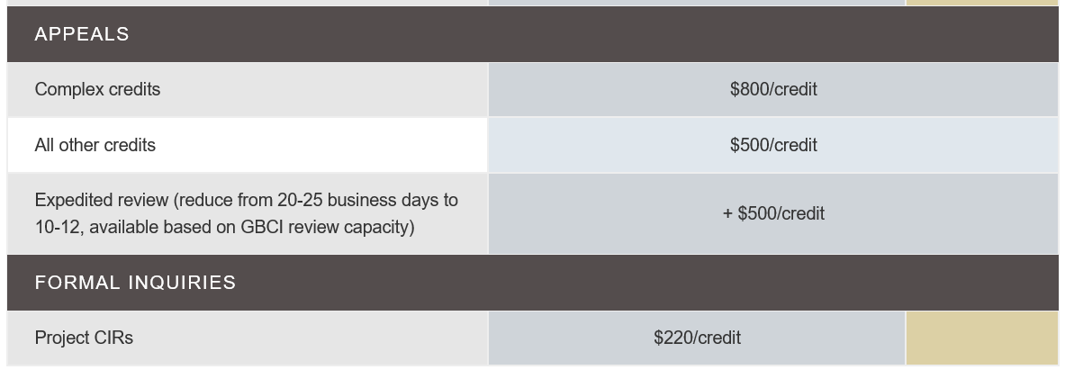
Project Certification
Application Review
Whether the design and construction credits are submitted together or separately, each credit undergoes one preliminary review.
The certification reviewer may request additional information or clarification.
The team then submits final documentation. After the final review, a team may appeal any adverse decisions on individual credits for an additional fee.

Slide 65
Project Certification
Certification
Certification is the final step in the LEED review process.
Once the final application review is complete, the project team can either accept or appeal the final decision.
LEED-certified projects receive formal certificates of recognition, a plaque, and tips for marketing the achievement.
Projects may be included in USGBC’s online LEED Project Directory of registered and certified projects.

Slide 66
Project Certification
http://www.usgbc.org/cert-guide

Slide 67
Project Certification
http://www.usgbc.org/cert-guide/commercial

Slide 68
Project Credit Interpretation Rulings
Project credit interpretation rulings (Project CIRs), administered by GBCI, allow teams to obtain technical guidance on how LEED requirements pertain to their projects.
Project CIRs do not guarantee credit award; the project applicant must still demonstrate and document achievement during the LEED certification application process.
The ruling remains confidential and generally applies only to the one project.

Slide 69
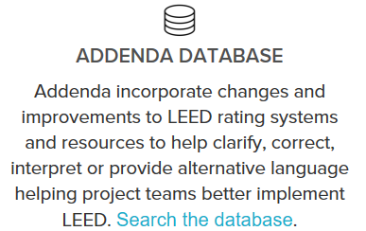
LEED Interpretations
LEED Interpretations, however, are precedent setting; project teams are required to adhere to all LEED Interpretations posted before their registration date.
These are posted publicly in the online Addenda database.

Slide 70
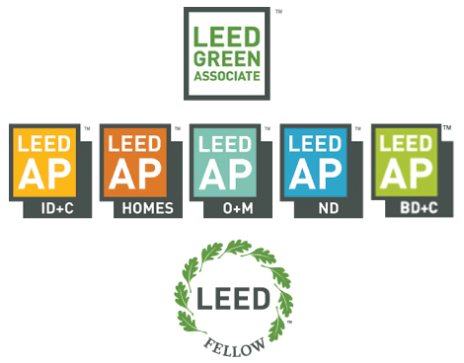
LEED Professional Credentials

Slide 71
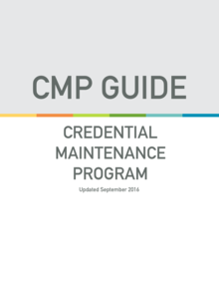
LEED Professional Credentials
Maintaining your credential
All LEED professionals are required to maintain their credential by earning continuing education hours.
LEED Green Associates must earn 15 continuing education hours within two years of earning their credential.
LEED APs must earn 30 continuing education hours within two years of earning their credential.

Slide 72
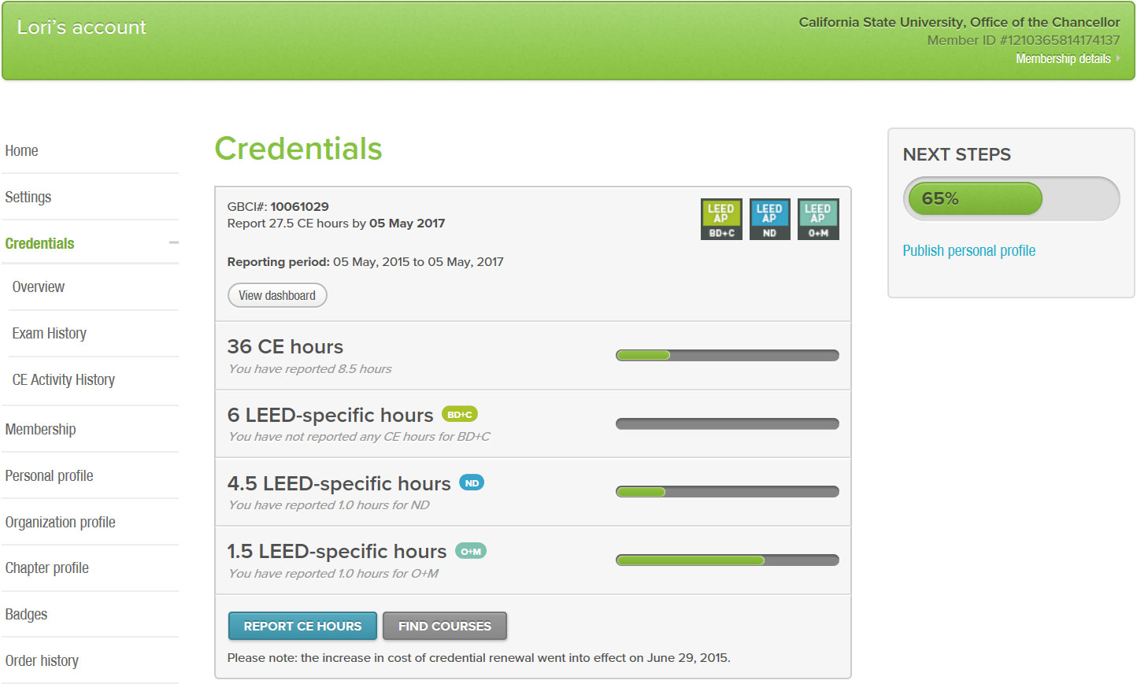

Slide 73
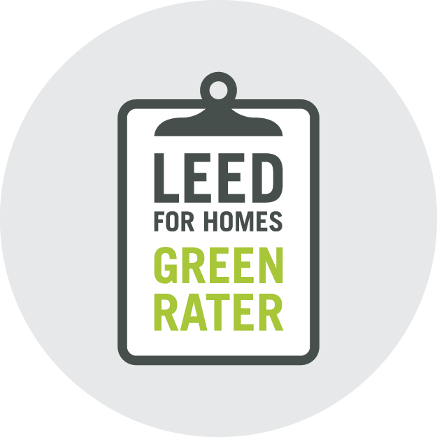
Certificates
Green Raters provide in-the-field verification services at each and every Homes project.

Slide 74
Certificates
Earn a Green Classroom Professional certificate and further the mission of creating green schools for everyone within this generation. Green classroom professionals advocate for healthier, more environmentally responsible places in which to work and teach.

