Slide 1
About USGBC and LEED
LEED Core Concepts Guide
Section 5

Slide 2
U.S. Green Building Council (USGBC) http://usgbc.org
USGBC’s Vision
Buildings and communities will regenerate and sustain the health and vitality of all life within a generation.

Slide 3
USGBC is transforming the building landscape in a number of ways:
Advocacy - https://www.usgbc.org/about/advocacy
USGBC is accelerating the uptake of policies and initiatives that enable and encourage market transformation toward a sustainable built environment.
Community - https://www.usgbc.org/membership
USGBC is a movement of community leaders, professionals, businesses, and innovators working to accomplish a single bold vision: healthy, efficient and equitable buildings and communities for all.
Education - https://www.usgbc.org/courses-and-events

Slide 4
Greenbuild International Conference and Expo - https://informaconnect.com/greenbuild/

Slide 5
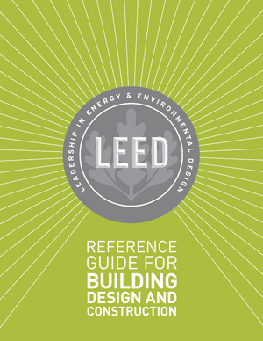
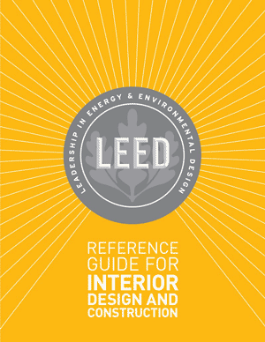
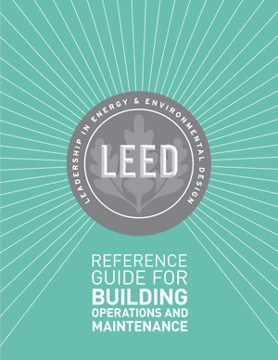
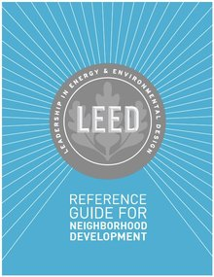
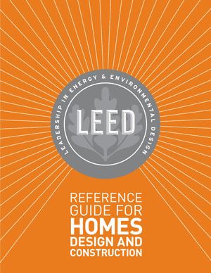
LEED Green Building Program - http://www.usgbc.org/leed
Leadership in Energy and Environmental Design (LEED) program – third-party certification program

Slide 6
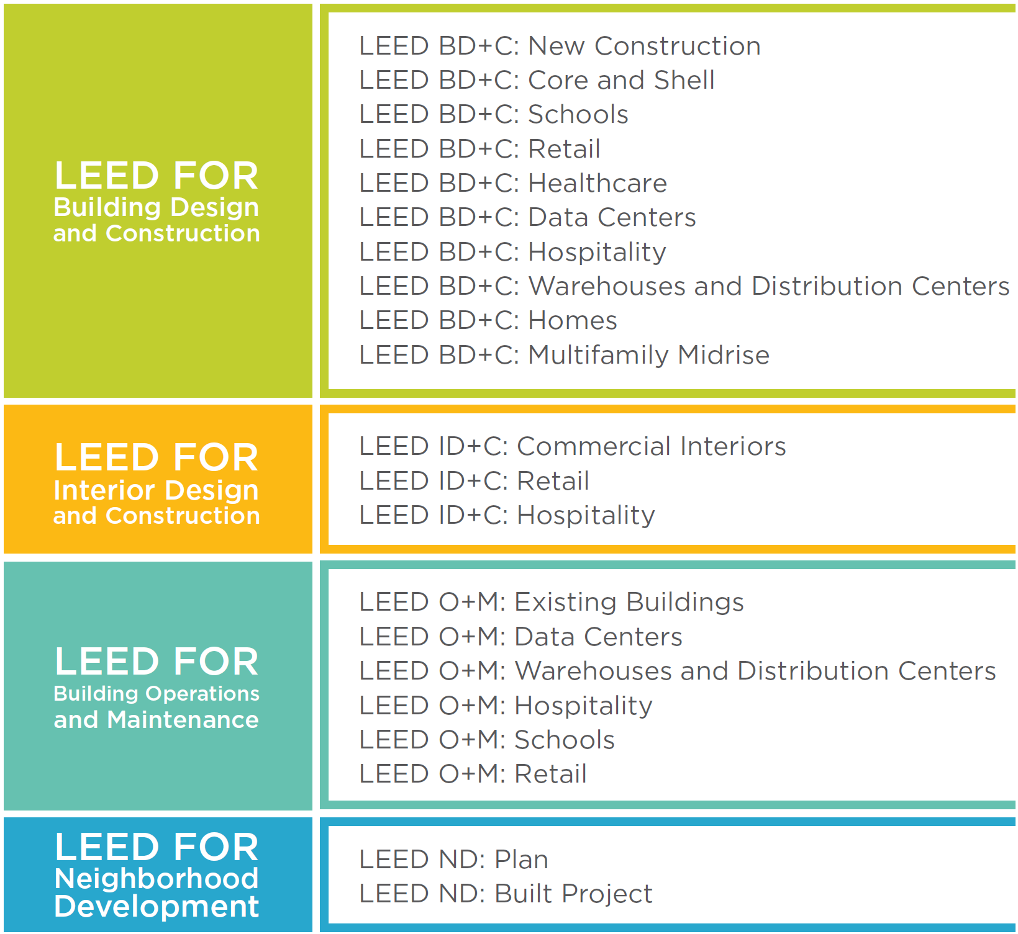
Adaptations

Slide 7
LEED (Leadership in Energy and Environmental Design) is the world's most widely used green building rating system.
LEED certification provides a framework for healthy, highly efficient, and cost-saving green buildings, which offer environmental, social and governance benefits.
LEED certification is a globally recognized symbol of sustainability achievement, and it is backed by an entire industry of committed organizations and individuals paving the way for market transformation.

Slide 8
Rating System Structure
Prerequisites
Required elements or green building strategies that must be included in any LEED-certified project.
Establish a minimum level of sustainability.
Credits
Optional elements—strategies that projects can elect to pursue to gain points toward LEED certification.
Achieving LEED certification requires:
Meet the Minimum Program Requirements (MPRs)
Satisfy all prerequisites
Earn a minimum number of credits for the desired level of certification

Slide 10
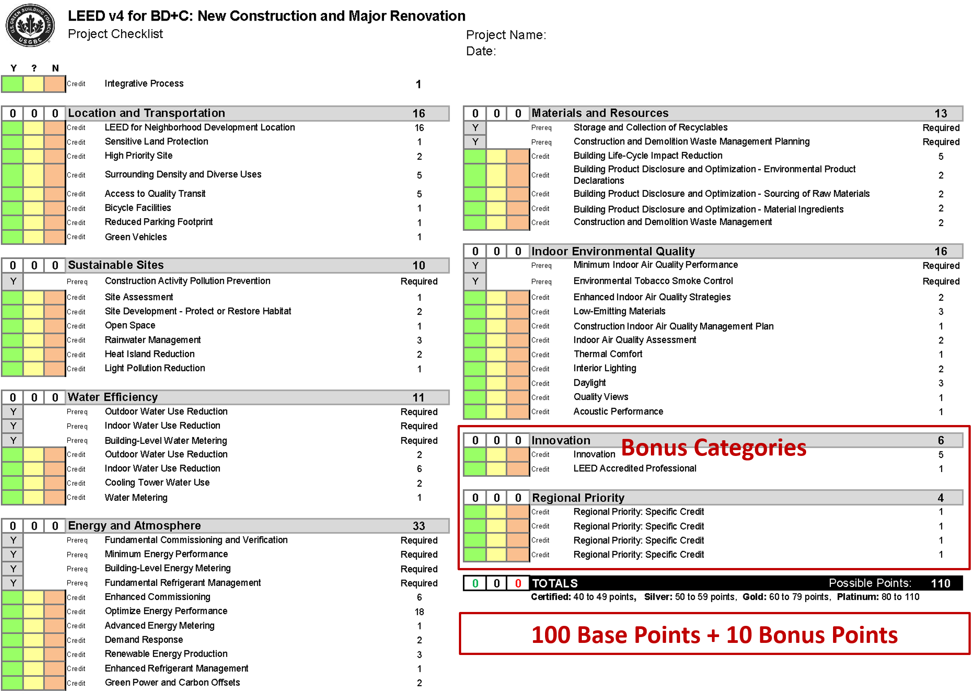

Slide 11
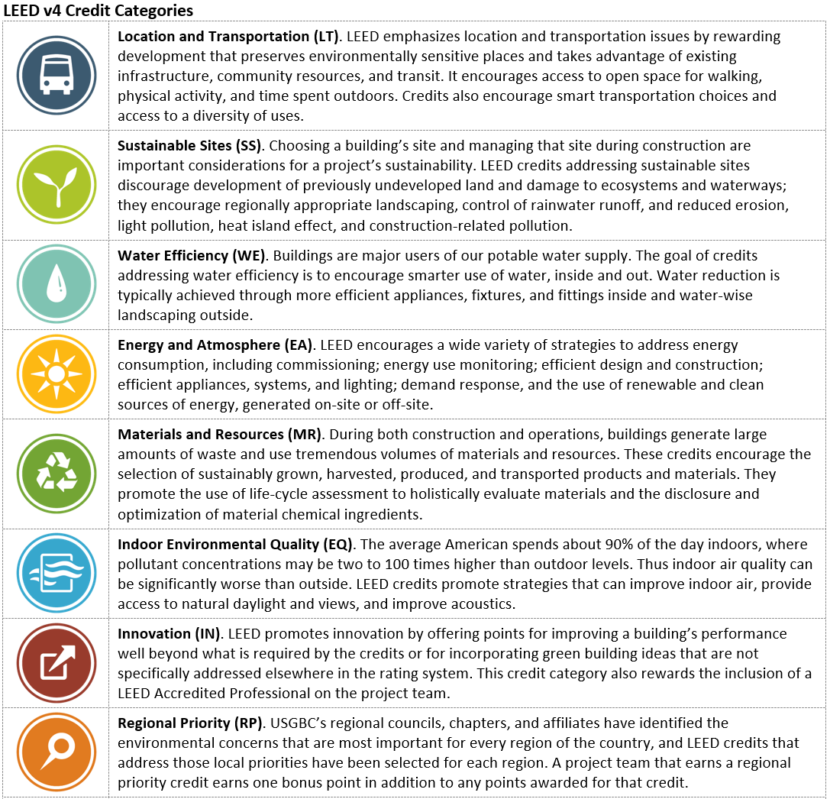

Slide 12
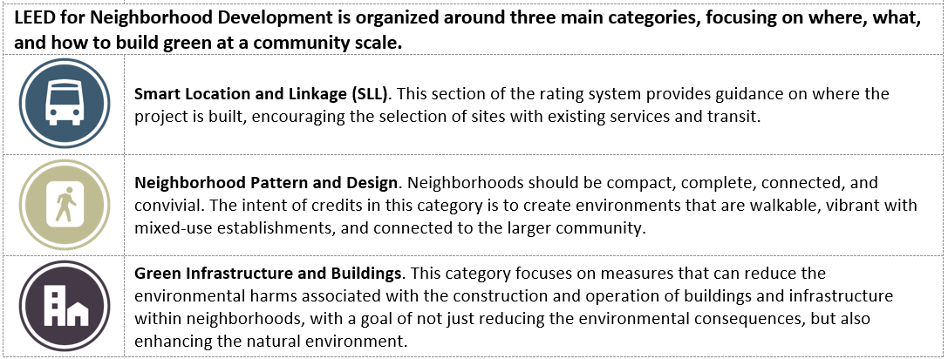

Slide 13
Rating System Development and Evolution
Since its launch in 2000, LEED has been evolving to address new markets and building types, advances in practice and technology, and greater understanding of the environmental and human health impacts of the built environment.
These ongoing improvements to LEED are based on principles of transparency, openness, and inclusiveness involving volunteer committees and working groups, as well as USGBC staff, and are approved by a membership-wide vote.

Slide 14
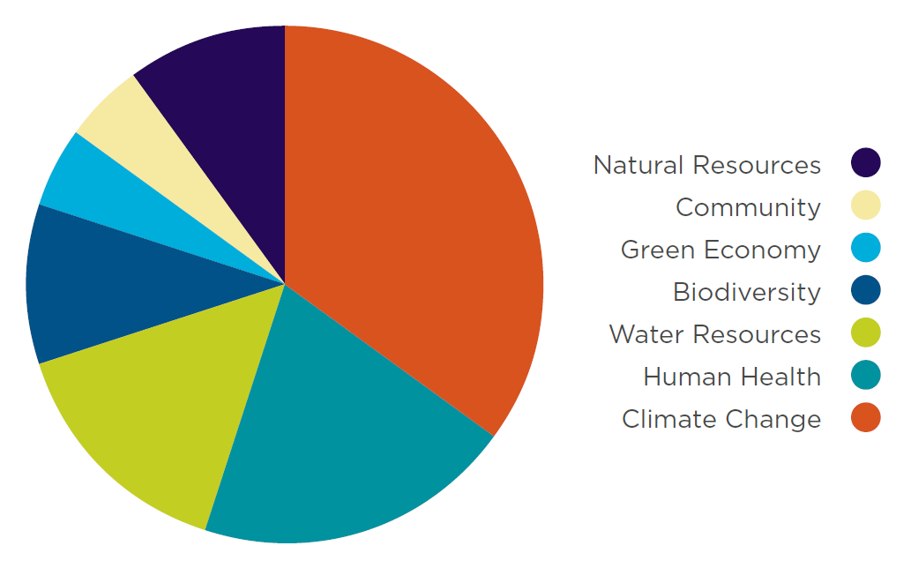
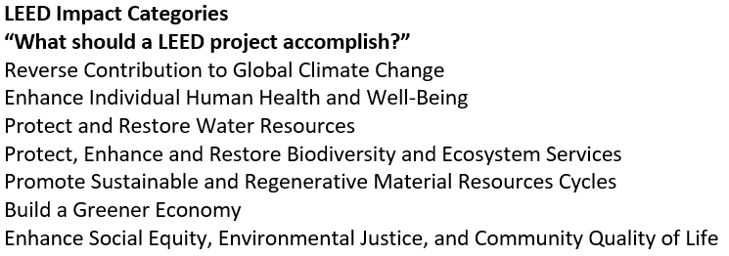
Credit Weightings
The weightings ensure that LEED assigns higher point values to the credits with the strongest relationship to the impact categories of greatest concern.

Slide 15
Green Building Codes, Standards, and Rating Systems
California Green Building Code (CALGreen Code)
http://www.bsc.ca.gov/Home/CALGreen.aspx
The California Green Building Standards Code (CALGreen Code) is Part 11 of the California Building Standards Code (Title 24) and is the first statewide "green" building code in the US.
International Green Construction Code (IGCC)
http://www.iccsafe.org/codes-tech-support/international-green-construction-code-igcc/international-green-construction-code/
The International Green Construction Code (IGCC), including ASHRAE Standard 189.1 as an alternate path to compliance, is a widely supported and first-of-its-kind regulatory framework that recognizes an entire set of risks not otherwise addressed in the codes.

Slide 16
Project Certification http://www.usgbc.org/cert-guide
LEED certification provides independent, third-party verification that a building project meets the highest green building and performance measures.
Early in the development of a project, the integrated project team needs to determine the project’s goals, the level of certification to pursue, and the credits that will help them achieve it.
LEED certification involves four main steps:
Register your project by completing key forms and submitting payment.
Apply for LEED certification by submitting your completed certification application through LEED Online and paying a certification review fee.
Review. Your LEED application is reviewed by GBCI.
Certify. Receive the certification decision. If you’ve earned LEED certification: congratulations!

Slide 17
Project Registration
The LEED process begins with registration. The project team submits a registration form and a fee to GBCI.
It is helpful if the project administrator—the team member who registers the project—has previous green building and LEED project experience; ideally, he or she is a LEED Accredited Professional with Specialty.
Once registered, the team receives information, tools, and communications that will help guide the certification process.
All project activity, including registration and credit compliance documentation, is completed in LEED Online, a data collection portal through which the team uploads information about the project. This site provides credit templates to be completed and signed by a specified member of the team.

Slide 18
Application Preparation
Each LEED credit and prerequisite has documentation requirements that must be completed as part of the application process.
The project team selects the credits it has chosen to pursue and when the necessary documentation, including required information and calculations, has been assembled, the project team uploads the materials to LEED Online.
Submission
When the team is ready for its application to be reviewed, the project administrator submits the appropriate fee and documentation.
For LEED BD+C and ID+C projects, the team can wait to submit documentation until the building project is complete, or the team can seek review of its design-related prerequisites and credits before completion, and then apply for construction-related credits after the project is finished.

Slide 19
Application Review
Whether the design and construction credits are submitted together or separately, each credit undergoes one preliminary review.
The certification reviewer may request additional information or clarification.
The team then submits final documentation. After the final review, a team may appeal any adverse decisions on individual credits for an additional fee.
Certification
Certification is the final step in the LEED review process.
Once the final application review is complete, the project team can either accept or appeal the final decision.
LEED-certified projects receive formal certificates of recognition, a plaque, and tips for marketing the achievement.
Projects may be included in USGBC’s online LEED Project Directory of registered and certified projects.

Slide 20
Project Credit Interpretation Rulings
Project credit interpretation rulings (Project CIRs), administered by GBCI, allow teams to obtain technical guidance on how LEED requirements pertain to their projects.
Project CIRs do not guarantee credit award; the project applicant must still demonstrate and document achievement during the LEED certification application process.
The ruling remains confidential and generally applies only to the one project.
LEED Interpretations
LEED Interpretations, however, are precedent setting; project teams are required to adhere to all LEED Interpretations posted before their registration date.
These are posted publicly in the online Addenda database.

Slide 21
