Slide 1
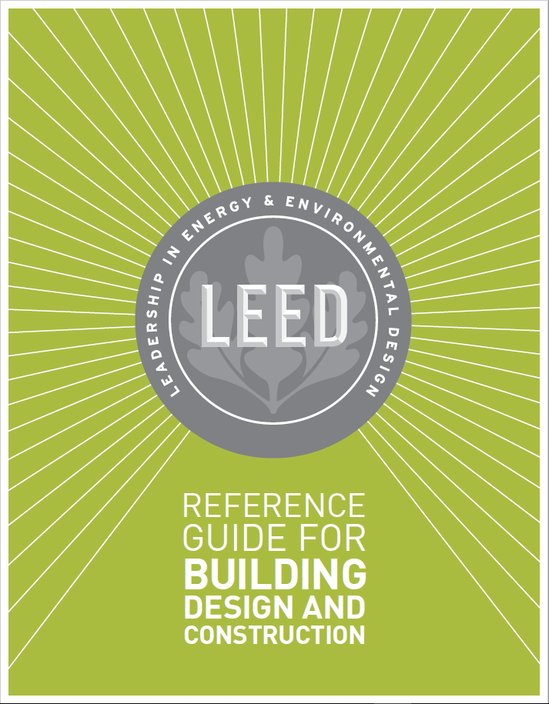
GA02 Introductory and Overview Sections: LEED BD+C Reference Guide, v4

Slide 5
GA02 Introductory and Overview Sections: LEED BD+C Reference Guide, v4
Example Credit: LT LEED for Neighborhood Development Location

Slide 6
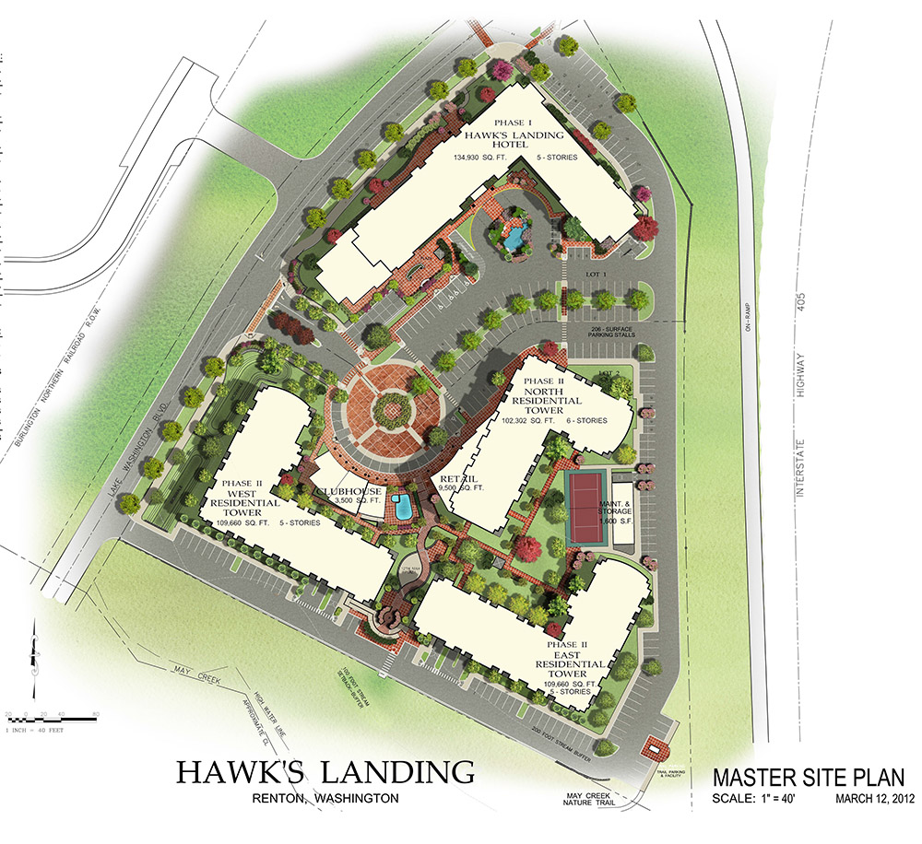
GA02 Introductory and Overview Sections: LEED BD+C Reference Guide, v4
Example Credits: Outdoor Water Use Reduction and Indoor Water Use Reduction
WE Credit Outdoor Water Use Reduction
Campus
Group Approach
All buildings in the group may be documented as one. Use the total landscaped area of the entire campus. The results of the Water Budget Tool apply to all buildings within the group.
Campus Approach
Eligible.
WE Credit Indoor Water Use Reduction
Campus
Group Approach
Submit separate documentation for each building.
Campus Approach
Ineligible. Each LEED project may pursue the credit individually.

Slide 7
GA02 Introductory and Overview Sections: LEED BD+C Reference Guide, v4
Projects Outside the US
International Tips
This section offers advice on how to determine equivalency to U.S. Standards or using non-U.S. standards referenced in the rating system.
Inch-Pound (IP) - inch, pound, and gallon
Derived from the English system and commonly used in the U.S.
International System of Units (SI) – meter, kilogram, and liter
Metric system used in most other parts of the world and defined by the General Conference on Weights and Measures.

Slide 8
GA02 Introductory and Overview Sections: LEED BD+C Reference Guide, v4
“local equivalent”
Means an alternative to a LEED referenced standard that is specific to a project’s locality. “Whichever is more stringent”
“USGBC-approved local equivalent”
Means a local standard deemed equivalent to the listed standard by the U.S. Green Building Council through its process for establishing non-U.S. equivalencies in LEED.

Slide 9
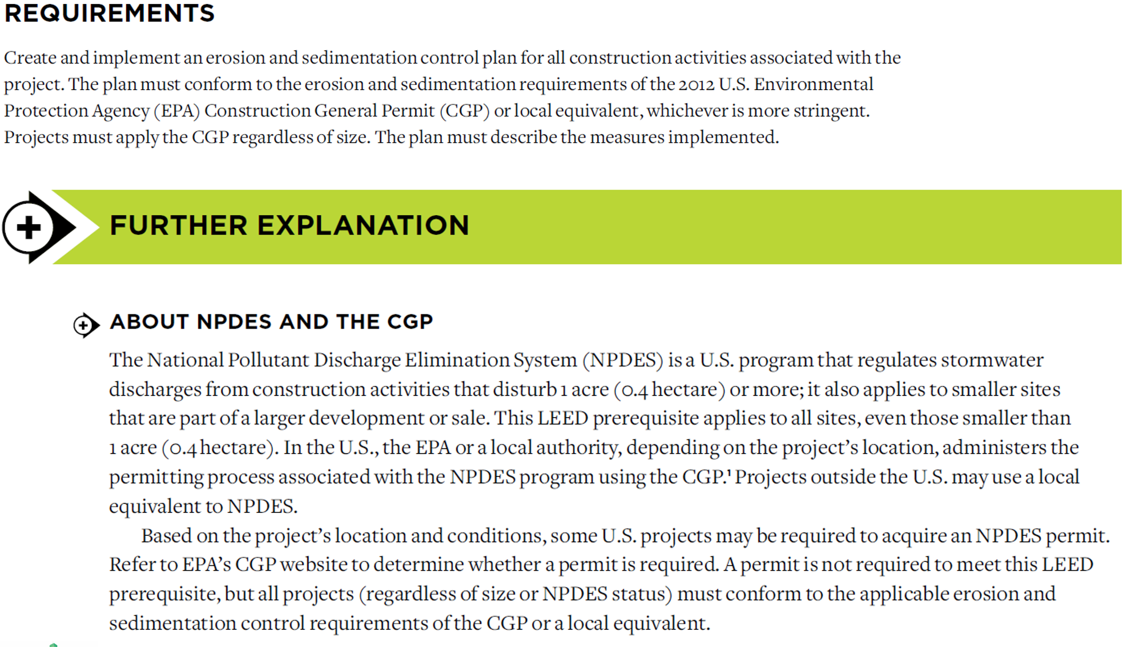
GA02 Introductory and Overview Sections: LEED BD+C Reference Guide, v4
Example Credits: SS Prerequisite Construction Activity Pollution Prevention

Slide 10
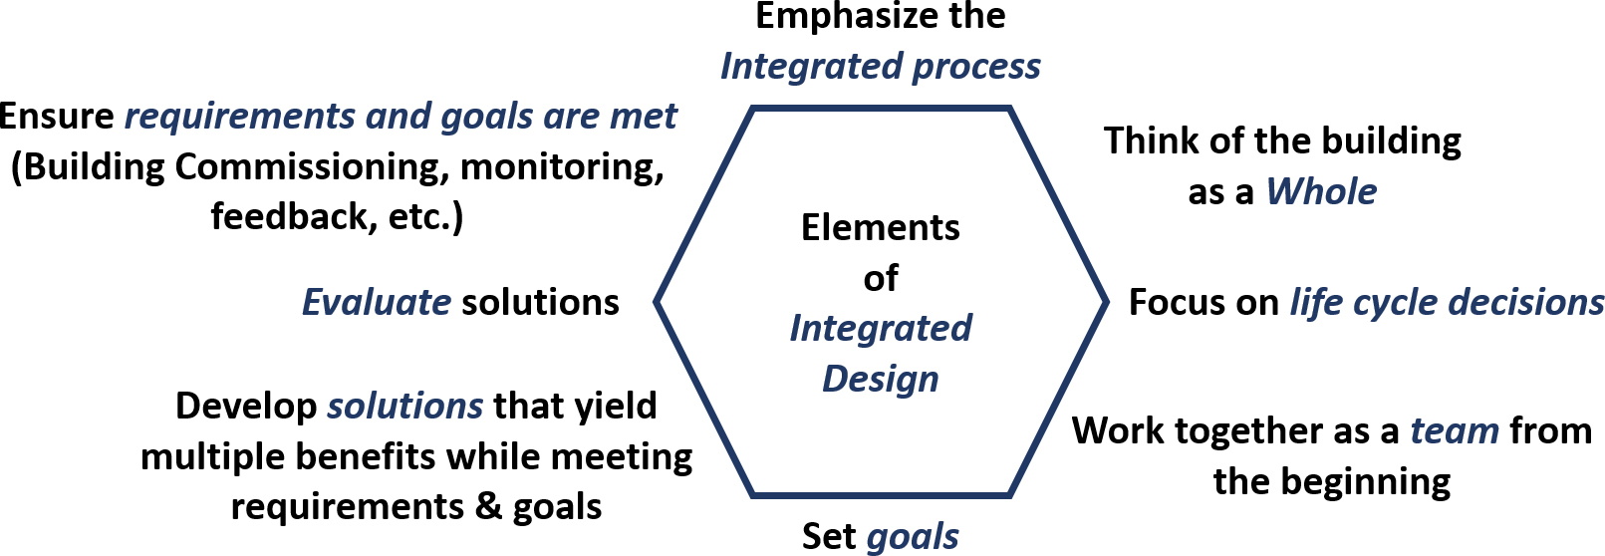
GA02 Introductory and Overview Sections: LEED BD+C Reference Guide, v4
Taking an Integrative Approach to Design and Construction

Slide 11
GA02 Introductory and Overview Sections: LEED BD+C Reference Guide, v4
Integrative Design Process
Engage all project team members.
Work in collaboration not isolation.
Look for interrelationships and synergies between systems and components.
The coordination of building and site systems should be addressed early, preferably before schematic design.

Slide 12
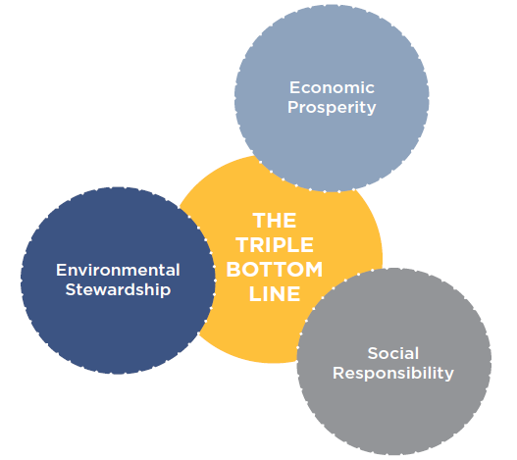
GA02 Introductory and Overview Sections: LEED BD+C Reference Guide, v4
The Integrative Process credit formally introduces this way of working into LEED so that the team members’ expertise in building and site systems can inform the performance, efficiency, and effectiveness of every system.
“When areas of practice are integrated, it becomes possible to significantly improve building performance and achieve synergies that yield economic, environmental, and human health benefits.”

Slide 13
GA02 Introductory and Overview Sections: LEED BD+C Reference Guide, v4
Integrative Process Includes Three Phases:
Discovery. The most important phase of the integrative process, discovery can be thought of as an extensive expansion of what is conventionally called predesign. A project is unlikely to meets its environmental goals cost-effectively without this discrete phase. Discovery work should take place before schematic design begins.
Design and construction (implementation). This phase begins with what is conventionally called schematic design. It resembles conventional practice but integrates all the work and collective understanding of system interactions reached during the discovery phase.
Occupancy, operations, and performance feedback. This third stage focuses on preparing to measure performance and creating feedback mechanisms. Assessing performance against targets is critical for informing building operations and identifying the need for any corrective action.

Slide 14
GA02 Introductory and Overview Sections: LEED BD+C Reference Guide, v4
The structure to manage this flow of people, information, and analysis is as follows:
All project team members, representing all design and construction disciplines, gather information and data relevant to the project.
Team members analyze their information.
Team members participate in workshops to compare notes and identify opportunities for synergy.
This process of research, analysis, and workshops is done in an iterative cycle that refines the design solutions.

Slide 15
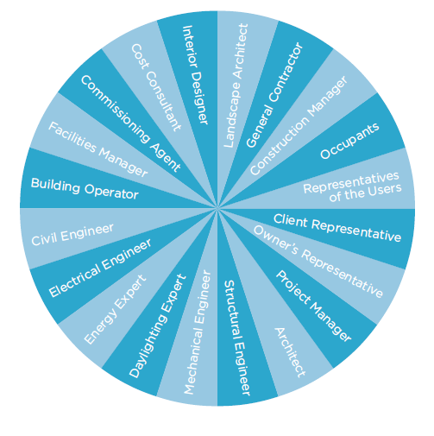
GA02 Introductory and Overview Sections: LEED BD+C Reference Guide, v4
Devising a LEED Work Plan
It is recommended that LEED applicants follow a series of steps to certification.
Step 1. Initiate discovery phase
Step 2. Select LEED rating system
Step 3. Check minimum program requirements
Step 4. Establish project goals
Step 5. Define LEED project scope
Step 6. Develop LEED scorecard
Step 7. Continue discovery phase
Step 8. Continue iterative process
Step 9. Assign roles and responsibilities
Step 10. Develop consistent documentation
Step 11. Perform quality assurance review and submit for certification

Slide 16
GA02 Introductory and Overview Sections: LEED BD+C Reference Guide, v4
Devising a LEED Work Plan
It is recommended that LEED applicants follow a series of steps to certification.
Step 1. Initiate discovery phase
Step 2. Select LEED rating system
Step 3. Check minimum program requirements
Step 4. Establish project goals
Step 5. Define LEED project scope
Step 6. Develop LEED scorecard
Step 7. Continue discovery phase
Step 8. Continue iterative process
Step 9. Assign roles and responsibilities
Step 10. Develop consistent documentation
Step 11. Perform quality assurance review and submit for certification
Charrette
When sufficient information has been gathered, hold a goal-setting workshop.

Slide 17
GA02 Introductory and Overview Sections: LEED BD+C Reference Guide, v4
Devising a LEED Work Plan
It is recommended that LEED applicants follow a series of steps to certification.
Step 1. Initiate discovery phase
Step 2. Select LEED rating system
Step 3. Check minimum program requirements
Step 4. Establish project goals
Step 5. Define LEED project scope
Step 6. Develop LEED scorecard
Step 7. Continue discovery phase
Step 8. Continue iterative process
Step 9. Assign roles and responsibilities
Step 10. Develop consistent documentation
Step 11. Perform quality assurance review and submit for certification
Charrette
When sufficient information has been gathered, hold a goal-setting workshop.
LEED Project Checklist
deliverables
Level of certification

Slide 18
GA02 Introductory and Overview Sections: LEED BD+C Reference Guide, v4
Maintaining Consistency in the LEED Application
Certain issues recur across multiple credits and credit categories and must be treated consistently throughout the submission.
Special Project Situations
Projects with a combination of space types or unusual space types should pay particular attention to how these characteristics influence credit achievement.

Slide 19
GA02 Introductory and Overview Sections: LEED BD+C Reference Guide, v4
Common project programs that require additional consideration include the following:
Mixed Use
Multitenant Complex
Incomplete Spaces
Projects with Several Physically Distinct Structures

Slide 20
GA02 Introductory and Overview Sections: LEED BD+C Reference Guide, v4
Mixed Use
Examples
Residential and Commercial
A multi-family residential building with 8 occupiable stories above grade certifying under BD+C: New Construction includes a retail grocery store on the ground level, the team could benefit from guidance for BD+C: Retail projects.
Commercial and Data Center
An office building certifying under BD+C: New Construction includes a small data center, the team should follow the data center guidelines for certain credits; these guidelines are not limited to BD+C: Data Centers projects.
Hospitality and Retail
A hotel project certifying under BD+C: Hospitality; in designing the retail spaces on the hotel’s ground floor, the team could benefit from guidance for BD+C: Retail projects.

Slide 21
GA02 Introductory and Overview Sections: LEED BD+C Reference Guide, v4
Multitenant Complex
Some projects may be part of a large complex of buildings or a master planned development.
Any project can follow the multitenant complex approach if it is part of a master plan development, regardless of whether the project is using the LEED Campus approach.

Slide 22
GA02 Introductory and Overview Sections: LEED BD+C Reference Guide, v4
Incomplete Spaces
No more than 40% of the certifying gross floor area of a LEED project may consist of incomplete space unless the project is using the LEED BD+C: Core and Shell rating system.
Projects that include incomplete spaces must use Appendix 2 Default Occupancy Counts to establish occupant counts for incomplete spaces.
For incomplete spaces in projects using a rating system other than LEED BD+C: Core and Shell, the project team must provide supplemental documentation.
Submit a letter of commitment, signed by the owner.
Incomplete spaces intended to be finished by tenants (i.e., parties other than the owner), submit a set of nonbinding tenant design and construction guidelines.

Slide 23
GA02 Introductory and Overview Sections: LEED BD+C Reference Guide, v4
Projects with Several Physically Distinct Structures
Primary and secondary school projects, hospitals (general medical and surgical), hotels, resorts, and resort properties, as defined for ENERGY STAR building rating purposes, are eligible to include more than one physically distinct structure in a single LEED project certification application without having to use the Campus Program, subject to the following conditions.
The buildings to be certified must be a part of the same identity. For example, the buildings are all part of the same elementary school, not a mix of elementary school and high school buildings.
The project must be analyzed as a whole (i.e., in aggregate) for all minimum program requirements (MPRs), prerequisites, and credits in the LEED rating system.
All the land area and all building floor areas within the LEED project boundary must be included in every prerequisite and credit submitted for certification.
There is no specific limit on the number of structures, but the aggregate gross floor area included in a single project must not exceed 1 million square feet (92,905 square meters).
Any single structure that is larger than 25,000 square feet (2,320 square meters) must be registered as a separate project or treated as a separate building in a group certification approach.

Slide 24
GA02 Introductory and Overview Sections: LEED BD+C Reference Guide, v4
Renovations and Additions
Refer to the minimum program requirements for information on how boundaries should be drawn for renovation and addition projects.
Additionally, use the following guidance for treating energy systems in any project with mechanical systems.
Separate systems. Mechanical systems are completely separate from those in the existing building (emergency generators excepted) and can be modeled separately.
Shared central systems located outside the project building or space. Each prerequisite and credit section related to energy modeling offers specific guidance on how to handle this situation; in particular, see the guidance for EA Prerequisite Minimum Energy Performance.

Slide 25
GA02 Introductory and Overview Sections: LEED BD+C Reference Guide, v4
Tenant Sales and Lease Agreement
Credits or thresholds beyond the construction scope of the LEED project, a binding tenant sales and lease agreement must be provided as documentation.
This must be signed by the future tenant and include terms related to how the technical credit requirements will be carried out by the tenant.

Slide 26
GA02 Introductory and Overview Sections: LEED BD+C Reference Guide, v4
Previous Development
previously developed altered by paving, construction, and/or land use that would typically have required regulatory permitting to have been initiated (alterations may exist now or in the past). Land that is not previously developed and landscapes altered by current or historical clearing or filling, agricultural or forestry use, or preserved natural area use are considered undeveloped land. The date of previous development permit issuance constitutes the date of previous development, but permit issuance in itself does not constitute previous development.
previously developed site a site that, prior to the project, consisted of at least 75% previously developed land.
previously disturbed areas that have been graded, compacted, cleared, previously developed, or disturbed in any way. These are areas that do not qualify as 'greenfield.’

Slide 27
GA02 Introductory and Overview Sections: LEED BD+C Reference Guide, v4
LEED Sites
Greenfield - area that has not been graded, compacted, cleared, or disturbed and that supports (or could support) open space, habitat, or natural hydrology.
Brownfield - real property or the expansion, redevelopment, or reuse of which may be complicated by the presence or possible presence of a hazardous substance, pollutant, or contaminant.
Hardscape - the inanimate elements of the building landscaping. It includes pavement, roadways, stonewalls, wood and synthetic decking, concrete paths and sidewalks, and concrete, brick, and tile patios.

Slide 28
GA02 Introductory and Overview Sections: LEED BD+C Reference Guide, v4
Buildable Land - the portion of the site where construction can occur, including land voluntarily set aside and not constructed on. When used in density calculations, buildable land excludes public rights-of-way and land excluded from development by codified law.
LEED ND: the portion of the site where construction can occur, including land voluntarily set aside and not constructed on. When used in density calculations, buildable land excludes public rights-of-way and land excluded from development by codified law or LEED for Neighborhood Development prerequisites.

Slide 29
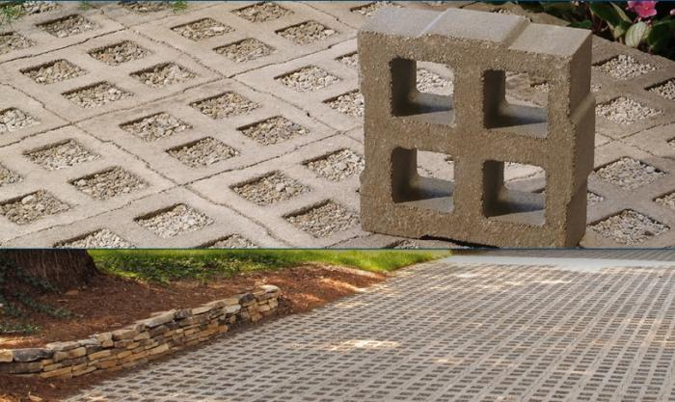
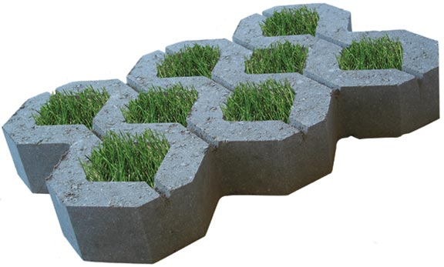
GA02 Introductory and Overview Sections: LEED BD+C Reference Guide, v4
Development Footprint
A project’s development footprint is all of its impervious surfaces.
development footprint the total land area of a project site covered by buildings, streets, parking areas, and other typically impermeable surfaces constructed as part of the project.
Surfaces paved with permeable pavement (at least 50% permeable) are excluded from the development footprint.

Slide 30
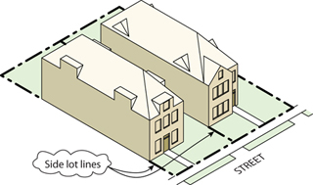
GA02 Introductory and Overview Sections: LEED BD+C Reference Guide, v4
Density
A measure of the total building floor area or dwelling units on a parcel of land relative to the buildable land of that parcel. Units for measuring density may differ according to credit requirements. Does not include structured parking.

Slide 31
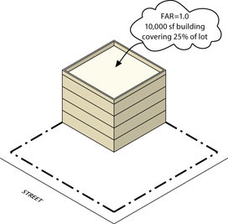
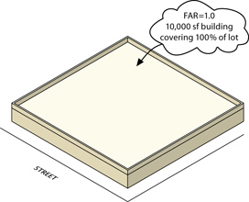
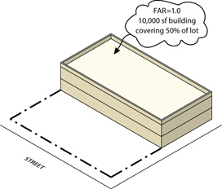
GA02 Introductory and Overview Sections: LEED BD+C Reference Guide, v4
Floor-Area Ratio (FAR)
The density of nonresidential land use, exclusive of parking, measured as the total nonresidential building floor area divided by the total buildable land area available for nonresidential structures.

Slide 32
GA02 Introductory and Overview Sections: LEED BD+C Reference Guide, v4
Determine the FAR
A LEED for Retail project has a total floor area of 12,400 square feet and the total buildable land is 0.4 hectacre. What is the Floor-Area Ratio for the project?

Slide 33
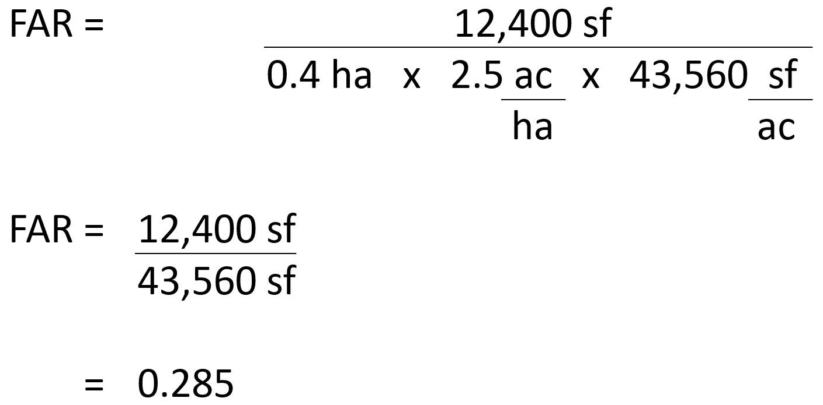
GA02 Introductory and Overview Sections: LEED BD+C Reference Guide, v4
Determine the FAR
A LEED for Retail project has a total floor area of 12,400 square feet and the total buildable land is 0.4 hectacre. What is the Floor-Area Ratio for the project?

Slide 34
GA02 Introductory and Overview Sections: LEED BD+C Reference Guide, v4
Occupancy
Regular Building Occupants Visitors
Part-time and full-time employees Retail customers
Staff Outpatients
Volunteers – regularly use a bldg. Volunteers – periodically use a bldg.
Residents Higher-education students
Primary and secondary school students
Hotel guests
Inpatients

Slide 35
GA02 Introductory and Overview Sections: LEED BD+C Reference Guide, v4

Slide 36
GA02 Introductory and Overview Sections: LEED BD+C Reference Guide, v4
In calculations, occupant types are typically counted in two ways:
Daily averages take into account all the occupants of a given type for a typical 24-hour day of operation.
Peak totals are measured at the moment in a typical 24-hour period when the highest number of a given occupant type is present.
Whenever possible, use actual or predicted occupancies.

Slide 37
GA02 Introductory and Overview Sections: LEED BD+C Reference Guide, v4
A LEED project has 8 employees that work 4 hrs per day; 12 employees that work 6 hours per day; and 20 employees work 8 hrs per day. What is the total Full Time Equivalent (FTE) for the project?
37
33
35
38

Slide 38
GA02 Introductory and Overview Sections: LEED BD+C Reference Guide, v4
A LEED project has 8 employees that work 4 hrs per day; 12 employees that work 6 hours per day; and 20 employees work 8 hrs per day. What is the total Full Time Equivalent (FTE) for the project?
37
33
35
38
Total Employee Hours = (8 x 4) + (12 x 6) + (20 x 8) = 264
FTE = Total Employee Hours / 8 = 33

Slide 39
GA02 Introductory and Overview Sections: LEED BD+C Reference Guide, v4
If occupancy cannot be accurately predicted, use one of the following resources to estimate occupancy:
Default occupant density from ASHRAE 62.1-2010, Table 6-1
Default occupant density from CEN Standard EN 15251, Table B.2
Appendix 2 Default Occupancy Counts
Results from applicable studies.
If numbers vary seasonally, use occupancy numbers that are a representative daily average over the entire operating season of the building.
If occupancy patterns are atypical (shift overlap, significant seasonal variation), explain such patterns when submitting documentation for certification.

Slide 40
GA02 Introductory and Overview Sections: LEED BD+C Reference Guide, v4
If occupancy cannot be accurately predicted, use one of the following resources to estimate occupancy:
Default occupant density from ASHRAE 62.1-2010, Table 6-1
Default occupant density from CEN Standard EN 15251, Table B.2
Appendix 2 Default Occupancy Counts
Results from applicable studies.
If numbers vary seasonally, use occupancy numbers that are a representative daily average over the entire operating season of the building.
If occupancy patterns are atypical (shift overlap, significant seasonal variation), explain such patterns when submitting documentation for certification.

Slide 41
GA02 Introductory and Overview Sections: LEED BD+C Reference Guide, v4
Minimum Program Requirements (MPRs)
The Minimum Program Requirements (MPRs) are the minimum characteristics or conditions that make a project appropriate to pursue LEED certification. These requirements are foundational to all LEED projects and define the types of buildings, spaces, and neighborhoods that the LEED rating system is designed to evaluate.
Purpose:
Give clear guidance to customers
Protect the integrity of the LEED program
Reduce challenges that occur during the LEED certification process

Slide 42
GA02 Introductory and Overview Sections: LEED BD+C Reference Guide, v4
1. Must be in a permanent location on existing land
Requirements
All LEED projects must be constructed and operated on a permanent location on existing land.
No project that is designed to move at any point in its lifetime may pursue LEED certification.
This requirement applies to all land within the LEED project.

Slide 43
GA02 Introductory and Overview Sections: LEED BD+C Reference Guide, v4
2. Must use reasonable LEED boundaries
Requirements
The LEED project boundary must include all contiguous land that is associated with the project and supports its typical operations.
The LEED boundary may not unreasonably exclude portions of the building, space, or site to give the project an advantage in complying with credit requirements.
The LEED project must accurately communicate the scope of the certifying project in all promotional and descriptive materials and distinguish it from any non-certifying space.

Slide 44
GA02 Introductory and Overview Sections: LEED BD+C Reference Guide, v4
3. Must comply with project size requirements
Requirements
LEED BD+C: minimum 1,000 square feet of gross floor area
LEED O+M: minimum 1,000 square feet of gross floor area
LEED ID+C: minimum 250 square feet of gross floor area
LEED for Homes: defined as a “dwelling unit” by all applicable codes
LEED for ND: at least 2 habitable buildings, no larger than 1500 acres

Slide 45
GA02 Introductory and Overview Sections: LEED BD+C Reference Guide, v4
Rating System Selection Guidance
Before Registering a project:
Identify an appropriate rating system
Determine the best adaptation
If a project team selects a rating system that doesn't apply, USGBC may request that they change the project's rating system.

Slide 46
GA02 Introductory and Overview Sections: LEED BD+C Reference Guide, v4
Rating System Selection Guidance
Minimum Program Requirements (MPRs)
The first step should be to make sure that LEED will work for your project no matter what rating system is selected.
Verify project can satisfy all of the LEED v4 Minimum Program Requirements.
Contact USGBC if it is not clear which rating system should be used.

Slide 47
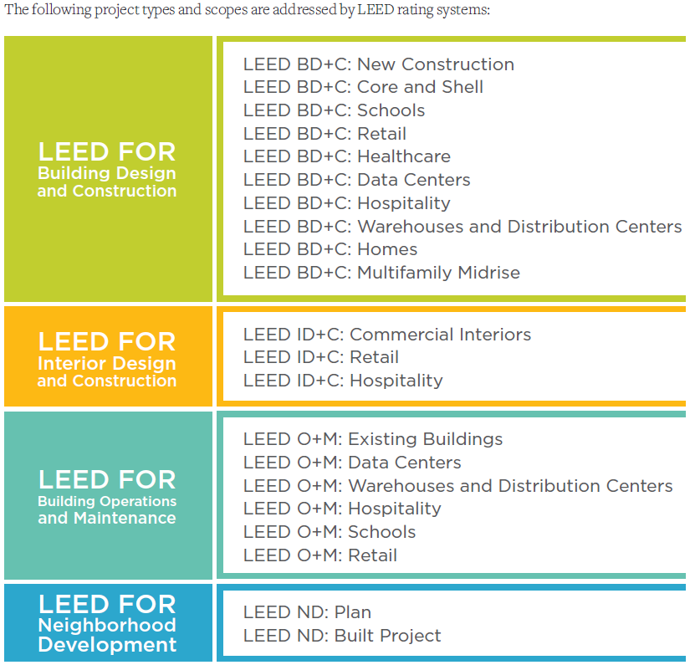
GA02 Introductory and Overview Sections: LEED BD+C Reference Guide, v4

Slide 48
GA02 Introductory and Overview Sections: LEED BD+C Reference Guide, v4
Rating System Selection Guidance
An owner wants to LEED certify an existing office building and commit to on-going sustainability goals. Which rating system would you recommend?
LEED for Interior Design and Construction
LEED for Building Design and Construction
LEED for Building Operations and Maintenance
LEED for Neighborhood Development

Slide 49
GA02 Introductory and Overview Sections: LEED BD+C Reference Guide, v4
Rating System Selection Guidance
An owner wants to LEED certify an existing office building and commit to on-going sustainability goals. Which rating system would you recommend?
LEED for Interior Design and Construction
LEED for Building Design and Construction
LEED for Building Operations and Maintenance
LEED for Neighborhood Development

Slide 50
GA02 Introductory and Overview Sections: LEED BD+C Reference Guide, v4
Rating System Selection Guidance
A new tenant in a commercial office building wants to pursue LEED certification. Which rating system would you recommend they use?
LEED for Interior Design and Construction
LEED for Building Design and Construction
LEED for Building Operations and Maintenance
LEED for Neighborhood Development

Slide 51
GA02 Introductory and Overview Sections: LEED BD+C Reference Guide, v4
Rating System Selection Guidance
A new tenant in a commercial office building wants to pursue LEED certification. Which rating system would you recommend they use?
LEED for Interior Design and Construction
LEED for Building Design and Construction
LEED for Building Operations and Maintenance
LEED for Neighborhood Development

Slide 52
GA02 Introductory and Overview Sections: LEED BD+C Reference Guide, v4
Rating System Selection Guidance
What LEED rating system focuses on the where, what, and how to build green at a community scale?
LEED BD+C: Retail
LEED BD+C: Schools
LEED BD+C: New Construction
LEED for Neighborhood Development

Slide 53
GA02 Introductory and Overview Sections: LEED BD+C Reference Guide, v4
Rating System Selection Guidance
What LEED rating system focuses on the where, what, and how to build green at a community scale?
LEED BD+C: Retail
LEED BD+C: Schools
LEED BD+C: New Construction
LEED for Neighborhood Development

Slide 54
GA02 Introductory and Overview Sections: LEED BD+C Reference Guide, v4
Choosing Between Rating Systems
40/60 rule provides guidance for making a decision when several rating systems appear to be appropriate for a project.
To use this rule, first assign a rating system to each square foot or square meter of the building. Then, choose the most appropriate rating system based on the resulting percentages.
The entire gross floor area of a LEED project must be certified under a single rating system and is subject to all prerequisites and attempted credits in that rating system, regardless of mixed construction or space usage type.

Slide 55
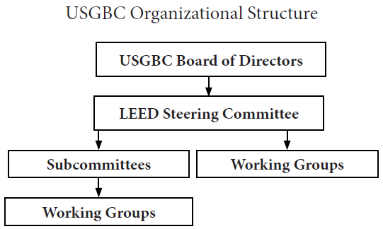
GA02 Introductory and Overview Sections: LEED BD+C Reference Guide, v4

Slide 56
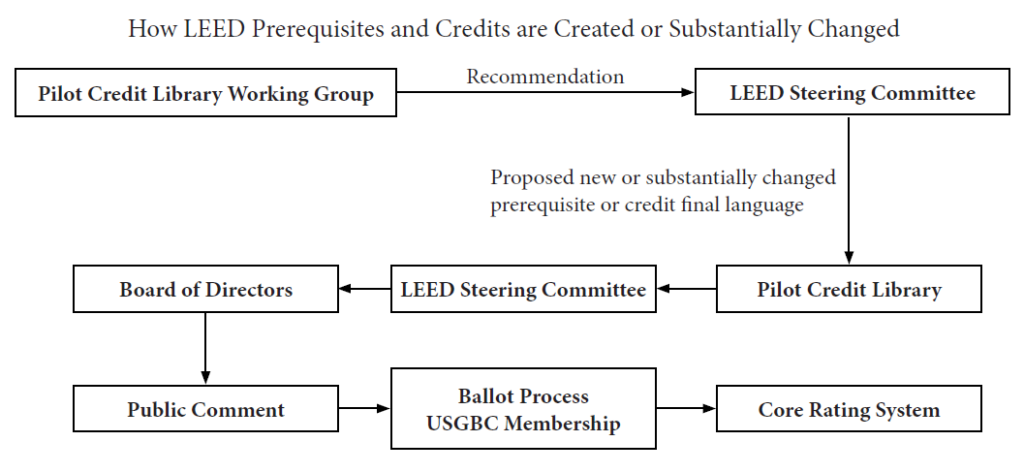
GA02 Introductory and Overview Sections: LEED BD+C Reference Guide, v4

