Slide 1
https://theoceancleanup.com/

Slide 2
Sustainable Thinking
LCCG
Section 2

Slide 3
Sustainable Thinking
LCCG
Section 2
Green Building and Sustainability
Three major concepts integral to green building and sustainability:
Systems Thinking
Life-Cycle Thinking
Integrative Process

Slide 4
System
an assemblage of parts that interact in a series of relationships to form a complex whole, which serves particular functions or purposes.

Slide 5
Types of Systems
Open System - materials and resources are constantly brought in from the outside, used in some way, and then released outside the system in some form of waste.
Closed System - is one where a quantity or series of quantities cannot enter or leave the system.

Slide 6
Types of Systems
Open System - materials and resources are constantly brought in from the outside, used in some way, and then released outside the system in some form of waste.
Closed System - is one where a quantity or series of quantities cannot enter or leave the system.
More sustainable.

Slide 7
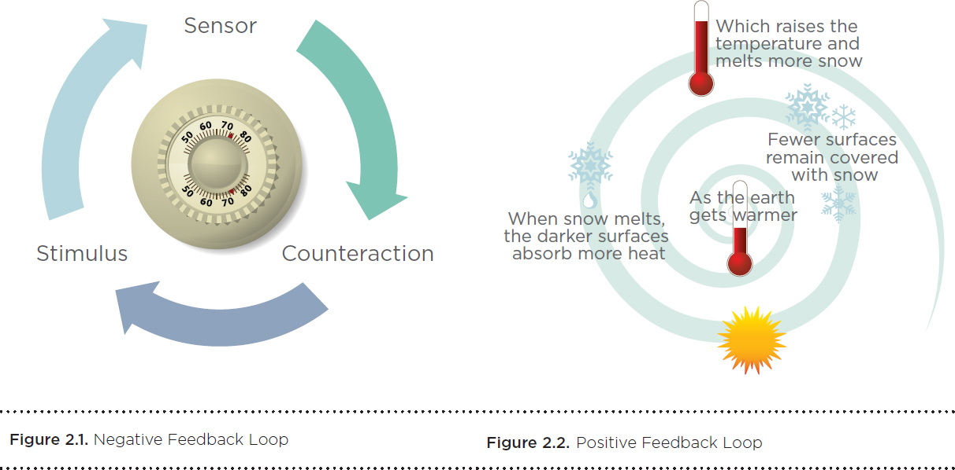
Feedback Loops
The concept of feedback loops helps explain how systems work.

Slide 8
Feedback Loops
The concept of feedback loops helps explain how systems work.
Unchecked, positive feedback loops can create chaos in a system.

Slide 9
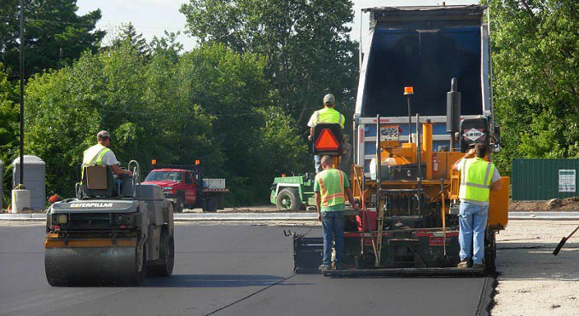
Positive Feedback Loop
heat island effect the absorption of heat by hardscapes, such as dark, non-reflective pavement and buildings, and its radiation to surrounding areas. Particularly in urban areas, other sources may include vehicle exhaust, air-conditioners, and street equipment; reduced airflow from tall buildings and narrow streets exacerbates the effect.

Slide 10
Negative Feedback Loop

Slide 11
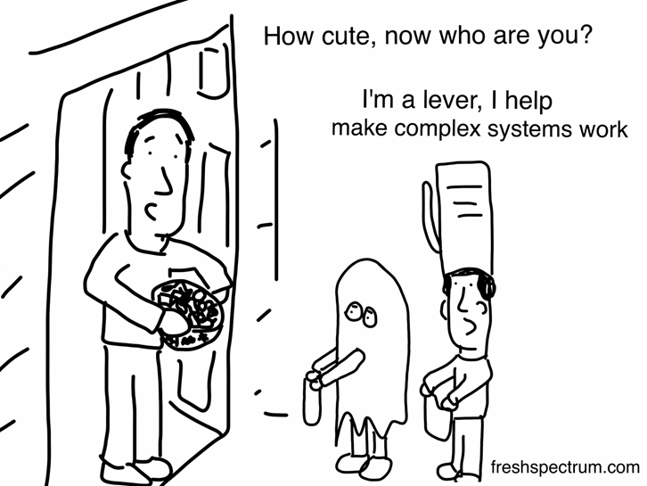
Leverage Points
To influence the behavior of a system, it is important to find the leverage points—places where a small intervention can yield large changes.

Slide 12
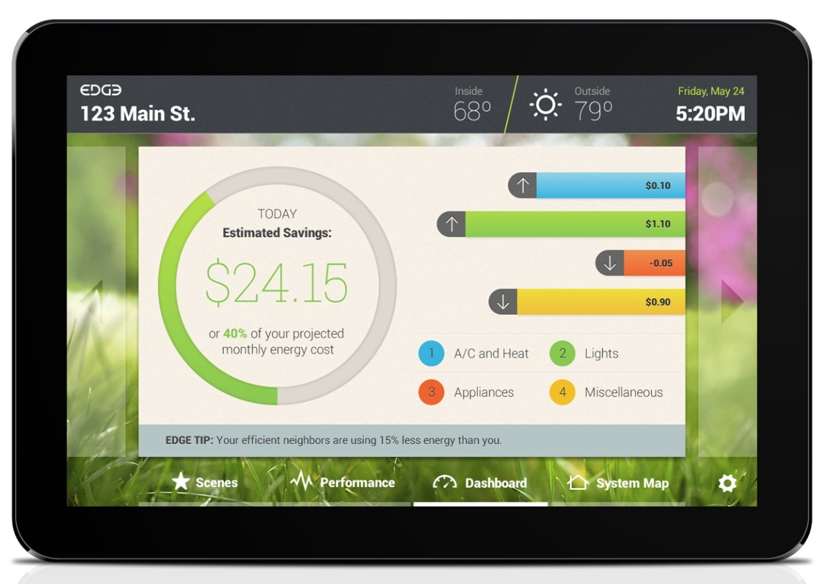
Leverage Points
Providing building occupants with real-time energy information is an example of using a leverage point to alter behavior.

Slide 14
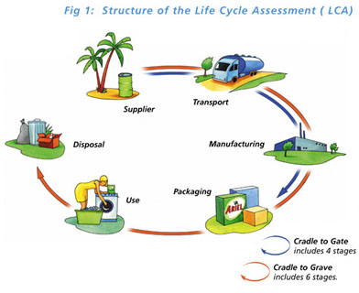
What is LCA?
Life Cycle Assessment (LCA) is a tool used to evaluate the potential environmental impact of a product, process or activity throughout its entire life cycle by quantifying the use of resources ("inputs" such as energy, raw materials, water) and environmental emissions ("outputs" to air, water and soil) associated with the system that is being evaluated.

Slide 15
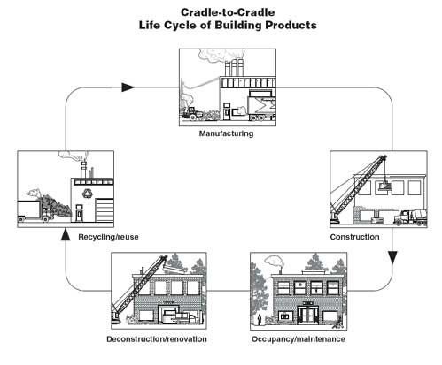
http://www.fs.fed.us/t-d/pubs/htmlpubs/htm08732839/page02.htm

Slide 16
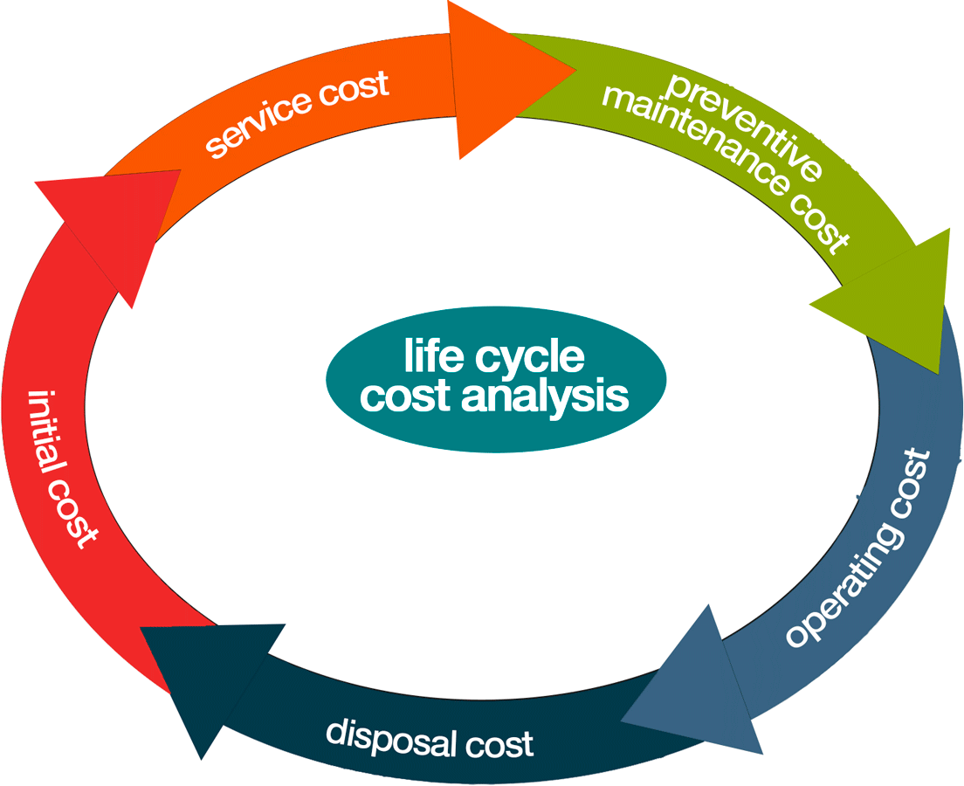
What is LCC?
Life Cycle Costing (LCC) a process of costing that looks at both purchase and operating costs as well as relative savings over the life of the building or product.

Slide 17
Life-Cycle Costing
LCC can be used in comparing alternatives with different initial and operating costs.
For a building this usually includes the following costs:
Initial purchase, acquisition, or construction
Fuel
Operation, maintenance, and repair
Replacement
Disposal (or residual value for resale or salvage)
Finance charges
Other intangible benefits or costs, such as increased employee productivity

Slide 18
The Key to Sustainability
Establish goals and targets early in the process
Understand the systems that are in play
Anticipate how those systems are likely to change and evolve
Assembling the right team, establishing goals, and understanding the systems and metrics for success will help ensure that we move closer to a sustainable built environment.

Slide 19
Phases of the Integrative Process
discovery—is also the most important and can be seen as an expansion of what is conventionally called predesign. Actions taken during discovery are essential to achieving a project’s environmental goals cost-effectively.
design and construction — begins with what is conventionally called schematic design. Unlike its conventional counterpart, however, in the integrative process, design will incorporate all of the collective understandings of system interactions that were found during discovery.
occupancy, operations, and performance feedback — Here, the integrative process measures performance and sets up feedback mechanisms. Feedback is critical to determining success in achieving performance targets, informing building operations, and taking corrective action when targets are missed.

Slide 20
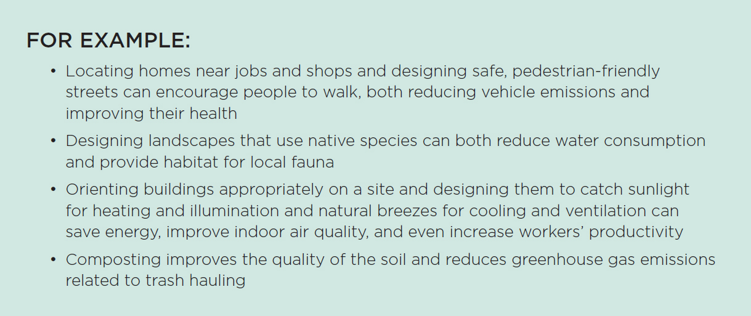
Design Synergies

Slide 21
Practitioners of an Integrative Process
Must develop new skills that might not have been required in their past professional work:
Critical thinking and questioning
Collaboration
Teamwork and communication
Deep understanding of natural processes
An integrative process is a different way of thinking and working, and it creates a team from professionals who have traditionally worked as separate entities.

Slide 22
The Integrative Process
Requires more time and collaboration during the early conceptual and design phases than conventional practices.
Time must be spent building the team, setting goals, and doing analysis before any decisions are made or implemented.
This upfront investment of time, however, reduces the time it takes to produce construction documents.

