Slide 1
Integrative Process (IP)

Slide 2
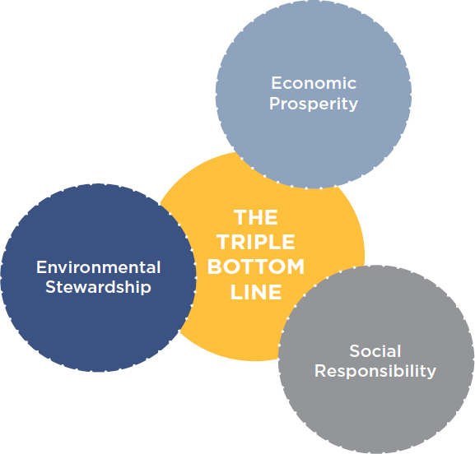
Integrative Project Planning and Design Prerequisite
HEALTHCARE
Intent
Maximize opportunities for integrated, cost-effective adoption of green design and construction strategies, emphasizing human health as a fundamental evaluative criterion for building design, construction and operational strategies. Utilize innovative approaches and techniques for green design and construction.

Slide 3
Integrative Project Planning and Design Prerequisite
HEALTHCARE
Requirements
Use cross-discipline design and decision making, beginning in the programming and pre-design phase.
At a minimum, ensure the following process:
Owner’s Project Requirements Document. Prepare an Owner’s Project Requirements (OPR) document. Develop a health mission statement and incorporate it in the OPR.
The health mission statement must address "triple bottom line" values—economic, environmental and social.

Slide 4
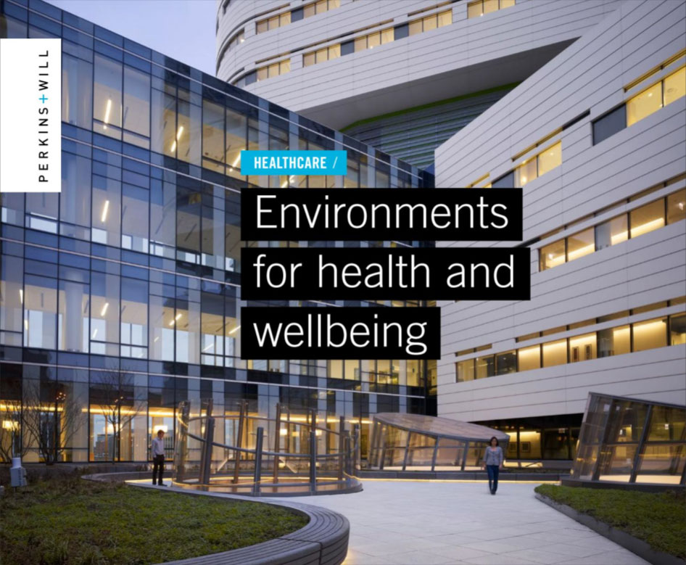
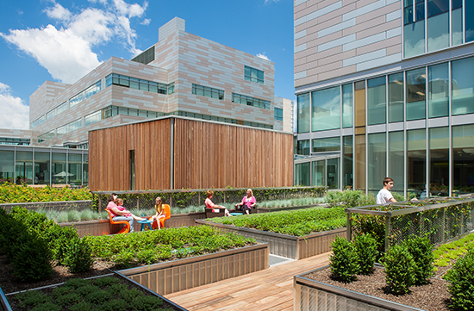
Integrative Project Planning and Design Prerequisite
HEALTHCARE
Include goals and strategies to safeguard the health of building occupants, the local community and the global environment, while creating a high-performance healing environment for the building’s patients, caregivers and staff.

Slide 5
Integrative Project Planning and Design Prerequisite
HEALTHCARE
Preliminary Rating Goals. As early as practical and preferably before schematic design, conduct a preliminary LEED meeting with a minimum of four key project team members and the owner or owner’s representative.
As part of the meeting, create a LEED® action plan that, at a minimum:
Determines the LEED certification level to pursue (Certified, Silver, Gold, or Platinum);
Selects the LEED credits to meet the targeted certification level; and
Identifies the responsible parties to ensure the LEED requirements for each prerequisite and selected credit are met.

Slide 6
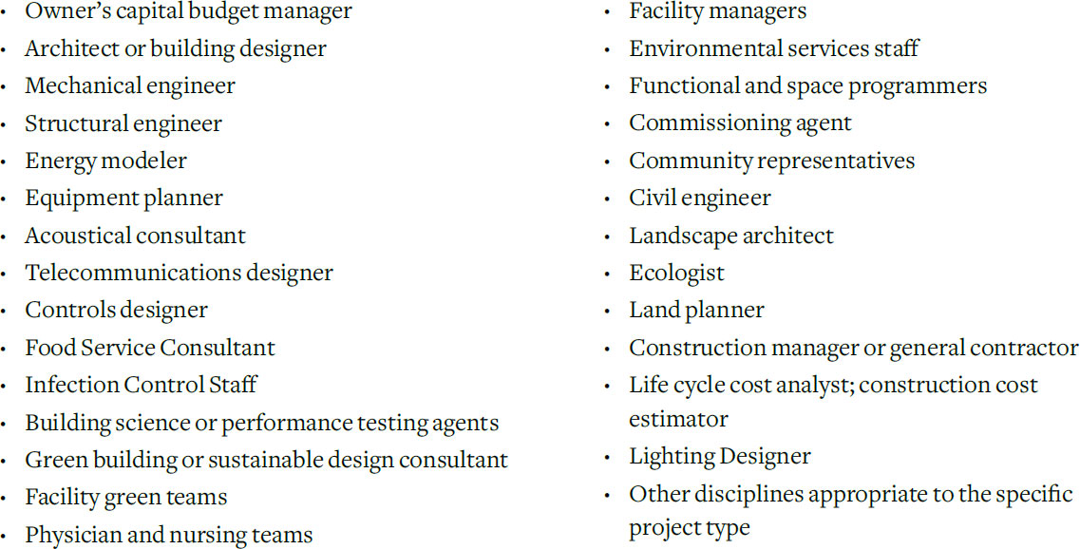
Integrative Project Planning and Design Prerequisite
HEALTHCARE
Integrated Project Team. Assemble an integrated project team and include as many of the following professionals as feasible (minimum of four), in addition to the owner or owner’s representative.

Slide 7
Integrative Project Planning and Design Prerequisite
HEALTHCARE
Design Charrette. As early as practical and preferably before schematic design, conduct a minimum four-hour , integrated design charrette with the project team as defined above.
The goal is to optimize the integration of green strategies across all aspects of building design, construction and operations, drawing on the expertise of all participants.

Slide 8
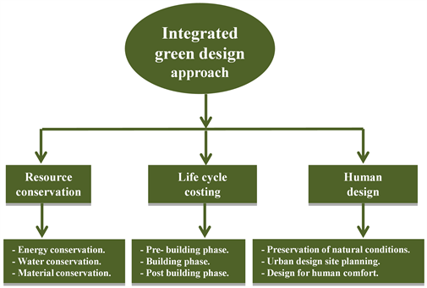
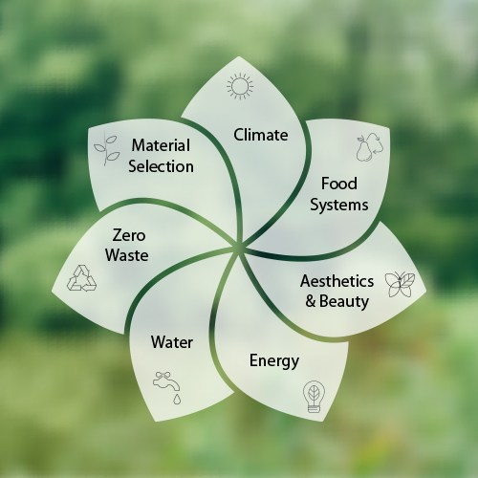
Integrative Process Credit
NC, CS, S, R, DC, WDC, HOS, HC
Intent
To support high-performance, cost-effective project outcomes through an early analysis of the interrelationships among systems.

Slide 9
Integrative Process Credit
NC, CS, S, R, DC, WDC, HOS, HC
Requirements

Slide 10
Integrative Process Credit
NC, CS, S, R, DC, WDC, HOS, HC
Other Key Points to Remember
Integrative Process
The strategies in the Integrative Process credit are recommended for all LEED projects because they encourage integration during early design stages, when it will be the most effective.
Approaching certification using an integrative process gives the project team the greatest chance of success.
The process includes three phases:
Discovery
Design and Construction
Occupancy, Operations, and performance feedback

Slide 11
Integrative Process Credit
NC, CS, S, R, DC, WDC, HOS, HC
LEED Work Plan
Establish Project Goals
Develop the LEED Scorecard
LEED v4.1 BD+C Scorecard

