Slide 1


Location and Transportation (LT)
GA02 Excerpt LT Overview. LEED BD+C RG v4 - Pgs. 55-57
Building Location
Compact development
Alternative transportation
Connection to amenities

Slide 2
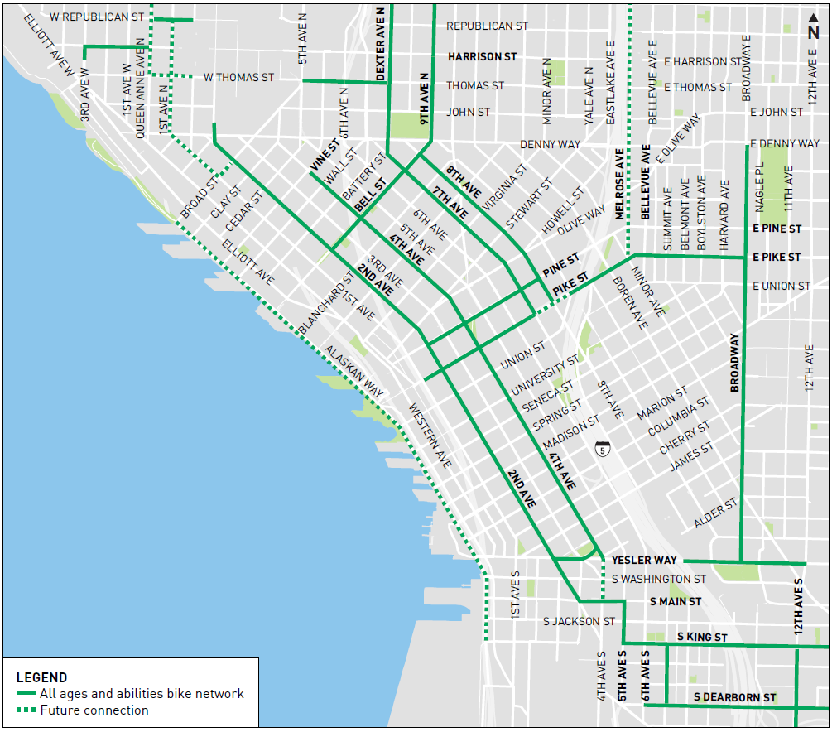
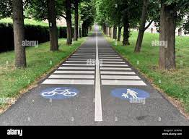
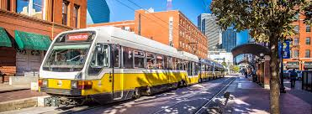
Location and Transportation (LT)
GA02 Excerpt LT Overview. LEED BD+C RG v4 - Pgs. 55-57
Existing infrastructure
Public transit
street networks
pedestrian paths
bicycle networks
services and amenities
and existing utilities, such as electricity, water, gas, and sewage

Slide 3
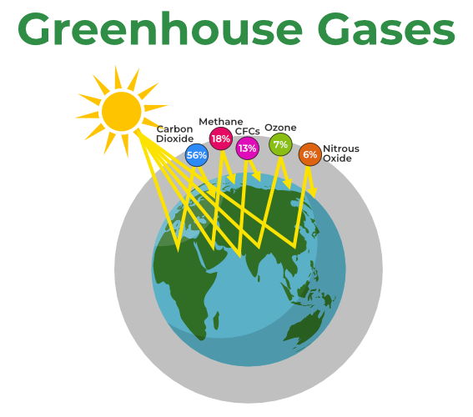
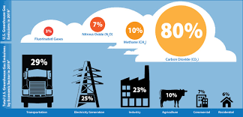
Location and Transportation (LT)
GA02 Excerpt LT Overview. LEED BD+C RG v4 - Pgs. 55-57
Alternatives to private automobile use:
Walking
Biking
Vehicle shares
Public transit
Reduce Green House Gas (GHG) Emissions from vehicle use.

Slide 4
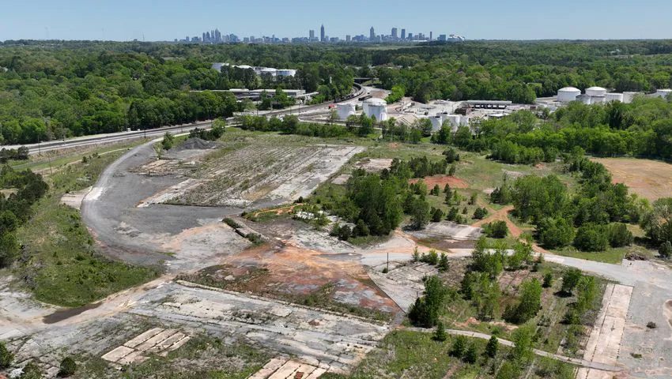
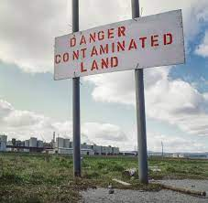
Location and Transportation (LT)
GA02 Excerpt LT Overview. LEED BD+C RG v4 - Pgs. 55-57
Reusing
previously developed land
cleaning up brownfield sites
and investing in disadvantaged areas
conserve undeveloped land and ensure efficient delivery of services and infrastructure.

Slide 5
Location and Transportation (LT)
GA02 Excerpt LT Overview. LEED BD+C RG v4 - Pgs. 55-57
Limit Parking.
Provide bicycle storage.
Alternative-fuel facilities.
Preferred parking for green vehicles.
Walking distances must be measured along infrastructure that is safe and comfortable for pedestrians: sidewalks, all-weather-surface footpaths, crosswalks, or equivalent pedestrian facilities.
Bicycling distances must be measured along infrastructure that is safe and comfortable for bicyclists: on-street bicycle lanes, off-street bicycle paths or trails, and streets with low target vehicle speed (25 mph or less).

Slide 6
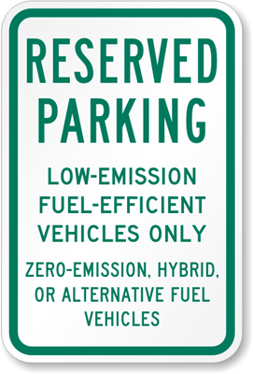
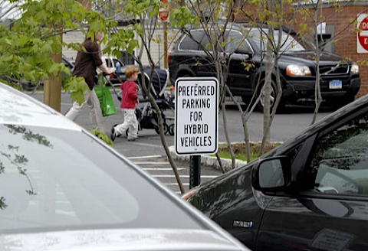
Location and Transportation (LT)
Overview
Preferred Parking
Preferred parking spaces have the shortest walking distance to the main entrance of the project, exclusive of spaces designated for people with disabilities.

Slide 7
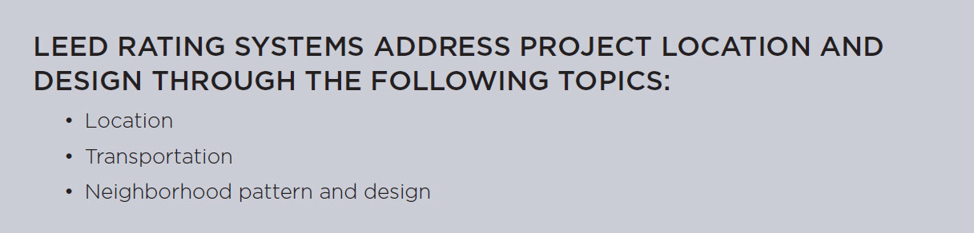

Slide 8
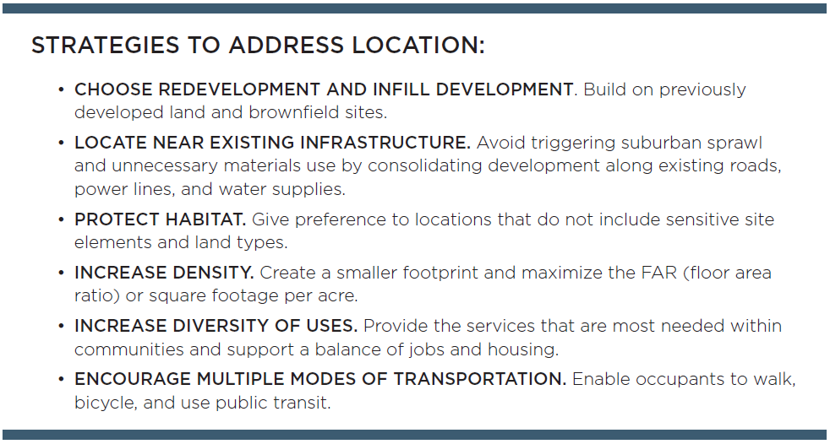
Location and Transportation (LT)
LEED Core Concepts Guide

Slide 9
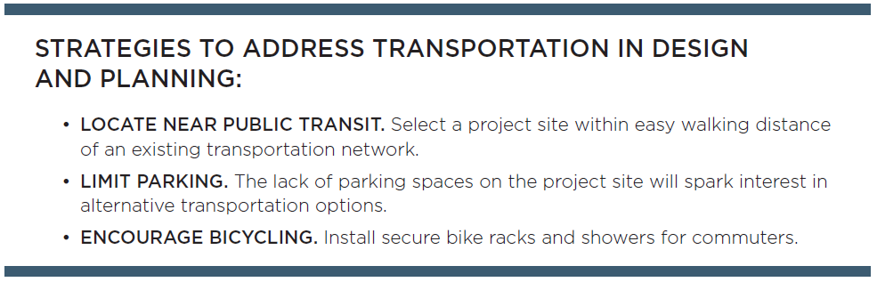
Location and Transportation (LT)
LEED Core Concepts Guide

Slide 10
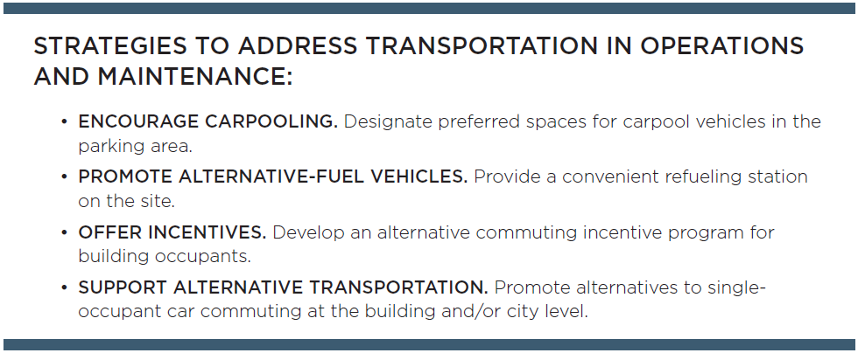
Location and Transportation (LT)
LEED Core Concepts Guide

Slide 11
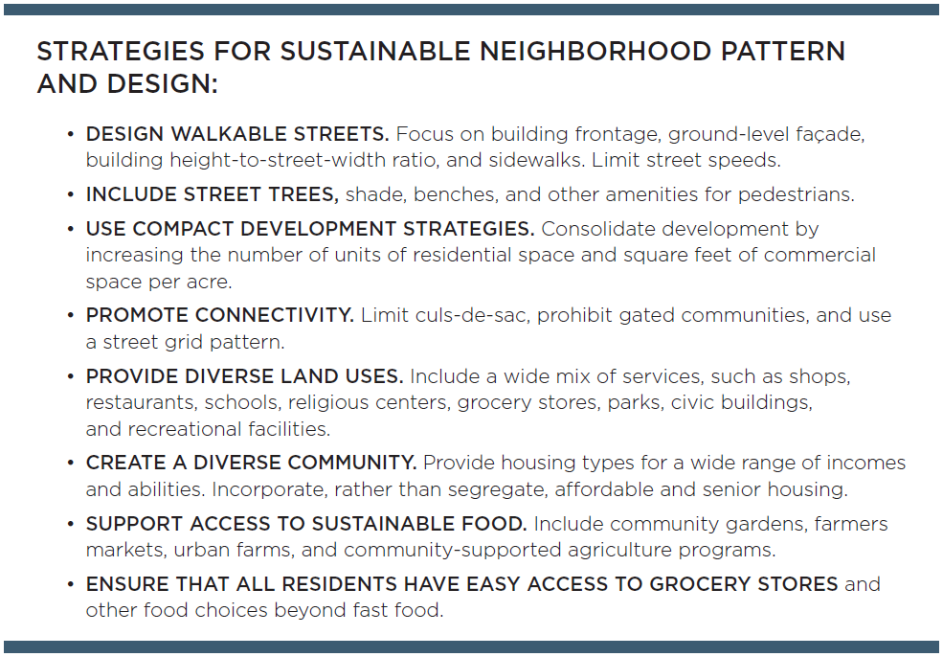
Location and Transportation (LT)
LEED Core Concepts Guide

Slide 12
