Slide 1
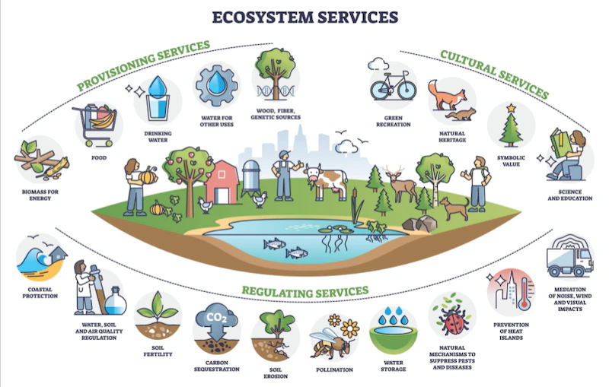
Sustainable Sites (SS)
GA02 Excerpt SS Overview. LEED BD+C RG v4 - Pgs. 137-138
The Sustainable Sites (SS) category rewards decisions about the environment surrounding the building, with credits that emphasize the vital relationships among buildings, ecosystems, and ecosystem services.

Slide 2
Sustainable Sites (SS)
GA02 Excerpt SS Overview. LEED BD+C RG v4 - Pgs. 137-138
It focuses on restoring project site elements, integrating the site with local and regional ecosystems, and preserving the biodiversity that natural systems rely on.

Slide 3
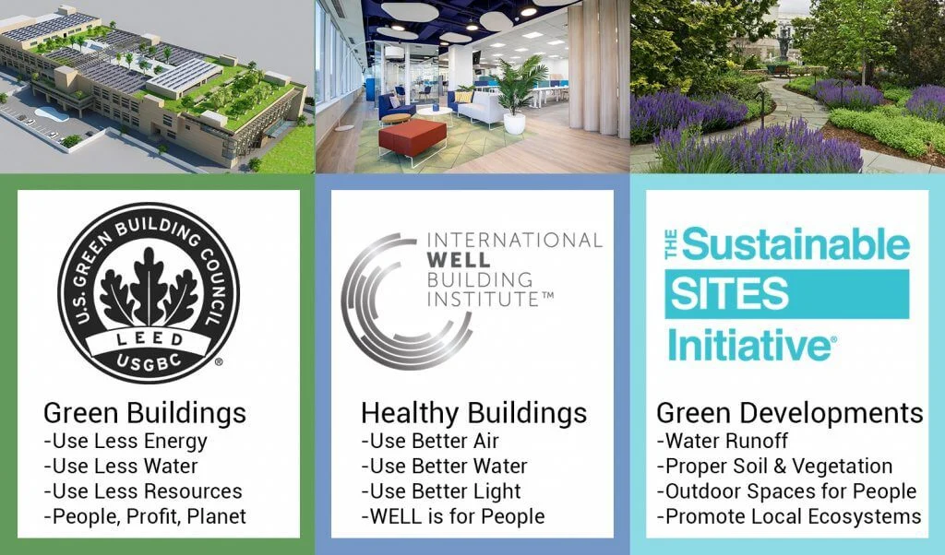
Sustainable Sites (SS)
GA02 Excerpt SS Overview. LEED BD+C RG v4 - Pgs. 137-138

Slide 4
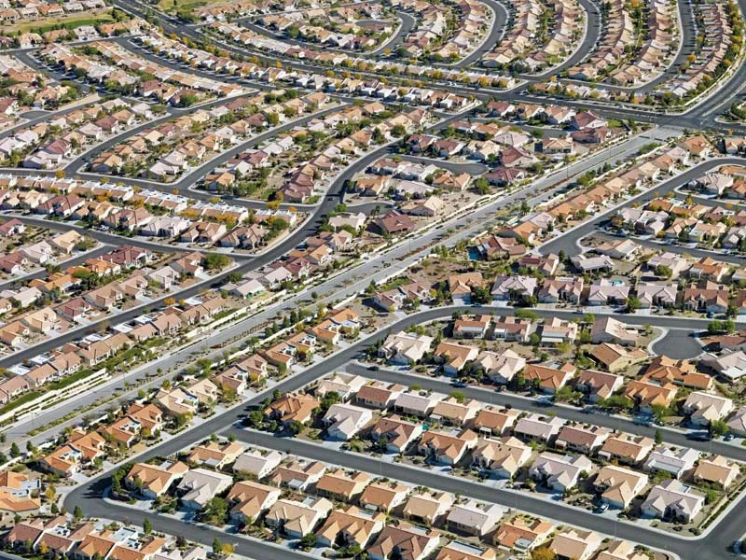
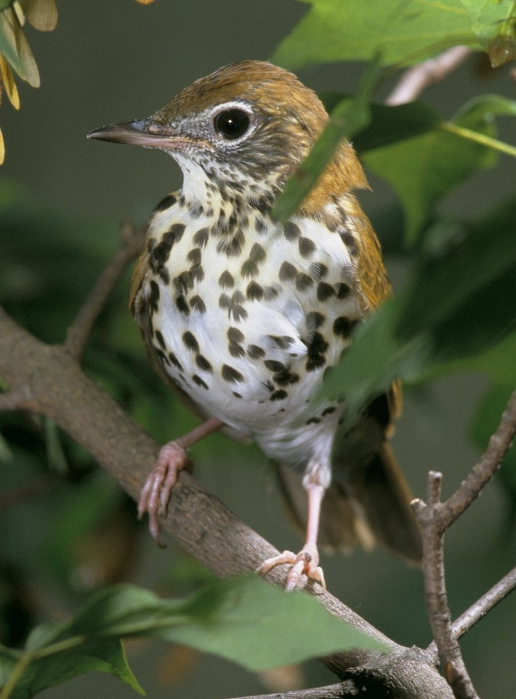
Sustainable Sites (SS)
GA02 Excerpt SS Overview. LEED BD+C RG v4 - Pgs. 137-138
Recent trends like exurban development and sprawl encroach on the remaining natural landscapes and farmlands, fragmenting and replacing them with dispersed hardscapes surrounded by nonnative vegetation.

Slide 5
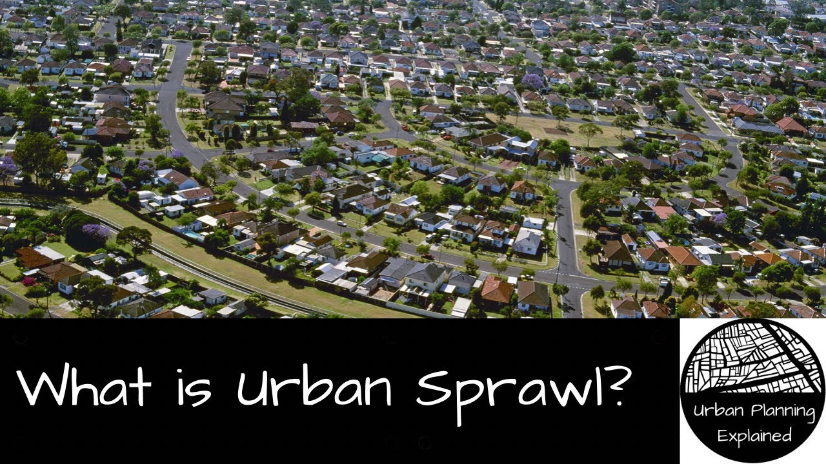
Sustainable Sites (SS)
GA02 Excerpt SS Overview. LEED BD+C RG v4 - Pgs. 137-138
Recent trends like exurban development and sprawl encroach on the remaining natural landscapes and farmlands, fragmenting and replacing them with dispersed hardscapes surrounded by nonnative vegetation.

Slide 6
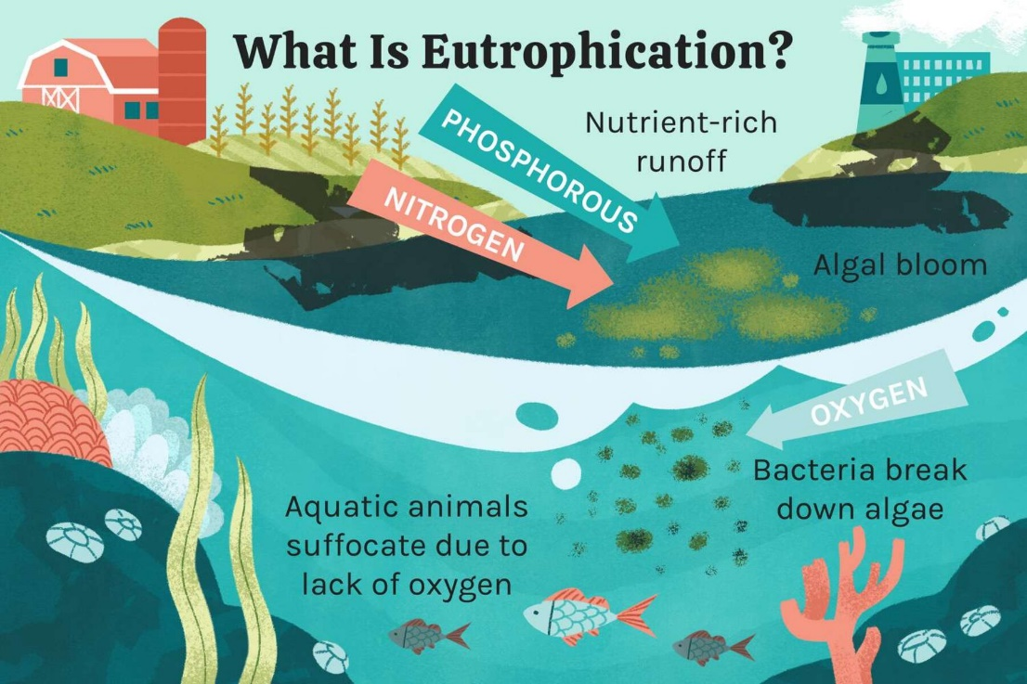
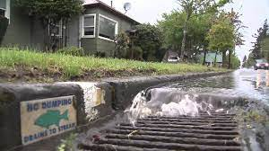
Sustainable Sites (SS)
GA02 Excerpt SS Overview. LEED BD+C RG v4 - Pgs. 137-138
Rainwater runoff carries such pollutants as oil, sediment, chemicals, and lawn fertilizers directly to streams and rivers, where they contribute to eutrophication and harm aquatic ecosystems and species.
SS credits are designed for projects to avoid harming habitat, open space, and water bodies.

Slide 7
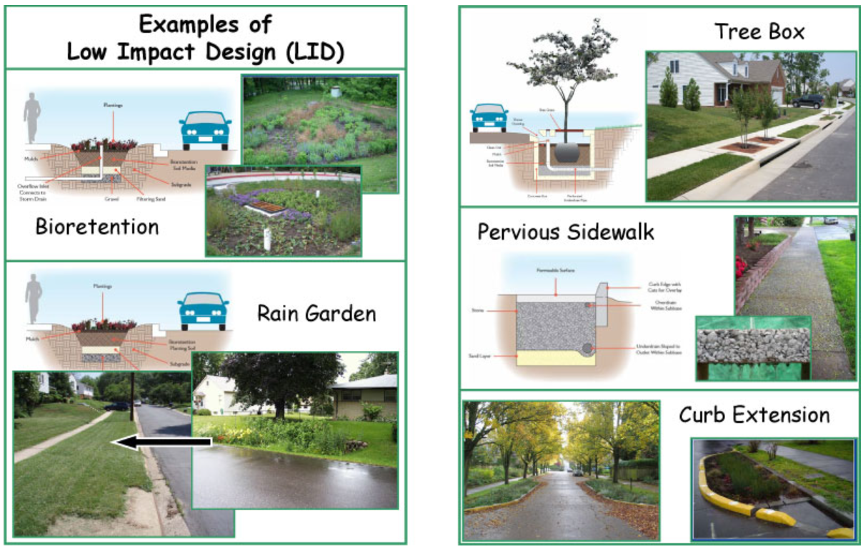
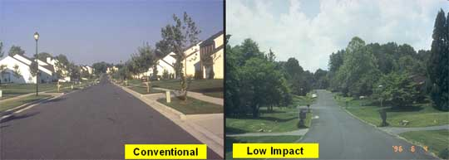
Sustainable Sites (SS)
GA02 Excerpt SS Overview. LEED BD+C RG v4 - Pgs. 137-138
Low Impact Development (LID)
Minimize construction pollution.
Reduce heat island effects and light pollution.
Mimic natural water flow patterns to manage rainwater runoff.

Slide 8
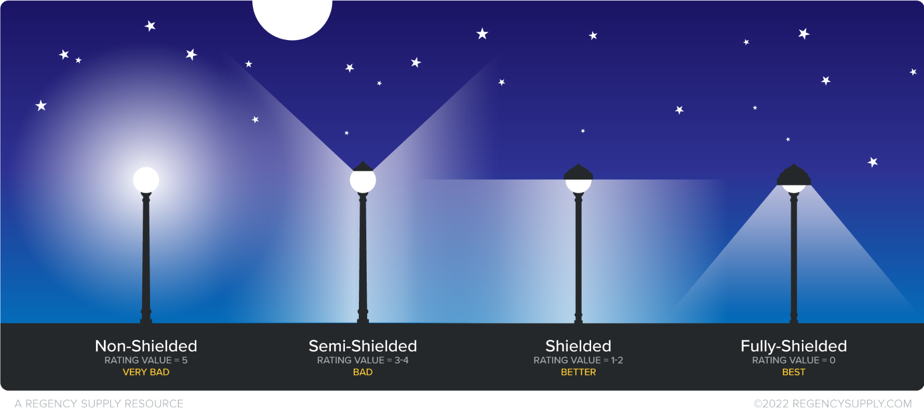
Sustainable Sites (SS)
GA02 Excerpt SS Overview. LEED BD+C RG v4 - Pgs. 137-138

Slide 10
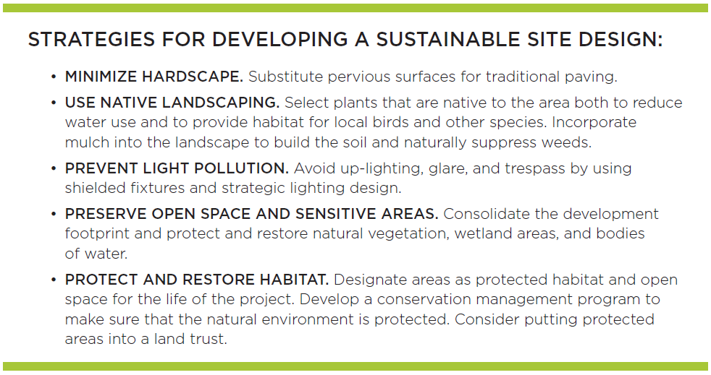
Sustainable Sites (SS)
Site Design and Management

Slide 11
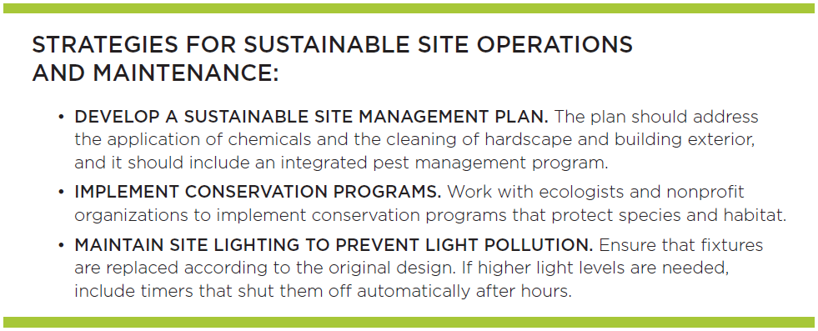
Sustainable Sites (SS)
Site Design and Management

Slide 12
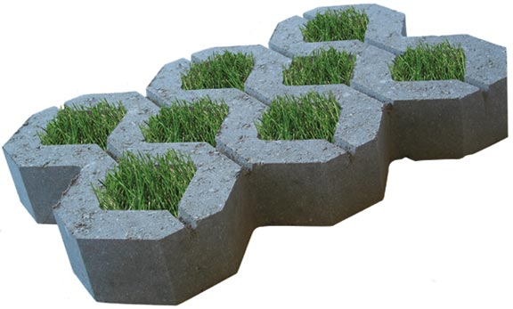
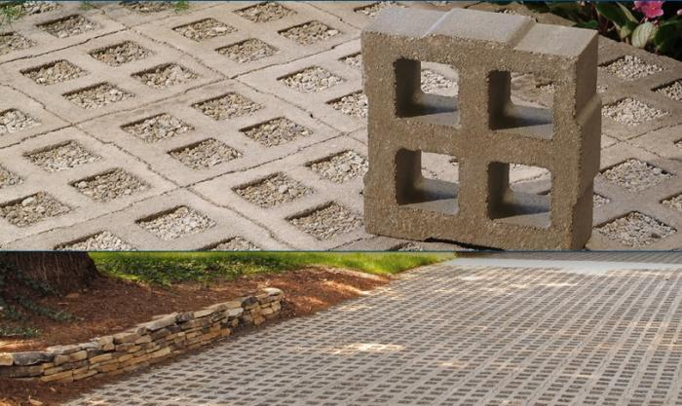
Sustainable Sites (SS)
Rainwater Management

Slide 13
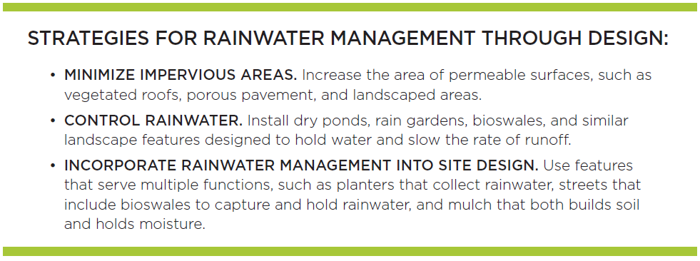
Sustainable Sites (SS)
Rainwater Management

Slide 14
Sustainable Sites (SS)
Rainwater Management

Slide 15
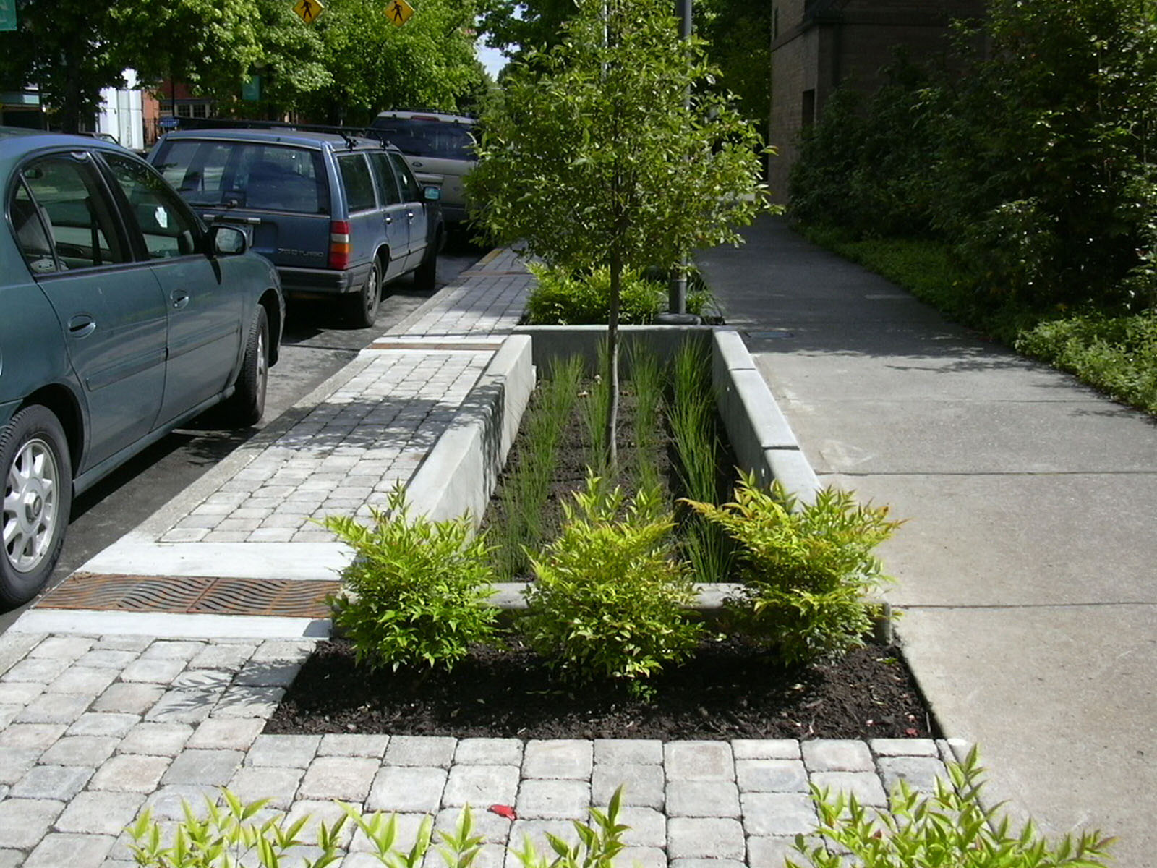
Sustainable Sites (SS)
Rainwater Management
Increase infiltration of rainfall into the ground, capture and reuse it, and use natural processes to treat the remaining water that runs off the property.

Slide 16
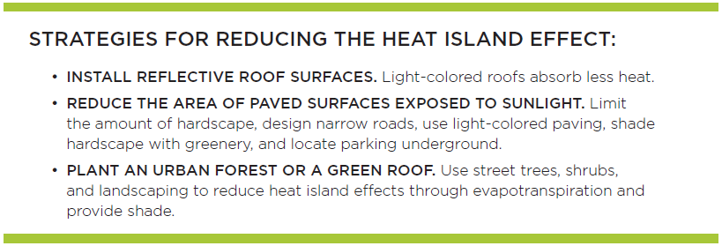
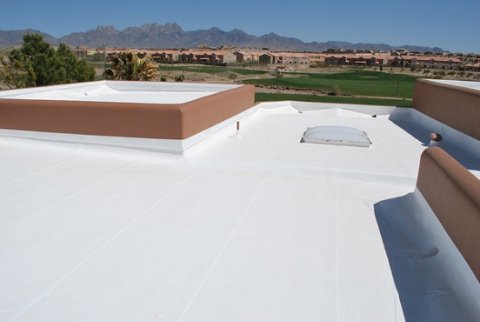
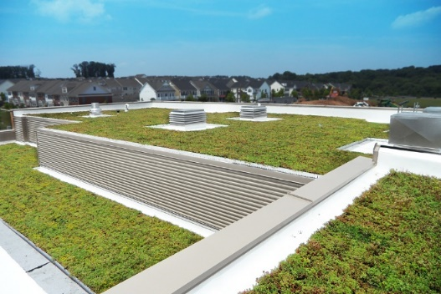
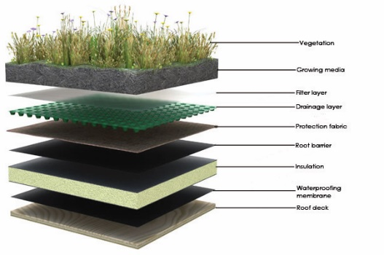
Sustainable Sites (SS)
Heat Island Effect

Slide 17
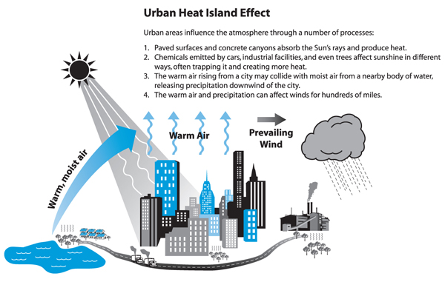
Sustainable Sites (SS)
Heat Island Effect
heat island effect the thermal absorption by hardscape, such as dark, nonreflective pavement and buildings, and its subsequent radiation to surrounding areas. Other contributing factors may include vehicle exhaust, air conditioners, and street equipment. Tall buildings and narrow streets reduce airflow and exacerbate the effect.

Slide 18
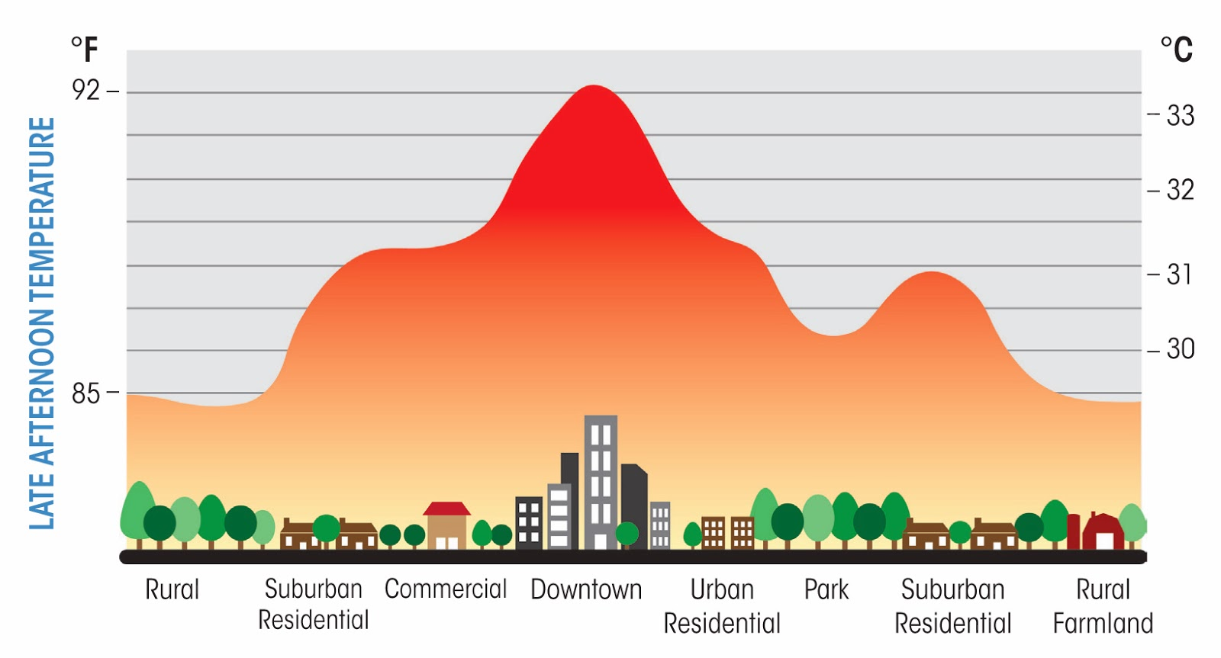
Sustainable Sites (SS)
Heat Island Effect

Slide 19
Sustainable Sites (SS)
Heat Island Effect
infrared (thermal) emittance a value between 0 and 1 (or 0% and 100%) that indicates the ability of a material to shed infrared radiation (heat). A cool roof should have a high thermal emittance. The wavelength range for radiant energy is roughly 5 to 40 micrometers.
Most building materials (including glass) are opaque in this part of the spectrum and have an emittance of roughly 0.9, or 90%. Clean, bare metals, such as untarnished galvanized steel, have a low emittance and are the most important exceptions to the 0.9 rule. In contrast, aluminum roof coatings have intermediate emittance levels. (Adapted from Lawrence Berkeley National Laboratory)

Slide 20
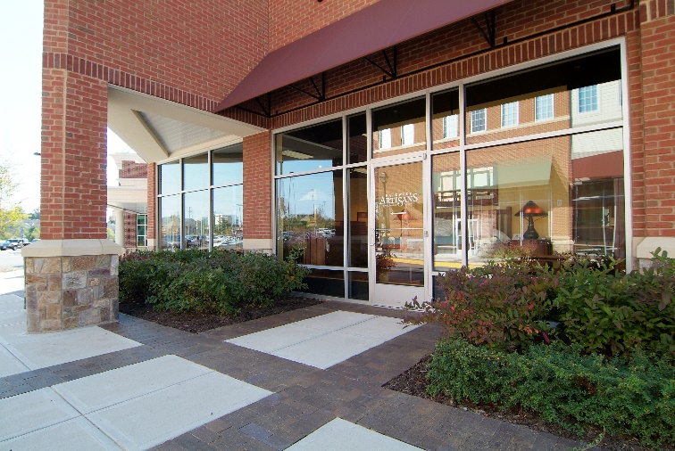
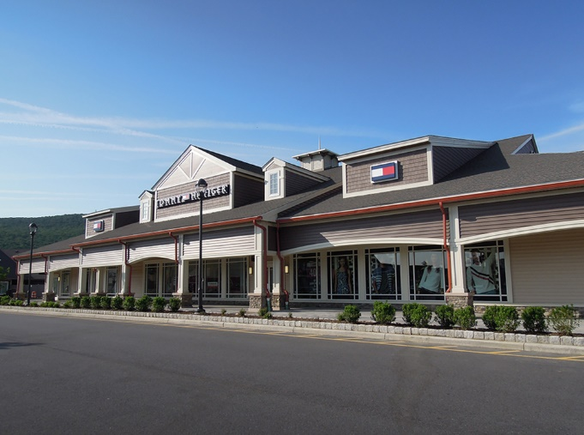
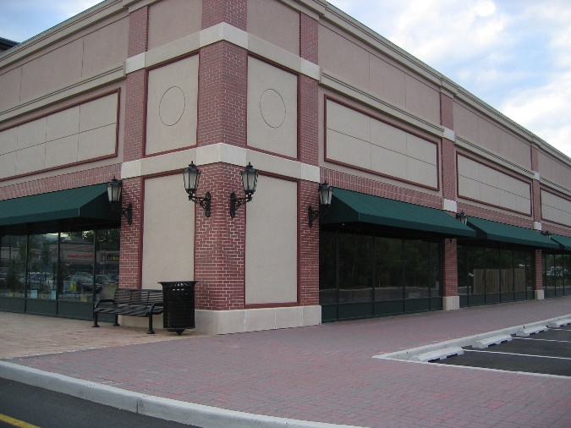
Sustainable Sites (SS)
Heat Island Effect
solar reflectance (SR) the fraction of solar energy that is reflected by a surface on a scale of
0 to 1.
Black paint has a solar reflectance of 0; white paint (titanium dioxide) has a solar reflectance of 1.

Slide 21
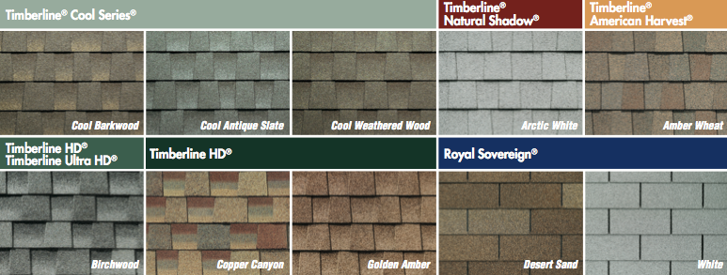
Sustainable Sites (SS)
Heat Island Effect
solar reflectance index (SRI) a measure of the constructed surface’s ability to stay cool in the sun by reflecting solar radiation and emitting thermal radiation.
It is defined such that a standard black surface (initial solar reflectance 0.05, initial thermal emittance 0.90) has an initial SRI of 0, and a standard white surface (initial solar reflectance 0.80, initial thermal emittance 0.90) has an initial SRI of 100.

Slide 22
Sustainable Sites (SS)
Heat Island Effect
three-year aged SR or SRI value a solar reflectance or solar reflectance index rating that is measured after three years of weather exposure
thermal emittance the ratio of the radiant heat flux emitted by a specimen to that emitted by a blackbody radiator at the same temperature (adapted from Cool Roof Rating Council)

Slide 23
