Slide 1
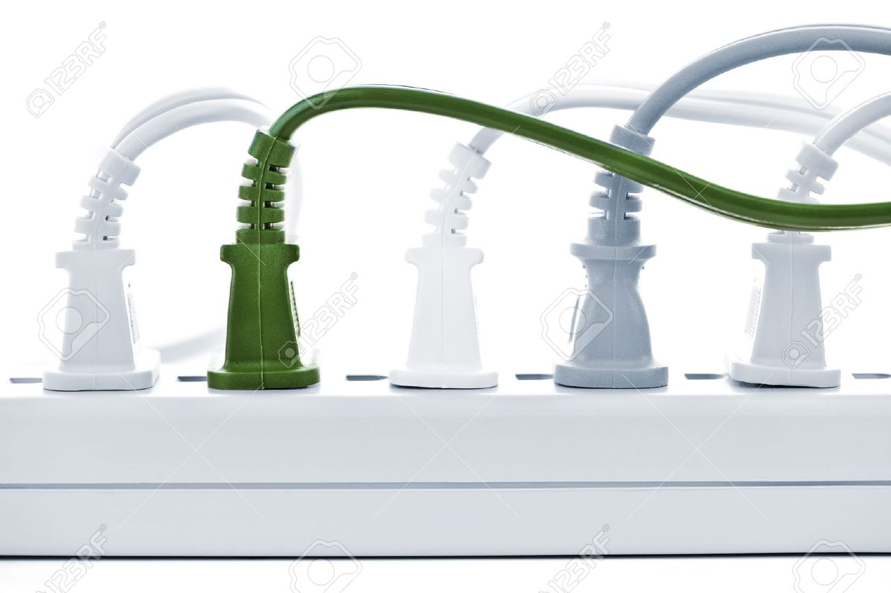
Energy and Atmosphere (EA)
GA02 Excerpt EA Overview. LEED BD+C RG v4 - Pgs. 323-324
The Energy and Atmosphere (EA) category addresses:
Energy use reduction
Energy-efficient design strategies
Renewable energy sources

Slide 2
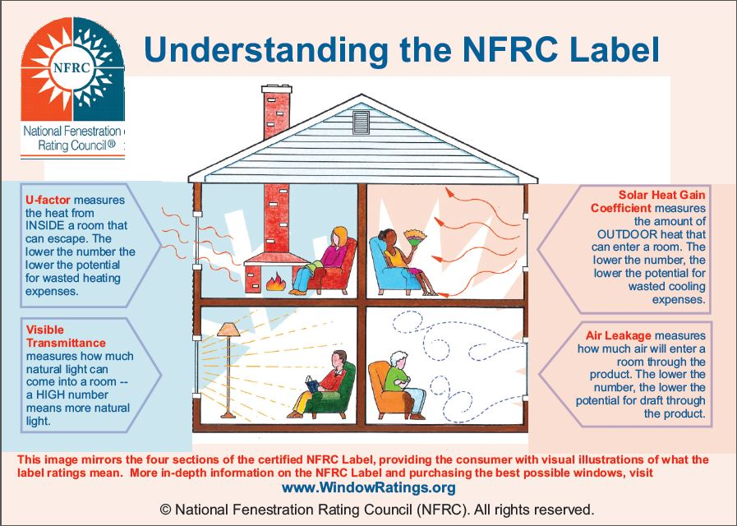
Energy and Atmosphere (EA)
GA02 Excerpt EA Overview. LEED BD+C RG v4 - Pgs. 323-324
Strategies to help reduce energy demand in a green building:
Building orientation and glazing selection
Choosing climate-appropriate building materials
Passive heating and cooling
Natural ventilation
High-efficiency HVAC systems partnered with smart controls

Slide 3
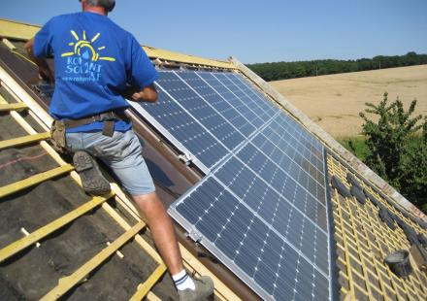
Energy and Atmosphere (EA)
GA02 Excerpt EA Overview. LEED BD+C RG v4 - Pgs. 323-324
Strategies to offset nonrenewable energy use with renewable energy sources:
Generation of renewable energy on the project site
Purchasing green power
RECs – Renewable Energy Certificates

Slide 4
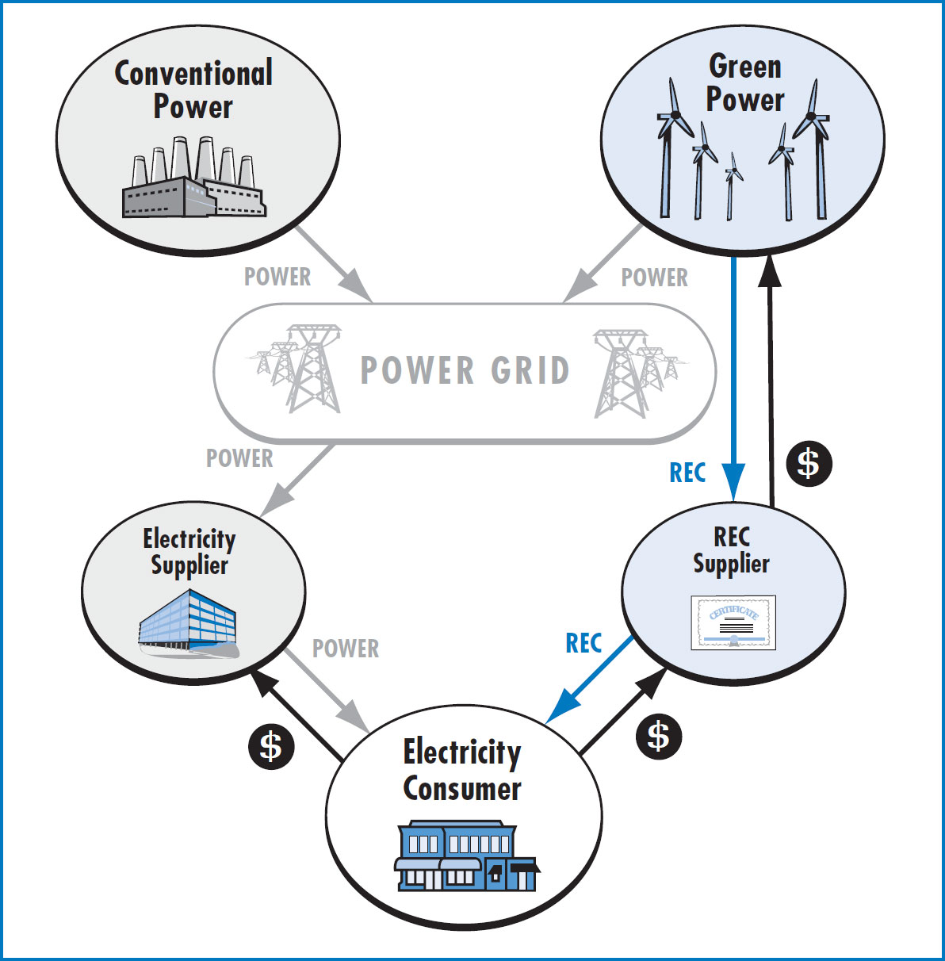
Energy and Atmosphere (EA)
GA02 Excerpt EA Overview. LEED BD+C RG v4 - Pgs. 323-324
green power a subset of renewable energy composed of grid-based electricity produced from renewable energy sources

Slide 5
Energy and Atmosphere (EA)
GA02 Excerpt EA Overview. LEED BD+C RG v4 - Pgs. 323-324
Commissioning (Cx)
the process of verifying and documenting that a building and all of its systems and assemblies are planned, designed, installed, tested, operated, and maintained to meet the owner’s project requirements.
Commissioning Authority (CxA)
the individual designated to organize, lead, and review the completion of commissioning process activities. The CxA facilitates communication among the owner, designer, and contractor to ensure that complex systems are installed and function in accordance with the owner’s project requirements.

Slide 6
Energy and Atmosphere (EA)
GA02 Excerpt EA Overview. LEED BD+C RG v4 - Pgs. 323-324
Demand Response (DR)
a change in electricity use by demand-side resources from their normal consumption patterns in response to changes in the price of electricity or to incentive payments designed to induce lower electricity use at times of high wholesale market prices or when system reliability is jeopardized.
Demand Response (DR) Event
a specific period of time when the utility or independent service operator calls for a change in the pattern or level of use in grid-based electricity from its program participants. Also known as a curtailment event.

Slide 8
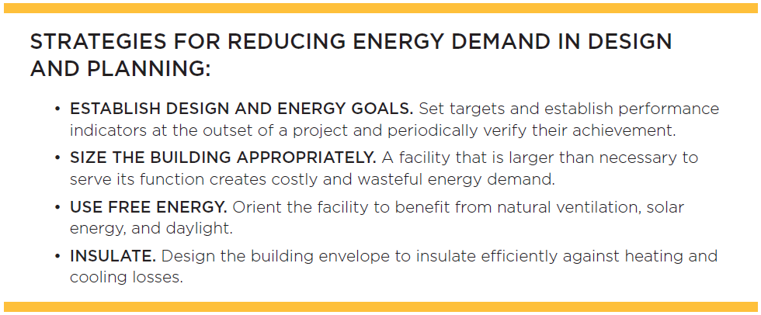
Energy and Atmosphere (EA)
LEED Core Concepts Guide

Slide 9
Energy and Atmosphere (EA)
LEED Core Concepts Guide

Slide 10
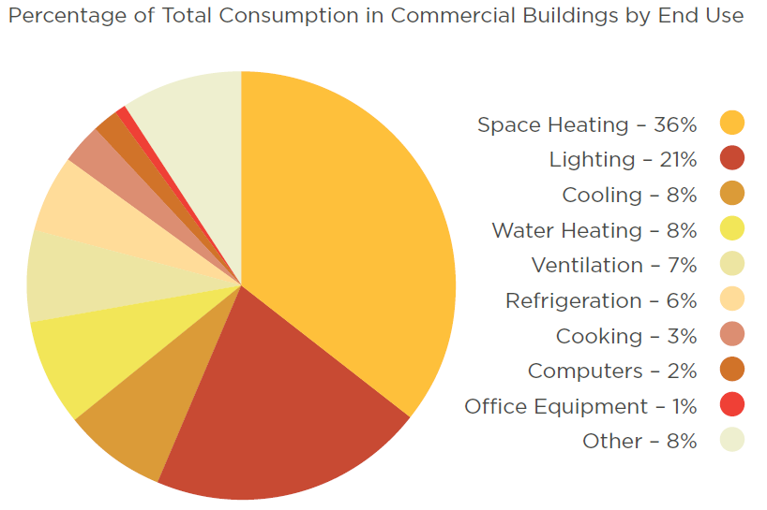
Energy and Atmosphere (EA)
LEED Core Concepts Guide

Slide 11
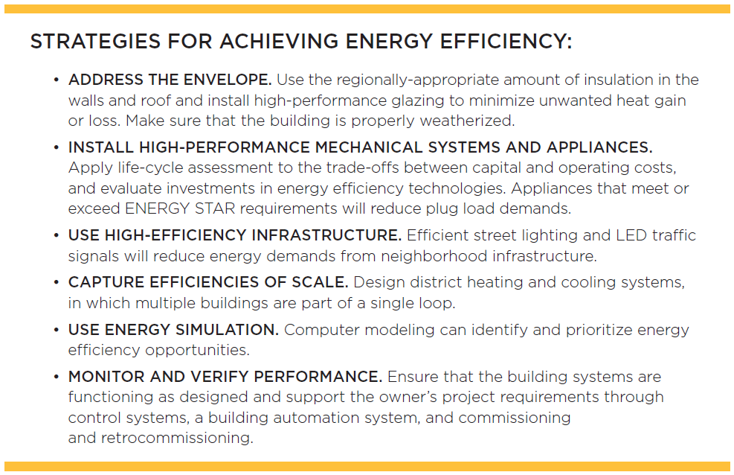
Energy and Atmosphere (EA)
LEED Core Concepts Guide

Slide 12
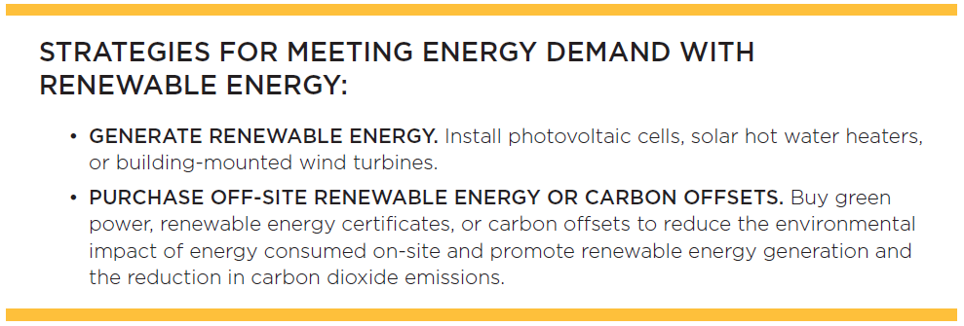
Energy and Atmosphere (EA)
LEED Core Concepts Guide

Slide 13
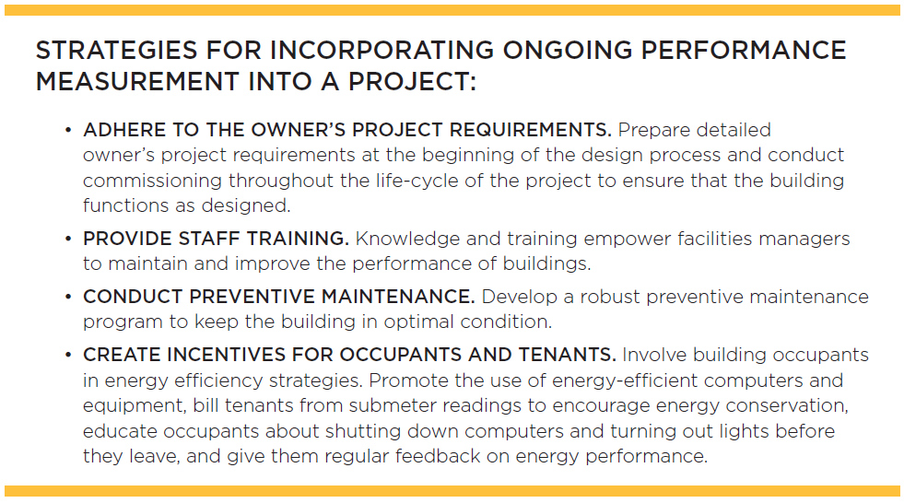
Energy and Atmosphere (EA)
LEED Core Concepts Guide

Slide 14
