Slide 1

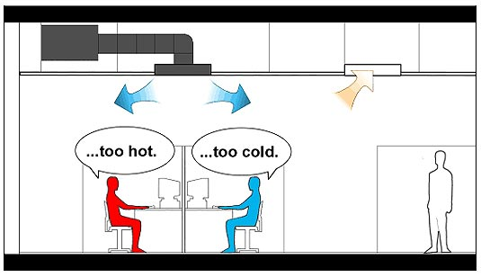
Indoor Environmental Quality
Overview
The Indoor Environmental Quality (EQ) category addresses:
Indoor Air Quality
Thermal, visual, and acoustic comfort

Slide 2
Indoor Environmental Quality
Overview
High-quality indoor environments:
Enhance productivity
Decrease absenteeism
Improve the building’s value
Reduce liability for building designers and owners

Slide 3
Indoor Environmental Quality
Overview
The Indoor Environmental Quality (EQ) category addresses:
Indoor Air Quality
Thermal, visual, and acoustic comfort

Slide 4
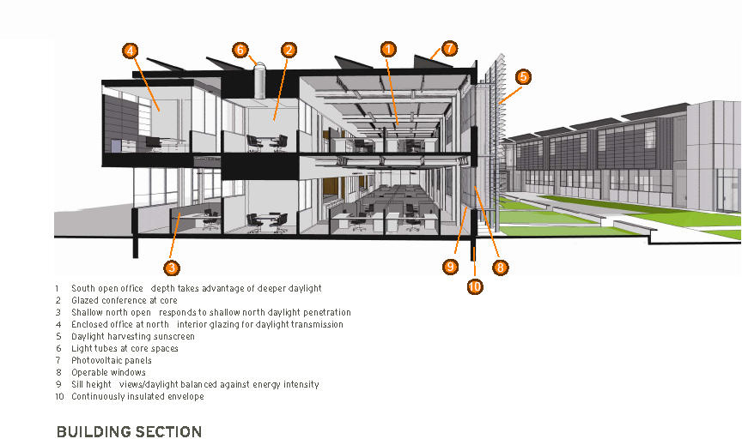
Indoor Environmental Quality
Overview
Floor Area Calculations and Floor Plans
For many of the credits in the EQ category, compliance is based on the percentage of floor area that meets the credit requirements.

Slide 5
Indoor Environmental Quality
Overview
Space categorization
Occupied versus unoccupied space
All spaces in a building must be categorized as either occupied or unoccupied.
Occupied spaces are enclosed areas intended for human activities.
Unoccupied spaces are places intended primarily for other purposes; they are occupied only occasionally and for short periods of time—in other words, they are inactive areas.

Slide 6
Indoor Environmental Quality
Overview
Regularly versus nonregularly occupied spaces
Occupied spaces are further classified as regularly occupied or nonregularly occupied, based on the duration of the occupancy.
Regularly occupied spaces are enclosed areas where people normally spend time, defined as more than one hour of continuous occupancy per person per day, on average; the occupants may be seated or standing as they work, study, or perform other activities.

Slide 7
Indoor Environmental Quality
Overview
For spaces that are not used daily, the classification should be based on the time a typical occupant spends in the space when it is in use.
For example, a computer workstation may be largely vacant throughout the month, but when it is occupied, a worker spends one to five hours there. It would then be considered regularly occupied because that length of time is sufficient to affect the person’s well-being, and he or she would have an expectation of thermal comfort and control over the environment.

Slide 8
Indoor Environmental Quality
Overview
Occupied Space Subcategories
Occupied spaces, or portions of an occupied space, are further categorized as individual or shared multioccupant, based on the number of occupants and their activities.
An individual occupant space is an area where someone performs distinct tasks.
A shared multioccupant space is a place of congregation or a place where people pursue overlapping or collaborative tasks.

Slide 9
Indoor Environmental Quality
Overview
Occupied Space Subcategories
Occupied spaces can also be classified as densely or non-densely occupied, based on the concentration of occupants in the space.
A densely occupied space has a design occupant density of 25 people or more per 1,000 square feet, or 40 square feet or less per person.
Occupied spaces with a lower density are non-densely occupied.

Slide 10

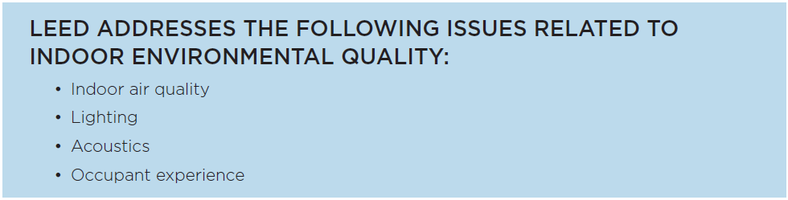

Slide 11
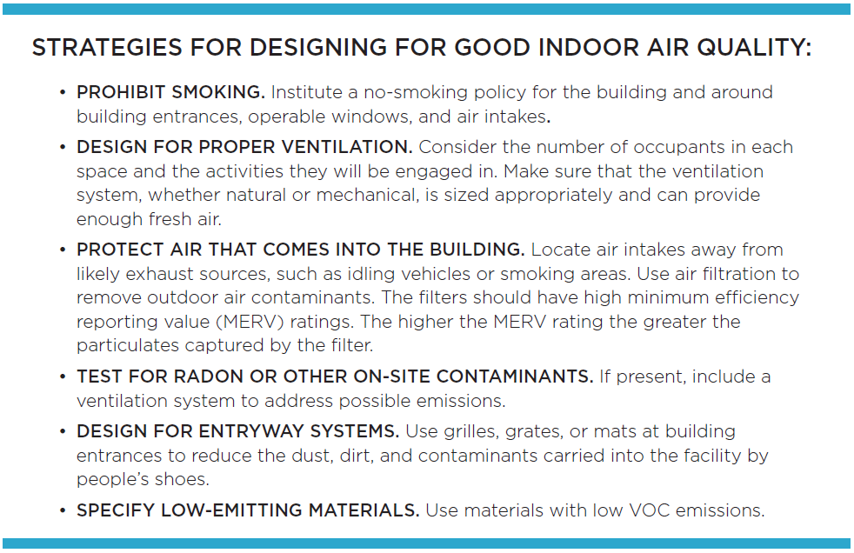
Indoor Environmental Quality
Indoor Air Quality (IAQ)

Slide 12
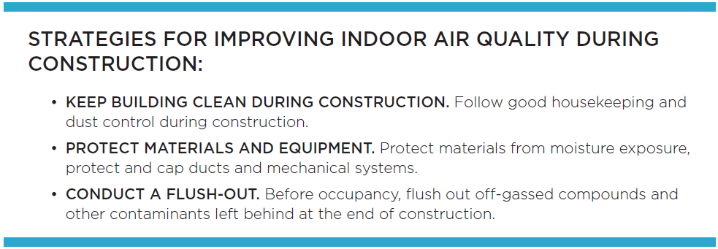
Indoor Environmental Quality
Indoor Air Quality (IAQ)

Slide 13
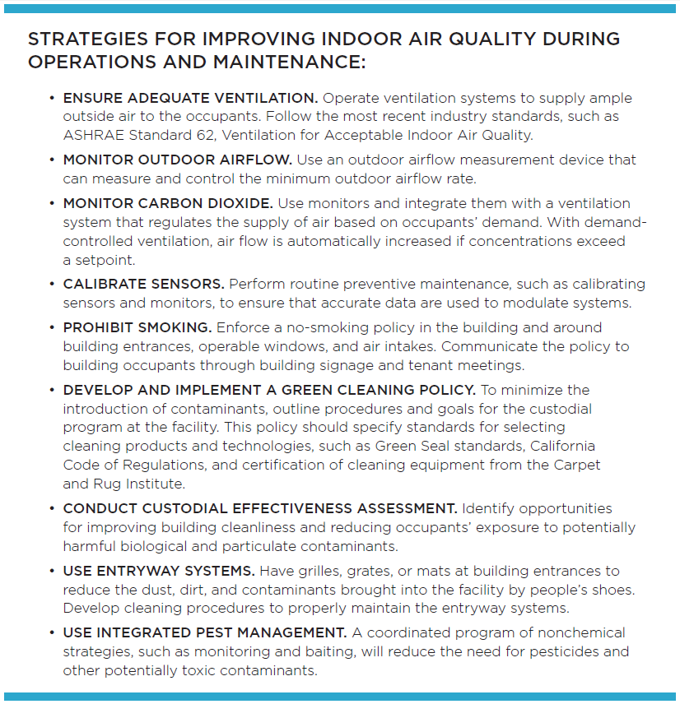
Indoor Environmental Quality
Indoor Air Quality (IAQ)

Slide 14
Indoor Environmental Quality
Lighting, Acoustics, Occupant Experience

Slide 15
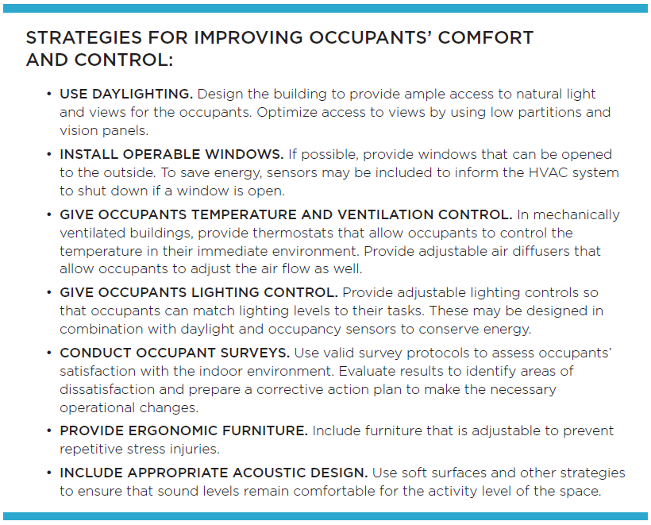
Indoor Environmental Quality
Lighting, Acoustics, Occupant Experience

Slide 16
