Slide 1

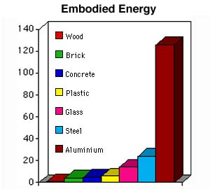
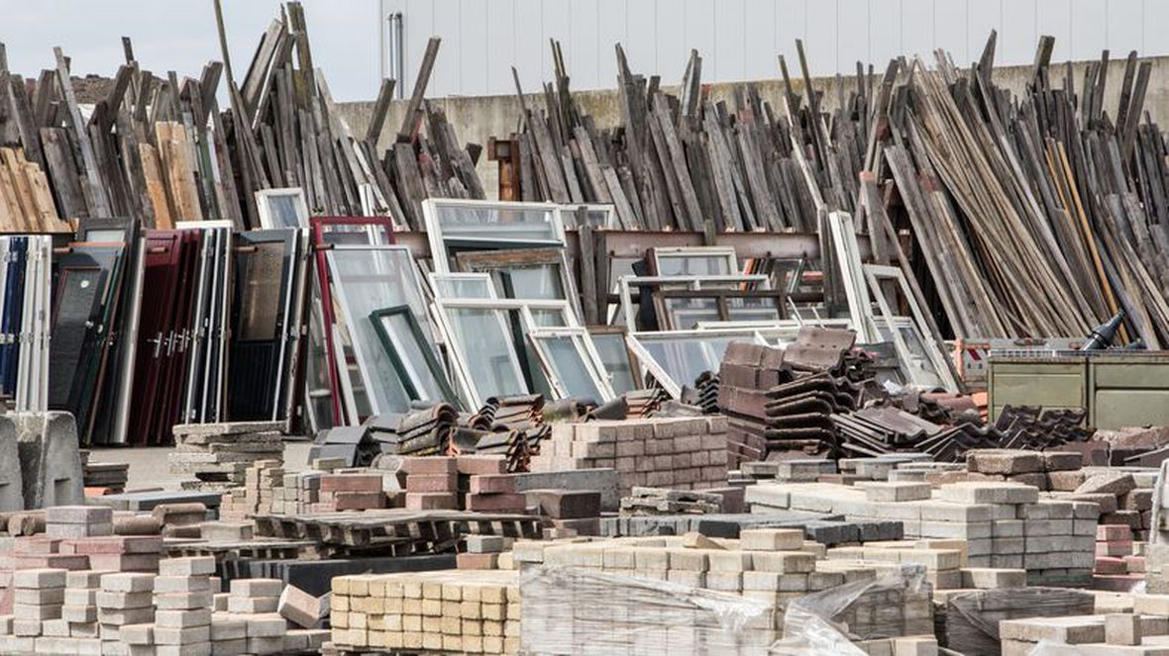
Materials and Resources
Overview
The Materials and Resources (MR) category addresses:
Minimizing the embodied energy and other impacts associated with the extraction, processing, transport, maintenance, and disposal of building materials.

Slide 2

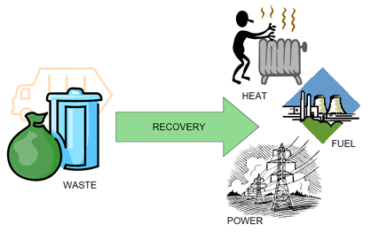
Materials and Resources
Overview
The Waste Hierarchy
Construction and demolition waste constitutes about 40 percent of the total solid waste stream in the United States and about 25% of the total waste stream in the European Union.
In its solid waste management hierarchy, the U.S. Environmental Protection Agency (EPA) ranks source reduction, reuse, recycling, and waste to energy as the four preferred strategies for reducing waste.

Slide 3
Materials and Resources
Overview
Life-cycle assessment (LCA)
Life-cycle assessment (LCA) provides a more comprehensive picture of materials and products, enabling project teams to make more informed decisions that will have greater overall benefit for the environmental, human health, and communities, while encouraging manufacturers to improve their products through innovation.
LCA is a “compilation and evaluation of the inputs and outputs and the potential environmental impacts of a product system throughout its life cycle.”

Slide 4
Materials and Resources
Overview
Qualifying Products and Exclusions
The MR section addresses “permanently installed building products,” which as defined by LEED refers to products and materials that create the building or are attached to it.
Examples include structure and enclosure elements, installed finishes, framing, interior walls, cabinets and casework, doors, and roofs. Most of these materials fall into Construction Specifications Institute (CSI) 2012 MasterFormat Divisions 3-10, 31, and 32. Some products addressed by MR credits fall outside these divisions.
Furniture is not required to be included in credit calculations. However, if furniture is included in MR credit calculations, all furniture must be included consistently in all cost-based credits.

Slide 5
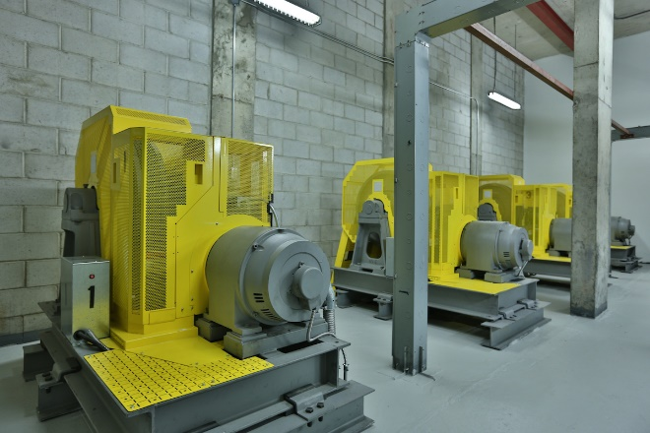

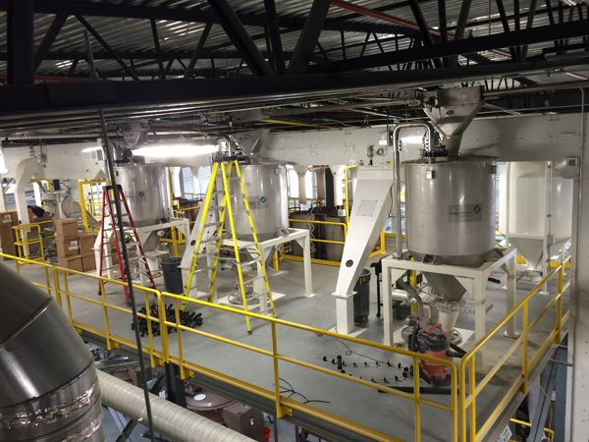
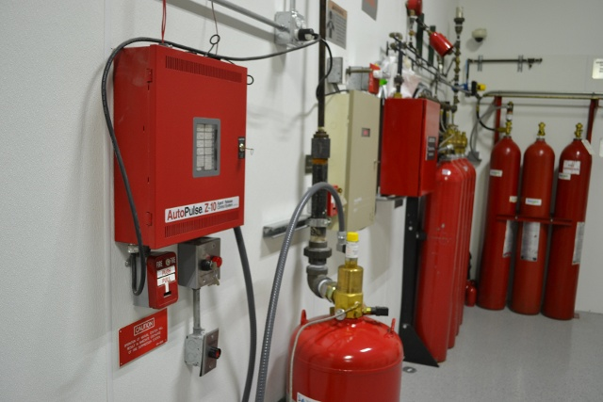
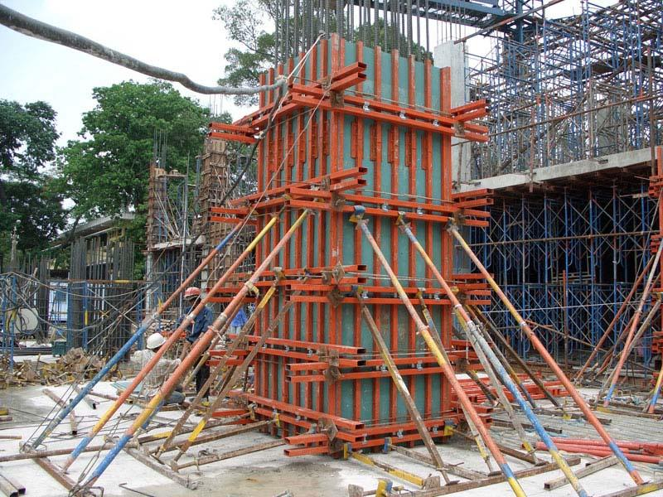
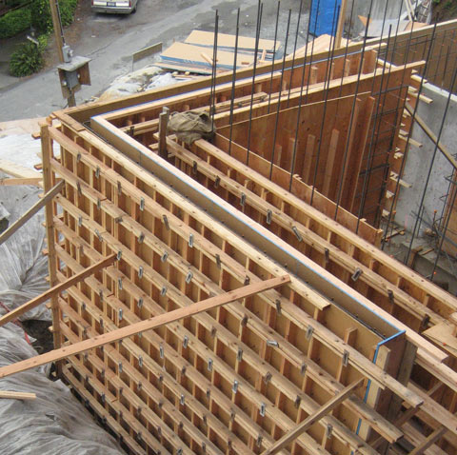
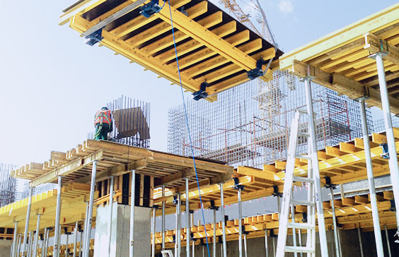
Materials and Resources
Overview
Special equipment, such as elevators, escalators, process equipment, and fire suppression, systems, is excluded from the credit calculations. Also excluded are products purchased for temporary use on the project, like formwork for concrete.

Slide 6
Materials and Resources
Overview
Determining Product Cost
To calculate the total materials cost of a project, use either the actual materials cost or the default materials cost.
Actual materials cost. This is the cost of all materials being used on the project site, excluding labor but including delivery and taxes.
Default materials cost. The alternative way to determine the total materials cost is to calculate 45% of total construction costs. This default materials cost can replace the actual cost for most materials and products, as specified above. If the project team is including optional products and materials, such as furniture and MEP items, add the actual value of those items to the default value for all other products and materials.

Slide 7

Materials and Resources
Overview
Location Valuation
Several credits in the MR section include a location valuation factor, which adds value to locally produced products and materials. The intent is to incentivize the purchase of products that support the local economy.
Products and materials that are extracted, manufactured, and purchased within 100 miles of the project are valued at 200% of their cost (i.e., the valuation factor is 2).
The distance must be measured as the crow flies, not by actual travel distance.

Slide 8
Materials and Resources
Overview
Location Valuation
Example:
A project team purchases 50 doors salvaged from a local deconstruction site and sold through a local Habitat for Humanity ReStore for $500. The value of equivalent new doors is documented at $400 each, or $20,000. Their contribution to the credit is as follows:
$20,000 x 1.0 criterion valuation * 2.0 location valuation = $40,000
$40,000 is the total sustainable criteria value for these doors

Slide 9
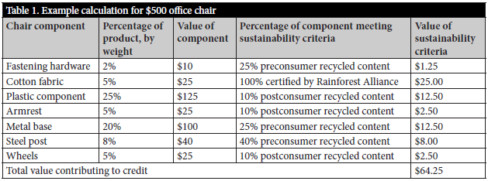
Materials and Resources
Overview
Determining Material Contribution of an Assembly

Slide 10



Slide 11
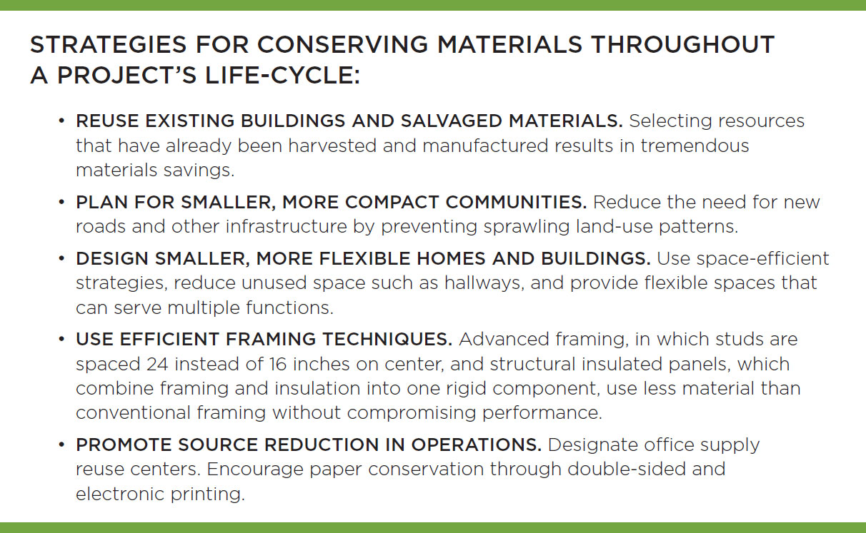
Materials and Resources
Conservation of Materials

Slide 12
Materials and Resources
Environmentally, Socially, Locally Preferable Materials
Environmentally preferable attributes to consider include:
Support the local economy
Sustainably grown and harvested
Have intended end-of-life scenarios that avoid landfill
Contain recycled content from industrial or consumer sources
Made of bio-based material
Free of toxins
Long lasting, durable, and reusable
Made in factories that support human health and workers’ rights
Product transparency tools like life-cycle assessment (LCA), Environmental Product Declarations (EPDs), and material ingredient disclosures provide a more comprehensive picture of materials and products, enabling project teams to make informed decisions.

Slide 13
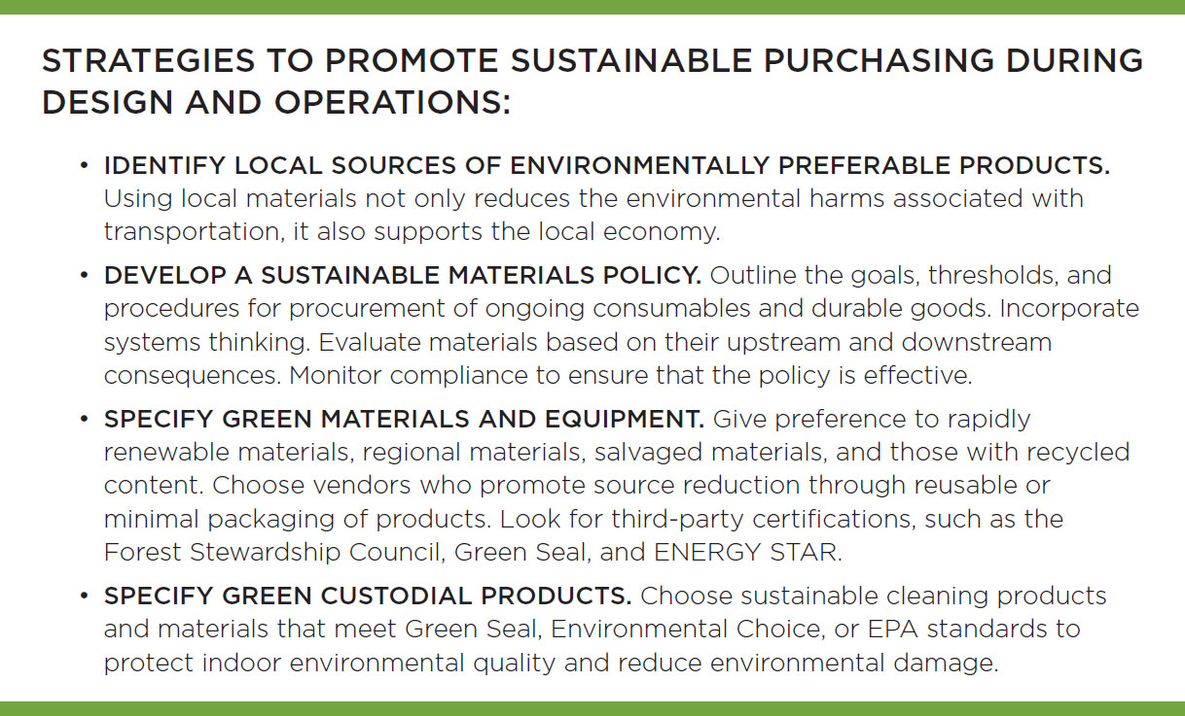
Materials and Resources
Environmentally, Socially, Locally Preferrable Materials

Slide 14
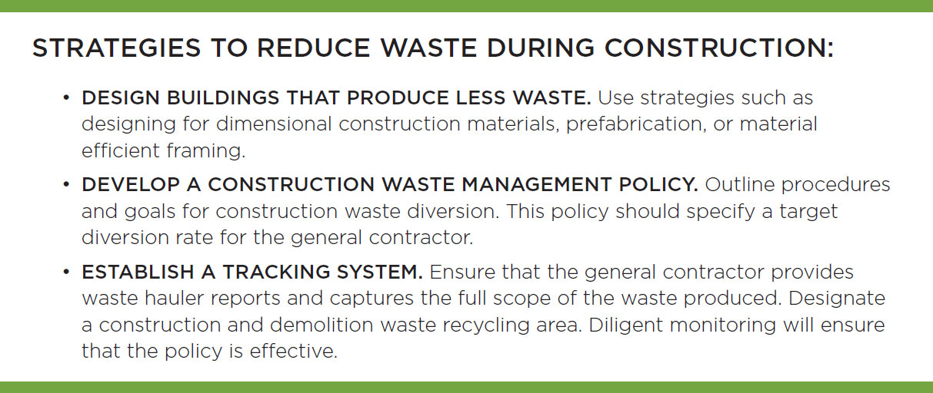
Materials and Resources
Waste Management and Reduction

Slide 15
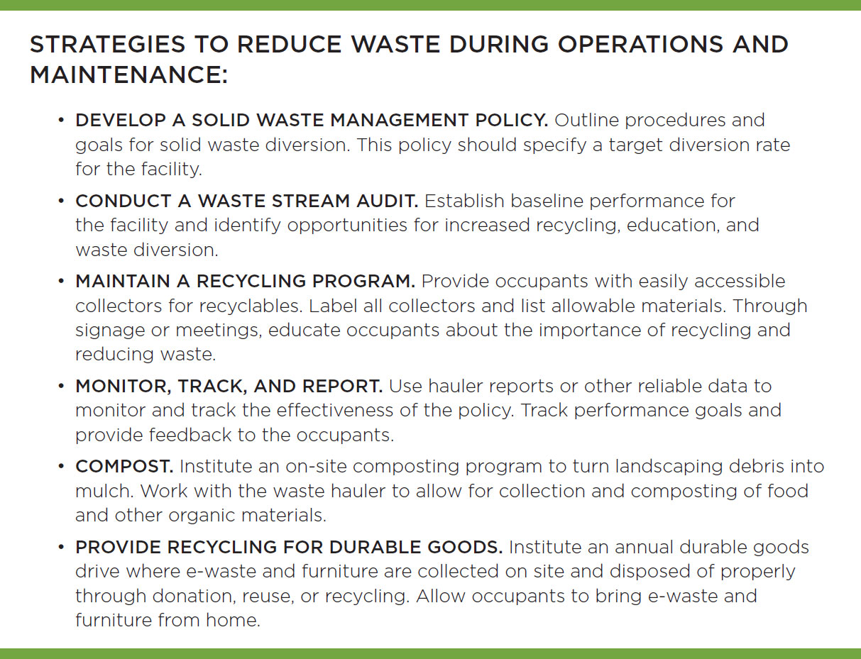
Materials and Resources
Waste Management and Reduction

Slide 16
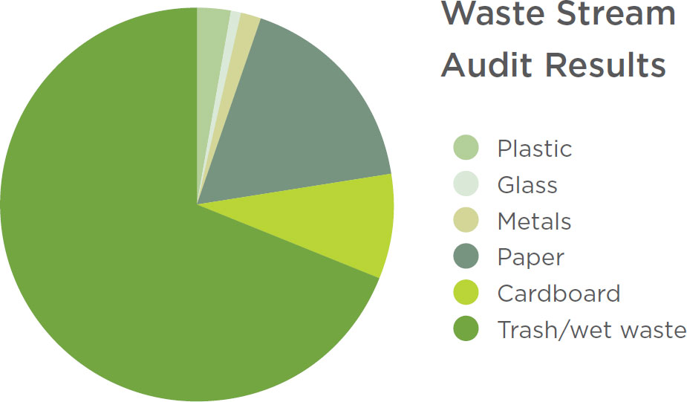
Materials and Resources
Waste Management and Reduction

Slide 17
