Slide 3
IN Innovation Credit
NC, CS, S, R, DC, WDC, HOS, HC
Intent
To encourage projects to achieve exceptional or innovative performance.

Slide 4
IN Innovation Credit
NC, CS, S, R, DC, WDC, HOS, HC
Requirements
To achieve all five innovation points, a project team must achieve at least one pilot credit, at least one innovation credit and no more than two exemplary performance credits.
Option 1. Innovation (1 point)
Achieve significant, measurable environmental performance using a strategy not addressed in the LEED green building rating system.
Identify the following:
the intent of the proposed innovation credit;
proposed requirements for compliance;
proposed submittals to demonstrate compliance; and
the design approach or strategies used to meet the requirements.
Examples of innovation may be found in the LEED Innovation Catalog.
AND/OR

Slide 5
IN Innovation Credit
NC, CS, S, R, DC, WDC, HOS, HC
Option 2. Pilot (1 point)
Achieve one pilot credit from USGBC’s LEED Pilot Credit Library.
AND/OR

Slide 6
IN Innovation Credit
NC, CS, S, R, DC, WDC, HOS, HC
Option 3. Additional Strategies
Innovation (1-3 points)
Defined in Option 1 above.
Pilot (1-3 points)
Meet the requirements of Option 2.
Exemplary Performance (1–2 points)
Achieve exemplary performance in an existing LEED v4 prerequisite or credit that allows exemplary performance, as specified in the LEED Reference Guide, v4 edition.
An exemplary performance point is typically earned for achieving double the credit requirements or the next incremental percentage threshold.

Slide 7
IN LEED Accredited Professional Credit
NC, CS, S, R, DC, WDC, HOS, HC
Intent
To encourage the team integration required by a LEED project and to streamline the application and certification process.

Slide 8
IN LEED Accredited Professional Credit
NC, CS, S, R, DC, WDC, HOS, HC
Requirements
At least one principal participant of the project team must be a
LEED Accredited Professional (AP) with a specialty appropriate for the project.
1 point for having one LEED AP with specialty on the project.
No additional points for having more than one LEED AP with specialty on the project.

Slide 9
IN LEED Accredited Professional Credit
NC, CS, S, R, DC, WDC, HOS, HC
Requirements
LEED APs without specialty (legacy LEED APs) do not qualify for this credit.
LEED AP

Slide 10
IN LEED Accredited Professional Credit
NC, CS, S, R, DC, WDC, HOS, HC
Required Documentation
Full Name and Specialty Credential of LEED AP

Slide 11
IN LEED Accredited Professional Credit
NC, CS, S, R, DC, WDC, HOS, HC
Maintaining a LEED Credential
The LEED AP with specialty credential can be maintained through either of the following methods:
Retaking and passing the LEED accreditation exam
Earning 30 continuing education hours per credentialing period
CMP = Credential Maintenance Program
My Account, Credentials (USGBC Web site)

Slide 12
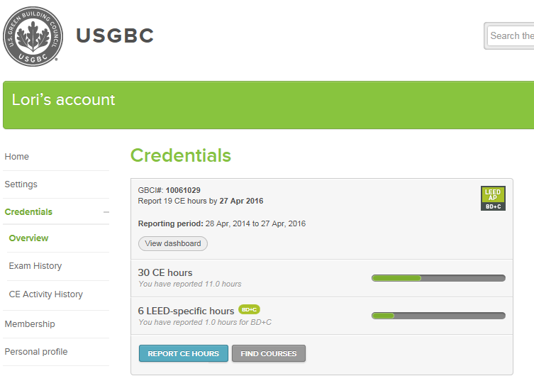
IN LEED Accredited Professional Credit
NC, CS, S, R, DC, WDC, HOS, HC

Slide 13
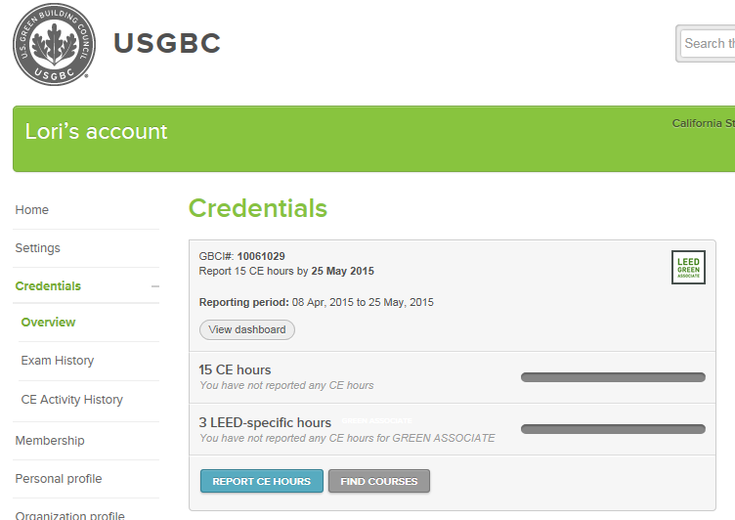
IN LEED Accredited Professional Credit
NC, CS, S, R, DC, WDC, HOS, HC

Slide 15
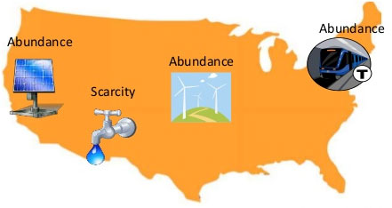

Slide 16
RP Regional Priority: Specific Credit Credit
NC, CS, S, R, DC, WDC, HOS, HC
Intent
To provide an incentive for the achievement of credits that address geographically specific environmental, social equity, and public health priorities.

Slide 17
RP Regional Priority: Specific Credit Credit
NC, CS, S, R, DC, WDC, HOS, HC
Requirements
Earn up to four of the six Regional Priority credits. These credits have been identified by the USGBC regional councils and chapters as having additional regional importance for the project’s region.
A database of Regional Priority credits and their geographic applicability is available on the USGBC website, http://www.usgbc.org/rpc
One point is awarded for each Regional Priority credit achieved, up to a maximum of four.

Slide 18
RP Regional Priority: Specific Credit Credit
NC, CS, S, R, DC, WDC, HOS, HC
Additional Information to Consider
Required Documentation
No additional documentation is required to earn Regional Priority credits.
Document compliance for the selected credits, and the related RP bonus points for their achievement will be awarded automatically.

Slide 19
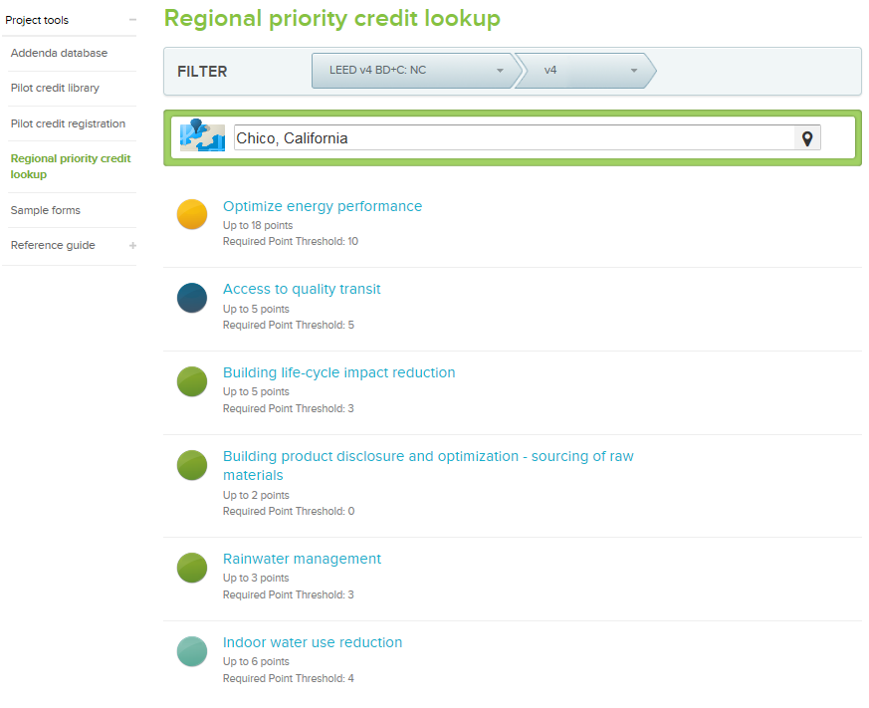
RP Regional Priority: Specific Credit Credit
NC, CS, S, R, DC, WDC, HOS, HC

