Slide 1
GA05 Guide to LEED Certification: Commercial
LEED Process
LEED certification involves four main steps:
Register your project by completing key forms and submitting payment.
Apply for LEED certification by submitting your completed certification application through LEED Online and paying a certification review fee.
Review. Your LEED application is reviewed by GBCI.
Certify. Receive the certification decision. If you’ve earned LEED certification: congratulations!

Slide 2
GA05 Guide to LEED Certification: Commercial
Achieving LEED certification requires:
Meet the Minimum Program Requirements (MPRs)
Satisfy all prerequisites
Earn a minimum number of credits for the desired level of certification

Slide 3
GA05 Guide to LEED Certification: Commercial
Minimum Program Requirements (MPRs)
Building projects pursuing LEED v4 certification must:
Be in a permanent location on existing land
Use reasonable LEED boundaries
Comply with project size requirements

Slide 4
GA05 Guide to LEED Certification: Commercial
Select the appropriate Rating System for your project.
LEED v4 Rating System Selection Guidance
Identify an appropriate rating system
Determine the best adaptation
New Construction and Major Renovation (NC)
Core and Shell (CS)
Schools (S)
Retail (R)
Datacenters (DC)
Warehouses & Distribution Centers (WDC)
Hospitality (HOS)
Healthcare (HC)
Commercial Interiors
Retail
Hospitality
Existing Buildings
Retail
Schools
Hospitality
Datacenters
Warehouses & Distribution Centers
Plan
Built Project
Homes and Multifamily Lowrise
Multifamily Midrise
Adaptation
Adaptation
Adaptation
Adaptation
Adaptation

Slide 5
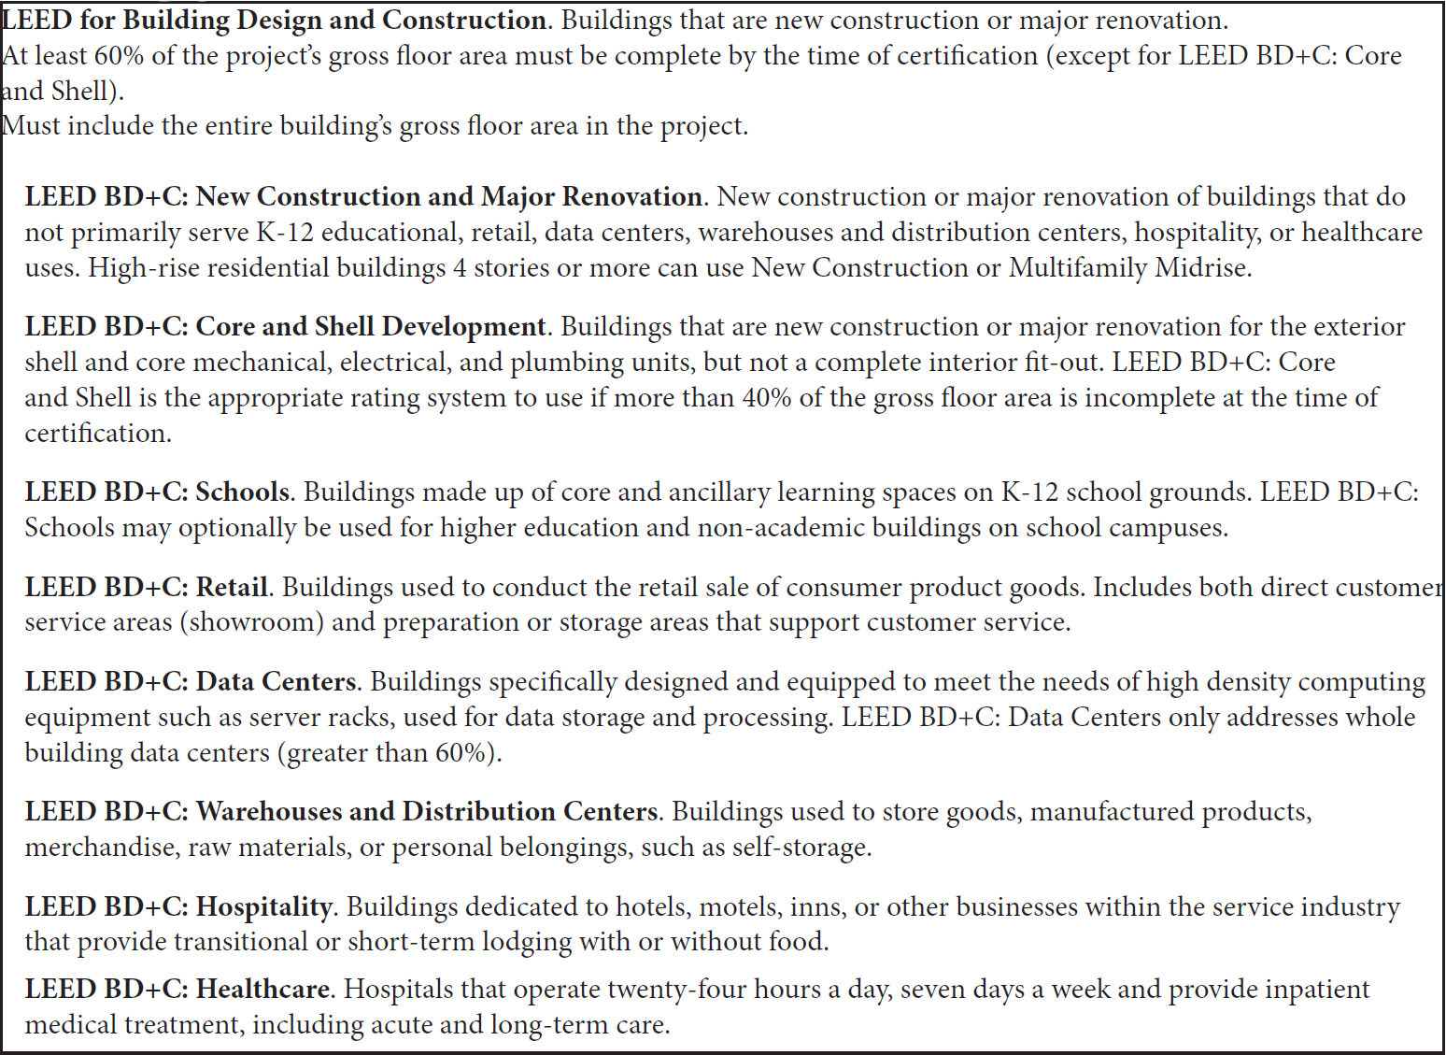
GA05 Guide to LEED Certification: Commercial

Slide 6
GA05 Guide to LEED Certification: Commercial

Slide 7
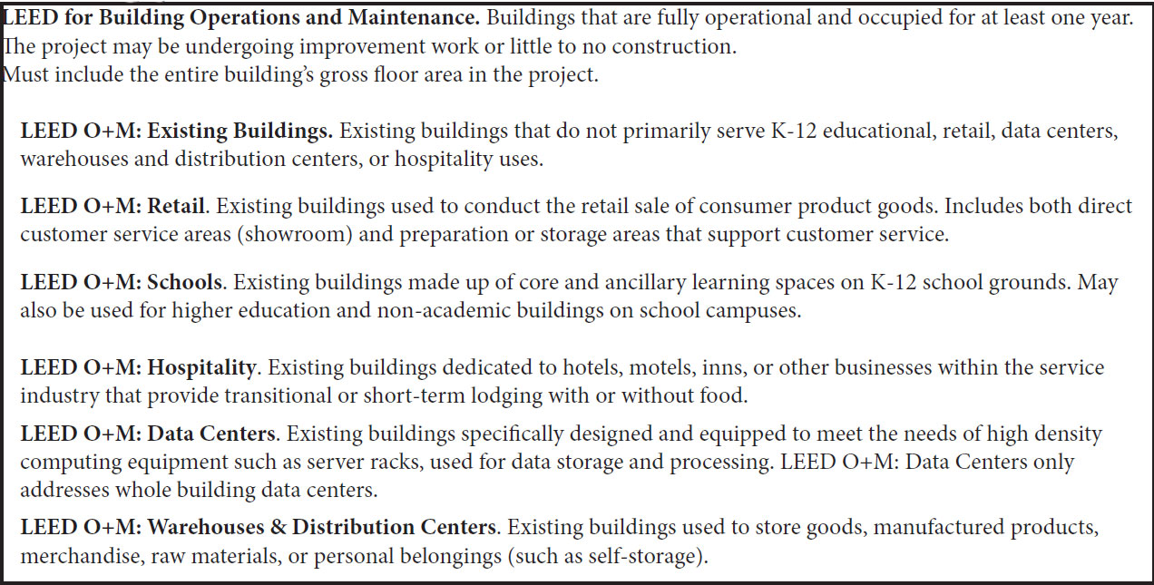
GA05 Guide to LEED Certification: Commercial

Slide 8
GA05 Guide to LEED Certification: Commercial

Slide 9
GA05 Guide to LEED Certification: Commercial

Slide 10
GA05 Guide to LEED Certification: Commercial
Choosing Between Rating Systems
40/60 Rule provides guidance for making a decision when several rating systems appear to be appropriate for a project.
To use this rule, first assign a rating system to each square foot or square meter of the building, and then choose the most appropriate rating system based on the resulting percentages.
The entire gross floor area of a LEED project must be certified under a single rating system and is subject to all prerequisites and attempted credits in that rating system, regardless of mixed construction or space usage type.

Slide 11
GA05 Guide to LEED Certification: Commercial
Register
LEED Online - online portal through which projects submit their application for certification, as well as access a variety of tools and resources, provide the registration information related to their project, submit payment and sign the certification agreement (the project owner must do this last one).
Once registered, the project application will be accessible in LEED Online.
From LEED Online the project team can be assembled and the entire LEED documentation process is managed.

Slide 12
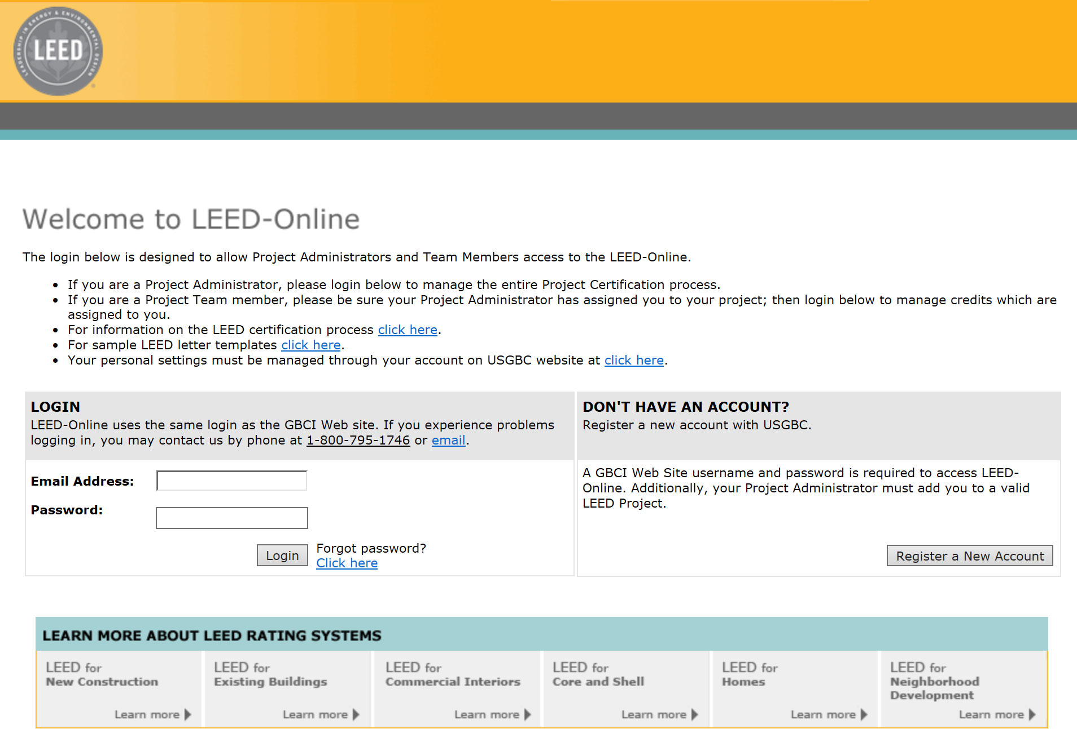
GA05 Guide to LEED Certification: Commercial
Project Team Roles
Owner
Agent
Project Administrator

Slide 13
GA05 Guide to LEED Certification: Commercial
Owner
The owner of the project is the person (or entity) who has the authority to hold and control the real and personal property associated with the project and accepts (or authorizes the acceptance of) the certification agreement.
While there may be multiple owners for a particular project (if so, please submit a Confirmation of Primary Owner’s Authority Form), USGBC ask that projects identify a single individual to administer the certification process.
Big takeaway: the owner has ultimate control over the LEED certification application, meaning that GBCI - the organization responsible for administering LEED certification, will respond to the owner regarding the administration of the project over any other member of the project team.

Slide 14
GA05 Guide to LEED Certification: Commercial
Agent
The agent is the person (or entity) who is granted actual authority by the owner to register the project and accept the certification agreement.
If the project uses this option, they must upload a signed
Confirmation of Agent’s Authority Form.

Slide 15
GA05 Guide to LEED Certification: Commercial
Project Administrator
This team member acts as a project manager, overseeing the LEED project as well as which project team members are responsible for certain tasks, credits or prerequisites.
The project administrator plays a key quality role by checking that the LEED submission is complete and accurate before submitting the project to GBCI for review, and accepting the review results once the review is complete.
Note: the individual who initially registers the project will automatically be granted the role of the project administrator, but the owner may transfer this role to another team member at any time.

Slide 16
GA05 Guide to LEED Certification: Commercial
LEED Certification Deadlines
As new versions of the LEED rating systems are introduced, earlier versions are phased out so that USGBC is constantly pushing for the transformation they aspire to.
At any given point, LEED rating systems are either:
Open for registration and certification, or
Closed for registration, but open for certification, or
Closed for registration and certification (sunset)
Deadlines are published on the USGBC Website @ http://www.usgbc.org/cert-guide/deadlines

Slide 17
GA05 Guide to LEED Certification: Commercial
Recertification (LEED O+M Only)
For certification to remain current projects must recertify within five years of the previous certification.
Projects are eligible for recertification after 12 months and every 12 months thereafter.

Slide 18
GA05 Guide to LEED Certification: Commercial
Campus Projects
Examples: a corporate or educational campus, government installation or commercial development
Projects planning to certify more than one building located on a single shared site and under the control of a single entity, may register their project as a campus or group project to streamline the documentation needed to submit for review.
Individual building registration and certification fees apply to campus and group projects.
Depending on the campus approach selected, projects will pursue a slightly modified registration process, as compared to one-off project registration.

Slide 19
GA05 Guide to LEED Certification: Commercial
Campus credit approach
This approach enables projects to streamline the documentation process by earning “campus credits” – prerequisites and credits that can be applied to all LEED projects on the master site.
Project’s register a “master site,” which includes a general narrative of the overall campus projects and a schematic site plan, in addition to registering each individual project on the site.

Slide 20
GA05 Guide to LEED Certification: Commercial
Campus group project approach
Project’s register the group of projects on the site as a single LEED project that will then receive a single LEED rating and certification.
To be eligible:
LEED BD+C and LEED ID+C projects must be under the same construction contract and be constructed at the same time.
LEED O+M projects must be under the same ownership and management, share the same performance period and have substantially similar space types.

Slide 21
GA05 Guide to LEED Certification: Commercial
Campus group project approach
The team’s campus project documentation must demonstrate that the group of projects collectively meets the credit requirements using a “group credit.”
Projects may use a campus group project certification independently or in combination with campus credits documented under a master site review, through the campus credit approach.

Slide 22
GA05 Guide to LEED Certification: Commercial
Apply
Collect and submit the appropriate documentation via LEED Online
The project team identifies the LEED credits to pursue and assigns them to project team members.
Team members collect information, perform calculations and analysis, and prepare documentation demonstrating achievement of the prerequisites and selected credits.
Completed documentation is uploaded using LEED Online
The Project Administrator submits the application along with the certification review fee.
GBCI reviews the project documentation.

Slide 23
GA05 Guide to LEED Certification: Commercial
LEED O+M Projects
Performance period for any prerequisite or credit may be extended to a maximum of 24 months preceding the certification application.
All performance periods must overlap and come to a conclusion within one month of each other.
Completed application must be submitted for review within 60 days of the conclusion of the performance period.

Slide 24
GA05 Guide to LEED Certification: Commercial
Campus Projects
Campus credit approach: If the project team is pursuing this approach, document all campus credit information within the master site.
Campus group project approach: The project team’s group project documentation must demonstrate that the group of projects collectively meets the credit requirements using a “group credit.”
Group project certification may be used independently or in combination with campus credits documented under a master site review, through the campus credit approach above.

Slide 25
GA05 Guide to LEED Certification: Commercial
Review
Part 1: Preliminary Review
Project administrator submits the completed application.
GBCI checks the application for completeness and compliance with the selected rating system and attempted credits.
GBCI will respond with its preliminary review within 20-25 business days, indicating which prerequisites and credits are anticipated to be awarded during final review, pending further information or denied.
Team can accept the preliminary review results as final, submit new or revised documentation, or attempt additional credits before submitting for final review.

Slide 26
GA05 Guide to LEED Certification: Commercial
Review
Part 2: Final Review
This stage allows the project team to submit supplementary information or amend the application.
GBCI suggests clarifications are submitted within 25 business days after receiving the preliminary review results. GBCI will then review revised or newly submitted prerequisites and credits, and reconsider any anticipated credits or prerequisites for which information has changed since the return of the preliminary review.
GBCI will respond with a final LEED certification review report within 20-25 business days, marking prerequisites and attempted credits as either awarded or denied.
Project team may either accept the review results as final, or revise the application and resubmit, this time as an appeal.

Slide 27
GA05 Guide to LEED Certification: Commercial
Review
Part 3: Appeal Review
This stage provides one additional round of review and allows the project team to submit supplementary information, amend the application or add new credits not previously attempted.
GBCI will review the pending or newly submitted prerequisites and credits, and reconsider any anticipated credits or prerequisites for which information has changed since the return of the final review.
The fee associated with appeals varies depending on the level of complexity of the credits or prerequisites involved in the appeal.
GBCI will respond with an appeal LEED certification review report within 20-25 business days, marking prerequisites and attempted credits as either awarded or denied.
Like the final review, the project team can either accept the appeal review results as final, or submit a further appeal. There is no cap on the number of appeals you may submit.

Slide 28
GA05 Guide to LEED Certification: Commercial
Standard Review (all Rating Systems)
The project administrator submits the entire application (all credits and prerequisites) once the project team has completed the project.

Slide 29
GA05 Guide to LEED Certification: Commercial
Split Review (LEED BD+C and LEED ID+C Rating Systems)
Design credits and prerequisites are submitted at the conclusion of the project’s design phase.
Construction credits and prerequisites at the conclusion of the project’s construction phase.
Designed to help project teams determine if the project is on track to achieve LEED certification at its preferred level.
Only credits and prerequisites identified as design credits can be submitted during the design review, and the application must be submitted before your project is substantially completed.

Slide 30
GA05 Guide to LEED Certification: Commercial
Precertification Review (LEED for BD+C: CS projects only)
Optional review pathway available for a fee for LEED BD+C: Core & Shell projects that is focused on their intended design and construction strategies.
USGBC offers precertification to help projects attract tenants and to help determine which credits and prerequisites the project is likely to achieve during the full review.

Slide 31
GA05 Guide to LEED Certification: Commercial
Expedited Review
Contact GBCI at least five business days (please allow longer if you are paying by check) prior to submitting an application to request an expedited review to cut the review time in half (reduced from 20-25 business days to 10-12 business days per review phase).
There is an additional charge for this service, and GBCI’s ability to fulfill requests depends on their current review capacity.
If GBCI can accommodate the request, they will confirm availability and provide a custom review schedule for the project.

Slide 32
GA05 Guide to LEED Certification: Commercial
Submitting an Inquiry
Allows project teams to gain clarification before registering a project or during the documentation process.
Registered Projects – submit inquiries through LEED Online
Projects that have not registered can reach out to GBCI
Address only one prerequisite or credit per inquiry.

Slide 33
GA05 Guide to LEED Certification: Commercial
Credit Interpretation Ruling (CIR)
Obtain technical guidance related to a particular credit or facet of the LEED rating system.
Review team decides if the interpretation of a particular credit or prerequisite is consistent with published rating system requirements. [Can be appealed.]
Must provide documentation demonstrating fulfillment of the CIR and indicate the approved CIR within the application for certification.
CIRs are not precedent setting; the project team can only utilize the ruling for the project under which the CIR was submitted.

Slide 34
GA05 Guide to LEED Certification: Commercial
LEED Interpretation (LI)
Administered by USGBC
LEED Interpretations focus on the evolution of the LEED rating system and are published periodically in the form of official addenda.
Differ from Project CIRs in that, as USGBC issued addenda, these rulings are precedent-setting and applicable to all projects registered in the future.
Projects registered before a LEED Interpretation is published may voluntarily elect to follow these revisions.

Slide 35
GA05 Guide to LEED Certification: Commercial
Deadline for Submitting for Review
LEED BD+C and LEED ID+C rating systems
Must submit for a construction phase review (preliminary standard review or preliminary construction review) no later than two years after the project is substantially completed (the date on which the building receives a certificate of occupancy or similar official indication that it is fit and ready for use).
LEED O+M projects
Are required to submit for review within 60 days of the end of their performance period.

Slide 36
GA05 Guide to LEED Certification: Commercial
Deadline for Submitting for Review
Campus projects
Campus credit approach: USBGC recommends that projects complete the master site review prior to submitting any associated, individual or group projects for review, since the campus credits earned through the master site review will then become available to the individual or group projects associated with it.

Slide 37
GA05 Guide to LEED Certification: Commercial
Appeals
If a project team feels that the results of a review appeal or a CIR appeal are incorrect and wish to challenge those results, they may do so by contacting GBCI.

Slide 38
GA05 Guide to LEED Certification: Commercial
Upgrading the Project’s Version of LEED Online
Check the USGBC Website for available upgrades.
If the project has been submitted for review, it will need to stick with the version of LEED Online that it was registered with – the project cannot be transferred.

Slide 39
GA05 Guide to LEED Certification: Commercial
Certify
Accepting the certification is the final step in the LEED review process.
Once the final application review is complete, the project team can either accept or appeal GBCI’s final certification report.
Once the project team has accepted the final certification report, the project will be deemed “closed out” –meaning that the project team will no longer be able to appeal the certification level or review decisions for specific credits or prerequisites.

Slide 40
GA05 Guide to LEED Certification: Commercial
Certification Levels
LEED Certified™ 40-49 points earned
LEED Silver® 50-59 points earned
LEED Gold® 60-79 points earned
LEED Platinum® 80+ points earned

Slide 41
GA05 Guide to LEED Certification: Commercial
Promote the LEED-certified Project!
USGBC provides a Public Relations Guide for LEED-certified projects
USGBC provides a formal Certificate of Recognition
Projects can order LEED Plaques and Certificates

Slide 42
GA05 Guide to LEED Certification: Commercial
How USGBC is Using Project Data
LEED-registered and certified projects are, by default, considered “public” projects, and thereby included in USGBC’s public LEED project directory.
Projects can opt-out of the LEED project directory and publicity opportunities as a “private project” at the time of registration: specific instructions on how to do so are available in LEED Online.

Slide 43
GA05 Guide to LEED Certification: Commercial
Deadline for achieving certification
Each rating system will remain open and available for certification for at least six years after the rating system registration close date.
To certify a project under a specific rating system, projects must submit for certification by that rating system's certification close date, also called the sunset date.
If the project team has difficulty meeting this deadline, the can reach out to GBCI—they’ll work with them on a solution for their project.

Slide 44
GA05 Guide to LEED Certification: Commercial
Expiration of LEED certification
LEED O+M projects, must recertify within five years of the previous certification.

Slide 45
GA05 Guide to LEED Certification: Commercial
Revocation of LEED certification
In rare situations, LEED certification may be revoked.
USGBC created the Certification Challenge Policy to ensure that all LEED project submittals and subsequent reviews by GBCI team members are done so with integrity, accuracy and truthfulness.
A certification challenge may be initiated by GBCI or by any third party within 18 months of a project’s certification.
Projects must retain all project documentation related to certification, and the achievement of prerequisites and credits, on-site at the certified project for two years after receiving certification, to ensure that this information is available in case of a challenge.

Slide 46
GA05 Guide to LEED Certification: Commercial
Fees
Registration Fee
Flat Fee paid at the time of registration
Organizational Level or Non-members: $1,700
Silver, Gold and Platinum Level Members: $1,350

Slide 47
GA05 Guide to LEED Certification: Commercial
Fees
Certification Fee
Charged on a per-project (building) basis
Based on the size of the project and the rating system under which the project is registered
Due when the project team submits the application for review. GBCI will not begin the review until payment in full has been received and cleared their system

Slide 48
GA05 Guide to LEED Certification: Commercial
Other Fees
Appeals
Formal Inquiries: Credit Interpretation Rulings (CIRs)
Expedited Review
Precertification Review (Optional, LEED CS Only)

Slide 49
GA05 Guide to LEED Certification: Commercial
Resources and Tools
General Resources
Credit Library
Addenda database
Pilot Credit library
Regional Priority Credit lookup
LEED Online: v4, v3
Legal agreements: LEED Certification Agreement, Confirmation of Agent's Authority, Confirmation of Primary Owner's Authority, Change of Owner Agreement
BD+C specific
LEED v4 Reference Guide
Rating System Document
Checklist

